Slide 1
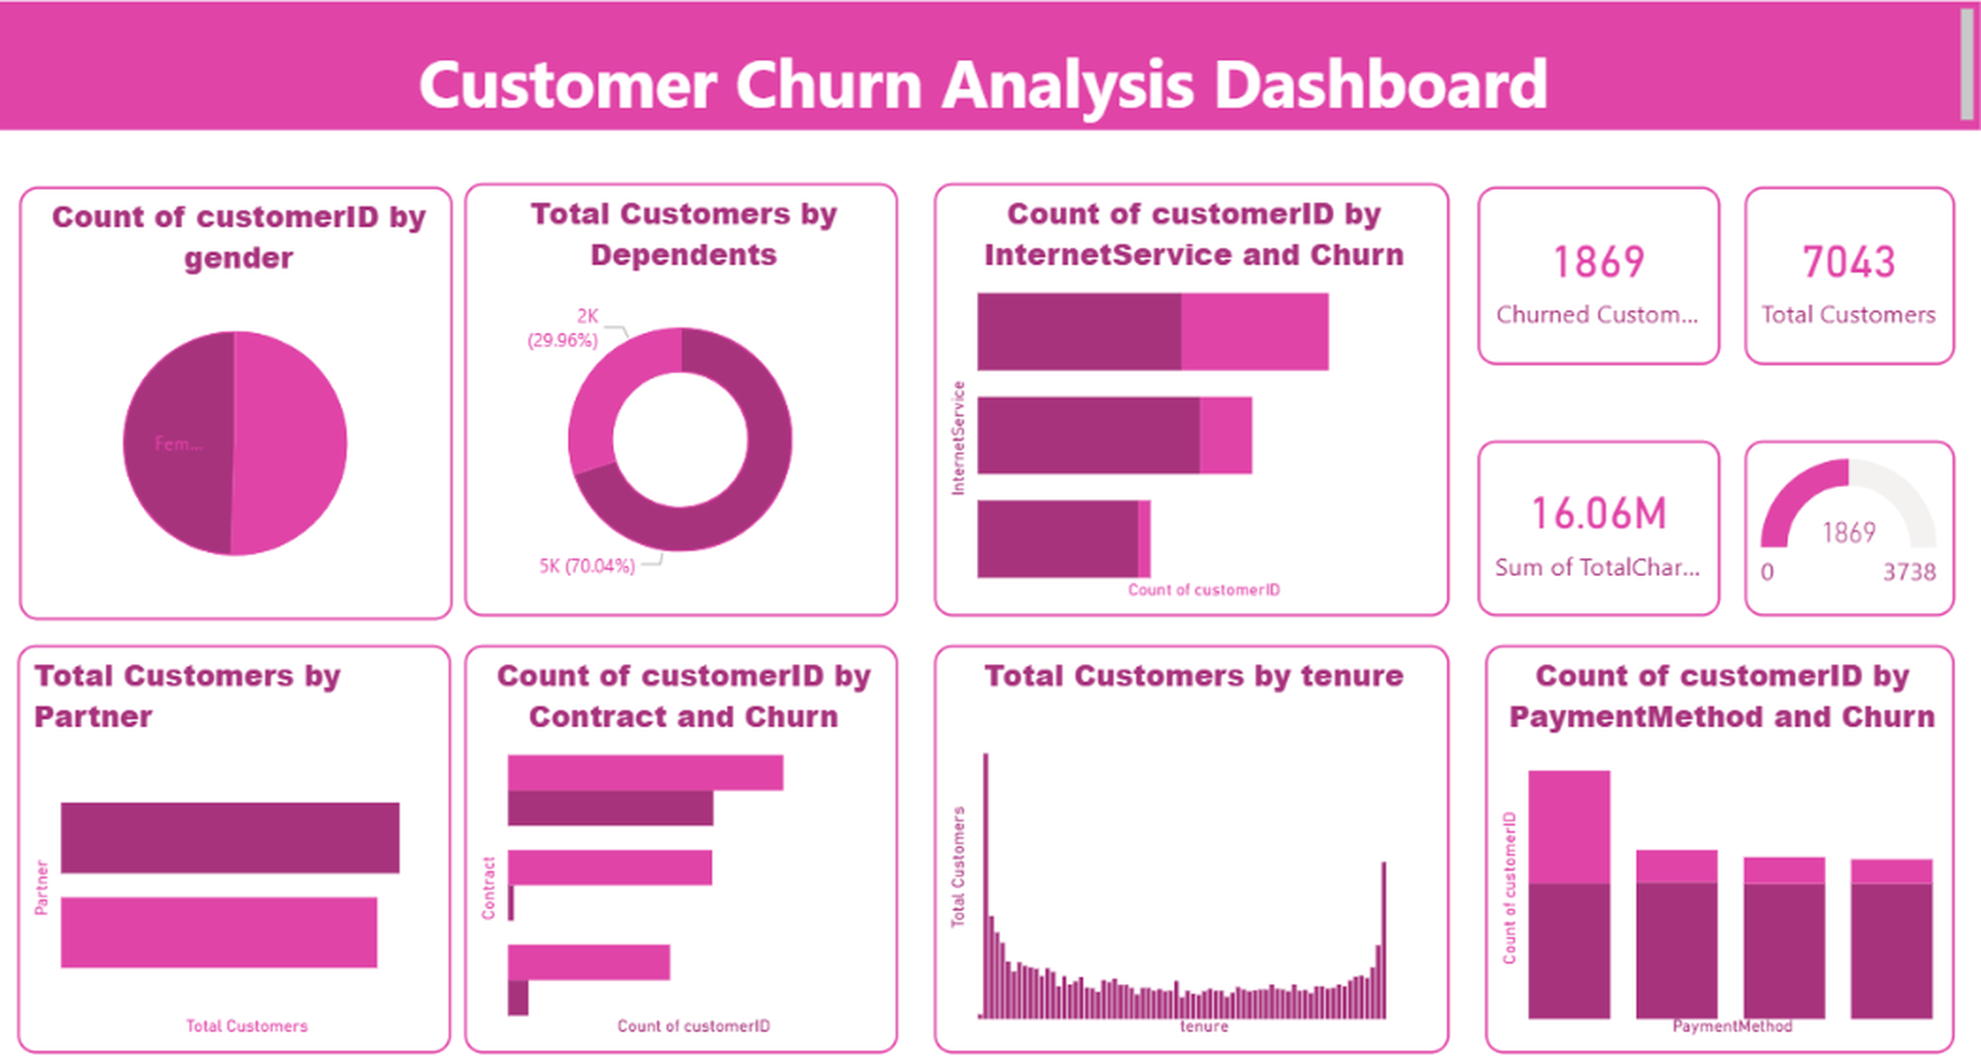
Customer Churn Analysis Dashboard
Power BI Project
TOOLS USED
Power BI
Power Query
DAX
PREPARED BY
Your Name
Notes:
Introduce the project: an end-to-end customer churn analysis built in Power BI using Power Query for preparation and DAX for measures.

Slide 2
Project Objective
1
Measure customer churn rate
OBJECTIVE
Analyze customer behavior and identify the factors contributing to customer churn.
Analyze customer demographics
2
3
Identify churn patterns
4
Evaluate business factors affecting churn
5
Generate actionable insights for retention
Notes:
Five goals: measure churn, understand demographics, find patterns, evaluate business drivers, and recommend retention actions.

Slide 3
Dataset Overview
DATA ATTRIBUTES
The dataset contains customer demographics, subscription details, payment methods and churn status.
Customer ID
Gender
Senior Citizen
Partner Status
Dependents
Contract Type
7,043
12
Payment Method
Internet Service
Monthly Charges
Total Records
Key Attributes
Total Charges
Tenure
Churn Status
Notes:
7,043 customer records. The 12 key attributes cover demographics, services, billing and the churn flag.

Slide 4
Data Preparation & Transformation
1
2
3
4
5
Remove Duplicates
Handle Missing Values
Verify Data Types
Rename Columns
Add Calculated Fields
Ensured each customer appears once
Cleaned blank and null entries
Set correct numeric and text types
Clear, business-friendly field names
Created helper columns for analysis
Tool used: Power Query Editor
All transformations were applied before loading the data into the model.
Notes:
Walk through the cleaning flow in Power Query. You can add a Power Query screenshot to this slide if you want to show the applied steps.

Slide 5
Data Model
Customer
DAX Measures
Optimized schema design
1
Clean structure that keeps the model simple and fast
CustomerID
Gender
SeniorCitizen
Partner
Dependents
Tenure
Contract
PaymentMethod
InternetService
MonthlyCharges
TotalCharges
Churn
Total Customers
Churned Customers
Active Customers
Churn Rate
Efficient data relationships
2
Fields organized for accurate filtering across visuals
Improved reporting performance
3
Lightweight model keeps dashboard visuals responsive
Notes:
The Customer table feeds a set of DAX measures that power every KPI card and chart on the dashboard.

Slide 6
DAX Calculations
Total Customers
Churned Customers
Total Customers =
COUNT(Customer[CustomerID])
Churned Customers =
CALCULATE(
COUNT(Customer[CustomerID]),
Customer[Churn] = "Yes"
)
Active Customers
Churn Rate
Active Customers =
[Total Customers] - [Churned Customers]
Churn Rate =
DIVIDE(
[Churned Customers],
[Total Customers]
) * 100
Notes:
Four core measures. Churn Rate uses DIVIDE to avoid divide-by-zero errors. 1,869 / 7,043 = 26.5%.

Slide 7
Dashboard Overview
Dashboard Components
KPI Cards
Customer Segmentation
Churn Distribution
Contract Analysis
Payment Method Analysis
Tenure Analysis
Interactive Filters and Slicers
Customer Churn Analysis Dashboard built in Power BI
Notes:
Show the full dashboard first, then drill into the sections on the next slides.

Slide 8
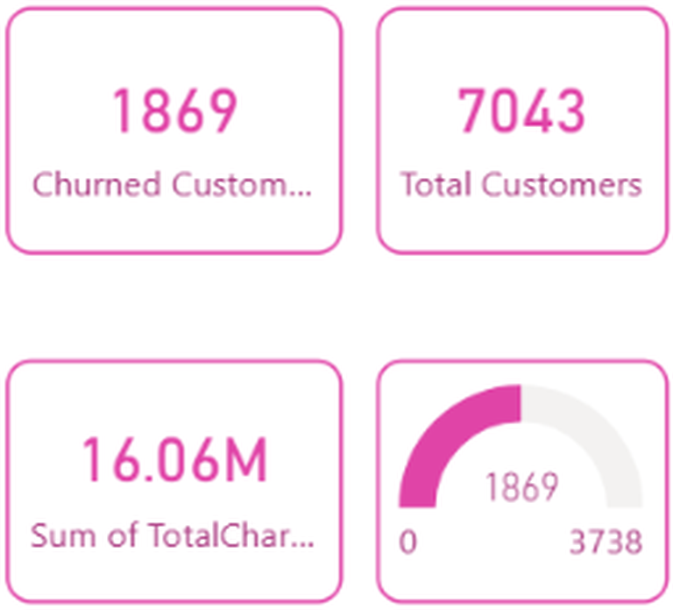
Key Performance Indicators
7,043
1,869
Total Customers
Churned Customers
5,174
26.5%
Active Customers
Churn Rate
Gives an overall view of customer retention, enables quick assessment of business performance, and helps monitor churn trends.
Notes:
Churn rate = 1,869 / 7,043 = 26.5%. Active customers = 7,043 - 1,869 = 5,174. The right-hand image is the KPI section of the dashboard.

Slide 9
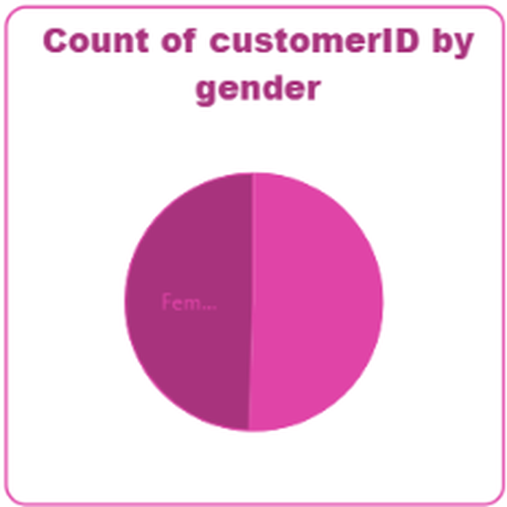
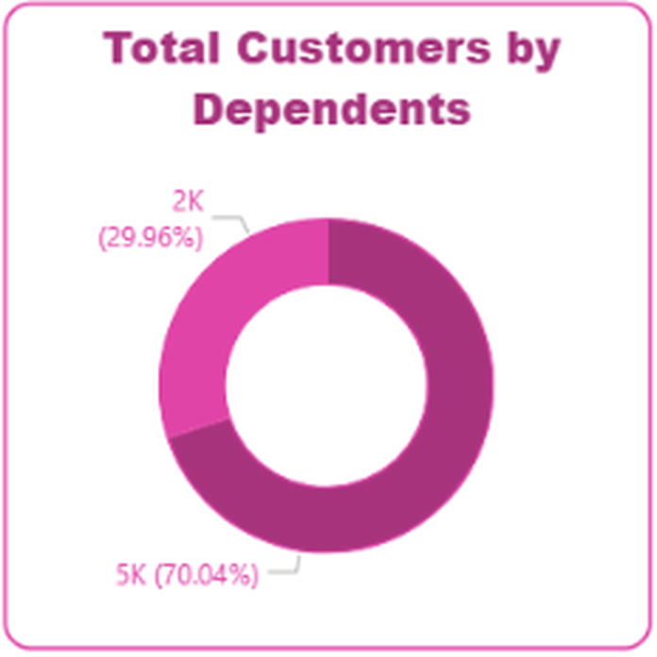
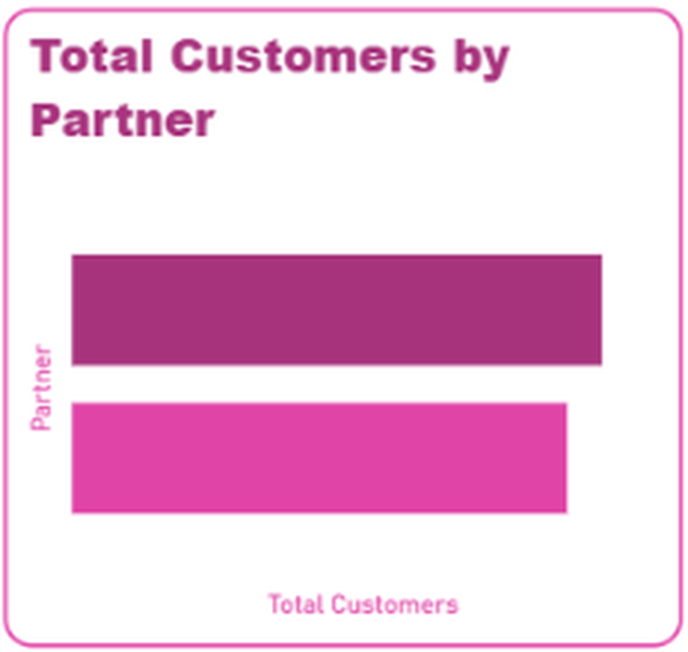
Customer Behavior Analysis
Gender
Dependents
Partner
Customers are split almost evenly between male and female.
About 30% of customers have dependents; 70% do not.
Customers with and without a partner are nearly equal.
Segments are balanced in size, so churn drivers are explored through contract, payment and service.
Notes:
Demographic splits: gender is roughly 50/50, dependents about 30/70, partner nearly equal. Senior citizen can be added here if you built that visual.

Slide 10
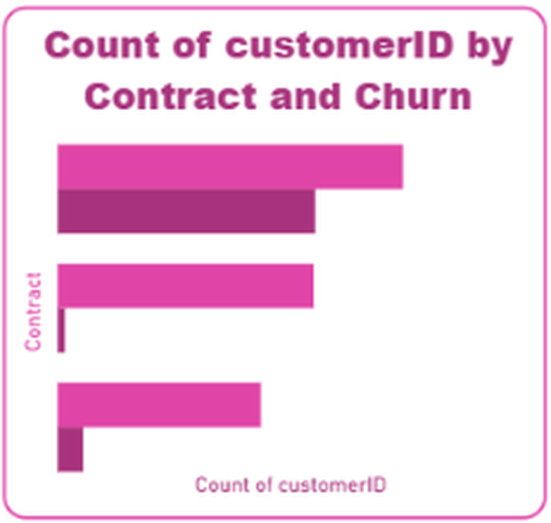
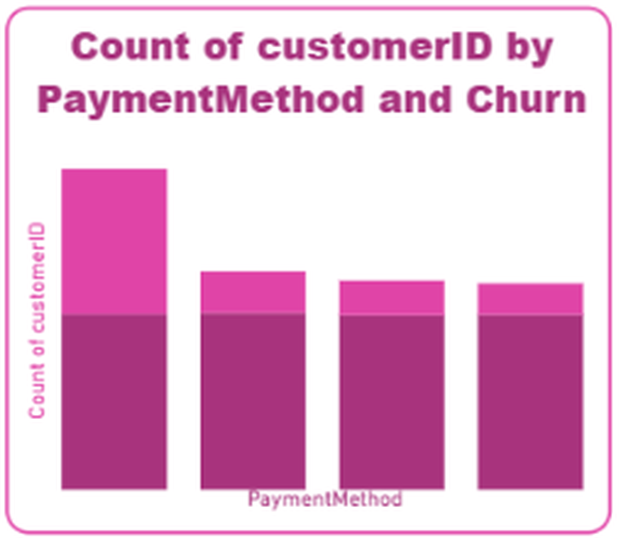
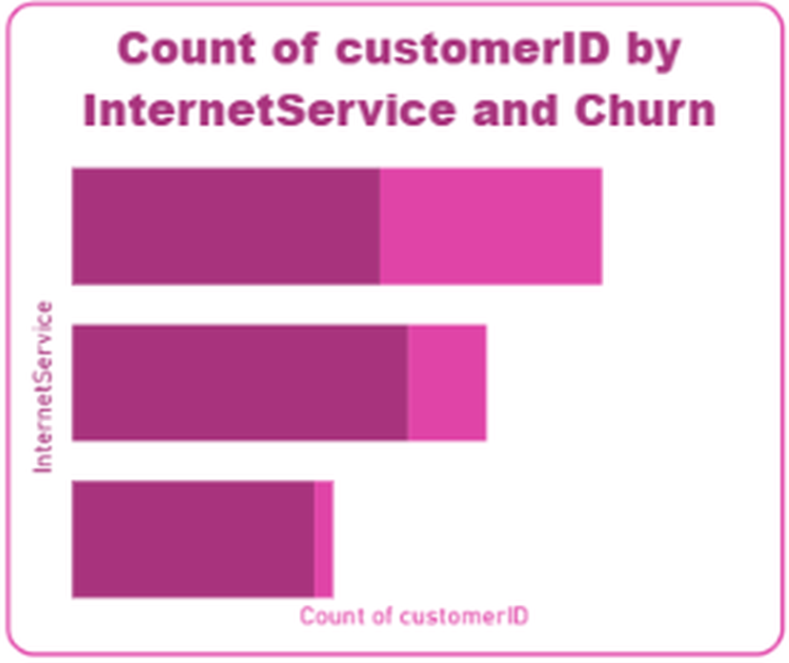
Churn Drivers Analysis
Contract Type
Payment Method
Internet Service
Month-to-month contracts carry the largest churned share.
Electronic check shows the highest churn volume.
Fiber optic customers show the most churn.
Key observation: flexible contracts and specific payment methods exhibit higher churn rates.
Notes:
Lighter pink segments show churned customers. Confirm the category labels (contract, payment, internet type) against your own report before presenting.

Slide 11
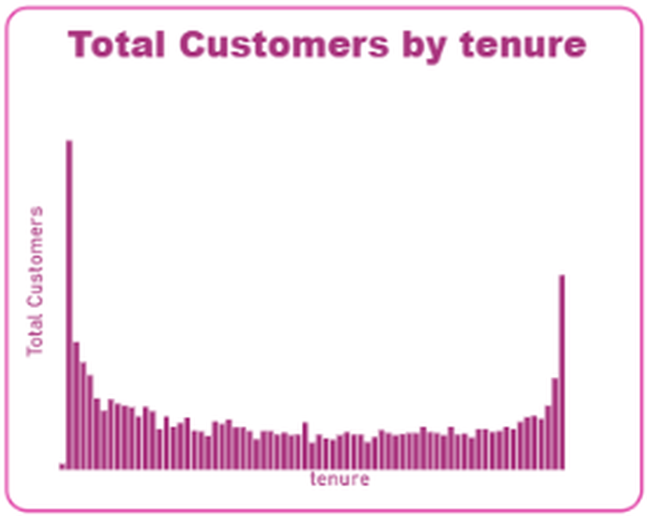
Tenure Analysis
Early-tenure spike
1
Many customers are in their first months, a critical window for retention.
Loyal long-term base
2
A second peak at the longest tenure shows customers who stay once established.
Retention focus
3
Onboarding and early engagement offer the best chance to reduce churn.
Notes:
The tenure histogram has a tall bar at the shortest tenure and another at the longest.

Slide 12
Business Insights & Recommendations
Insights
Recommendations
Churn is concentrated within specific customer segments
Contract duration significantly impacts retention
Customer tenure influences loyalty
Service preferences affect churn patterns
Encourage long-term subscriptions
Improve customer engagement programs
Offer retention incentives to high-risk customers
Develop targeted marketing campaigns
Provide personalized customer support
Notes:
Tie each recommendation back to a finding: contract type, payment method, tenure and service type.

Slide 13
Conclusion
Analyzed customer churn patterns across 7,043 customers
Built an interactive Power BI dashboard
Created DAX measures for KPI tracking
Generated business insights through visual analytics
Recommended strategies to improve customer retention
Thank You
Questions & Answers
Notes:
Flow recap: Dataset, cleaning, model, DAX, dashboard, insights, recommendations. Invite questions.

