Slide 1

SMART STREET LIGHTS
Illuminating our city with intelligence
210701246-SHREENIDHI G L
210701254- SONIYA V

Slide 2


Agenda
SMART STREET LIGHTS
Introduction and Purpose of the project
Components used
Circuit Diagram
Results
Prototype vs Realtime Implementation
Conclusion and Future scope
02
IOT PROJECGT

Slide 3
03
Introduction and Purpose of the project
The purpose of this project is to create an intelligent street lighting solution that dynamically adjusts lighting levels based on ambient light conditions (detected by the LDR) and presence of vehicles or pedestrians (detected by the IR sensor).
Unlike traditional street lighting systems that operate on fixed schedules or manual switches, the smart street light system autonomously adapts to environmental factors, conserves energy, and improves visibility and safety on the streets.

Slide 4
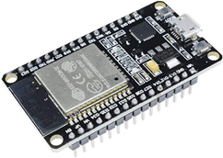
Components Used
ESP 32 Microcontroller
ESP32 Microcontroller
motion sensors
ambient light
IR sensors
LEDs
Resistors
Jumper wires
06
IOT PROJECT

Slide 5

Components used
LEDs
06
IOT PROJECT

Slide 6

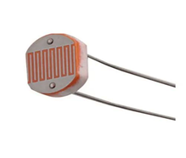
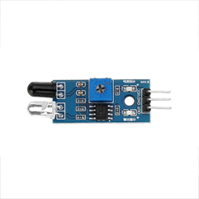

Components used
IR Sensors
components used
4
LDR Sensor

Slide 7
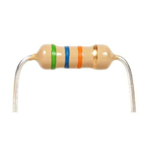
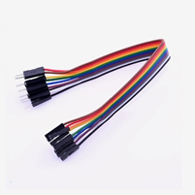
Components used
Jumper wires
components used
4
Resistors

Slide 8
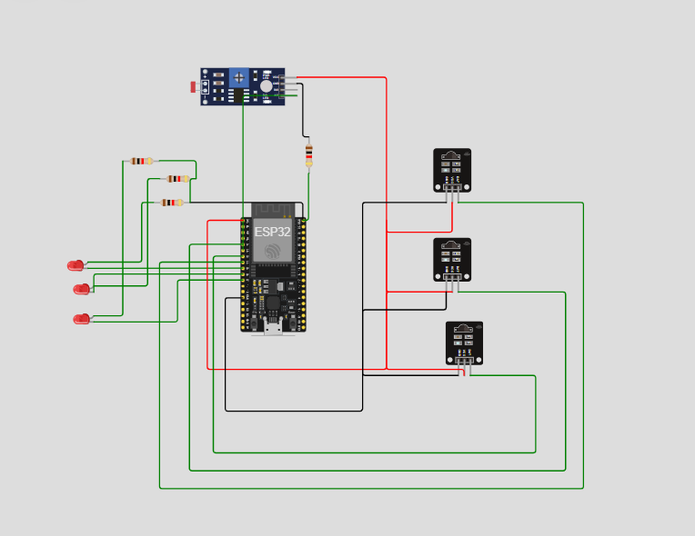
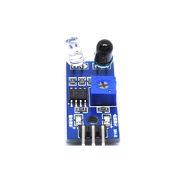
Circuit Diagram
IOT PROJECT
SMART STREET LIGHT

Slide 9
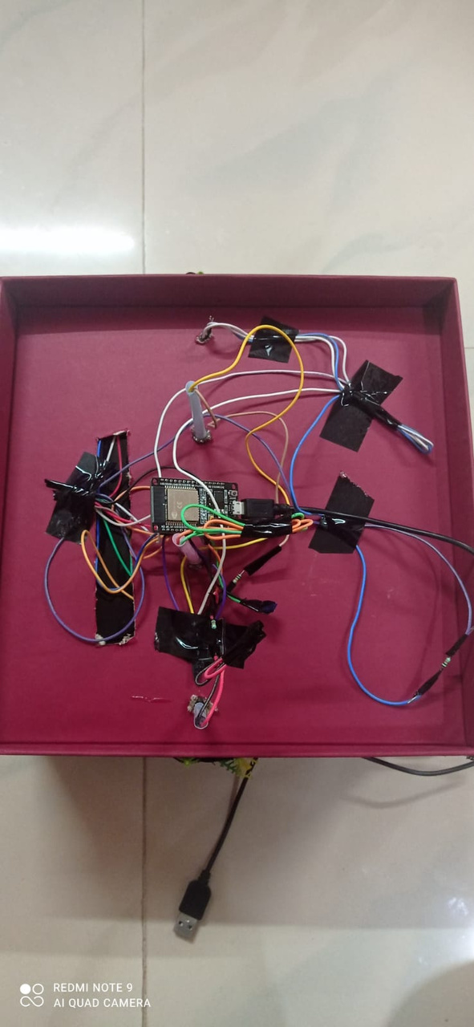
Results
SMART STREET LIGHT
Iot project

Slide 10
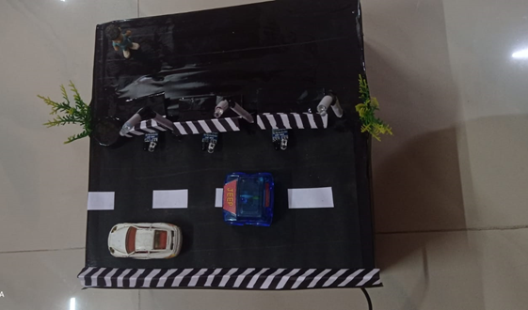
Results
iSMART STREET LIGHT
iot project

Slide 11

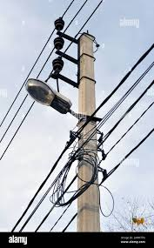
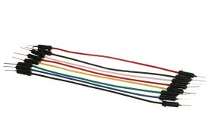
Prototype vs Real time Implementation
Jumper Wires
Multicore Cables

Slide 12

LED VS 100w LED BULBS
Power: 0.5 W
Power: 100 W

Slide 13
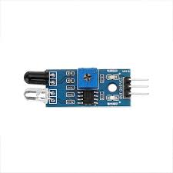

IR vs RADAR
Range: 20 meters
Affected by environmental factors
Do not provide speed or direction information
Long Detection RangeIntensity(200m)
All-Weather Functionality
Detection of Movement
Less Interference from Small Animals

Slide 14
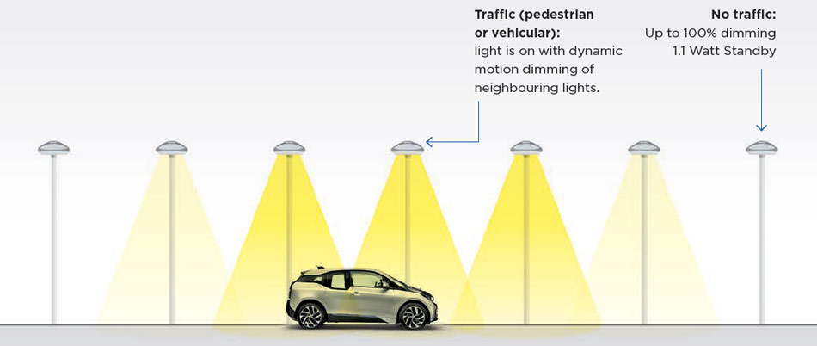
REAL-TIME IMPLEMENTATION

Slide 15
Conclusion
The smart street light IoT project successfully demonstrates how integrating advanced IoT technology into urban lighting systems can lead to significant reductions in power consumption, enhanced operational efficiency, and improved public safety.
By leveraging real-time data and intelligent controls, this project not only contributes to environmental sustainability but also provides a scalable and cost-effective solution for modern urban infrastructure.

Slide 16
Future Enhancements
Future enhancements for the smart street light IoT project could include integrating renewable energy sources such as solar panels to further reduce dependency on traditional power grids.
Additionally, incorporating advanced analytics and machine learning algorithms could optimize lighting schedules and predictive maintenance even further create a more comprehensive smart city ecosystem, providing holistic benefits and fostering smarter, more responsive urban environments.

Slide 17
SMART STREET LIGHT
Thank you!
A Presentation by Shreenidhi G L and Soniya V
IOT PROJECT

