Slide 1
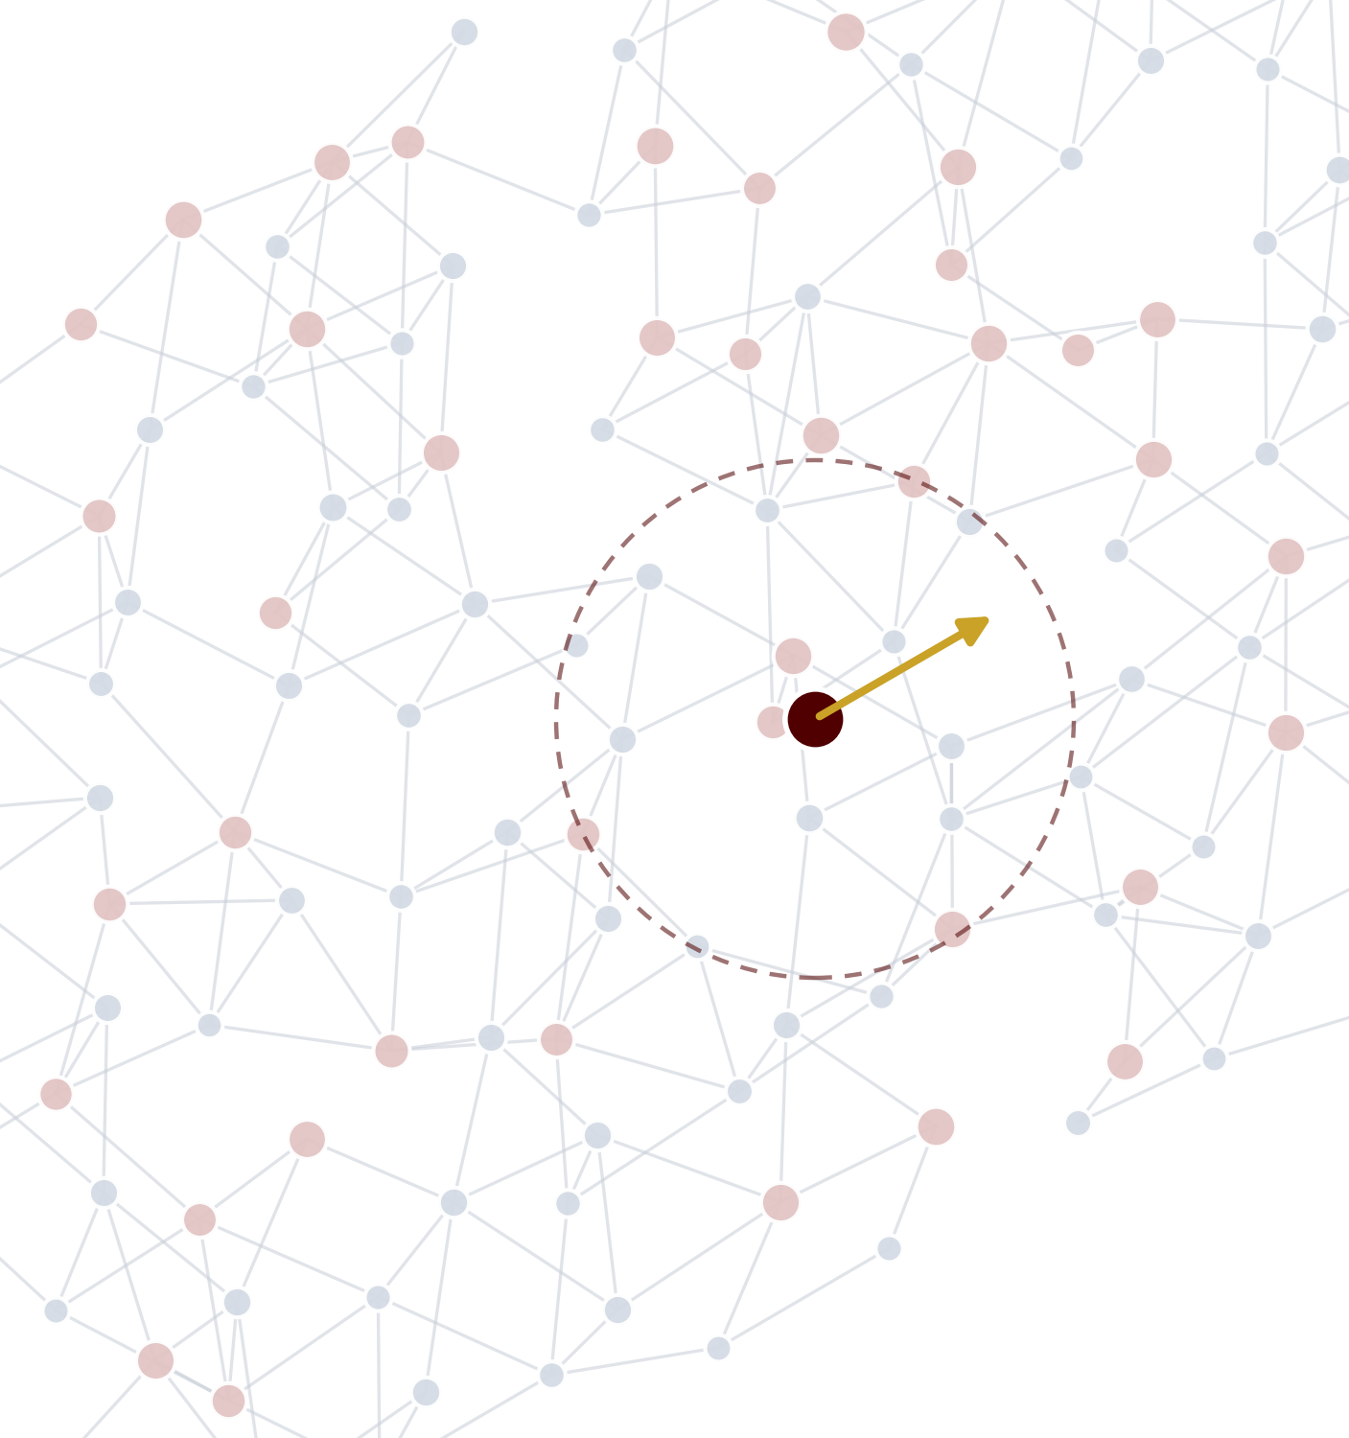
AGENTIC DISCOVERY & DEVELOPMENT · TEXAS A&M
MACE
Machine-learned atomic forces as an agent's physics engine
Joshua Jang · Yuvraj Soni · Fall 2026
Notes:
[0:00-0:15] Today: MACE, a machine-learned model of atomic forces, and why it is the kind of tool an AI agent needs to do real materials discovery. Three minutes of slides, then a seven-minute live demo where an agent fine-tunes MACE on our own DFT data, searches for the most stable copper-gold arrangement, and checks its answer against DFT.

Slide 2
PART 1 · THE MODEL
What is MACE?
A machine-learned interatomic potential: quantum-level accuracy at force-field speed
MACE
equivariant graph
neural network
E
total energy eV
F_{i}
force on every atom eV/Å
Atoms in
σ
stress on the cell GPa
positions r_{i} + elements Z_{i}
WHO USES IT
Li
C
MD
AI
Materials scientists
Chemists & pharma
Simulation engineers
AI agents
batteries, catalysts, alloys
molecules, liquids, drug-like systems
10⁴–10⁶ atoms, nanoseconds of motion
a fast, callable physics oracle
Batatia et al., NeurIPS 2022 (MACE); MACE-MP-0 foundation model covers 89 elements
02
Notes:
[0:15–0:45] MACE is a machine-learned interatomic potential. You give it atoms (where they are and what element they are) and it returns the energy, the force on every atom, and the stress on the cell. It is trained on quantum-mechanical DFT calculations, so it is close to DFT accuracy but thousands of times faster. Users: materials scientists, chemists, simulation engineers, and increasingly AI agents that need a physics tool they can call.

Slide 3
PART 1 · THE MODEL
Where MACE sits: accuracy vs. cost
Learn from expensive quantum calculations once, then predict cheaply forever
trained on DFT
Coupled cluster
DFT
10⁹× gap
at 10k atoms
MACE
accuracy →
Sweet spot: near-DFT accuracy at a tiny fraction of the cost
Classical force fields
compute cost per calculation (log scale) →
MACE scales linearly: big systems and long simulations become possible
Scaling curves are illustrative (DFT ~ O(N³), local ML potentials ~ O(N)); constants vary by code and hardware
03
Notes:
[0:45–1:15] Trade-off map. Classical force fields are fast but crude. DFT is accurate but expensive and scales as N cubed. Coupled cluster is the gold standard and even slower. MACE learns from DFT once, then predicts at a tiny fraction of the cost, and it scales linearly with the number of atoms, so the gap grows with system size.

Slide 4
PART 2 · THE AGENT
MACE as the agent's physics tool
The LLM plans and reasons; MACE answers “what would the atoms do?” in milliseconds
Plan
hypothesis
10⁶ ideas generated
agent / generative model
10⁴ screened with MACE
milliseconds each
LLM
agent
Analyze
rank · decide
Build
ASE · pymatgen
10² checked with DFT
hours each
10 made in the lab
weeks each
Simulate
MACE: relax · MD
Physics cheap enough for an agent to think with
06
Notes:
[2:40–3:20] Where agents come in. The LLM is good at planning and reasoning but cannot know what atoms will do. MACE is a tool it can call: build a structure, relax it or run dynamics, read the energies and forces, decide what to try next. In a discovery funnel, the agent can generate a million ideas, MACE screens ten thousand in milliseconds each, DFT checks the top hundred, and only ten go to the lab.

Slide 5
PART 2 · THE AGENT
Evolution with MACE as the fitness function
Generate, score, select, repeat — then verify the winner with the slow simulator (DFT)
Population
candidate structures
Select
keep the fittest
Mutate
crossover + bit flips
× generations
Score
fine-tuned MACE energy
GENOME: 8 SITES, 2×1×1 FCC CELL (shown: 00010001 = L1₂ Cu₃Au, the ground state)
■ Cu ■ Au bit string read left to right, site by site
Real run from today's demo: 8-site Cu/Au cell, MACE-MP-0 small fine-tuned on 135 DFT labels, 21 network calls at ~42 ms each; the ~9 meV/atom gap is the network's offset — DFT confirms the ranking
07
Notes:
[2:00-2:40] An evolutionary workflow: a population of candidate arrangements, each an 8-bit string saying which lattice sites are copper and which gold. Mutate and cross them, score every child with the fine-tuned network, keep the fittest, repeat. The chart is a real run: 21 network calls in about two seconds. The GA lands on L1-two Cu3Au; the dashed line is what the slow simulator says about that same structure. The network sits a few meV low across the board, but the ranking is right, and that is what the verify step confirms. You will see exactly this live in a minute.

Slide 6
LIVE DEMO
Claude Code × MACE
An agent runs the whole loop from a README — we only watch the dashboard
1
2
3
Learn
Test
Search + verify
Fine-tune MACE on 135 DFT labels for Cu–Au. About 3 minutes on this laptop.
51 structures it never saw: how far is the network from DFT, before vs after?
A genetic algorithm with MACE as fitness; DFT confirms the winner with 3 calls, not 27.
Watch for: the error curve falling · dots hugging the line · the population converging · three green checks
10
Notes:
[3:00] Switch to the dashboard. Paste the README prompt to the agent. Narrate from the presenter view: block 0 (DFT labels, done overnight on the cluster), block 1 learn, block 2 test, block 3 search, block 4 verify. Keep the audience on the dashboard; the terminal is the agent's.

Slide 7
Key takeaways
Four ideas to leave with
E→F
1
ν
2
AI
3
✓
4
One model, all forces
Physics built in
Agents need cheap physics
Close the loop
Learn the energy; forces and stress come free by differentiation.
Equivariant, many-body messages make it accurate and fast.
A 40 ms answer instead of a 10-minute one lets an agent search instead of guess.
Fine-tune on DFT, evolve with MACE, verify winners with DFT — then the lab.
Questions?
11
Notes:
[after demo, ~20 s] Recap: MACE learns the energy and gets forces for free; its equivariant many-body design is why it's accurate and fast; agents need exactly this kind of cheap, callable physics; and the loop closes with DFT and lab verification. Questions?

Slide 8
BACKUP · THE SIMULATOR
DFT in one slide
The slow, trusted physics calculation that produced our labels
ψ
✓
N³
What it is
Why it is trusted
Why not inside the loop
Electrons obey the Schrödinger equation — unsolvable directly beyond a few electrons.
Density functional theory (Kohn, Nobel 1998) rewrites it in terms of the electron density — three coordinates instead of 3N — solved iteratively (the SCF loop).
One approximation: the exchange–correlation functional. We use PBE, the standard for solids.
First principles: inputs are atomic numbers and positions; nothing fitted to experiment for the system at hand.
Lattice constants within 1–2 %, formation energies to tens of meV/atom, forces for free (Hellmann–Feynman).
Ours: Cu 3.65 Å, Au 4.18 Å (experiment 3.61 / 4.08).
Cost grows as N³ in the electrons: minutes for 8 atoms, hours for 100, impossible for a million-step simulation.
Known systematic errors — PBE underbinds Cu–Au by ~30 %. The learned model inherits them.
Zero kelvin: temperature needs many more evaluations.
Our calculations
VASP 6.3.2 · PBE · PAW (Cu, Au: 11 valence e⁻) · ENCUT 400 eV · Γ-centred 8×8×8 / 4×8×8 k-points · Methfessel–Paxton 0.1 eV · 186 single points (energy + forces at fixed geometry), minutes each on 12 cores, SLURM array on TAMU HPRC Grace.
Hohenberg & Kohn 1964; Kohn & Sham 1965; Perdew, Burke & Ernzerhof 1996
12
Notes:
Backup: DFT for a non-specialist. What it is, why we trust it, and the three reasons it cannot sit inside a search loop.

Slide 9
BACKUP · LEARNED POTENTIALS
From DFT to a learned potential
Treat the energy as a regression target — with three physics constraints built in
Σ
⟳
∇
Locality
Symmetry
Forces by differentiation
Total energy is a sum of atomic energies, each depending only on neighbours within a cut-off (MACE: 6 Å).
This is why a model trained on 4- and 8-atom cells works on any size, and why cost is linear in N.
Translate, rotate or relabel identical atoms: the energy must not change; forces must rotate along.
Built into the architecture, not learned from data.
F = −∂E/∂r, computed exactly by automatic differentiation.
Energy-conserving by construction, and every DFT structure gives 3N force labels — most of the training signal.
LINEAGE
2007
2010
2019
2022
2022
Behler–Parrinello
GAP
ACE
NequIP
MACE
atomic energies + neural nets
Gaussian processes
complete many-body basis
equivariant graph nets
ACE products inside an equivariant GNN
Behler & Parrinello 2007 · Bartók et al. 2010 · Drautz 2019 · Batzner et al. 2022 · Batatia et al. NeurIPS 2022
13
Notes:
Backup: the three design principles every machine-learned potential shares, and where MACE sits in the lineage.

Slide 10
BACKUP · THE MODEL
MACE: a graph of atoms passing messages
Two layers, many-body messages, exact rotational symmetry
atom i and its neighbourhood (cut-off 6 Å)
Embed
1
Each atom starts with a learned vector for its element.
2
Collect neighbours
For every neighbour: distance (radial basis) × direction (spherical harmonics) × its features. Summed: a two-body description Aᵢ.
i
Multiply
3
Products of Aᵢ with itself encode angles and dihedrals — many-body information in one message (body order 4). This is the ACE idea.
4
Update, read out, repeat
Update the atom's features; after 2 layers a readout gives Eᵢ. Total E = Σ Eᵢ; forces = −∂E/∂r.
nodes = atoms · edges = pairs within the cut-off · each layer passes messages along edges
2 layers × 6 Å = 12 Å receptive field. MACE-MP-0: 1.5 M structures, 89 elements, PBE.
Batatia, Kovács, Simm, Ortner & Csányi, NeurIPS 2022; Batatia et al., arXiv:2401.00096 (MACE-MP-0)
14
Notes:
Backup: the mental model. Graph, messages, products for many-body information, two layers, readout, differentiate for forces.

Slide 11
BACKUP · SYMMETRY
Equivariance for absolute beginners
Rotate the input and the output rotates with it — exactly, not approximately
Invariant: the energy
Equivariant: the forces
Rotate the molecule → the same number comes out
Rotate the molecule → the force arrows rotate with it
→
→
E = −3.72 eV
E = −3.72 eV
same energy
arrows turned by the same angle — nothing else changed
Why it matters: forces are vectors. A network that must learn rotation from data wastes data and still gets it slightly wrong.
MACE builds the symmetry in — its features carry rotation labels (spherical harmonics), so symmetry is exact and training data goes further.
15
Notes:
Backup: invariance (scalars stay the same) vs equivariance (vectors transform along). MACE's features are equivariant by construction.

Slide 12
BACKUP · THE MATH
The math behind MACE, gently
Four equations, each with a plain-language reading
E = Σᵢ Eᵢ
The total energy is a sum of per-atom energies. Each Eᵢ depends only on atoms within the cut-off.
1
Aᵢ = Σⱼ R(rᵢⱼ) · Y(r̂ᵢⱼ) ⊗ hⱼ
Collect the neighbours: a radial function of the distance, spherical harmonics of the direction, and the neighbour's features. Summing over j makes it a two-body descriptor.
2
Bᵢ = Aᵢ ⊗ Aᵢ ⊗ Aᵢ (symmetrised)
Multiply the collection by itself. Products of pair terms encode angles and dihedrals — many-body geometry — without ever enumerating triples. Body order 4 per layer; this is the Atomic Cluster Expansion.
3
hᵢ ← W·Bᵢ , Eᵢ = readout(hᵢ) , F = −∂E/∂r
Update the atom's features with learned weights, repeat for the second layer, read out the energy, and differentiate for the forces. Every step is an equivariant tensor product, so rotations stay exact.
4
Training: minimise 100·(ΔE/atom)² + 10·(ΔF)² over 135 DFT structures, 20 epochs, starting from MACE-MP-0's weights.
Notation simplified: channel indices, learnable radial weights and the irreducible-representation bookkeeping are omitted
16
Notes:
Backup: the four equations. Sum of atomic energies; two-body collection; products for many-body terms (ACE); update, read out, differentiate.

Slide 13
BACKUP · RESULTS
Fine-tuning on our DFT labels: what changed
Held out: 51 structures of 17 orderings the model never saw
 | pretrained MACE-MP-0 | fine-tuned (20 epochs) | fine-tuned (30 epochs)
formation-energy error (MAE) | 10.7 meV/atom | 7.9 | ~4
force error (RMSE) | 112 meV/Å | 26 | ~23
186
DFT single points
27
distinct orderings; 10 trained, 17 held out
Raw MACE is already decent on energies — it was trained on PBE too. Fine-tuning's big wins: forces 4× better, and the few-meV ranking the convex hull needs.
The fine-tuned energies sit ~9 meV/atom low across the board; that offset cancels in rankings, which is why the hull matches DFT at all 5 vertices.
3 of 27
expensive calls in the verify step — all confirmed
~3.5 min
Training recipe: start from MACE-MP-0 small; per-element reference energies fitted by least squares; loss weights energy 100 : forces 10; Adam, lr 0.01, EMA; batch 16; 20 epochs ≈ 3 min on CPU.
the whole loop on a laptop CPU
Numbers from the run in this repository (results/validation.json, results/discovery.json)
17
Notes:
Backup: the quantitative result. Use when asked 'why fine-tune at all' or 'how good is it'.

Slide 14
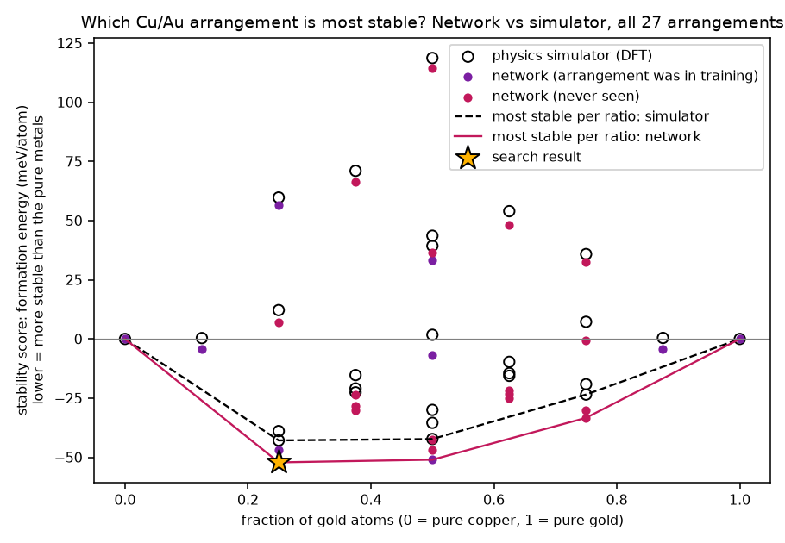
BACKUP · THE SYSTEM
Cu–Au: a real system with a textbook answer
Copper and gold mix in all proportions and order into intermetallic compounds
Why this system
Cu₃Au — L1₂ (Au on cube corners, Cu on faces); orders below ~390 °C.
CuAu — L1₀ (alternating Cu and Au layers); ~410 °C.
CuAu₃ — L1₂, weaker.
The Cu₃Au order–disorder transition is the classic example in physical metallurgy, and Cu–Au was the original testbed for computational ground-state searches.
Our PBE formation energies: Cu₃Au −46.7, CuAu −48.6, CuAu₃ −28.2 meV/atom (experiment is more negative — PBE underbinds).
Formation energy = E(mixture) − x·E(Au) − (1−x)·E(Cu), per atom. Negative = favourable. The convex hull = the stable compounds.
Every distinct ordering: network (pink) vs DFT (circles). Hull vertices agree; the star is Cu₃Au L1₂.
18
Notes:
Backup: the system is real and the answer is known, which is why the audience can judge the result.

Slide 15
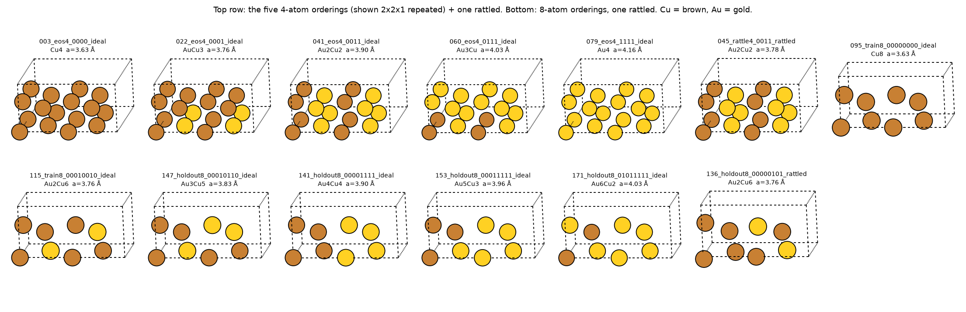
BACKUP · THE DATA
The 186 DFT calculations
An active-learning snapshot: DFT on under 40 % of the ordering space; the network ranks the rest
group | count | why it is there
4-atom cells · 7-point volume scan for each of 5 orderings | 35 | energy vs lattice constant per composition
4-atom cells · rattled (σ 0.05 / 0.10 Å) at three volumes | 60 | non-zero forces: the local shape of the energy surface
8-atom cells · 10 orderings (Cu₈, Au₈ + 8 random mixed), ideal + 3 rattled | 40 | ordering patterns a 4-atom cell cannot hold
8-atom cells · the other 17 orderings, ideal + 2 rattled | 51 | never trained on: validation in step 2, answer key in step 3
Geometries are fixed (no relaxation) so the network and DFT are compared on identical structures; all 27 orderings have DFT labels
19
Notes:
Backup: what was computed and why each group exists.

