Slide 1
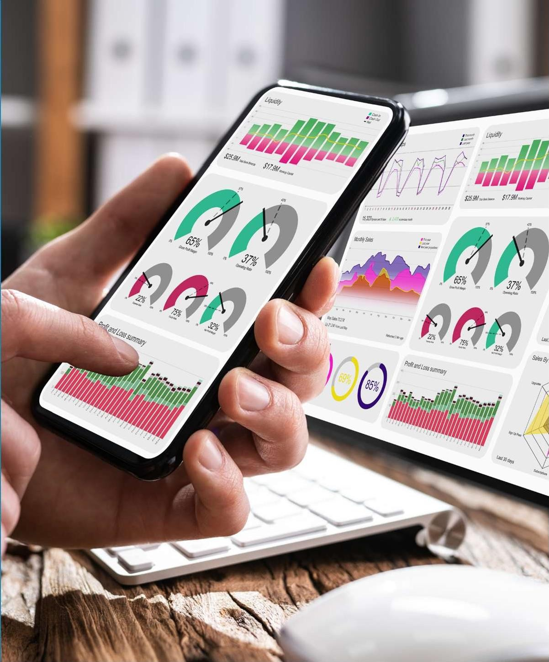

CASE STUDIES
www.infinite-uptime.com
12

Slide 2





{{Plant Name}}
Case Enabler:
{{Case Enabler}}
{{Equipment}}
Machine Details, Construction and Working
Sequence of Events
{{Machine Details}}
{{Observation Date}}
{{Date of Recommendation}}
{{Date of Corrective action Taken}}
{{Date of closed Report}}
IMPACT
{{Observation}}
{{Recommendation}}
{{Corrective Action Details}}
{{Closed Report Status}}
downtime saved
{{Downtime Hours}}
Vibration Trends
{{Equipment Image}}
{{Trend for Image-1}}:
{{Trend for Image-2}}:
Substantial decrease in vibration after machine maintenance.
Substantial decrease in vibration after machine maintenance.
{{Trend Image 1}}
{{Trend Image 2}}
$ xxx
Cost per Hour (USD)

Slide 3
Thank you!
For more details contact our customer success team.

