Slide 1
Fast Food Order System
Object-Oriented Progamminng
MSIS2433.M12.CTTT
Author:
Duong Tran Son Long – 17520706
Lecturer:
Nguyen Thanh Binh

Slide 2
Agenda
Introduction
Idea
Diagrams And Design
Code And Demo
References

Slide 3
Instructions
What is it ?
This is a sales management software that is programmed based on the actual needs of each retail point and mini supermarket… compatible with touch vending machine hardware and devices.
What is for ?
The system helps customers to view information and choose dishes more conveniently .
The system helps managers easily calculate invoices, consult customer products,...

Slide 4
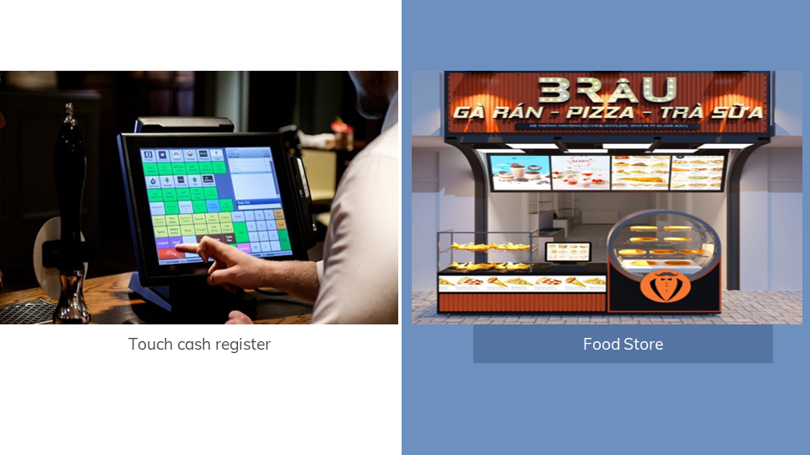
Idea
Based on the times I have ordered and paid for them at the store blow.

Slide 5
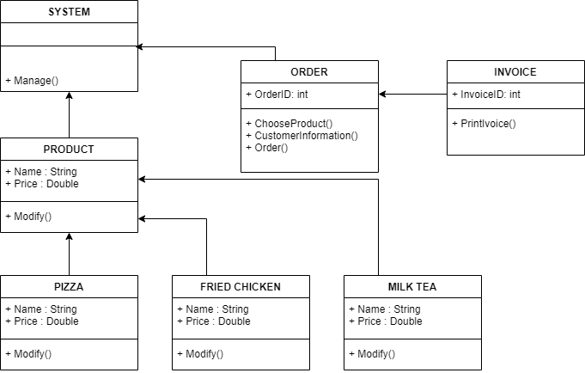
Diagram And Design

Slide 6
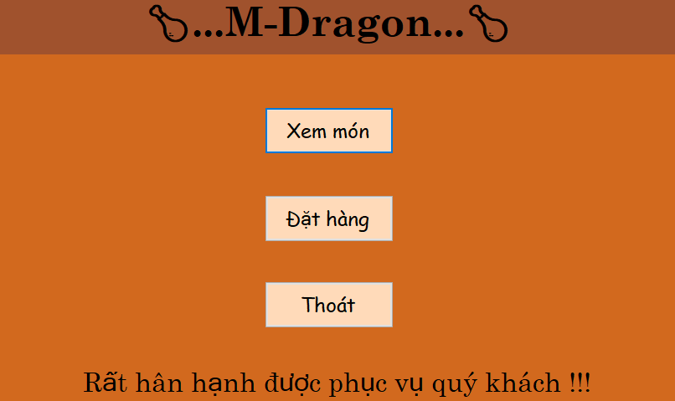
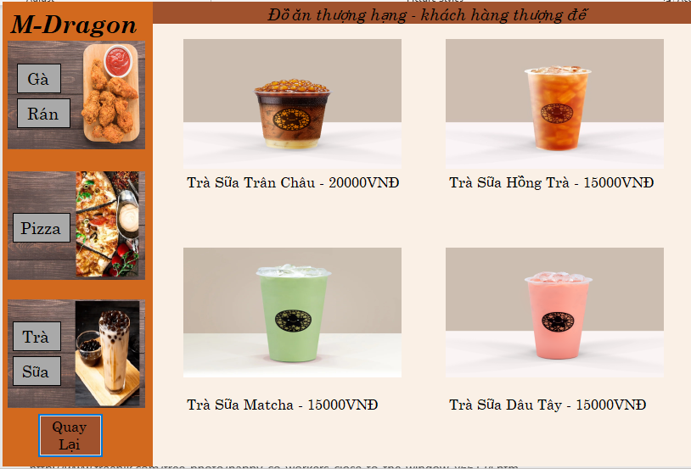
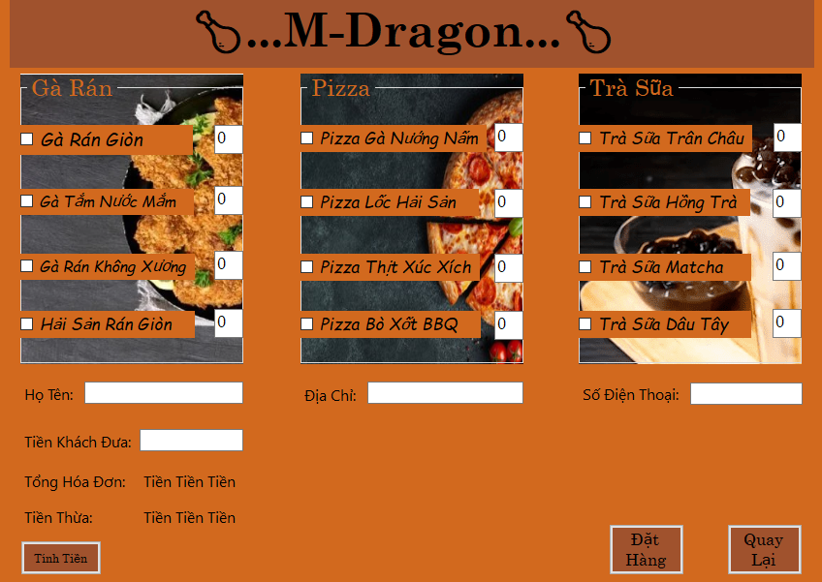
Diagram And Design
”
Step 1
Step 2
Step 3

Slide 7
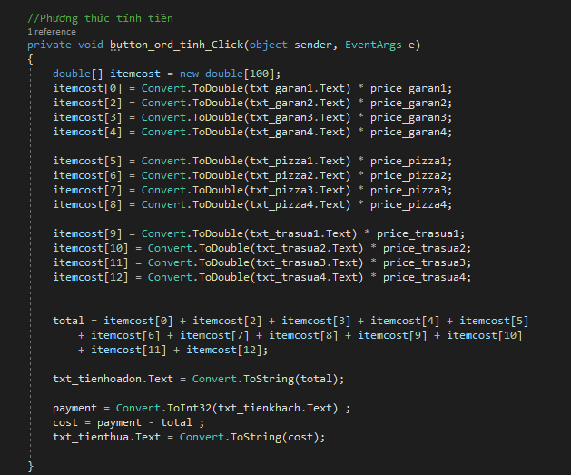
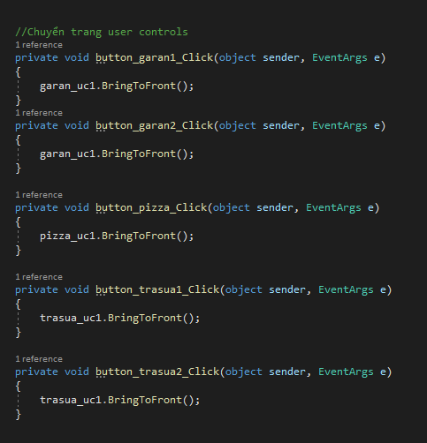
Code And Demo
Payment processing
Switching pages in Product page

Slide 8

This is a
Demo
This is your App Demo

Slide 9
References
- Product Page: https://www.youtube.com/watch?v=peb7kO3GDuQ&ab_channel=BythamDevelopers
- Edit textbox check False: https://stackoverflow.com/questions/38758988/textbox-enabled-true-false/38759089
- Reset textbox : https://stackoverflow.com/questions/38758988/textbox-enabled-true-false/38759089
- UML : https://www.youtube.com/watch?v=gX54HnLpiog&list=PLoaAbmGPgTSMpPS7L1vFDRsPCFvncUc_D&ab_channel=%C3%94ngDev

Slide 10

Thank you !

