Slide 1
Chapter 4.
Spectral Density and Correlation
Introduction to communication systems - <number> -

Slide 2
4. 1
Energy Spectral Density
Introduction to communication systems - <number> -

Slide 3
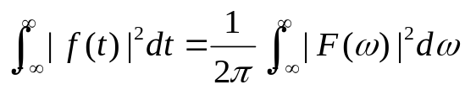


Parseval’s theorem
  : The energy spectral density (or energy) of the signal
  Quantity : energy per unit frequency
Introduction to communication systems - <number> -

Slide 4





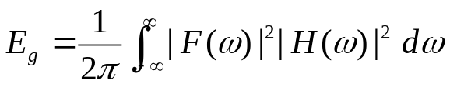
Consider a Linear System
  The spectral density of the output
  The energy spectral density of G(w)
  The energy in the output signal
Introduction to communication systems - <number> -

Slide 5
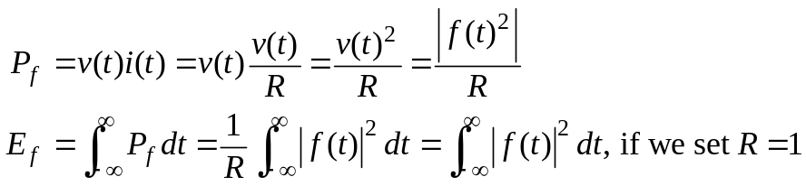





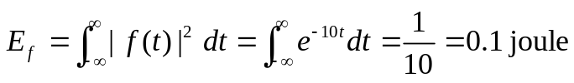
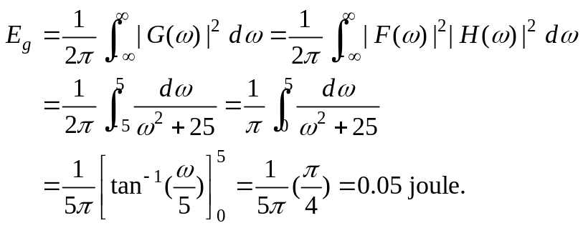
Ex 4.1.1 ) Find energy of the input, output signal
solution
  The energy in the input signal f(t) is
  The energy in the output signal g(t) is
Introduction to communication systems - <number> -

Slide 6
4. 2
Power Spectral Density
Introduction to communication systems - <number> -

Slide 7
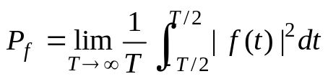





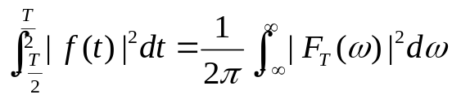
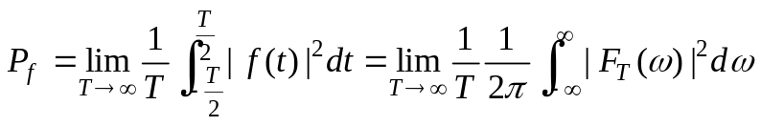
Note
  Not all signals of interest have finite energy. Some signals have infinite energy, but they may have a finite time-average of energy. This time average of energy is called average power and such signal are called power signals.
  The time averaged power of a signal,
  Define as the power spectral density function. (in units of power (watt)/Hz) which satisfies
  Consider a truncated function where is a power signal.
    Its Fourier transform:
    Parseval’s theorem for this truncated function is
    Hence, the average power P is given by
Introduction to communication systems - <number> -

Slide 8
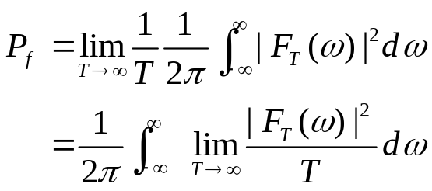
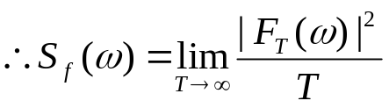

Introduction to communication systems - <number> -

Slide 9


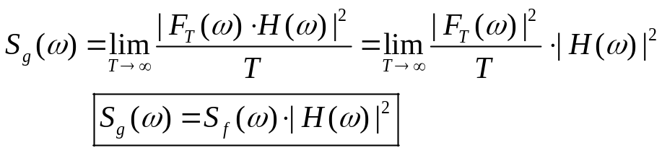
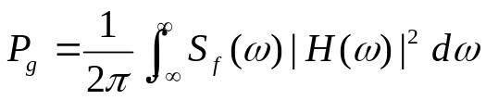
  Consider the transmission of power signal linear system
    The power spectral density of the output signal
    And the average power
Introduction to communication systems - <number> -

Slide 10
4. 4
Correlation Function
Introduction to communication systems - <number> -

Slide 11

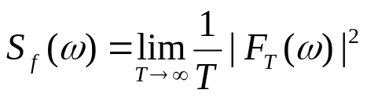

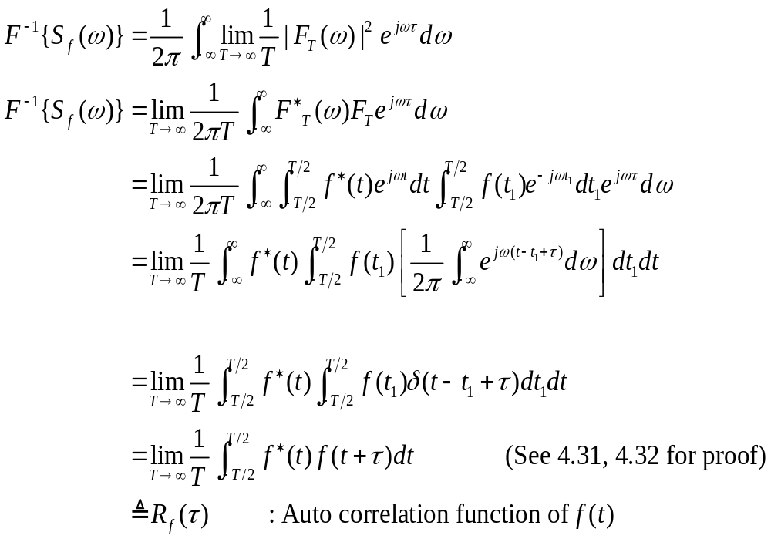


: Power spectral density in frequency
  Let’s take an inverse Fourier transform of .
Introduction to communication systems - <number> -
Notes:
F⁻¹
Power spectral Auto correlation
F

Slide 12
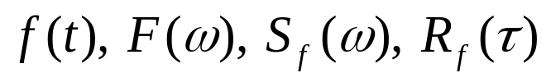




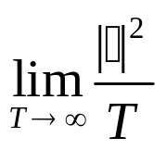

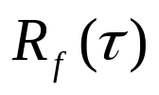
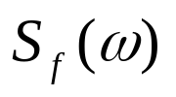
의 관계도
P.S.D(Power Spectral Density)
Introduction to communication systems - <number> -

Slide 13

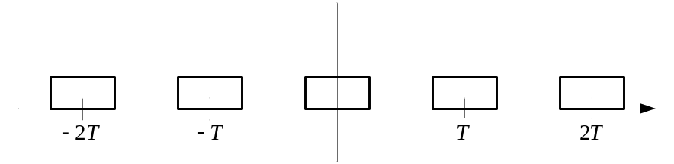

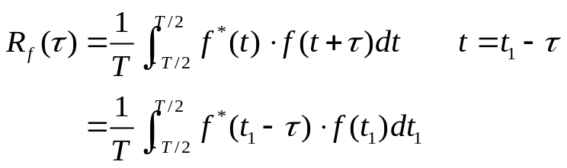

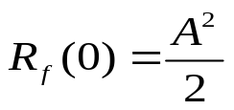
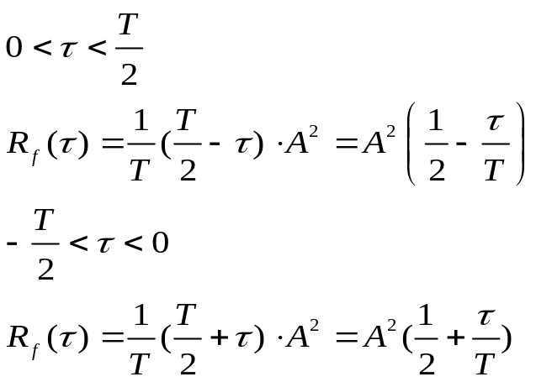
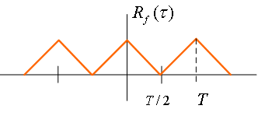
  Example 4.4.1 )
A
(주기함수)
(주기함수)
Autocorrelation Function
Introduction to communication systems - <number> -

Slide 14
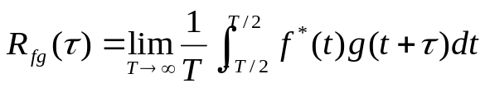
  Cross-correlation,
Introduction to communication systems - <number> -

Slide 15
  Exercise
  1.
Introduction to communication systems - <number> -

Slide 16
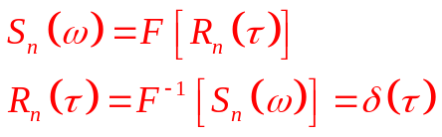
  Exercise
  1.
Introduction to communication systems - <number> -

Slide 17
4. 5
Some Properties of
Correlation Functions
Introduction to communication systems - <number> -

Slide 18
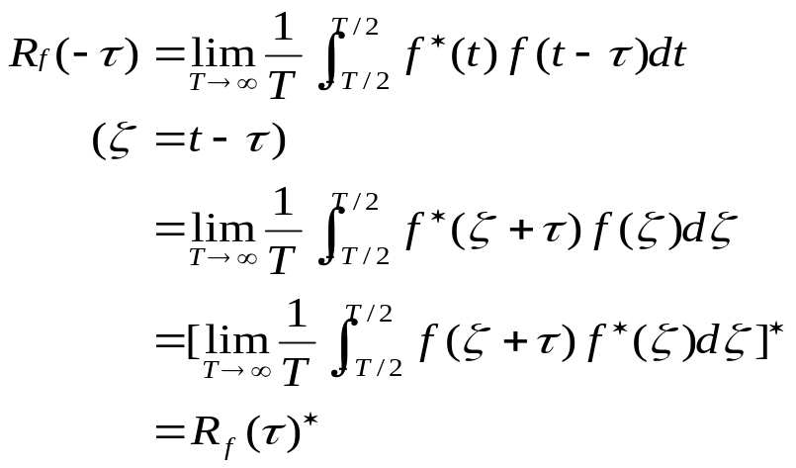
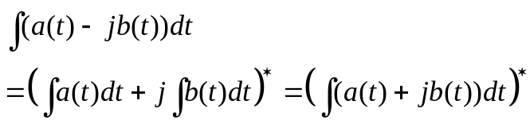


4.5.1 Symmetry
Note
Conjugate의 적분은
적분의 Conjugate와 같다.
  Hermitian symmetry
    Magnitude :
    Phase :
Introduction to communication systems - <number> -

Slide 19
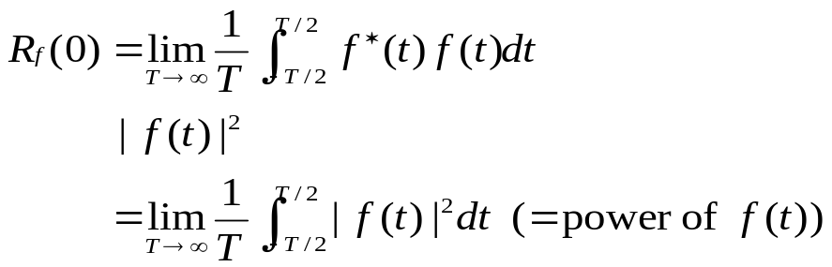
4.5.2 Mean-Square Value
Note
  Relationship of power and autocorrelation
Introduction to communication systems - <number> -

Slide 20




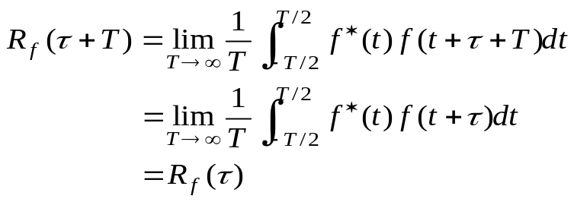
4.5.3 Periodicity
Note
  If for All , Then
  Proof )
Introduction to communication systems - <number> -

Slide 21




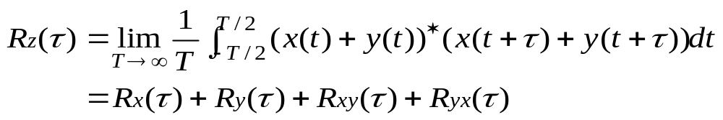






4.5.6 Additivity
Note
  Let and are uncorrelated,
then,
  Proof)
    When,
      We say that are uncorrelated
      And , so
    So,
  Autocorrelation -> Fourier Transform -> Power spectral Density (P.S.D)
  P.S.D are also additive if are uncorrelated
Introduction to communication systems - <number> -

Slide 22
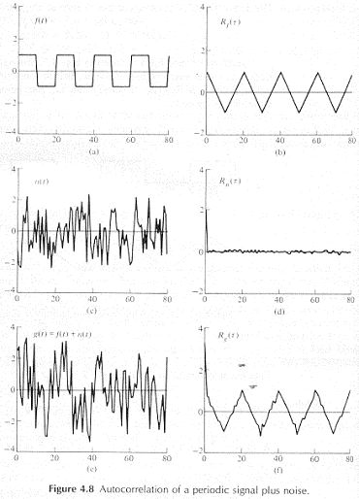
Autocorrelation / Cross-correlation in signal analysis
+
주기적인 신호의 correlation
+
Noise
Introduction to communication systems - <number> -

Slide 23

  Exercise
  1.
Introduction to communication systems - <number> -

Slide 24
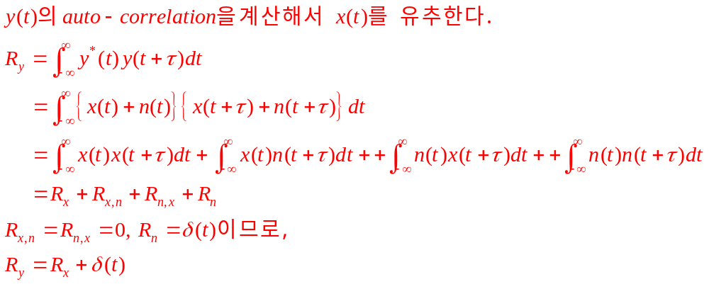
  Exercise
  1.
Introduction to communication systems - <number> -

Slide 25
4. 6
Correlation Functions
For Finite-Energy Signals
Introduction to communication systems - <number> -

Slide 26
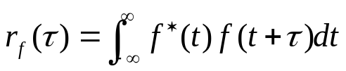
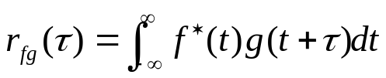
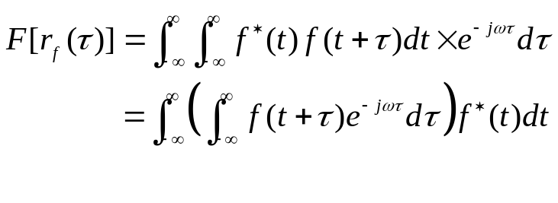

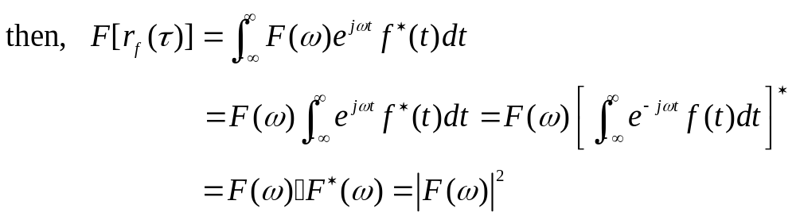
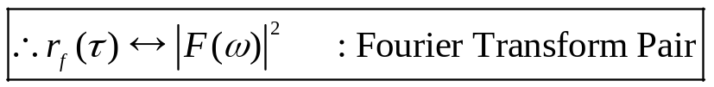

Note
  Autocorrelation
  Crosscorrelation
  After Fourier Transform
Energy Spectral Density (E.S.D)
Introduction to communication systems - <number> -

Slide 27



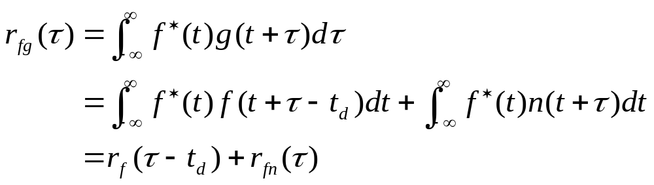




Distance measurement using Crosscorrelation
  Pulse signal : , Reflected and received signal :
  Relation
  Even for a noisy channel, we can detect from using cross correlation
  We calculate the crosscorrelation of and
  Because is known, we can estimate by comparing
Introduction to communication systems - <number> -

Slide 28
  Exercise
  1.
Introduction to communication systems - <number> -

Slide 29
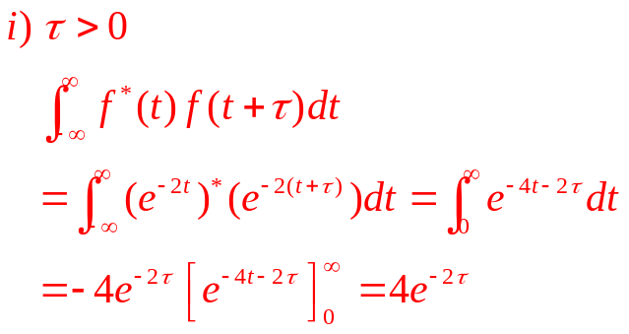
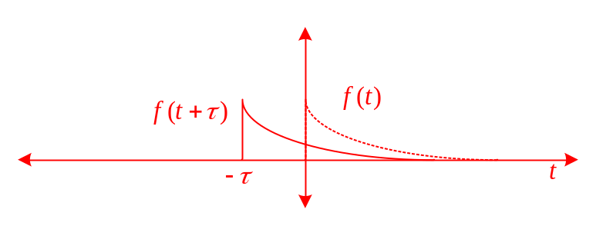
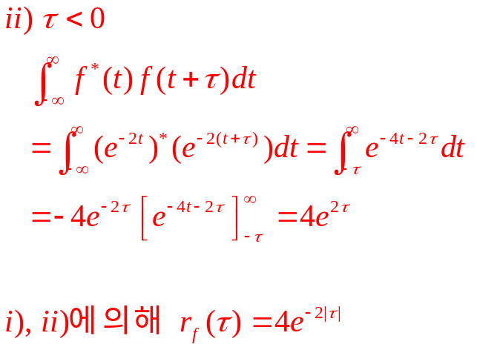
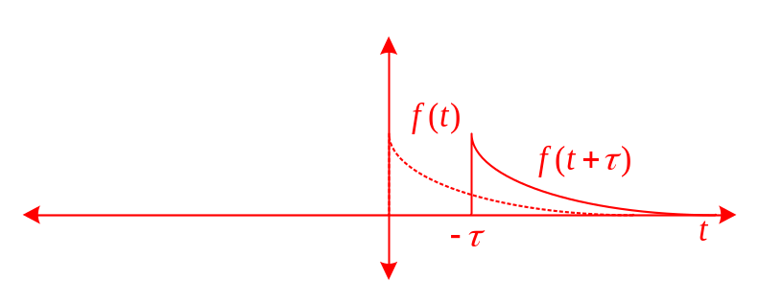
  Exercise
  1.
Introduction to communication systems - <number> -

Slide 30
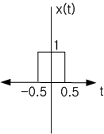
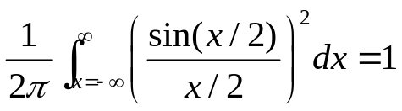
  Exercise
  2.
  _{(a)}
  _{(b)}
  _{(c)}
Introduction to communication systems - <number> -

Slide 31
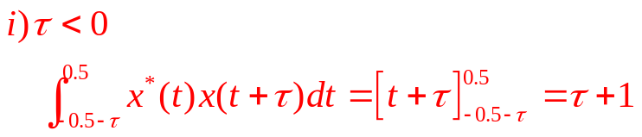

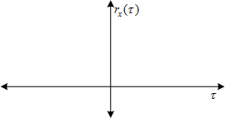
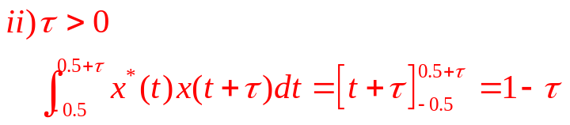

  Exercise
  2.
  _{(a)}
1
-1
1
Introduction to communication systems - <number> -

Slide 32
  Exercise
  2.
  _{(a)}
  _{(b)}
  _{(c)}
Introduction to communication systems - <number> -

Slide 33

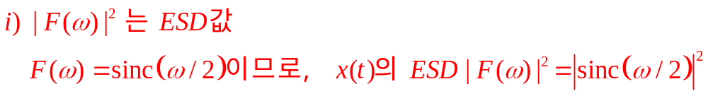
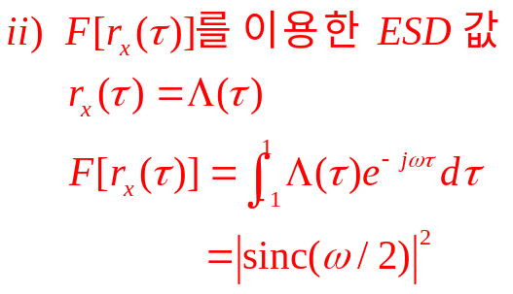
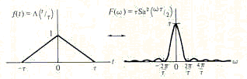
  Exercise
  2.
  _{(b)}
Introduction to communication systems - <number> -

Slide 34
  Exercise
  2.
  _{(a)}
  _{(b)}
  _{(c)}
Introduction to communication systems - <number> -

Slide 35

  Exercise
  2.
  _{(c)}
Introduction to communication systems - <number> -

Slide 36



4. 7
Band limited white noise
Introduction to communication systems - <number> -

Slide 37








Note
  Purely white noise
  Band limited white noise.
    The practical BW of the measuring device is finite. The noise seems to have a finite power. So, measurements are restricted to finite BW. What we are really interested in is a band limited white noise. If P.S.D. of noise is flat within the system BW, the noise seems to be white to the system.
    Ex)
Introduction to communication systems - <number> -
Notes:
Noise는 조금이라도 Shift되면 0이 된다.(Auto correlation)

Slide 38







4.7.2 Transmission of Thermal Noise through Linear Systems
  Input P.S.D.
  Output P.S.D.
Introduction to communication systems - <number> -

Slide 39










4.7.3. Equivalent Noise Bandwidth.
Note
  Consider a System Transfer function H(w) and find it’s equivalent noise bandwidth
    See Fig 4.14
    Find : Noise equivalent bandwidth
Introduction to communication systems - <number> -

Slide 40

  Exercise
  1.
  _{(a)}
  _{(b)}
Introduction to communication systems - <number> -

Slide 41
  Exercise
  1.
  _{(a)}
  _{(b)}
Introduction to communication systems - <number> -

Slide 42


  Exercise
  1.
  _{(b)}
Introduction to communication systems - <number> -

