Slide 1
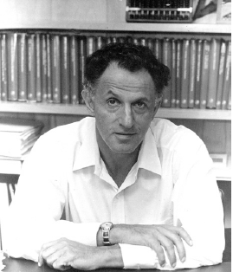
Topic 25
Dynamic Programming
"Thus, I thought dynamic programming was a good name. It was something not even a Congressman could object to. So I used it as an umbrella for my activities"
- Richard E. Bellman

Slide 2
Knapsack Problem
You have a set of items
Each item has a weight and a value
You have a knapsack with a weight limit
Goal: Maximize the value of the items you put in the knapsack without exceeding the weight limit

Slide 3
Knapsack Example
Items:
Weight
Limit = 8
One greedy solution: Take the highest ratio item that will fit: (1, 6), (2, 11), and (4, 12)
Total value = 6 + 11 + 12 = 29
Is this optimal? A. No B. Yes
Item Number | Weight of Item | Value of Item | Value per unit Weight
1 | 1 | 6 | 6.0
2 | 2 | 11 | 5.5
3 | 4 | 1 | 0.25
4 | 4 | 12 | 3.0
5 | 6 | 19 | 3.167
6 | 7 | 12 | 1.714

Slide 4
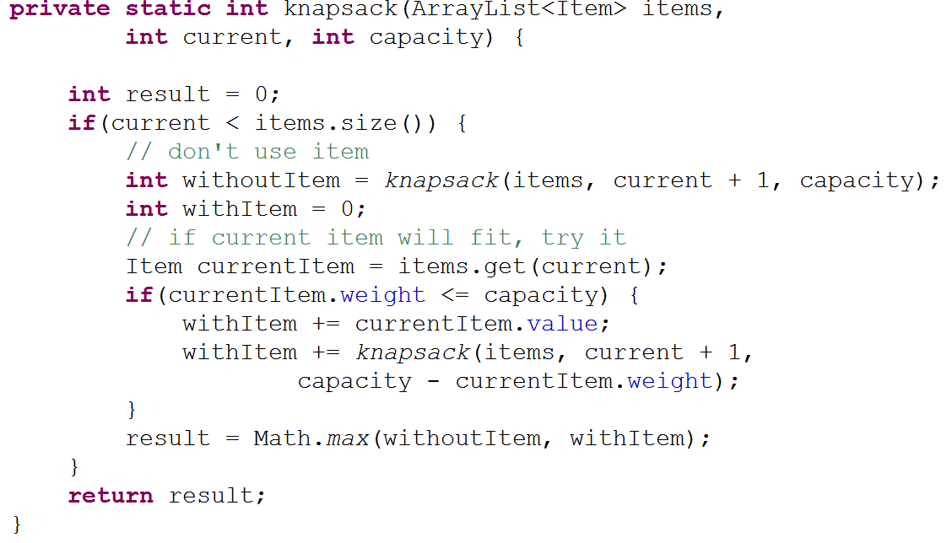
Knapsack - Recursive Backtracking

Slide 5
Knapsack Optimal Function
OptimalSolution(items, weight limit) =
0 if 0 items
OptimalSolution(items - 1, weight) if weight of ith item is greater than allowed weight
w_{i} > w (In others i^{th} item doesn't fit)
max of (OptimalSolution(items - 1, w),
value of i^{th} item +
OptimalSolution(items - 1, w - w_{i})

Slide 6
Knapsack - Algorithm
Create a 2d array to store
value of best option given
subset of items and
possible weights
In our example 0 to 6
items and weight limits of of 0 to 8
Fill in table using OptimalSolution Function
Item Number | Weight of Item | Value of Item
1 | 1 | 6
2 | 2 | 11
3 | 4 | 1
4 | 4 | 12
5 | 6 | 19
6 | 7 | 12

Slide 7
Knapsack Algorithm
Given N items and WeightLimit
Create Matrix M with N + 1 rows and WeightLimit + 1 columns
For weight = 0 to WeightLimit
M[0, w] = 0
For item = 1 to N
for weight = 1 to WeightLimit
if(weight of ith item > weight)
M[item, weight] = M[item - 1, weight]
else
M[item, weight] = max of
M[item - 1, weight] AND
value of item + M[item - 1, weight - weight of item]

Slide 8
Knapsack - Table
Item | Weight | Value
1 | 1 | 6
2 | 2 | 11
3 | 4 | 1
4 | 4 | 12
5 | 6 | 19
6 | 7 | 12
items / capacity | 0 | 1 | 2 | 3 | 4 | 5 | 6 | 7 | 8
{} | 0 | 0 | 0 | 0 | 0 | 0 | 0 | 0 | 0
{1}
{1,2}
{1, 2, 3}
{1, 2, 3, 4}
{1, 2, 3, 4, 5}
{1, 2, 3, 4, 5, 6}

Slide 9
Knapsack - Completed Table
Item | Weight | Value
1 | 1 | 6
2 | 2 | 11
3 | 4 | 1
4 | 4 | 12
5 | 6 | 19
6 | 7 | 12
items / weight | 0 | 1 | 2 | 3 | 4 | 5 | 6 | 7 | 8
{} | 0 | 0 | 0 | 0 | 0 | 0 | 0 | 0 | 0
{1} [1, 6] | 0 | 6 | 6 | 6 | 6 | 6 | 6 | 6 | 6
{1,2} [2, 11] | 0 | 6 | 11 | 17 | 17 | 17 | 17 | 17 | 17
{1, 2, 3} [4, 1] | 0 | 6 | 11 | 17 | 17 | 17 | 17 | 18 | 18
{1, 2, 3, 4} [4, 12] | 0 | 6 | 11 | 17 | 17 | 18 | 23 | 29 | 29
{1, 2, 3, 4, 5} [6, 19] | 0 | 6 | 11 | 17 | 17 | 18 | 23 | 29 | 30
{1, 2, 3, 4, 5, 6} [7, 12] | 0 | 6 | 11 | 17 | 17 | 18 | 23 | 29 | 30

Slide 10
Knapsack - Items to Take
items / weight | 0 | 1 | 2 | 3 | 4 | 5 | 6 | 7 | 8
{} | 0 | 0 | 0 | 0 | 0 | 0 | 0 | 0 | 0
{1} [1, 6] | 0 | 6 | 6 | 6 | 6 | 6 | 6 | 6 | 6
{1,2} [2, 11] | 0 | 6 | 11 | 17 | 17 | 17 | 17 | 17 | 17
{1, 2, 3} [4, 1] | 0 | 6 | 11 | 17 | 17 | 17 | 17 | 17 | 17
{1, 2, 3, 4} [4, 12] | 0 | 6 | 11 | 17 | 17 | 18 | 23 | 29 | 29
{1, 2, 3, 4, 5} [6, 19] | 0 | 6 | 11 | 17 | 17 | 18 | 23 | 29 | 30
{1, 2, 3, 4, 5, 6} [7, 12] | 0 | 6 | 11 | 17 | 17 | 18 | 23 | 29 | 30

