Slide 1
Fibonacci Numbers
Computing the n^{th} Fibonacci number recursively:
F(n) = F(n-1) + F(n-2)
F(0) = 0
F(1) = 1
Top-down approach
int Fib(int n)
{ if (n <= 1) return 1; else return Fib(n - 1) + Fib(n - 2); }
F(n)
F(n-1) + F(n-2)
F(n-2) + F(n-3) F(n-3) + F(n-4)

Slide 2
Fibonacci Numbers
Computing the n^{th} Fibonacci number using a bottom-up approach:
F(0) = 0
F(1) = 1
F(2) = 1+0 = 1
…
F(n-2) =
F(n-1) =
F(n) = F(n-1) + F(n-2)
Efficiency:
Time – O(n)
Space – O(n)

Slide 3
Fibonacci Numbers
The bottom-up approach is only Θ(n).
Why is the top-down so inefficient?
Recomputes many sub-problems.
How many times is F(n-5) computed?
F(n)
F(n-1) + F(n-2)
F(n-2) + F(n-3) F(n-3) + F(n-4)
… … …
n levels

Slide 4
Fibonacci Numbers
Fib(5) +
Fib(4) +
Fib(3) +
Fib(3) +
Fib(2) +
Fib(2) +
Fib(1)
Fib(2) +
Fib(1)
Fib(1)
Fib(0)
Fib(1)
Fib(0)
Fib(1)
Fib(0)

Slide 5
Matrix Chain-Products
Review: Matrix Multiplication.
C = A*B
A is d × e and B is e × f
O(d⋅e⋅f ) time
f
B
j
e
e
A
C
d
i
i,j
d
f

Slide 6
Matrix Chain-Products
Matrix Chain-Product:
Compute A=A₀*A₁*…*A_{n-1}
A_{i} is d_{i} × d_{i+1}
Problem: How to parenthesize?
Example
B is 3 × 100
C is 100 × 5
D is 5 × 5
(B*C)*D takes 1500 + 75 = 1575 ops
B*(C*D) takes 1500 + 2500 = 4000 ops

Slide 7
Dynamic Programming Approach
Define the following:
Then the optimal solution N_{0,n-1} is the sum of two optimal sub-problems, N_{0,k} and N_{k+1,n-1} plus the time for the last multiplication.

Slide 8
Recursive Approach
We could implement the calculation of these N_{i,j}’s using a straight-forward recursive implementation of the equation (aka not pre-compute them).
Algorithm RecursiveMatrixChain(S, i, j):
Input: sequence S of n matrices to be multiplied
Output: number of operations in an optimal parenthesization of S
if i=j
then return 0
for k ← i to j do
N_{i, j} ← min{N_{i,j}, RecursiveMatrixChain(S, i ,k) + RecursiveMatrixChain(S, k+1,j) + d_{i} d_{k+1} d_{j+1}}
return N_{i,j}

Slide 9
Subproblem Overlap
1..4
1..1
2..4
1..2
3..4
1..3
4..4
2..2
3..4
2..3
4..4
1..1
2..2
3..3
4..4
...
3..3
4..4
2..2
3..3

Slide 10
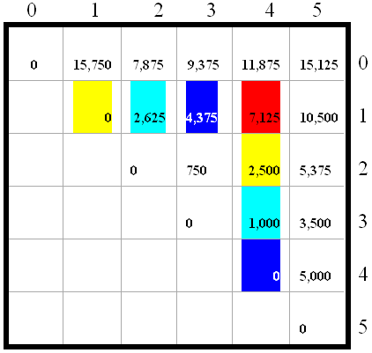
Algorithm Visualization
A₀: 30 X 35; A₁: 35 X15; A₂: 15X5;
A₃: 5X10; A₄: 10X20; A₅: 20 X 25

Slide 11
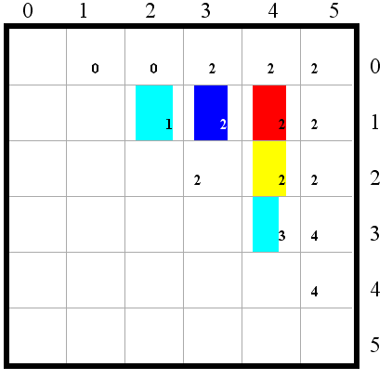
Algorithm Visualization
(A₀*(A₁*A₂))*((A₃*A₄)*A₅)

