Slide 1

FINAL PROJECT – SNEAKY score – WeB presentation What technology used? Overall Design

Slide 2
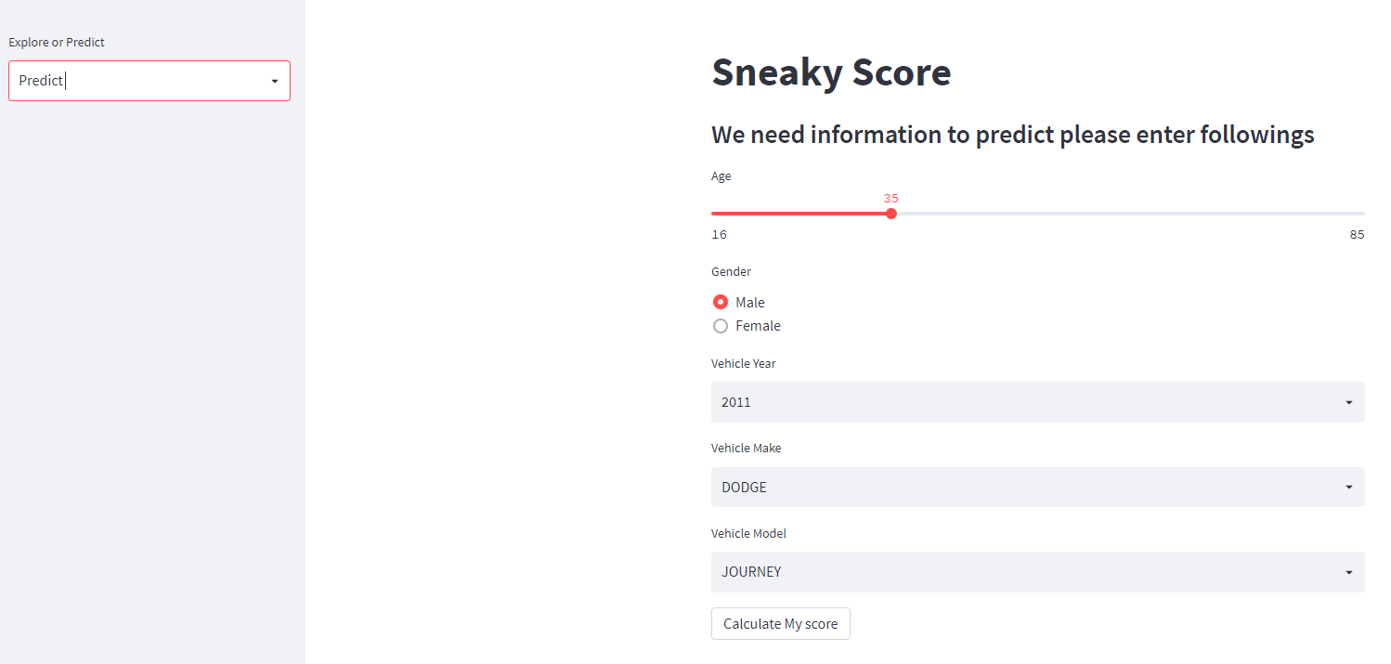
FINAL PROJECT Show off SNEAKY score
Presenting
The Score using StreamLit - Demo

Slide 3
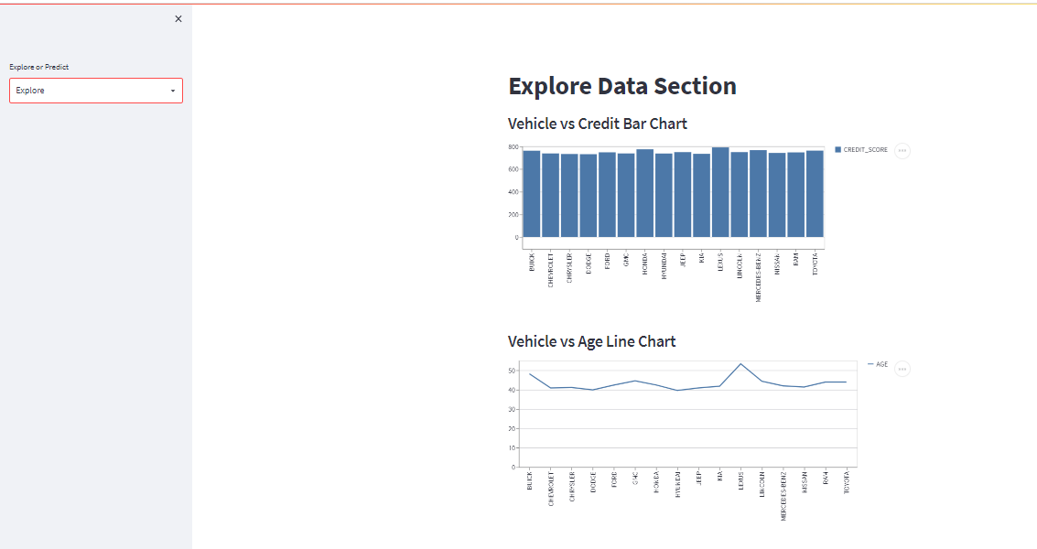
FINAL PROJECT Show off SNEAKY score
Presenting
The Score using StreamLit

Slide 4
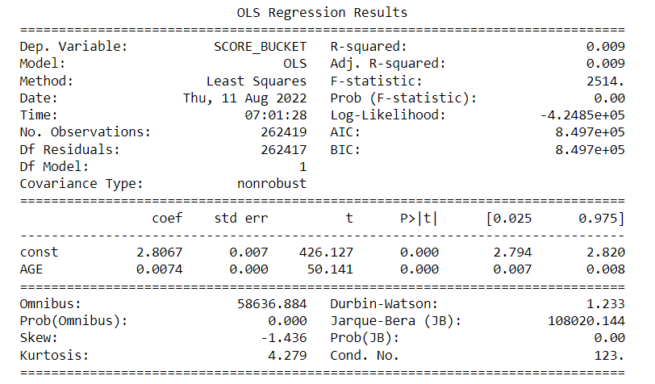
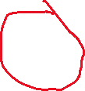
FINAL PROJECT Show off SNEAKY score – After math
Without CAR Variables
OLS (Ordinary Least Square)
R squared / Adj. R-squared
= 0.009
Which measurement is calculated by Variability explained by regression / total variability of the dataset
Close to zero means there is none of the variability which explains why the results are very similar one to another.
This tells that variability of our model is telling us 2%

Slide 5
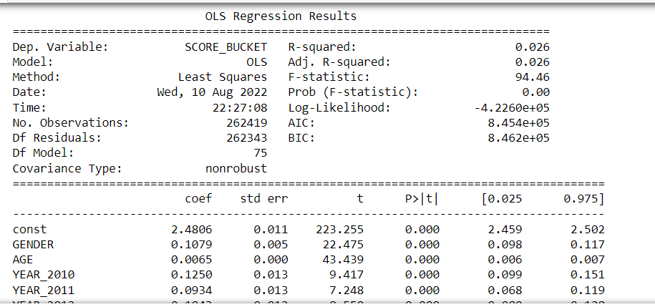

FINAL PROJECT Show off SNEAKY score –After math
With CAR Variables
OLS (Ordinary Least Square)
R squared / Adj. R-squared
= 0.026
Which measurement is calculated by Variability explained by regression / total variability of the dataset
Close to zero means there is none of the variability which explains why the results are very similar one to another.
This tells that variability of our model is telling us 2%

Slide 6
FINAL PROJECT Show off SNEAKY score - Bias
OMITTED VARIABLE BIAS:
Where do we draw the sample from? A Car Insurance Company (Secondary)
Why the predictions were similar? Co-Variance were lower, meaning credit scores were concentrated in higher credit score
Was it significant to adding cars to prediction model significant? Depending on perspective.
These Omitted Variable Bias can be very Sneaky, in other words, it can crawl upon us and produced very narrowed predictions
The F-stat is used for testing the overall significance of the model which very high it this case.
From previous page A large F-value (94) means The signal or the differences in means is greater than would be expected by random chance. Therefore, we can reject the null hypothesis (definite Consequential relationship)
However, keep this numbers in mind, let’s continue. ☺

Slide 7
FINAL PROJECT Show off SNEAKY score –Web Design
Input from the user:
AGE
GENDER
Vehicle Year
Vehicle Make
Vehicle Model
Range 16 thru 85
Male or female
Year 2011 thru 2022
Counts more than 1000
Label: | AGE | GENDER | YEAR | MAKE | MODEL
Input: | 35 | Female | 2015 | FORD | F-150
How input is converted to dummy input to the Machine Model (Two ways) :
Adopt one column from injected table and update fields from the user
Create input and dummify the input and the trained column – input column and assign zero to the columns are missing
Example:

Slide 8
FINAL PROJECT Show off SNEAKY score –Streamlit
StreamLit is an open-source app framework in python language. It is compatible with major Python Libraries, especially for Machine Learning and Data Science projects.
Pickle: in Python is primarily used in serializing and deserializing a Python object structure. In other words, it is the process of converting a Python object into a byte stream to store it in a file, maintain program state across sessions, or transport data over the network.
StreamLit : https://sonmiannkim-sneakyscore-app-0dnw3w.streamlitapp.com/

