Slide 1

FINAL PROJECT – SNEAKY score – WeB What technology used? Overall Design

Slide 2
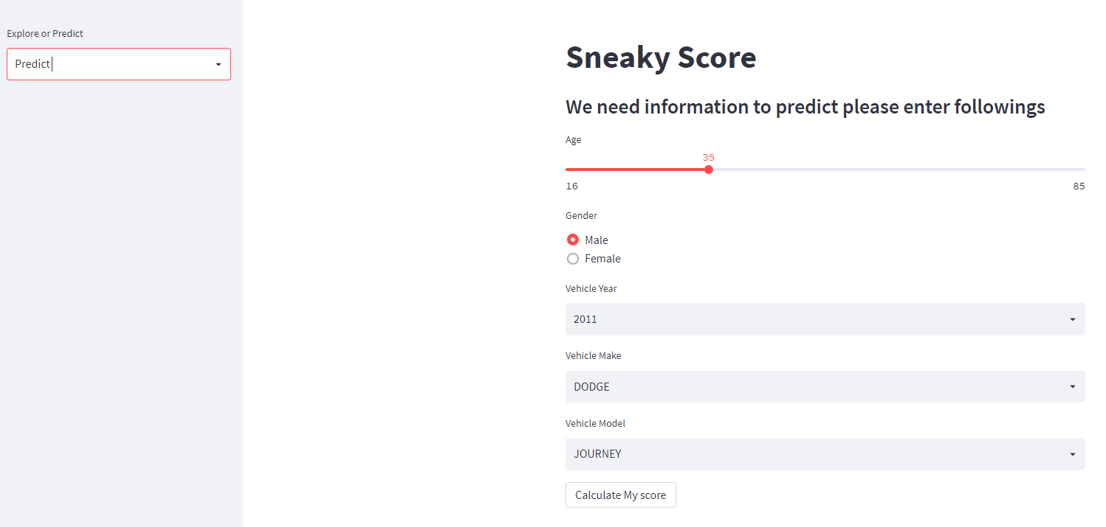
FINAL PROJECT Show off SNEAKY score
Presenting
The Score using StreamLit - Demo

Slide 3
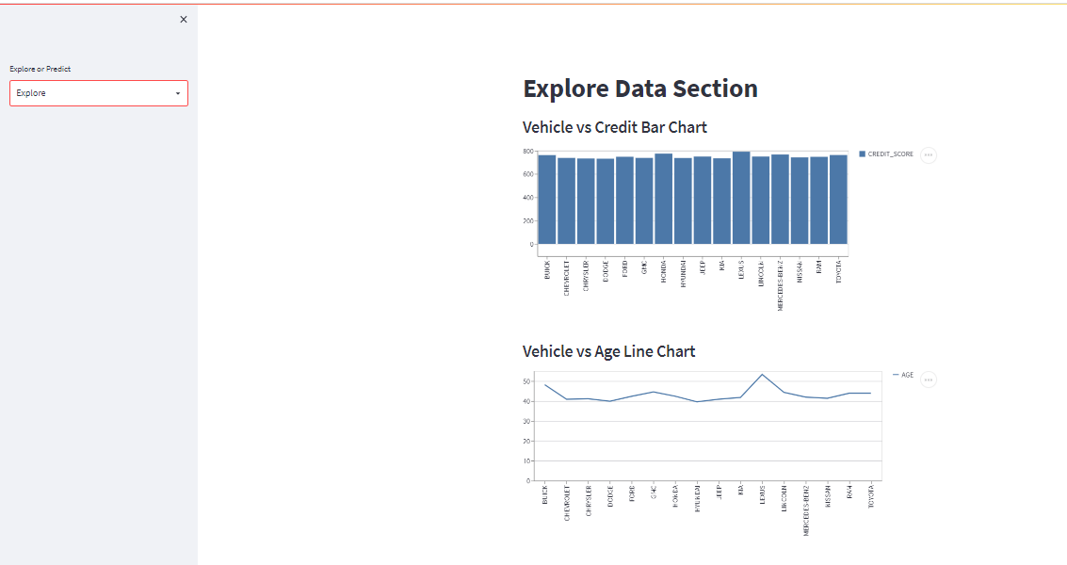
FINAL PROJECT Show off SNEAKY score
Presenting
The Score using StreamLit

Slide 4
FINAL PROJECT Show off SNEAKY score –Web Design
Input from the user:
AGE
GENDER
Vehicle Year
Vehicle Make
Vehicle Model
Range 16 thru 85
Male or female
Year 2011 thru 2022
Counts more than 1000
Label: | AGE | GENDER | YEAR | MAKE | MODEL
Input: | 35 | Female | 2015 | FORD | F-150
How input is converted to dummy input to the Machine Model (Two ways) :
Adopt one column from injected table and update fields from the user
Create input and dummify the input and the trained column – input column and assign zero to the columns are missing
Example:

Slide 5
FINAL PROJECT Show off SNEAKY score –Streamlit
StreamLit is an open source app framework in python language. It is compatible with major Python Libraries , especially for Machine Learning and Data Science projects.
Pickle: in Python is primarily used in serializing and deserializing a Python object structure. In other words, it is the process of converting a Python object into a byte stream to store it in a file, maintain program state across sessions, or transport data over the network.
StreamLit : https://sonmiannkim-sneakyscore-app-0dnw3w.streamlitapp.com/

