Slide 1
Architecting Android with DataBinding and MVVM
Son Nguyen

Slide 2
Contents
I. Problems
II. MVVM + DataBinding
III. Conclusions

Slide 3
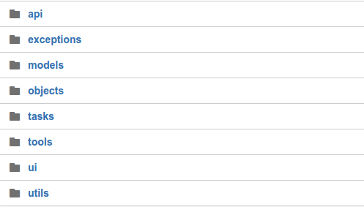
I. Problems

Slide 4
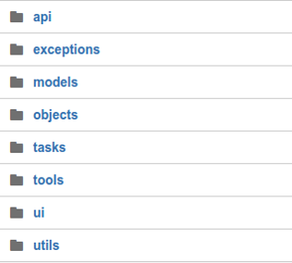
I. Problems
It is kind of MVC…but not really.
Activity/ Fragment are kind of Controller and are kind of View too.
→ There is no boundary between them, too much code in Activity/ Fragment make UI logic impossible to unit test.
The controller are tightly coupled to the view. If we change the view, we have to go back and change the controller

Slide 5
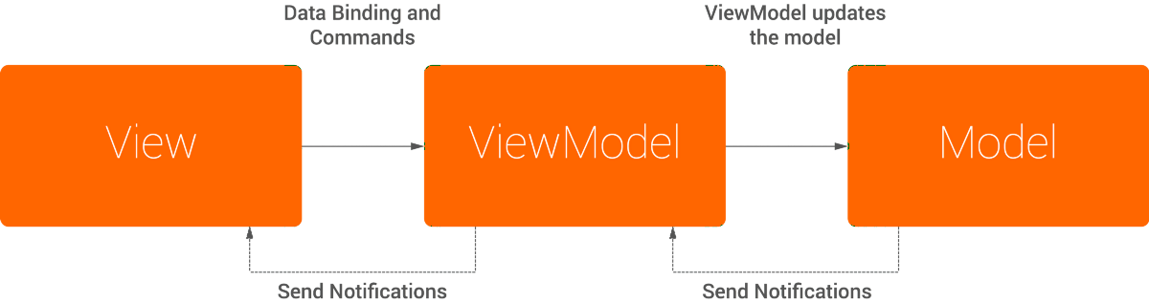
II. MVVM + DataBinding

Slide 6
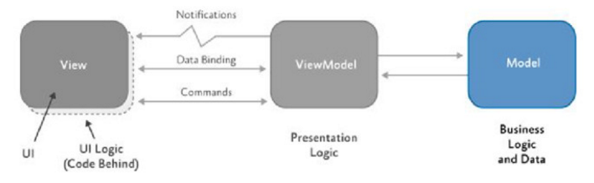
MVVM
Model: The Model represents a set of classes that describes the business logic and data.

Slide 7
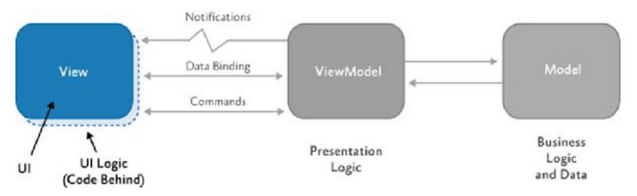
MVVM
View: The View represents the UI components.

Slide 8
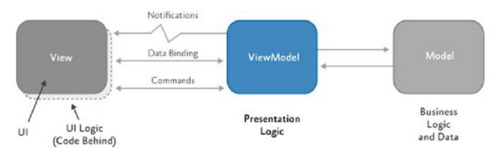
MVVM
ViewModel: It is responsible for exposing methods, commands, and other properties that helps to maintain the state of the view, manipulate the model.

Slide 9
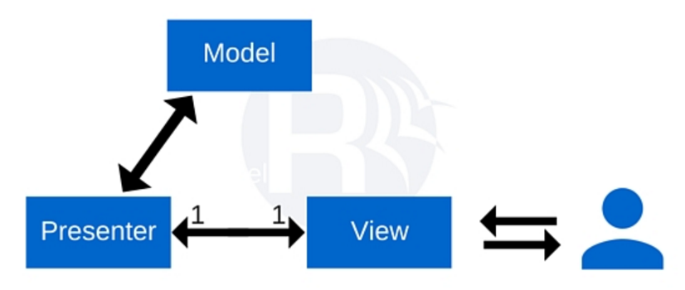
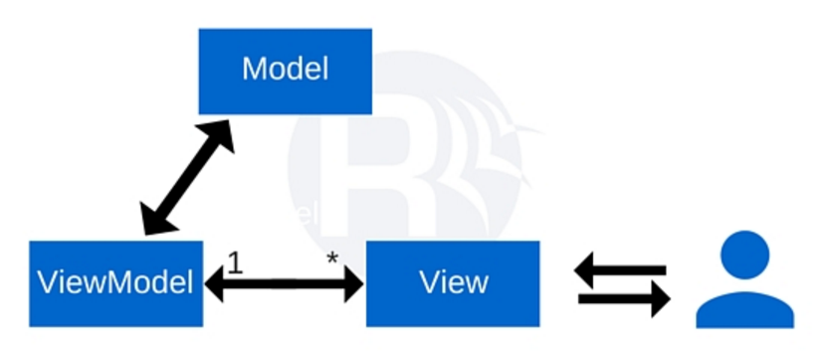
MVVM
MVP | MVVM
The connection between Presenter & View is one to one. Presenter knows both Model and View. | There is many-to-one relationship between View and ViewModel. ViewModel has no information about View. Binding

Slide 10
MVVM
Advantages:
No more clumsy code to do the refresh or update. You can very easily replace the View without affecting the ViewModel.
It’s significantly easier to write tests as you separate logic and presentation.
You get the opportunity to use all the benefits of the Data Binding library .
“This architecture is partially readable, partially testable, and
most developers likes working with this architecture."

Slide 11
MVVM
Disadvantages:
Can be overkill for simple UI.
Harder to debug with databinding.
The ViewModel can be hard to design.

Slide 12
Data Binding Library
Library to write declarative layouts and minimize the glue code necessary to bind your application logics and layouts.

Slide 13
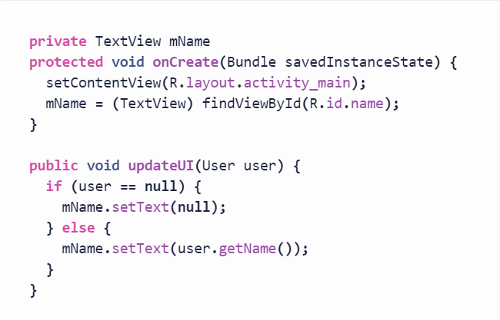
Data Binding Library
Data Binding wires your data and your view in a way that the view responds automatically to data changes, and vice versa.
The use of a Data Binding engine avoids a lot of boilerplate.
Instead of:

Slide 14
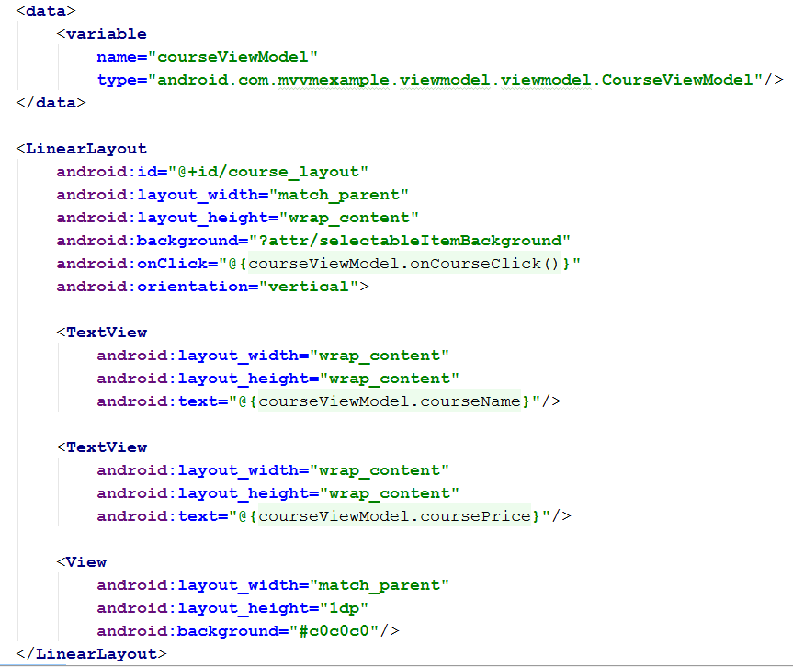
Data Binding

Slide 15
III. Conclusion
Both MVP and MVVM do a better job than MVC in breaking down your app into modular, single purpose components, but they also add more complexity to your app.
MVVM with data binding is attractive as it follows a more reactive programming model and produces less code.
The data binding library, if used correctly, has the potential to really change the way in which we develop applications.

Slide 16
References
Approaching Android with MVVM – Joe Brirch
https://labs.ribot.co.uk/approaching-android-with-mvvm-8ceec02d5442#.at4tzghbi
Android MVVM pattern – Milan Barta
https://barta.me/android-mvvm-pattern/
MVC vs. MVP vs. MVVM on Android – Eric maxwell
https://realm.io/news/eric-maxwell-mvc-mvp-and-mvvm-on-android/
Architecting Android with Data Binding and MVVM in mind – Josip Jurisic
https://medium.cobeisfresh.com/architecting-android-with-data-binding-and-mvvm-in-mind-8874bbec0b0d#.23gtw2k19

Slide 17
THANKS FOR WATCHING

