Slide 1
App presentation: irc client
Contributors
Do Duc Minh | 22BI13279
Tran Duc Manh | 22BI13274
Do Ba Hoang Minh | 22BI13278
Hoang Duc Nghia | 22BI13329
Tran Binh Minh | 22BI13308

Slide 2

Overview
Goal And Introduction
Architecture
Conclusion

Slide 3
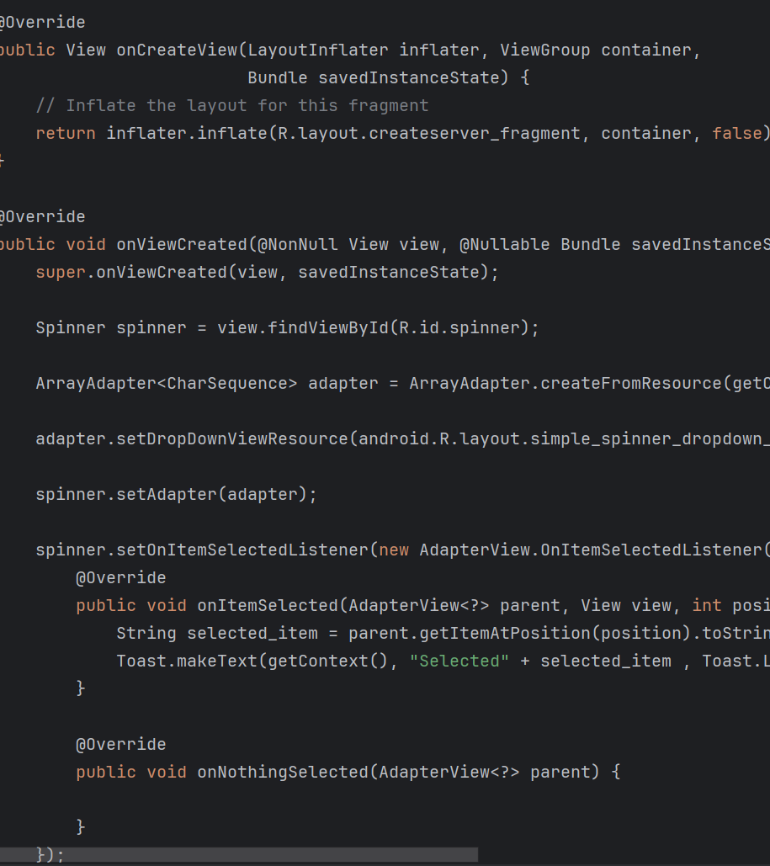
Goal and
INtroduction

Slide 4
About irc
IRC (Internet Relay Chat) is a real-time messaging protocol where users can chat in public channels or privately. It’s commonly used in tech and gaming communities.

Slide 5
The goal of this project
A complete IRC client app that based on IRCcloud
Simple and functional
Intuitive and user-friendly

Slide 6
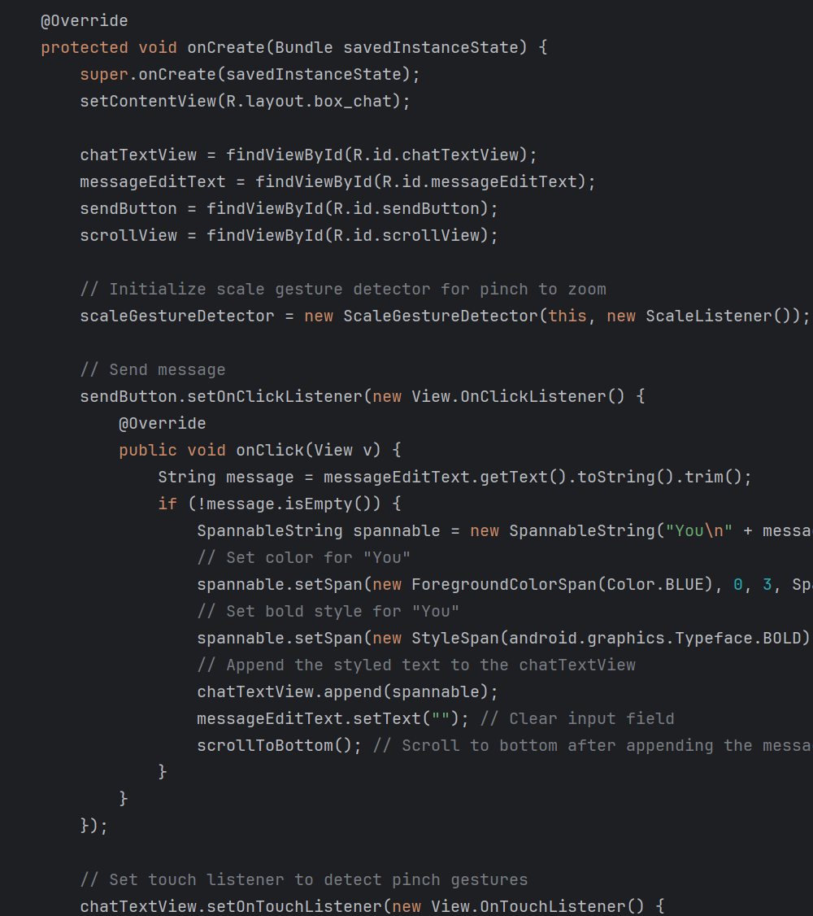
Architecture

Slide 7
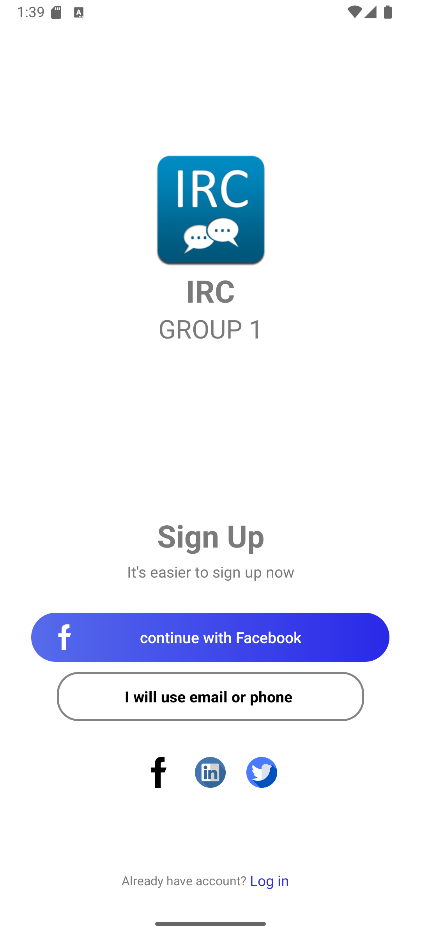
THE WELCOME SCREEN

Slide 8
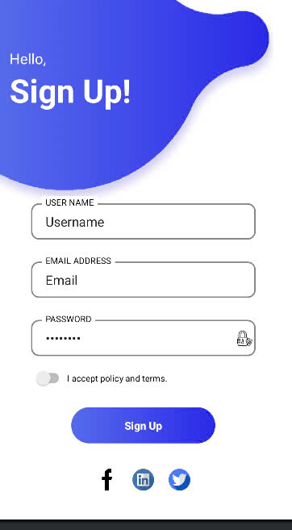
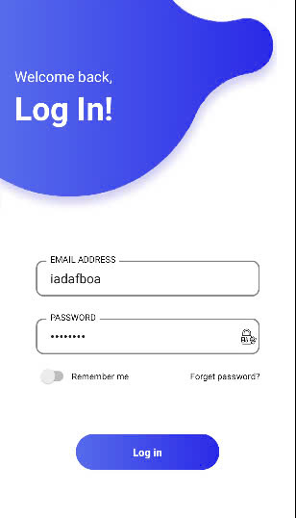
THE LOG IN AND SIGN UP SCREEN

Slide 9
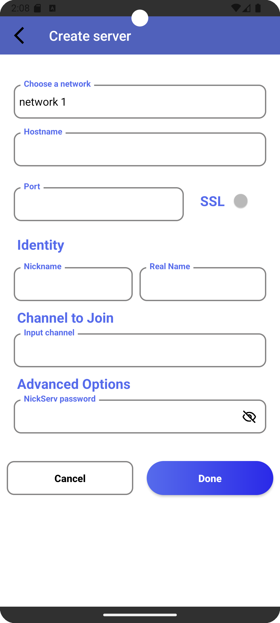
Create Server

Slide 10
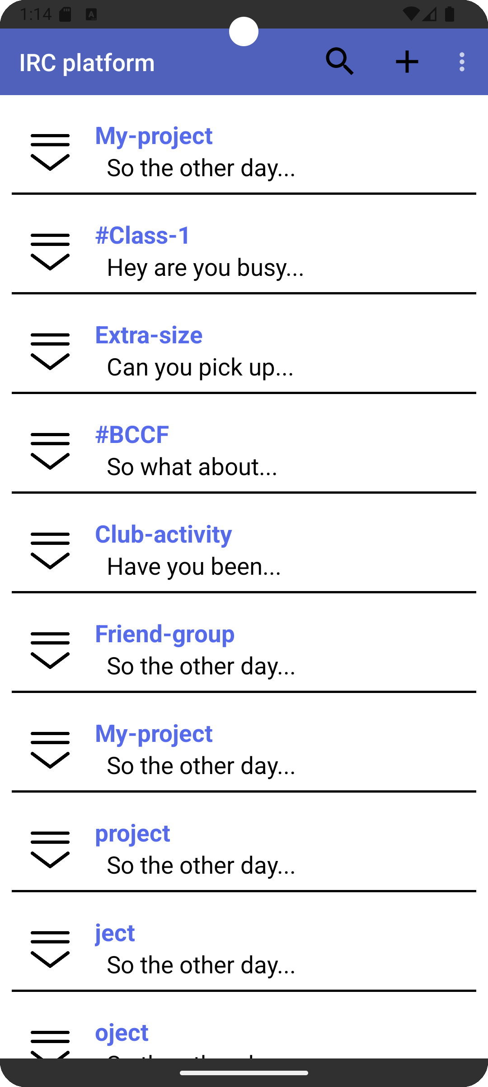
Search box
Add server/chatroom
The server list
THE SERVER LIST

Slide 11
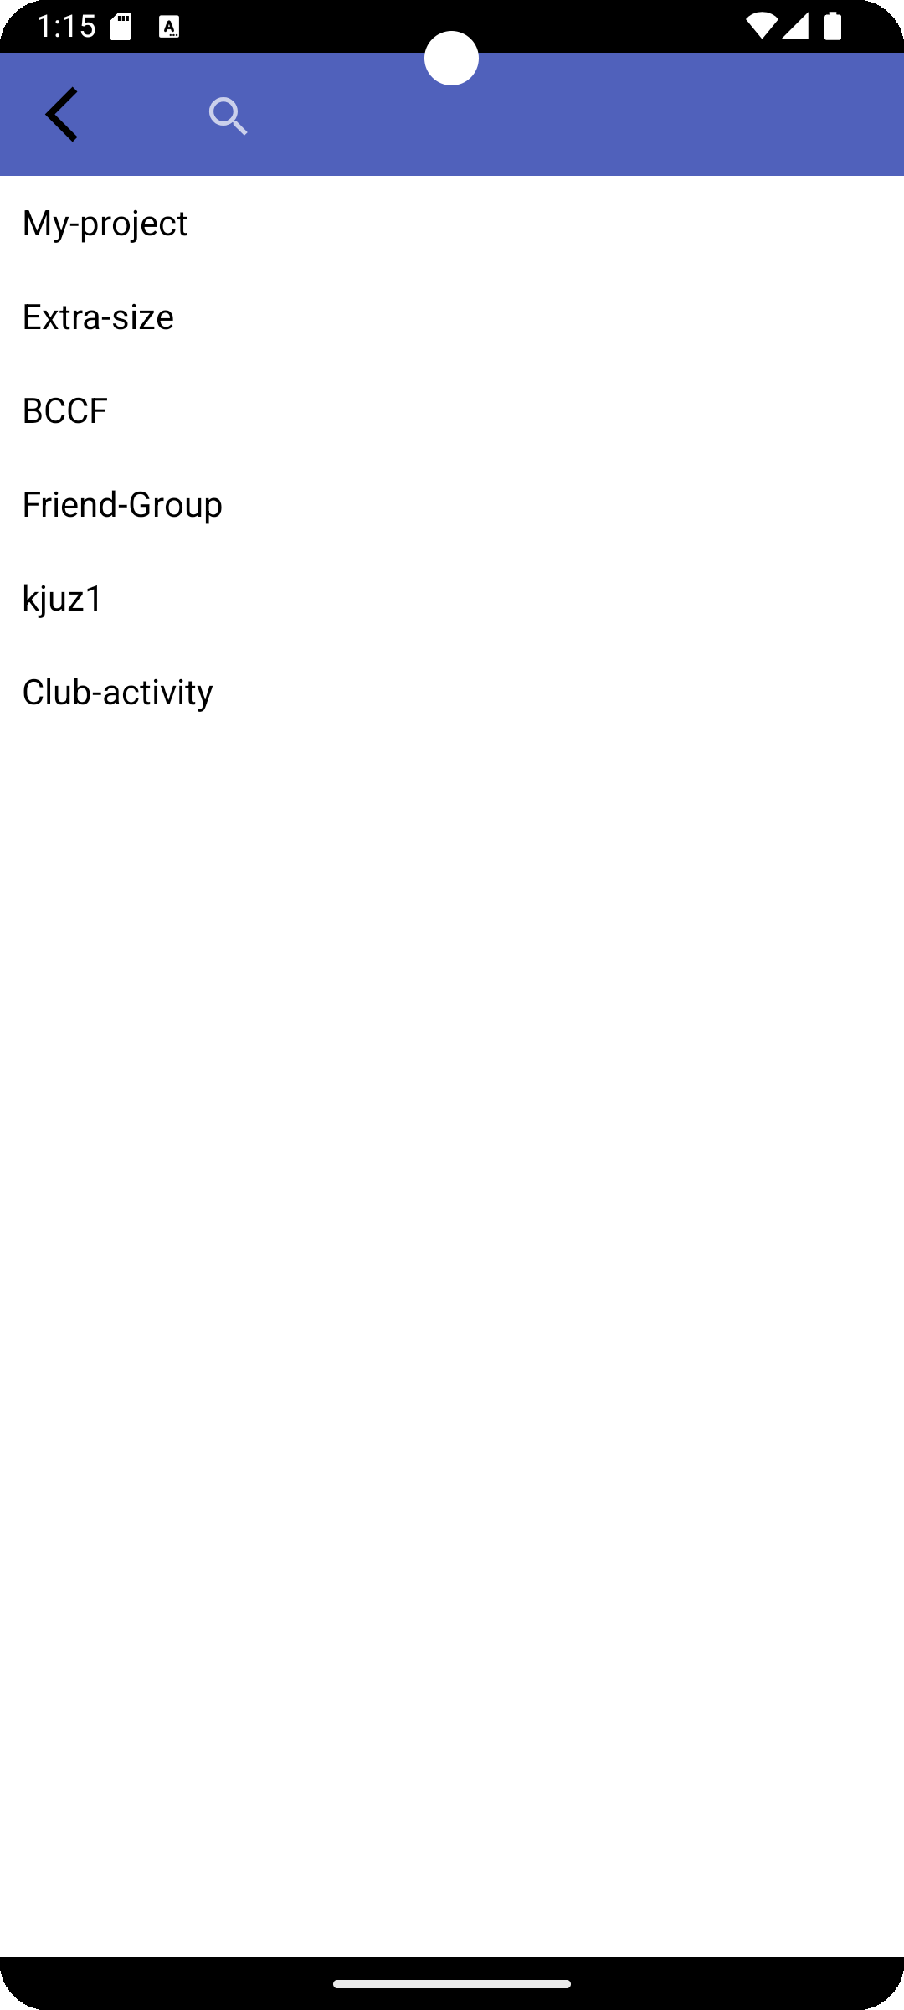
THE SEARCH VIEW

Slide 12
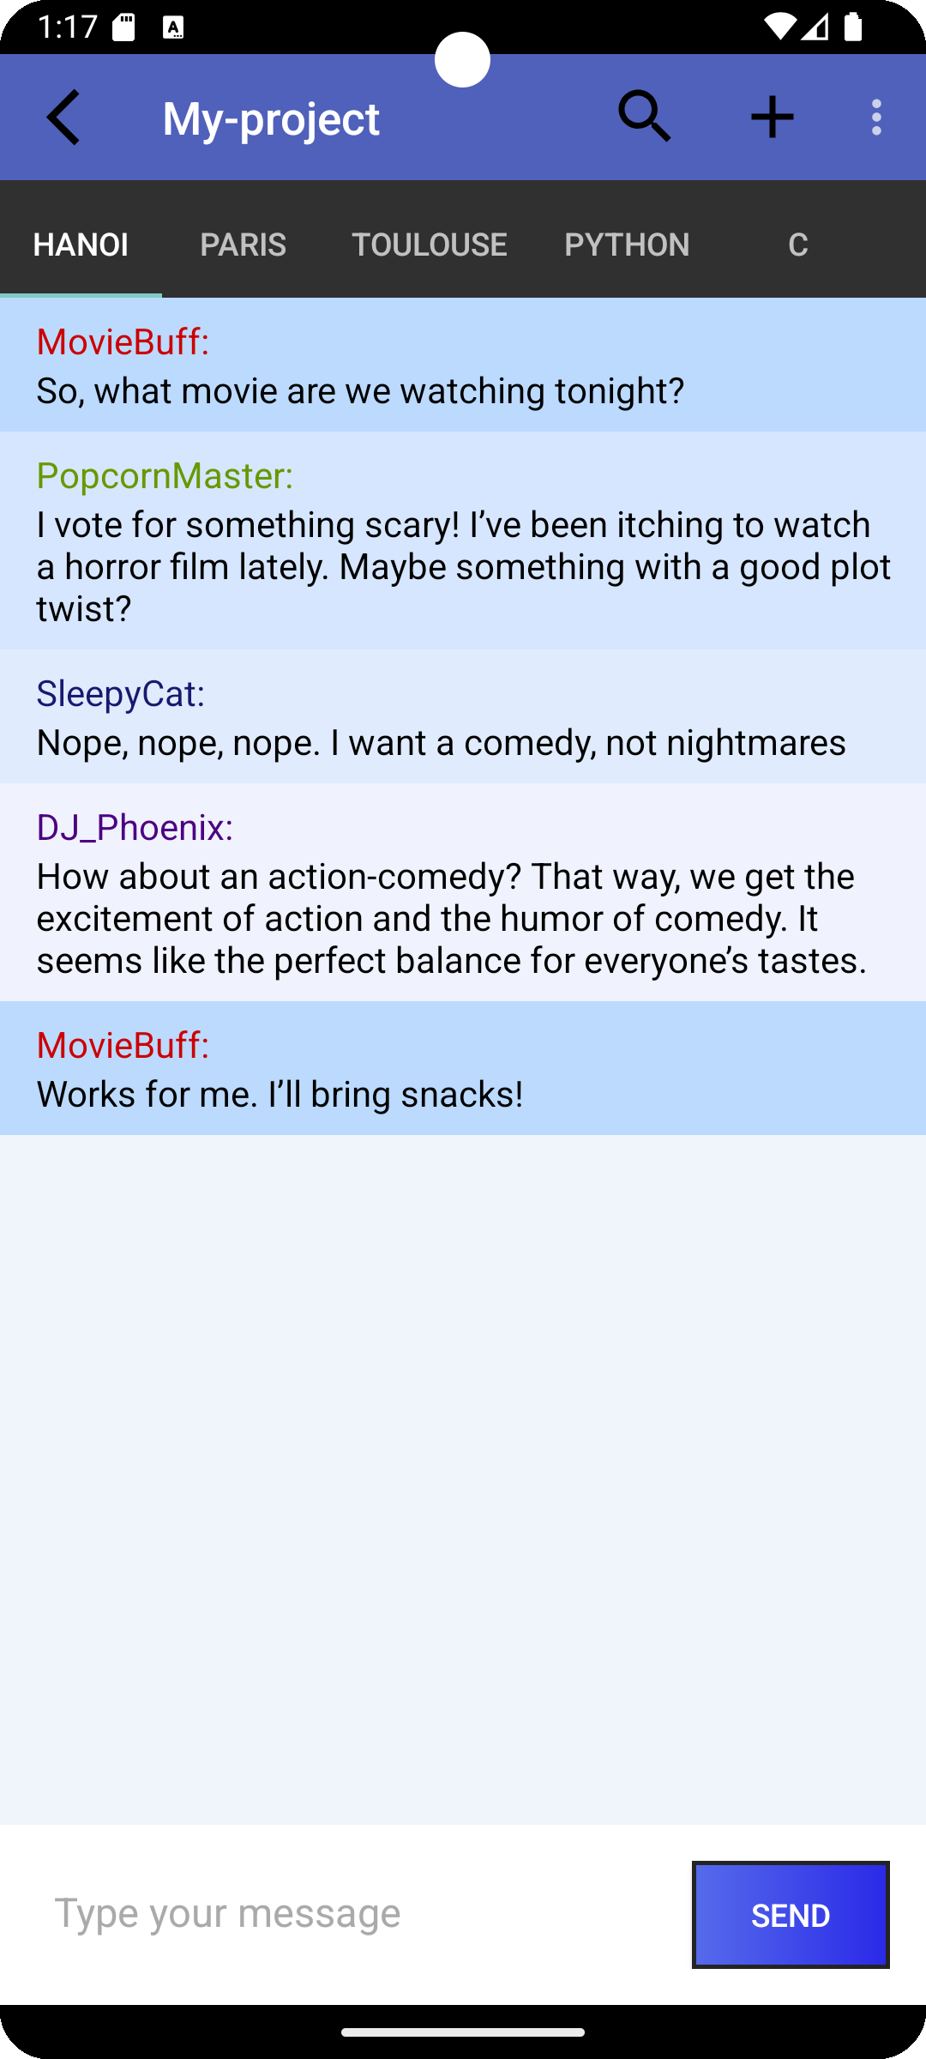
The CHAT BOX
The username
The messages
The type bar

Slide 13

demo

Slide 14
Conclusion
What we’ve done?
What needs to be improved?
Future updates.

Slide 15
Thank you!

