Slide 1
NLP : Sentiment analysis of tweets
The objective is to construct user Interest data (i.e what type of content is discussed by users) from tweets posted by the users along with user sentiment about that subject.
This task focuses heavily on text processing. The data source for this task is a 1-month collection of twitter tweets (July 1 2019 - July 31 2019) throughout London. Each tweet contains a text field with content posted by a user.

Slide 2
Methodology and Implementation
Pre-processing
Raw tweets extracted from twitter generally results into a noisy dataset. So before we feed the data to a model or a classification technique, it is mandatory to remove all the irrelevant words from the collection. This helps to reduce the complexity of the classification procedure. Following steps are taken as part of pre-processing.
All the stop words (like 'a', 'about', 'above', 'after', 'again', 'against' ) are removed from the collection of data.
Usage of Punctuations are also ignored as it doesn't contribute much to the text analytics procedure we follow.
As we are dealing with sentiment analysis / text classification of tweets, the numbers involved in the texts are not much influential. Hence we can neglect its occurrence from the tweets involved.
Removing URLs from the texts

Slide 3
Approaches Text classification can be mainly done in two ways
Supervised
Unsupervised
Labelled dataset
Easy to build models
Accuracy of the models can be calculated
Clustering of data is not required
Unlabelled dataset
Clustering of data is essential
Helps to find unknown relationships and categories
Modelling is difficult

Slide 4
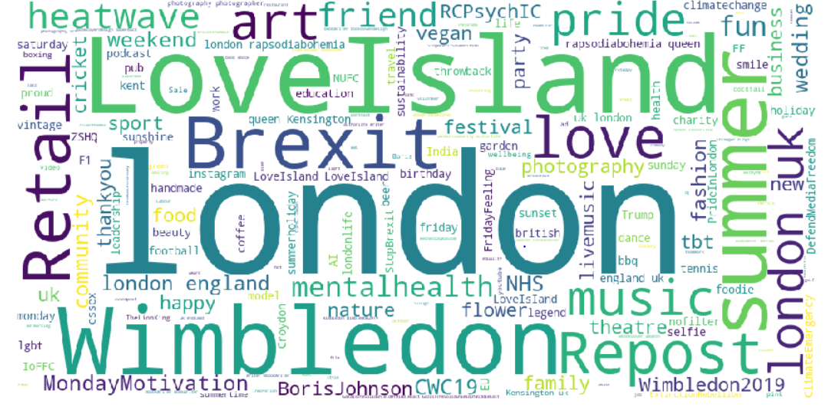
Approach A Here we selected major topics by analyzing the word cloud of all hash tagged words in the dataset. Then we considered a subset of the original dataset such that the subset contains all the tweets related to the selected topics. So basically we follow a supervised method by labelling the tweets involved in the subset. From the word cloud, it is found that the most frequent hash tagged words appearing in the given dataset are "#loveisland", "#wimbledon", "#brexit", "#repost", "#summer", "#heatwave", "#london".

Slide 5
Sentiment analysis - vader
It is a lexicon and rule-based sentiment analysis tool that is specifically attuned to sentiments expressed in social media. VADER uses a combination of A sentiment lexicon is a list of lexical features (Words) which are generally labelled according to their semantic orientation as either positive or negative. We will use the polarity scores() method to obtain the polarity indices for the given sentence. The polarity value ranges between -1 and 1.
If the polarity of tweet is less than 0 , we categorize it as a negative emotion.
If the polarity of tweet is greater than 0 , we categorize it as a positive emotion.
If the polarity of tweet is equal to 0 , we categorize it as a neutral emotion.
WHY VADER?
It works exceedingly well on social media type text, yet readily generalizes to multiple domains
It doesn’t require any training data but is constructed from a generalizable, valence-based, human-curated gold standard sentiment lexicon
It does not severely suffer from a speed-performance tradeoff.
Handles emojis, slangs and emoticons

Slide 6
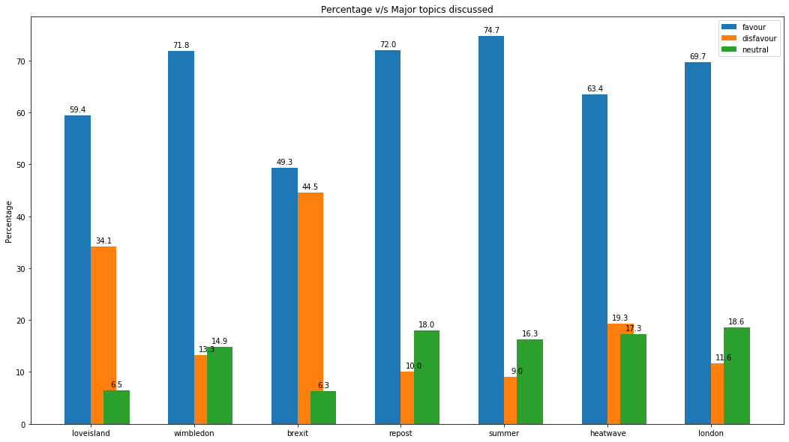
Analysing the sentiment of users on different topics
From the bar graph, it is evident that all the major topics have overall positive sentiment.
The percentage of people who have neutral opinion on any topic is very less.
The topics – Brexit and Love island have a higher negative sentiment compared to rest of the topics involved.
Brexit is the most controversial topic discussed in twitter during the given period.

Slide 7
Model creation
Vectorize the tweets
Allows to have numerical representation of text and each word is considered as a feature. Initial step is to create a vocabulary set for all the tweets involved and represent each sentence as a vector.
N grams Model
This n-gram model is integrated in most document classification tasks and it almost always boosts accuracy. But this may depend upon the type of corpus that we are dealing with. Sometimes we may get corpuses that works well with one gram model, usually when the dataset is labelled and texts involved in each document are not long.
TDF-IDF
It stands for term frequency-inverse document frequency. This technique helps to increase the significance for certain words in a sentence/document by considering the occurrence of that word in the entire collection of documents. If a word in a document is occurring more in other documents as well, then we can say that the selected word is less significant. On the other hand, if a word in a document is occurred less in other documents, then the word can be considered as a significant one.

Slide 8
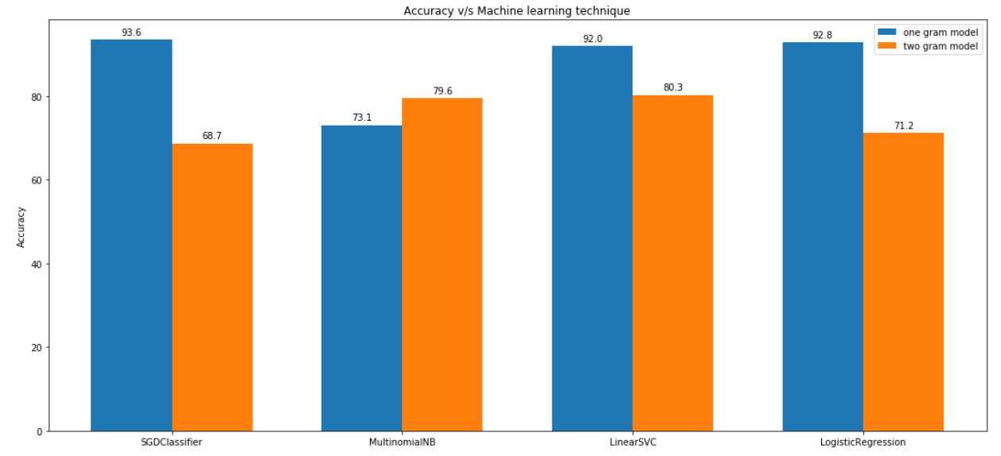
Comparison of models
From the plot, it is evident that all algorithms except multinomialNB outclasses two gram method of vectorization.
Highest accuracy is achieved by sgd classifier (stochastic gradient decent classifier).
Lowest accuracy is achieved by multinomialNB.
Accuracy is not the only measure to find out the best model. We can consider ROC-AUC curves of each model as well.

Slide 9
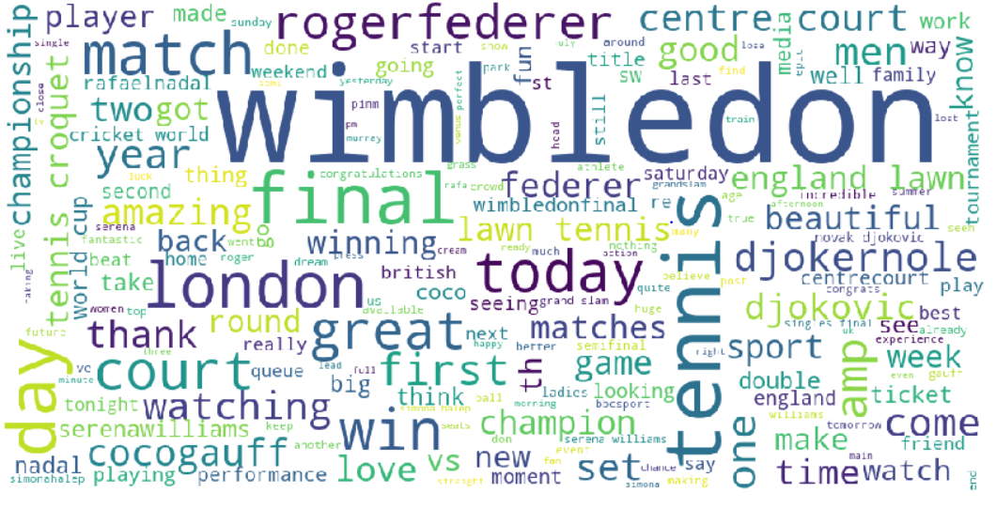
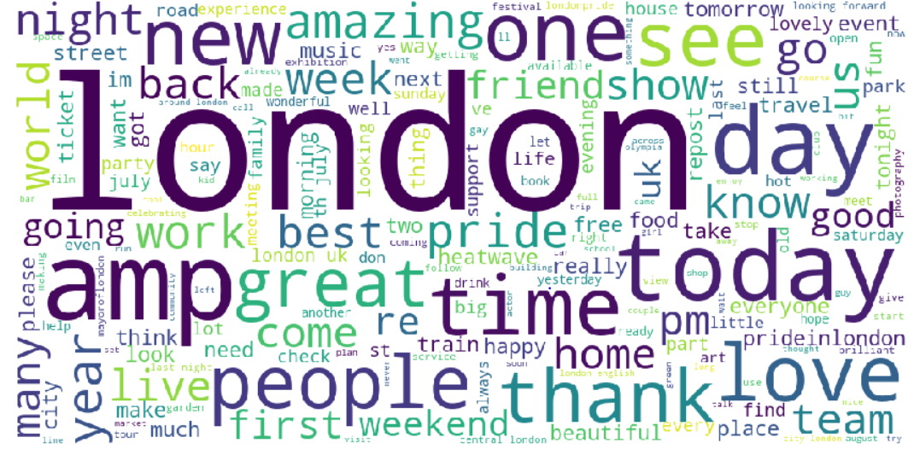
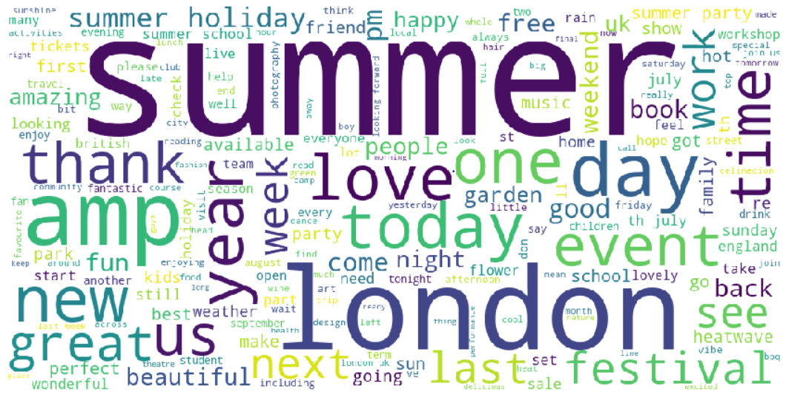
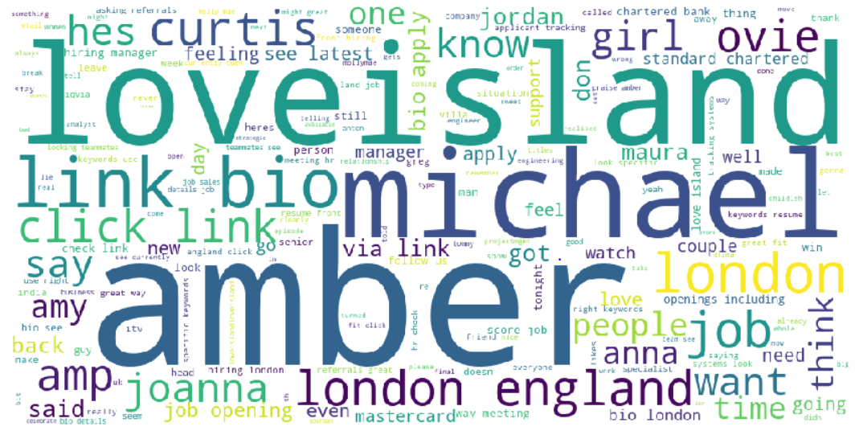
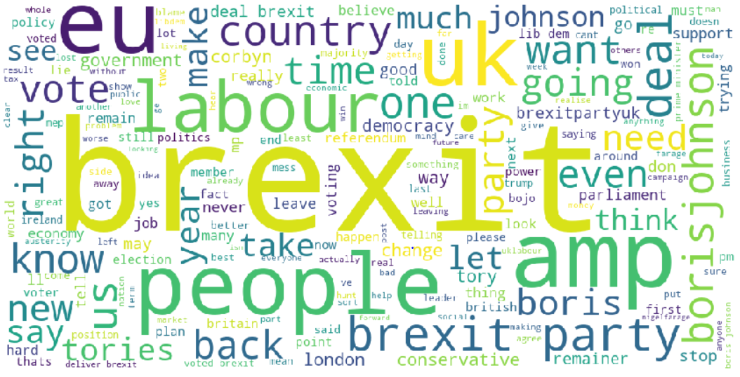
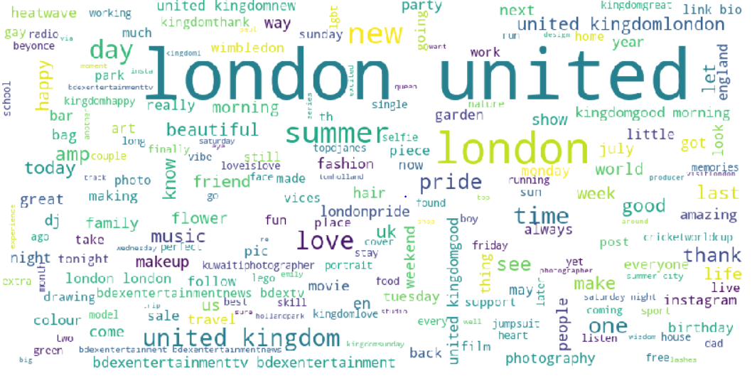
APPROACH B : UNSUPERVISED METHOD As we don't have labelled dataset in this case, we are supposed to do the cluster analysis in order to obtain the major topics discussed. This can be done by clustering methods like - hierarchical clustering/ kmeans. Once we are done with our data pre-processing steps, we can vectorize our data. This numerical data is fed into a clustering model which predicts the category of each tweet. In this way, we classify our original dataset into 6 major topics called- sports, politics, travel/events, others, TV shows/music’ and climate by following word clouds.

Slide 10
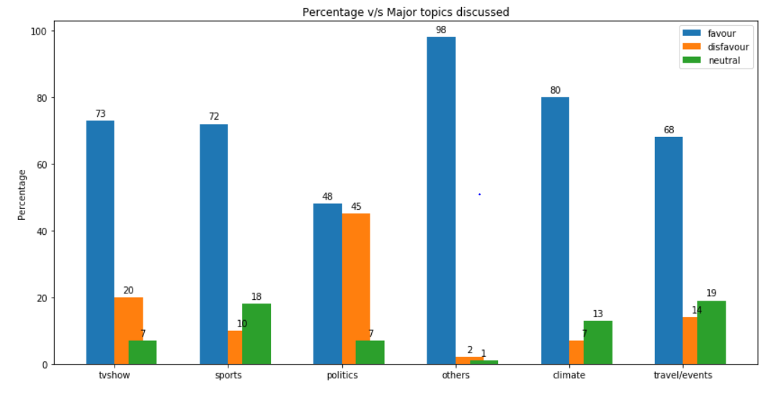
CONCLUSION All the major topics that we derived from clustering method: kmeans has overall positive sentiment.
From the plot, it is evident that politics is the category which has most negative sentiment among twitter users.
This conclusion matches with the one that we got from approach A : supervised method, as Brexit was the topic which has highest negative sentiment

