Slide 1

AGENCY 5 - VP ANALYTICS EMPLOYER PROJECT
The QSR Location Health Index
A defensible, evidence-tested digital-health scorecard for quick-service restaurant operators -- built to be challenged, not just believed.
19,154
13,719
0.83
4
QSR locations scored
currently open
ROC-AUC, leakage-audited (not the inflated 0.97)
competing index designs compared
Prepared for VP Analytics leadership - LSE Data Analytics Career Accelerator - Source: Yelp Open Dataset, historical through 19 Jan 2022
Notes:
Good afternoon, everyone. Today we're presenting the QSR Location Health Index -- think of it as a health check-up for every one of VP Analytics' restaurant locations, built entirely from public customer reviews and ratings. We looked at over 19,000 locations, and about 14,000 of those are still open today. The one number to remember from this whole presentation is 0.83 -- that's how confident we are in our model once we removed every shortcut it could have taken. We'll explain what that means shortly. We also didn't settle for one version of this scorecard -- we built four different versions and tested them against each other, so what you're seeing today has been challenged, not just accepted on the first try.

Slide 2
BUSINESS CONTEXT - 01
A useful scorecard must answer four operational questions
Which outlets are at risk?
A portfolio-wide view of location health, identifying which outlets are stable, vulnerable, or require attention.
What is driving the risk?
Pillar attribution and customer-voice evidence, not just a number.
How do they compare to peers?
Health only means something in the context of nearby competition.
What should be prioritised first?
Health and trajectory combined -- not just the lowest-scoring location.
Audience: VP Analytics leadership. Source: QSR_LHI_Technical_Report_Agency5_v5.pdf, Section 02 (The Business Problem and Assignment).
02
Notes:
Every restaurant brand asks the same four questions about its locations, but a simple star rating can't answer any of them well. Which locations are struggling? What's actually causing the problem? How does a location compare to the restaurants around it? And out of everything that needs fixing, what should be tackled first? This scorecard was built specifically to answer these four questions, not just to produce one more number to glance at.

Slide 3
PROJECT DEVELOPMENT PROCESS - 02
A four-phase pipeline, each phase asserting its own evidence before the next begins
1
2
3
4
>
>
>
Understand the data
Build the evidence
Construct and validate
Operationalise
- Data QA
- Aspect sentiment
- Leakage gate
- Explainability
- Review extraction
- Peer / CX scoring
- ML modelling
- Confidence / fallback
- Deep EDA
- Trajectory
- 4 LHI candidates
- Final export
- Robustness grid
Fail loudly, not silently -- a misleading 96.9%-accurate model was caught at the leakage gate (Slide 05) before it could shape the index.
Source: QSR_LHI_Technical_Report_Agency5_v5.pdf, Section 03 (Analytical Design). Thirteen independently re-runnable stages, grouped here into four phases.
03
Notes:
Here's how we got there, in four stages. First, we made sure the data could be trusted before building anything on top of it. Second, we built the evidence -- reading through customer reviews to understand what people were saying and how each location was trending over time. Third, we built and tested the actual scoring system, comparing different versions against each other rather than picking one and hoping it was right. Fourth, we made it usable -- explaining every score in plain terms and being upfront about how confident we are in each one. Here's why that discipline mattered: early on, one version of our model looked incredibly accurate, over 95 percent -- but it turned out to be cheating. We caught that before it could mislead anyone, and the next slide explains how.

Slide 4
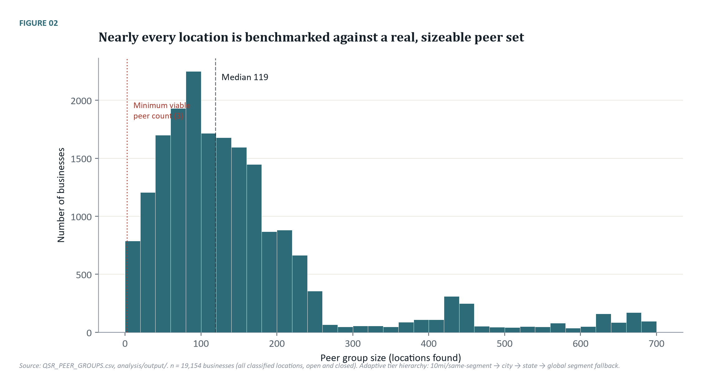
EDA AND PORTFOLIO UNDERSTANDING - 03
Nearly every location is benchmarked against a real, local peer set
119
median peer group size
315
locations with fewer than 10 peers
A thin peer group means a noisier benchmark -- peer-tier quality feeds directly into each location's confidence score, so a weak comparison is disclosed, not hidden.
Source: QSR_PEER_GROUPS.csv, analysis/output/. n = 19,154 businesses (all classified locations, open and closed).
04
Notes:
Before scoring anything, we made sure we were comparing similar restaurants to each other. A coffee shop and a burger place don't get the same star ratings on average, so it wouldn't be fair to judge them side by side. Instead, every location is compared only to similar, nearby competitors -- the typical location has well over a hundred comparable peers to be measured against. A small number of locations don't have many peers nearby, and for those we're upfront that our confidence in the score is lower.

Slide 5
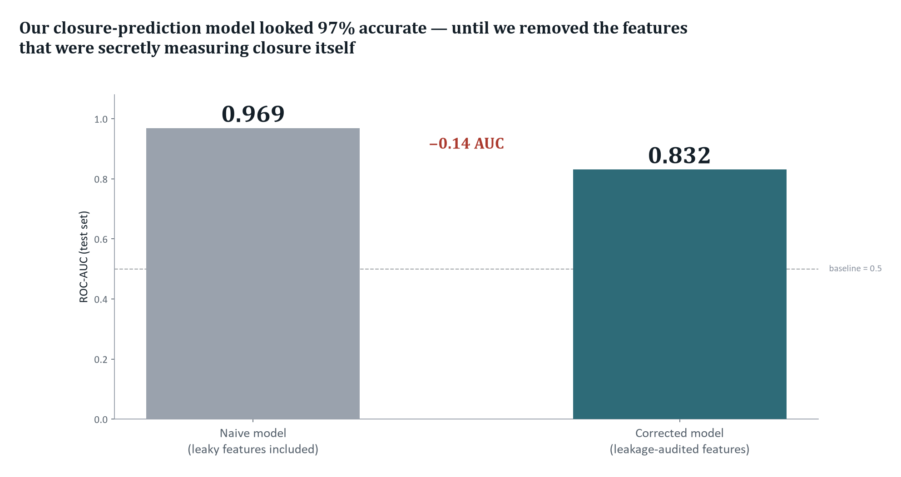
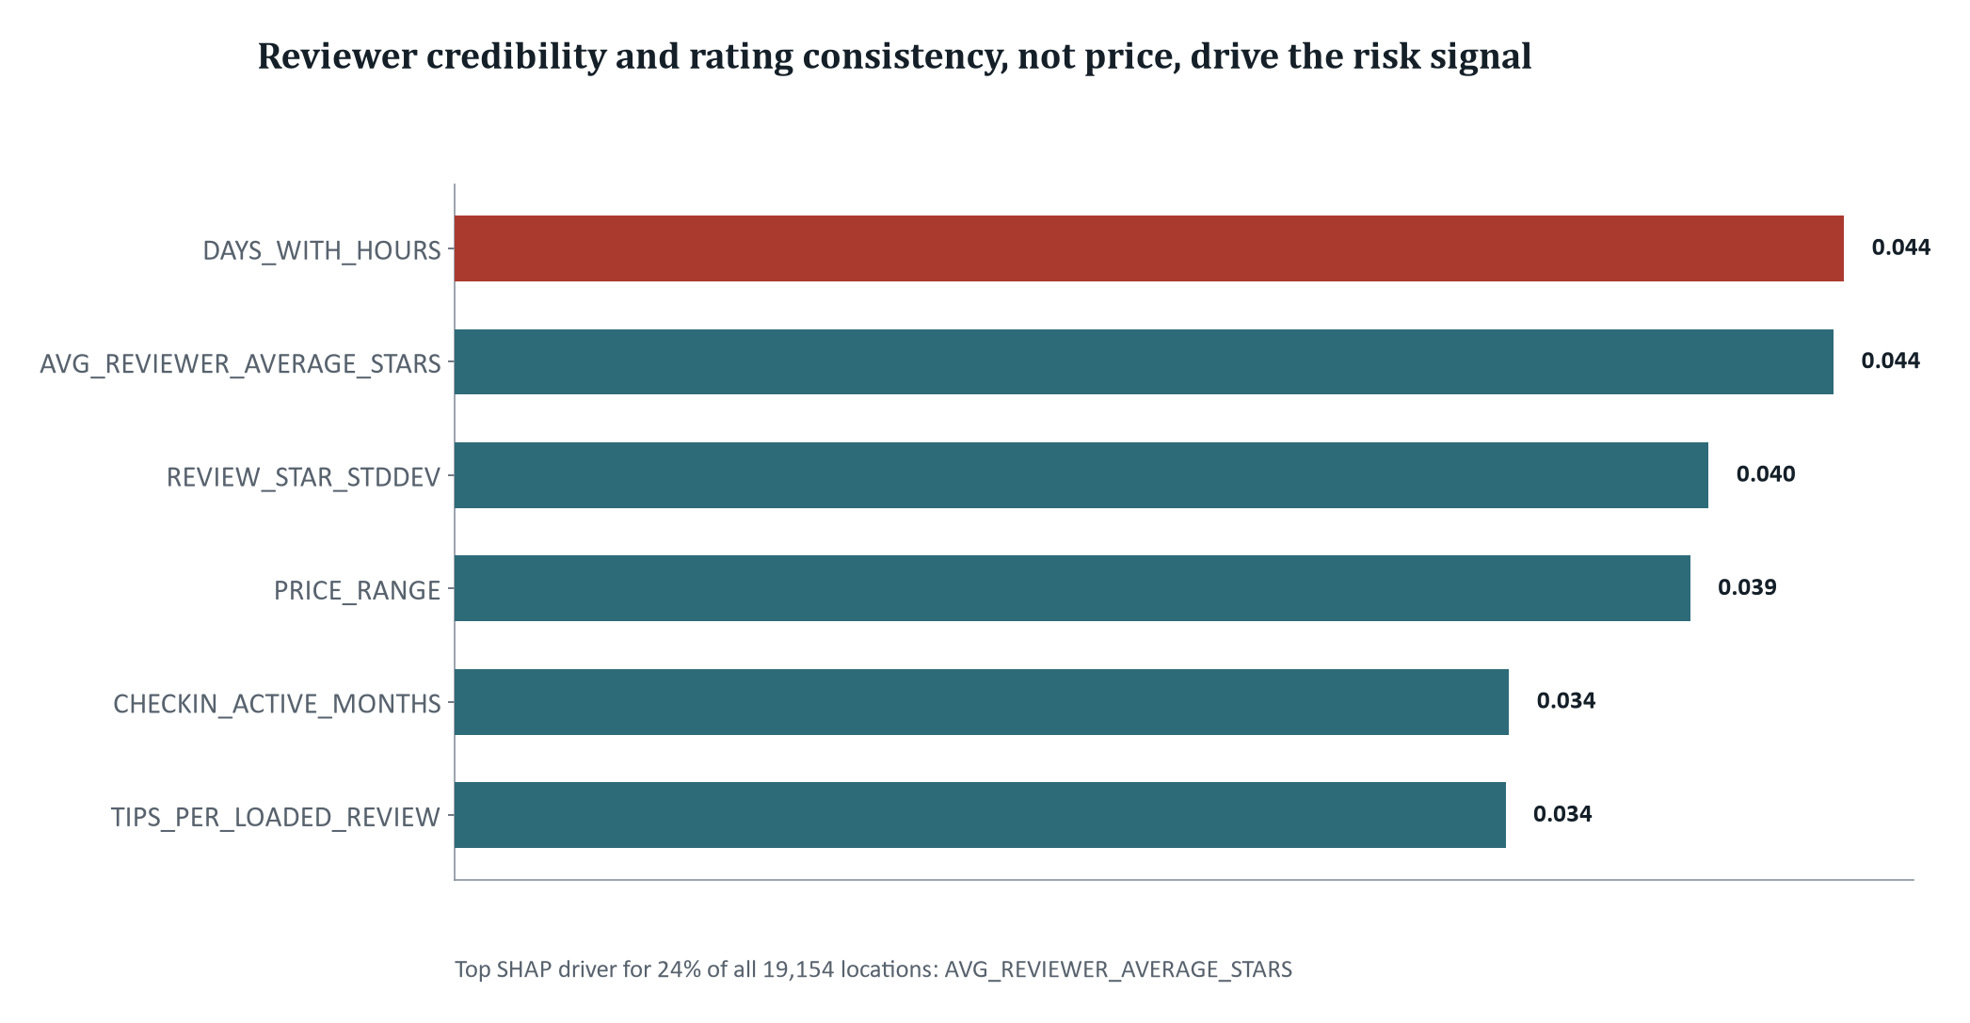
WHY MODELLING WAS NECESSARY - 04
Leakage inflated model performance; the corrected model provides a more credible signal
Supporting evidence -- what the corrected model actually finds
Every number in this deck is checked against this standard -- evidence first, nothing assumed correct because it was the obvious first guess.
Source: QSR_MODEL_RESULTS.csv, QSR_ML_FEATURE_IMPORTANCE.csv, analysis/output/. n = 3,831 test-set holdout.
05
Notes:
This is probably the most important slide in the deck, so let's slow down here. We don't have sales figures or confirmed closure records for these locations, so we needed some real-world way to check whether the signals behind our score -- peer ratings, engagement, review sentiment -- actually mean anything, rather than just being numbers that look reasonable. So we tested them against the closest real-world fact we do have: can these same signals predict whether a restaurant is still open today, or has it already closed down? If they can, that's good evidence they're picking up something real. Our first attempt looked amazing -- right 97 percent of the time. But when we dug in, it was cheating: a closed restaurant simply stops getting new reviews, so the model was just noticing which places had gone quiet, not which places were actually unhealthy. Once we removed that shortcut and forced it to work only with fair, honest signals, accuracy dropped to a more modest 83 percent. That lower number is the trustworthy one -- it tells us the ingredients behind our score genuinely relate to whether a business survives, and it's the number we stand behind for the rest of this work.

Slide 6
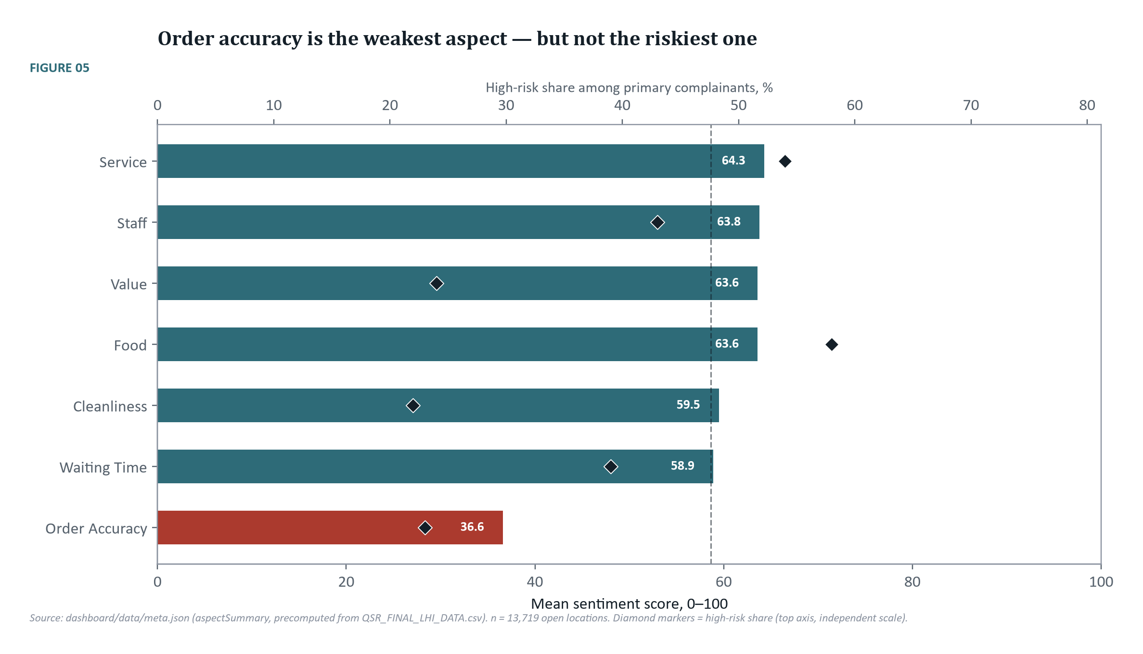
CUSTOMER-EXPERIENCE INSIGHTS - 05
Bars rank sentiment; diamonds mark which aspects actually predict High or Critical Risk -- the two do not point to the same aspect.
Source: dashboard/data/meta.json (aspectSummary). n = 13,719 open locations.
06
Notes:
We also read through customer reviews to work out exactly what people are complaining about -- is it slow service, food quality, cleanliness, staff friendliness, order accuracy, or price? Interestingly, the thing customers mention most often isn't always the thing that best predicts real trouble at a location. That distinction matters for operators: knowing what people talk about most is useful, but knowing what actually predicts risk is what should guide where attention goes.

Slide 7
MEET TWO REAL LOCATIONS - 06
The same four pillars, two very different stories
STRUGGLING
HEALTHY
Bryn and Dane's
In-N-Out Burger
Horsham, PA · 17 local/state peers
Tucson, AZ · 173 local peers
36.6
High Risk
Critical priority
85.3
Healthy
Low priority
Deteriorating -2.3 (1.6★ recent vs. 3.9★ prior)
Improving +1.0 (4.75★ recent vs. 3.79★ prior)
10.7th percentile vs. peers · -0.62★ vs. peer median
79.9th percentile vs. peers · +1.21★ vs. peer median
Peer
20
Peer
87
Engagement
76
Engagement
94
Momentum
4
Momentum
64
Cust. Exp.
39
Cust. Exp.
93
Strong engagement (76) wasn't enough on its own -- peer standing and momentum both collapsed.
Consistently strong across all four pillars -- healthy here means no weak link, not one standout number.
Every one of the 19,154 scored locations gets a card like this -- not just a number, but the specific pillars and evidence behind it, so an operator knows exactly what to fix first.
Source: QSR_FINAL_LHI_DATA.csv, analysis/output/. Two real, individually identifiable locations shown as a worked example of the scoring logic.
07
Notes:
Let's make this real with two actual locations rather than just talking in the abstract. On the left is Bryn and Dane's in Horsham, Pennsylvania -- a struggling location. Its overall score is 36 out of 100, it's flagged High Risk, and it has been getting worse. Notice it actually has strong customer engagement -- plenty of reviews and check-ins -- but that alone couldn't save it, because how it compares to nearby competitors, and its recent direction, are both weak. On the right is an In-N-Out Burger in Tucson, Arizona -- a healthy location scoring 85 out of 100, improving, and strong across every single measure, not just one. That contrast is really the whole point of this slide: a location doesn't become healthy by being great at one thing, it becomes healthy by not having a weak link. Every one of our 19,000-plus locations gets exactly this kind of breakdown, not just a single number.

Slide 8
HOW THE WEIGHTS WERE CHOSEN - 07
Every weight is a business judgement -- tested, not just assumed
31.8%
29.2%
20.3%
18.7%
Peer Standing
Engagement
Momentum
Cust. Experience
Health only means something next to comparable local competition, so this counts for the most.
Reviews, check-ins, and tips show a location people are actually visiting and talking about.
Direction of travel -- a good-looking score that is quietly getting worse is exactly what this is meant to catch.
The specific, fixable drivers -- food, service, cleanliness -- weighted lowest because review-level signal is noisier.
These weights blend business judgement with statistical and model-based evidence -- none of it is precision science. The next slide shows the ranking barely moves even under five deliberately extreme alternative weightings.
Source: QSR_LHI_Technical_Report_Agency5_v5.pdf, Section 06 (Building the LHI). LHI-3, the hybrid construction, is the version scored throughout this deck.
08
Notes:
A fair question at this point is: why do we weigh these four things the way we do? To be upfront -- this isn't hard science, it's business judgement, and that's a perfectly reasonable way to build something like this. We weigh how a location compares to its local competitors the most, because health only really means something in context. Engagement -- reviews, check-ins, tips -- comes next, because it shows real customer activity. Direction of travel matters too, so we don't miss a location that looks fine today but is quietly sliding. And the specific, fixable things like food quality or cleanliness carry real weight, just slightly less, because that signal is noisier at the individual review level. The next slide shows why we're comfortable with this: even if you would weigh these quite differently, the overall picture barely changes.

Slide 9
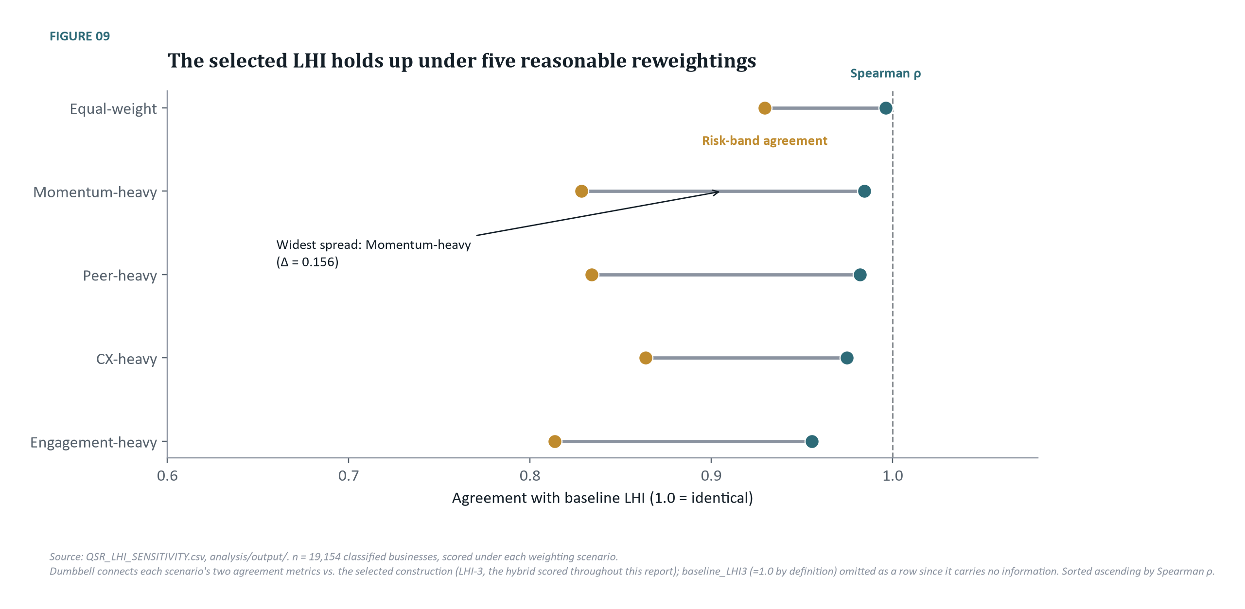
LHI CONSTRUCTION AND VALIDATION - 08
Location rankings remain broadly stable across alternative LHI constructions
Across five deliberately extreme reweightings, agreement with LHI-3 -- the version actually scored throughout this deck -- never drops below 0.95.
Source: QSR_LHI_SENSITIVITY.csv, analysis/output/. n = 19,154 classified businesses, scored under each weighting scenario, tested against LHI-3.
09
Notes:
This is a second, separate check -- not the four-way comparison from a moment ago. Here we took the formula we actually chose and asked: what if someone reasonably disagreed with these exact weights? We tried five deliberately different alternative weightings -- what if peer standing mattered a lot more, or engagement did, or momentum did -- and re-ran the numbers each time. The reassuring finding is that no matter which of those five we tried, the overall picture of which locations are healthy and which are struggling stayed at least 95 percent consistent with what we actually chose. That tells us the formula isn't fragile -- even a real disagreement about the exact weights wouldn't flip the results. What can still shift under those same alternative weights is any single location's exact position -- we'll come back to that in the recommendations.

Slide 10
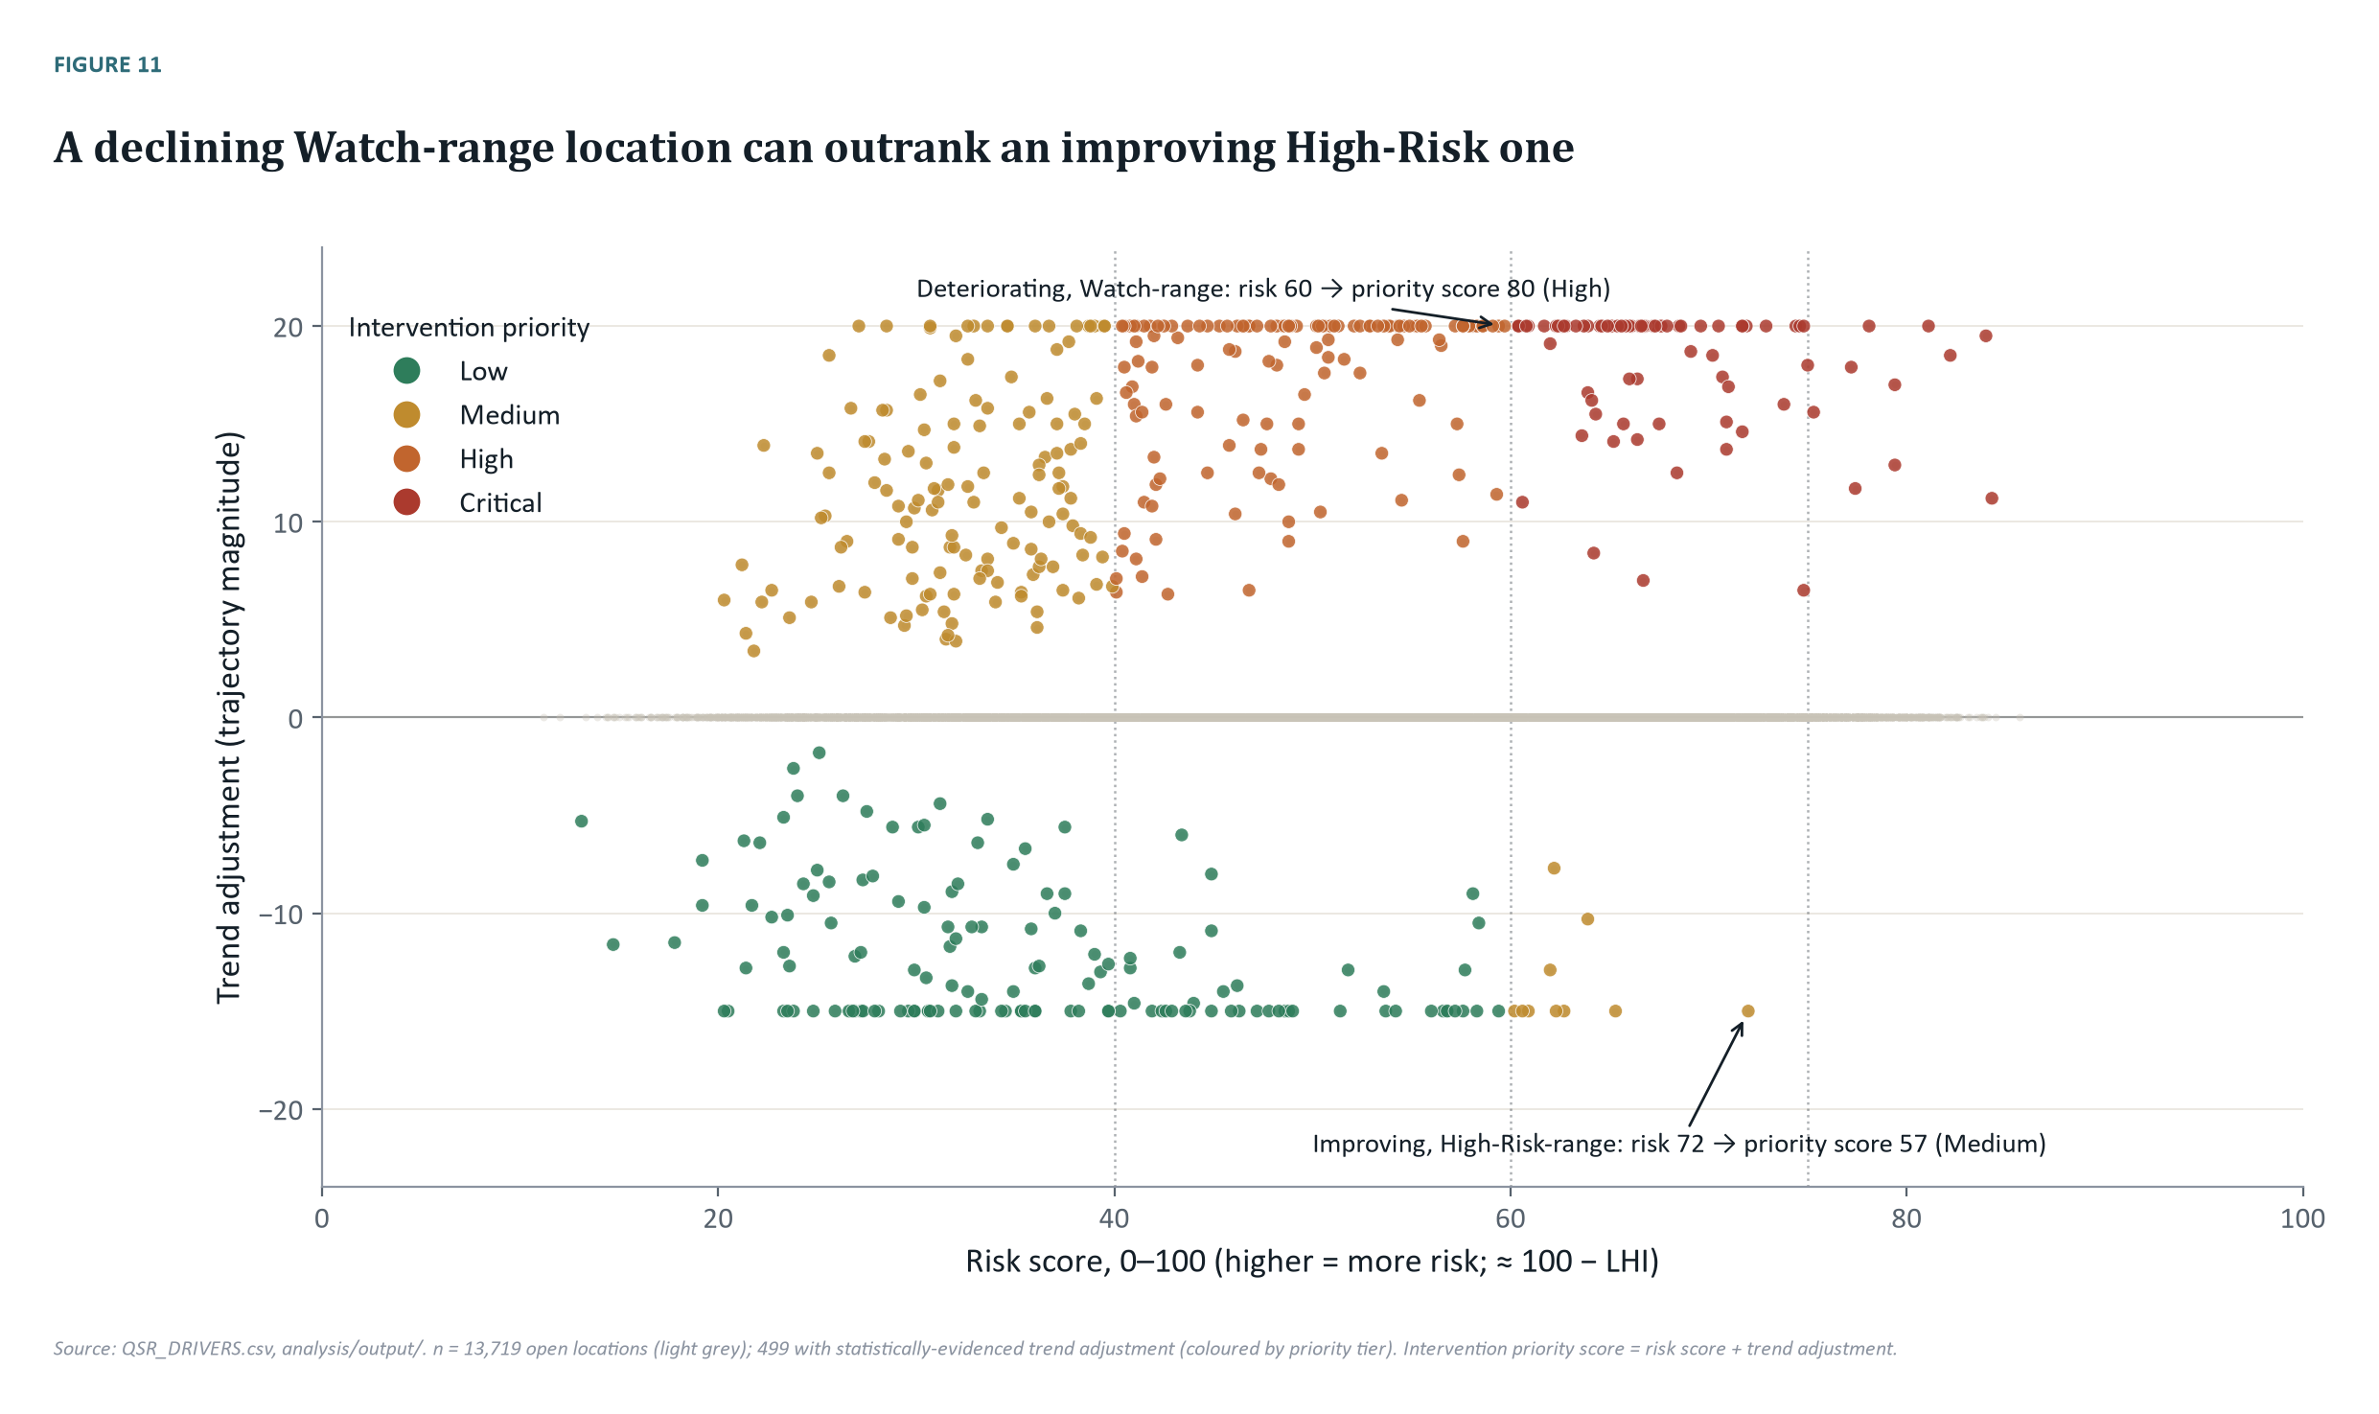
OPERATIONAL PRIORITISATION - 09
Health band
x
Trajectory
x
Confidence
x
>
Intervention priority
Priority is an explicit lookup table across these three fields, not health plus a trend nudge added arithmetically -- confidence acts as a damper, so a low-evidence signal never drives urgent action alone.
Source: QSR_DRIVERS.csv, analysis/output/. n = 13,719 open locations; 499 with statistically-evidenced trend adjustment.
10
Notes:
Knowing a location is unhealthy isn't enough -- you also need to know whether it's getting better or worse, and how much evidence we actually have behind that read. So instead of boiling everything into one number, we combine three things: how healthy a location is right now, which direction it's heading, and how confident we are in that direction. That means a location that looks fine today but is clearly sliding can be flagged as more urgent than one that's already struggling but stable -- because the sliding location is the bigger opportunity to step in before it becomes a real problem.

Slide 11
RECOMMENDATIONS - 10
Three moves before this framework drives automated action
1
2
3
Strengthen the evidence
Govern the framework
Deploy responsibly
Get a real outcome variable -- dated closures, sales trend, or pilot audit scores.
Ship the priority lookup table as a governed artifact operators can read.
Pilot with analyst-in-the-loop review before wiring the priority queue into an automated workflow.
Re-run sentiment validation against a multi-annotator gold set.
Version every threshold-based shortlist -- 38.4% of locations move rank under reasonable alternative weights.
Source: QSR_LHI_Technical_Report_Agency5_v5.pdf, Section 12 (Recommendations).
11
Notes:
So what should VP Analytics do with this? Three things. First, get real business outcomes -- actual sales figures or confirmed closures -- so we can check this scorecard against reality, not just against itself. Second, treat the rules behind the scorecard as something to be written down and reviewed regularly, not buried in code where no one can question it. Third, roll this out with a person reviewing the flagged locations at first, rather than moving straight to fully automatic action -- today this is a strong decision-support tool, not a replacement for judgement.

Slide 12
LIMITATIONS - 11
What this framework can't yet claim
1
2
3
No ground truth yet
Simplifications we made
Not yet in scope
No sales figures, confirmed closures, or audit outcomes exist in this dataset to check the score against.
Review sentiment is read by a transparent, rule-based system, not a deep-learning model -- it can miss sarcasm.
No roll-up across multi-location franchise ownership -- every location is scored on its own.
The data is a historical snapshot through January 2022, not a live feed of current conditions.
Which businesses count as "QSR" was set by an automated rule, not manually checked one by one.
A single location's exact rank can shift under different reasonable weightings; the overall picture does not.
Source: QSR_LHI_Technical_Report_Agency5_v5.pdf, Section 11 (Limitations and Assumptions).
12
Notes:
Before we close, it's important to be upfront about what this can and can't do yet. We don't have real sales figures or confirmed closures to check our score against -- so far, everything is validated against itself, not against outside proof. The data is also a snapshot through January 2022, not a live feed. We made some deliberate simplifications too -- reading sentiment with a simpler, transparent method rather than the most advanced language models available, and using an automated rule rather than manually checking every single one of the 19,000-plus locations. And there are things we haven't tackled yet, like rolling scores up across multiple locations owned by the same franchise. None of this undermines the overall picture, but it does mean any single location's exact position shouldn't be treated as gospel.

Slide 13
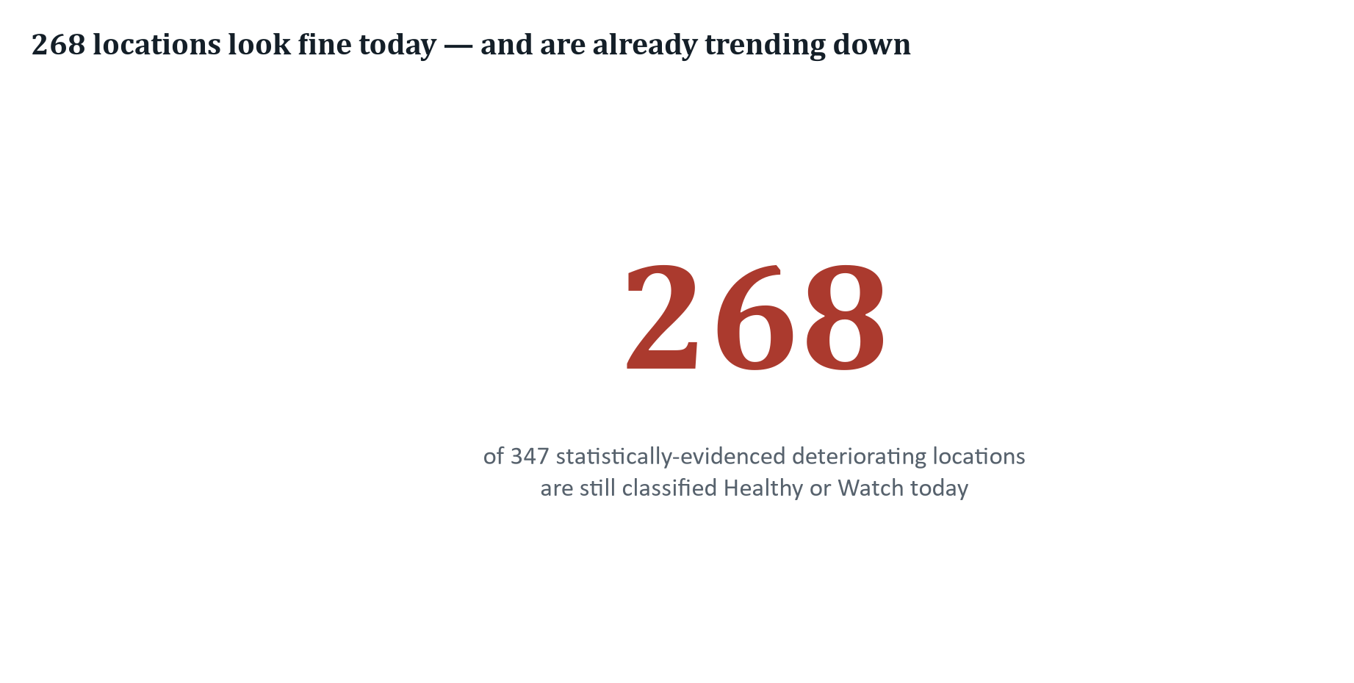
CONCLUSION - 12
One defensible score for 19,154 locations, tested against three alternatives.
Direction, evidence strength, and priority -- what a score alone cannot show.
For VP Analytics: a ranked, evidence-backed shortlist operators can act on today.
The practical value is what this framework refuses to claim, as much as what it finds.
Source: QSR_DRIVERS.csv, QSR_FINAL_LHI_DATA.csv, dashboard/data/meta.json (trajectoryCounts). n = 347 open, statistically-evidenced deteriorating locations.
13
Notes:
To bring it all together: we built one clear, defensible health score covering every location, and we tested it against several alternatives rather than assuming we'd got it right the first time. The score doesn't just say how healthy a location is -- it says which direction it's heading and how much to trust that read, which a single number never could. For VP Analytics, that means a ranked, evidence-backed shortlist operators can actually act on today. And perhaps the most important part of this work is what we chose not to claim: we're not saying this proves how a location is actually run, only that it's a strong, honest read of the public signals available to us today.

Slide 14
Thank you
Questions and discussion
Agency 5 - LSE Data Analytics Career Accelerator - QSR Location Health Index
Notes:
Thank you for your time. We're happy to take any questions, whether that's about the numbers, the recommendations, or where this could go next.

