Slide 1

RESEARCH PORTFOLIO
Closed-Loop Control Systems Robust to
Objective and Environment Shift
Resource management and other closed-loop control that adapt through RL policy transfer and LLM agents, built and validated through systems engineering
① Reinforcement Learning — Resource Management & Cloud Robotics
② Agentic AI — LLM Agents for System Operation (Robotics & V2G)
③ Systems Engineering — Simulators, Testbeds, Protocols & Deployment
Youngseok Lee
Ph.D. Candidate, Dept. of Electrical & Computer Engineering, Sungkyunkwan University
Advisor: Prof. Honguk Woo (CSI-Agent Group) · Expected graduation Feb. 2027
yslee.gs@gmail.com · Google Scholar: scholar.google.com/citations?user=GhwtxtgAAAAJ

Slide 2
2
Introduction
Youngseok Lee — Ph.D. Candidate, Sungkyunkwan Univ.
Education — Integrated M.S.–Ph.D., Electrical & Computer Engineering, Sungkyunkwan University (Mar. 2013 – Feb. 2027, expected) · Advisor: Prof. Honguk Woo (CSI-Agent Group) · Dissertation: Reinforcement Learning for Quality-Driven Network Control
  2018: moved to Prof. Honguk Woo's group and defined the dissertation topic · Expert Research Personnel service (Mar. 2017 – Mar. 2020) · Global Ph.D. Fellowship, 5-year term (2013–2018, Ministry of Education / NRF Korea)
Achievements — 8 granted patents (US 5 / KR 3, first inventor on 4) · 5 systems delivered · IEEE INFOCOM 2027 (first author, under review) · NeurIPS 2024 (second author) · 3 SCIE journal papers (first author 2 / second author 1) · 35 earlier publications (2012–2018)
  Delivered to Samsung Electronics ×2, Polaris AI, Acryl, and ADD (Agency for Defense Development), each as technical leader · 20 funded projects (principal investigator 1 · technical leader 10 · researcher 9) · 9 software copyrights
Research area | Representative work | Outcomes
① Reinforcement Learning — Resource Management & Cloud Robotics | Repot — Bandwidth allocation transferred across network environments by flow embedding and action shaping XferQoE — One QoS-pretrained rate controller, adapted per application by objective-weight fitting from QoE feedback Physical-AI PoC — Code-as-Policies demo · robot foundation model (RFM) fine-tuning on a real arm (SO-101) Off-board RFMs under network delay (in progress; page 12) | IEEE Access 2021 (first author) 1 first-inventor patent family (KR 2023 · US 2026) IEEE INFOCOM 2027 (first author, under review)
② Agentic AI — LLM Agents for System Operation (Robotics & V2G) | LDuS — LLM-guided skill diffusion for zero-shot policy adaptation AgentV2G (in progress) — LLM-agent V2G (vehicle-to-grid) fleet operation under drift, day-ahead → real-time; SAC dispatch policy | NeurIPS 2024 (second author)
③ Systems Engineering — Simulators, Testbeds, Protocols & Deployment | S-Sim packet simulator → NS-3 → 16-node Raspberry Pi NiL testbed Code-as-Policies demo pipeline · SO-101 real-arm fine-tuning setup V2G fleet-operation environment (market rules · SMP · EV sessions) FL with knowledge distillation → edge-NPU YOLOv8n inference pipeline NVMe-oF storage simulator with dual-output DNN surrogate Delay-injection evaluation harness for off-board RFMs | Systems delivered ×5 (Samsung ×2, Polaris AI, Acryl, ADD) 3 US patents with Samsung (storage ×2 · IoT resource identification)

Slide 3
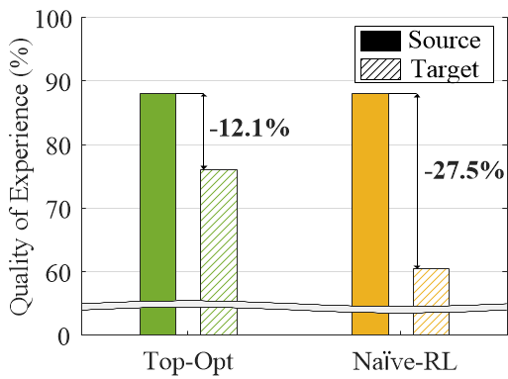
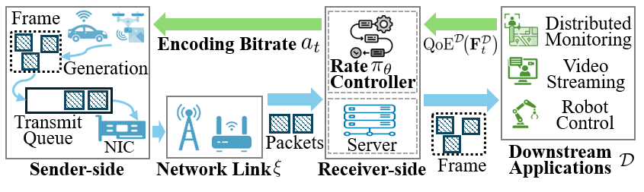
3
Research Coverage
Control Robust to Objective and Environment Shift
Problem — A learned model matches a hand-crafted model in the source environment, yet degrades far more severely than the hand-crafted model when the objective or the environment shifts even slightly between source and target (left figure)
  Such shifts occur after deployment as changes in the application objective (the definition of quality of experience, or QoE) or the execution environment (network condition, demand pattern, market rule); the hand-crafted model degrades gracefully but requires manual re-tuning for each condition, whereas the learned model needs data collection and retraining for each condition
Goal — Closed-loop control that combines the robustness of the hand-crafted model with the performance of the learned model and, when the objective or the environment shifts after deployment, adapts from a small amount of data without retraining the deployed policy
  ① Reinforcement Learning — RL policies for resource management and cloud robotics: a meta-RL rate controller and a bandwidth-allocation policy that transfer to new objectives and environments with little or no retraining (XferQoE · Repot), and a SAC dispatch policy for V2G fleets (AgentV2G), with RL serving control for off-board robot foundation models in progress (page 12)
  ② Agentic AI — AgentV2G uses LLM agents to turn market rules into solver-ready objectives and constraints for V2G operation; LDuS uses an LLM to turn user requirements into executable loss-function code and validate code and trajectories in a feedback loop for skill adaptation
  ③ Systems Engineering — The two approaches are implemented and validated on purpose-built simulators, surrogate models, and testbeds; five systems built with the same engineering were delivered to Samsung Electronics ×2, Polaris AI, Acryl, and ADD
Representative system — QoE-driven control loop (right figure): RL-based rate controller → network link → application QoE feedback
Hand-crafted model
Learning-based model
Closed-loop QoE-driven adaptive rate control (XferQoE)
Motivating measurement (Repot)

Slide 4
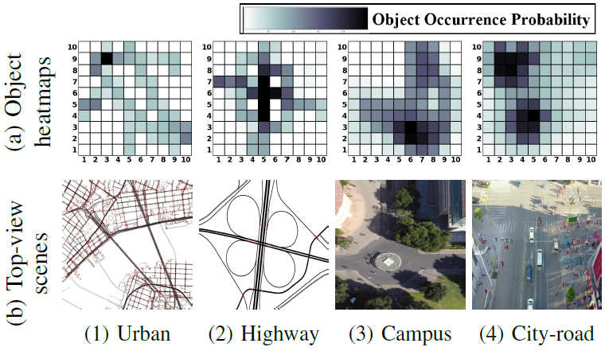
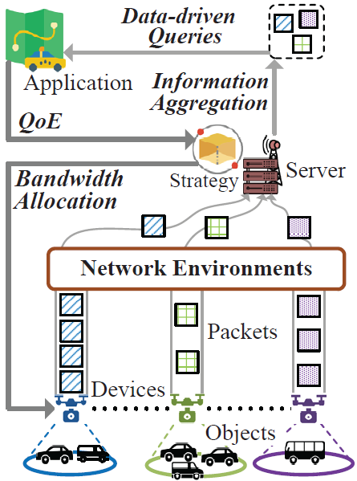
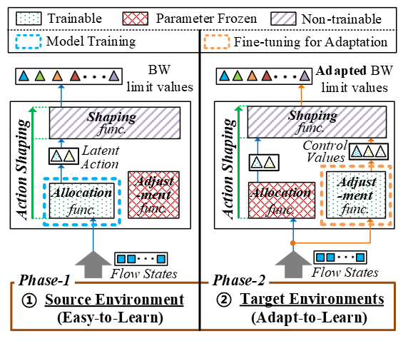
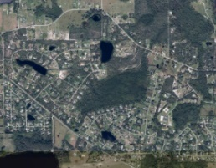
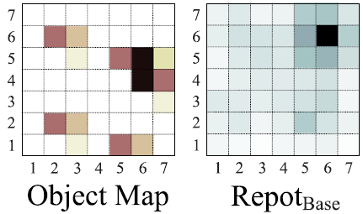
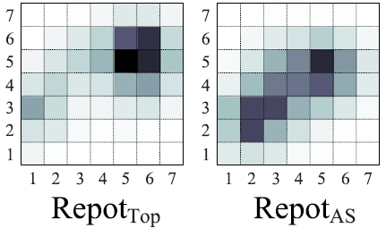
4
① Reinforcement Learning — Resource Management & Cloud Robotics
[RL, Finetuning] Repot — Transferable RL for Networked Monitoring
Overview — 2020–2021 · IEEE Access 2021 (first author) · Network Monitoring System patent, KR 2023 / US 2026 (first inventor)
Role: Leader — problem definition, algorithm design, implementation, experiments
Problem — When sensing devices share a single link, the bandwidth allocation must keep a server's continual query accurate as the network degrades. Re-learning that allocation from scratch for each new network scale and condition is prohibitively expensive (left figure)
Approach — Two-phase transfer (center figure): ① the policy is trained end to end with SAC (soft actor–critic) in an ideal time-slotted source environment with inexpensive samples; ② in the NS-3 target, all learned modules are frozen and a second, small SAC policy (the adjustment function, with its own critics) is trained on expensive samples. Its outputs enter the shaping function together with the frozen latent action
Structure — Flow embedding: a Transformer encoder (per-device MLP vectorization + self-attention over all flows) represents every stream by its history and its relation to the others in one vector space → Allocation: a trainable function emits a latent action → Shaping: a non-trainable function maps it to per-device bandwidth limits by a distance-weighted softmax; the adjustment function supplies the control values
Result — The policy adapts with 6.25% of the from-scratch training samples and reaches 14.5–20.8% higher QoE (quality of experience) than the two learning-based baselines in the target. QoE holds at 91–94% of the equal-share reference across 49–400 devices in the source, and the SUMO (Simulation of Urban MObility) vehicle study shows +6.5% (urban) and +12.6% (suburban) over Top-Opt, a Top-K heuristic (right figure)
(a1) Top-view map
(a2) Object map
Action attention map
(b1) During pretraining
Action attention map
(b2) During adaptation
Networked monitoring systems
Action shaping model structure
Action attention map transfer

Slide 5
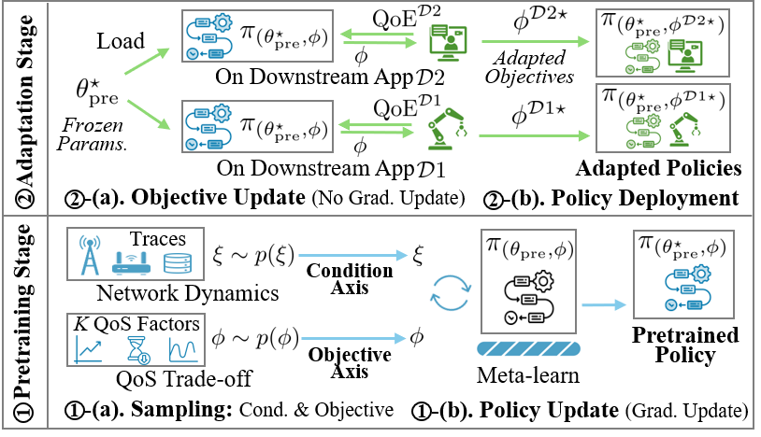
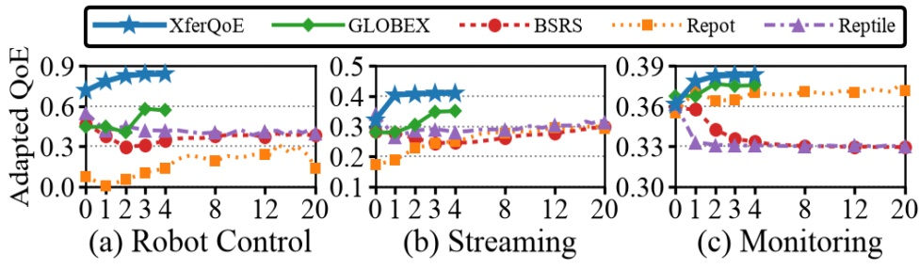
5
① Reinforcement Learning — Resource Management & Cloud Robotics
[Meta-RL, Transformer] XferQoE — QoS-Pretrained Rate Control for Model Serving
Overview — 2024–2026 · IEEE INFOCOM 2027 (first author, under review) · Physical-AI Core-Technology PoC, MSIT (Ministry of Science and ICT) / NIPA (National IT Industry Promotion Agency), 2025
Role: Leader — (full cover) problem definition, algorithm design, implementation, experiments, testbed
Target system — A cloud robot streams observation frames over a wireless link to an edge server that runs the manipulation policy, so the served model receives only the frames the link can carry. On a limited link the highest frame quality is not the highest QoE (quality of experience), because quality gained at the cost of timeliness deprives the control loop of up-to-date observations. The best stream differs per deployment and the served model (e.g., a robot foundation model, an LLM, or a recognition model) cannot be fine-tuned for each, so XferQoE leaves the model untouched and controls the sending rate, and with it the quality, of the remotely sourced input
Problem — Each application weighs the QoS (quality of service) factors (timeliness, throughput, smoothness) in its own way, and its QoE is observable only through the complete network-to-application stack, so training a controller per application incurs both costs again: the per-application objective design and the full-stack QoE collection
Approach — Meta-RL (meta-reinforcement learning) in two stages: ① one rate controller is meta-pretrained on QoS objectives alone in S-Sim (Simplified Simulator), each episode sampling a task over two axes, the bandwidth dynamics (condition) and the objective weight w (trade-off), so the policy learns to infer the condition from recent history instead of being retrained for it; ② the policy is then frozen and only w is fitted from a few QoE feedback shots on each downstream application, with no gradient update (left figure)
Structure — SAC (soft actor–critic) with one module per meta-training axis: a regime–context encoder (a bidirectional Transformer with mean pooling → regime latent; a per-patch 1-D CNN with a cross-attention readout → step latent, 8-dim each) and factor critics (one Q-head per QoS factor, ensemble of 3) that compose the value linearly under w. The actor reads the state, both latents, and w (policy ≈ 0.3 MB, encoder ≤ 3.5 MB)
Adapted QoE per adaptation shot (one shot = one adaptation round)
QoS pretraining → QoE adaptation

Slide 6
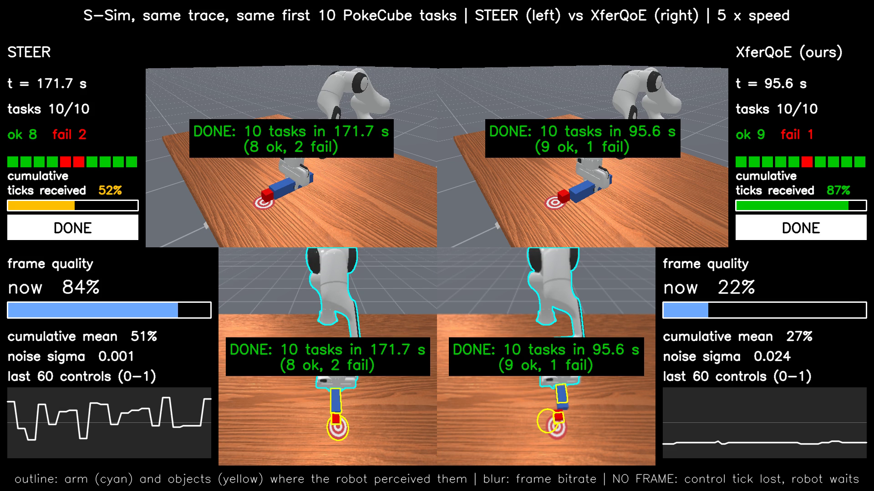
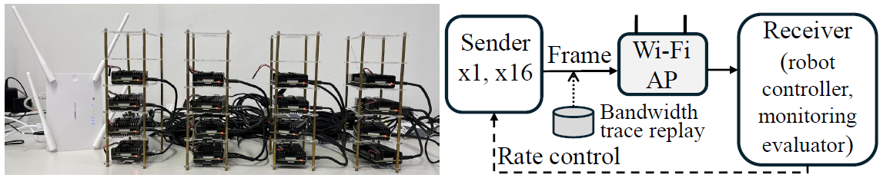
6
① Reinforcement Learning — Resource Management & Cloud Robotics
[Sim2Real] XferQoE — Frozen Rate Controller on a Real Wi-Fi Link with a Simulated Robot
Target system — The edge server runs the manipulation policy and the rate controller, and only observations cross the wireless link. The Sim2Real target is therefore the network side, while the robot runs in ManiSkill3 (SAPIEN, learned policy) and Meta-World (MuJoCo, scripted policy) simulation and its task QoE (quality of experience) is defined from manipulation success, control continuity, and completion efficiency
Built — The NiL (network-in-the-loop) testbed: one Raspberry Pi 4 sender for robot control or up to 16 for monitoring on a real 802.11ac link via an access point to the edge server. C/C++ daemons implement episode-level clock synchronization. A sender-side queue model and frame-deadline expiry accounting track traffic; the receiver reconstructs queue growth, dropped bytes, and frame lateness from sender-stamped packet headers
Validation path — Three network environments of increasing fidelity replay the Puffer bandwidth trace (the hardest to predict of the eight traces) behind one state-input, rate-output interface shared by all three: packet-level C++ S-Sim → full-stack NS-3, the NiL testbed, a real Raspberry Pi 4 with its OS stack and packet timing. The same frozen rate controller runs on all three with its parameters unchanged
Result — On the link, only the objective weights are refit while the rate controller stays frozen. XferQoE has the highest QoE in all three real-link evaluations. ManiSkill3 QoE is 0.439 vs. 0.367 for the per-application hand-crafted controller (success rate 67.8% vs. 64.7%, table)
Demo video, S-Sim — Same trace, first 10 PokeCube tasks at 5× speed, one example run: STEER (left, a learning-based rate controller) keeps mean frame quality at 50.6%, but the robot receives a complete observation on only 51.6% of its control ticks and finishes in 171.7 s with 2 of the 10 tasks failing. XferQoE (right) lowers mean frame quality to 27.2%, reaches 86.8% of ticks, and finishes in 95.6 s with 1 failing
NiL testbed: Raspberry Pi 4 senders, Wi-Fi AP, edge server
Real-link robot control, ManiSkill3 PokeCube (HC = hand-crafted)
Method | QoE | Success Rate (%) | Frame Quality (%) | Control Continuity (%) | Efficiency (%) | Working Time (s) | Completion Time (s)
XferQoE | 0.439 | 67.8 | 27.3 | 88.5 | 81.4 | 7.7 | 9.34
STEER | 0.003 | 54.2 | 37.5 | 59.1 | 86.6 | 7.2 | 14.54
GLOBEX | 0.203 | 60.7 | 33.4 | 74.0 | 85.4 | 7.2 | 10.94
Per-app HC | 0.367 | 64.7 | 25.7 | 86.7 | 80.8 | 7.7 | 9.36
Demo video: STEER vs. XferQoE
sonny0714.github.io/demo_video_robot/xferqoe-vs-steer.html

Slide 7
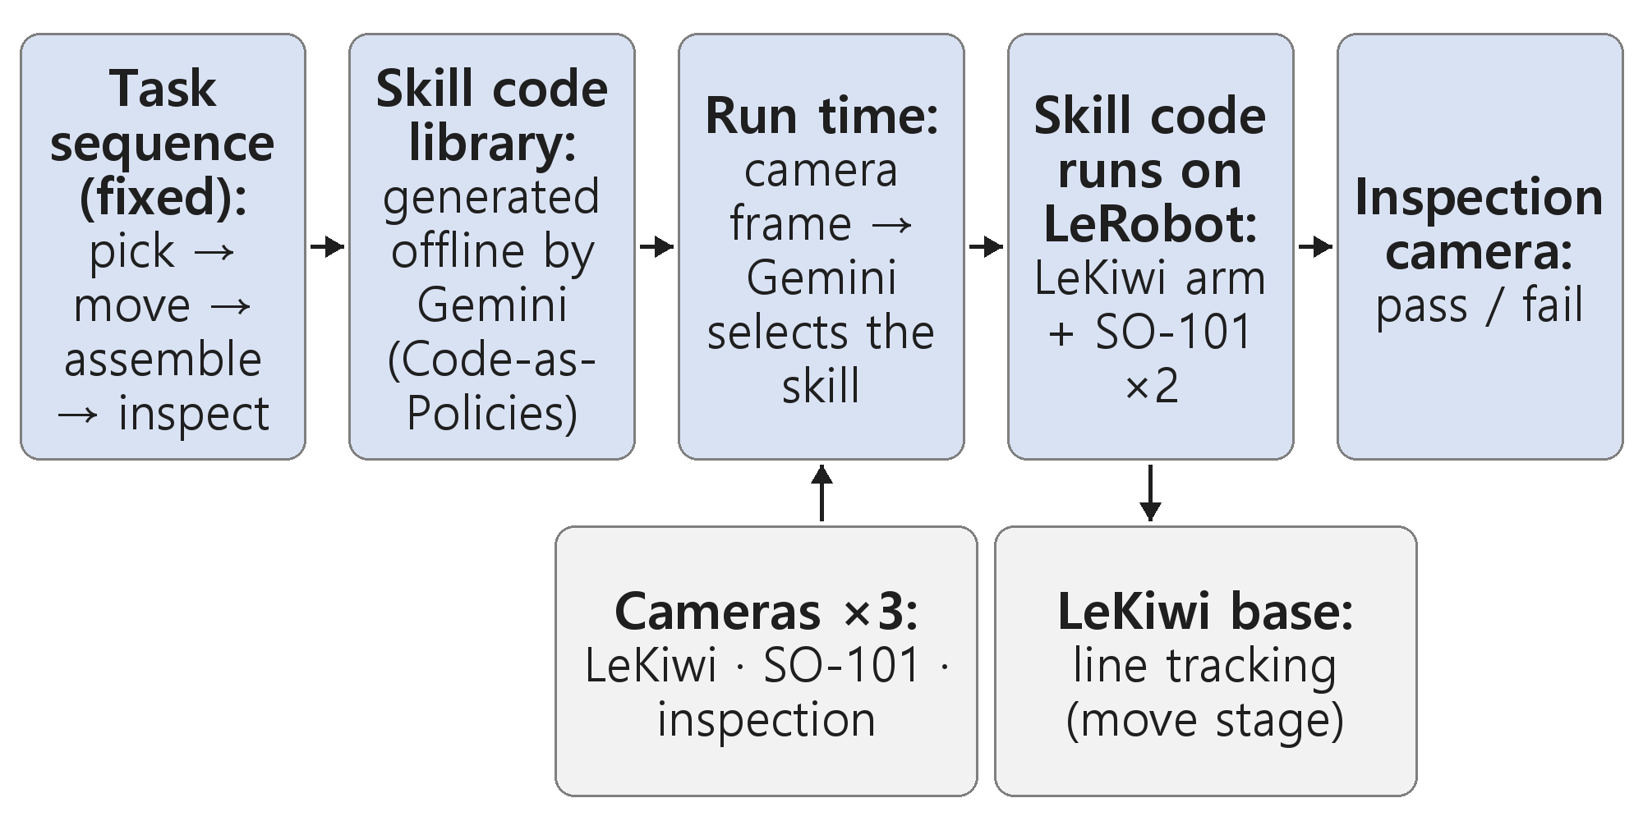
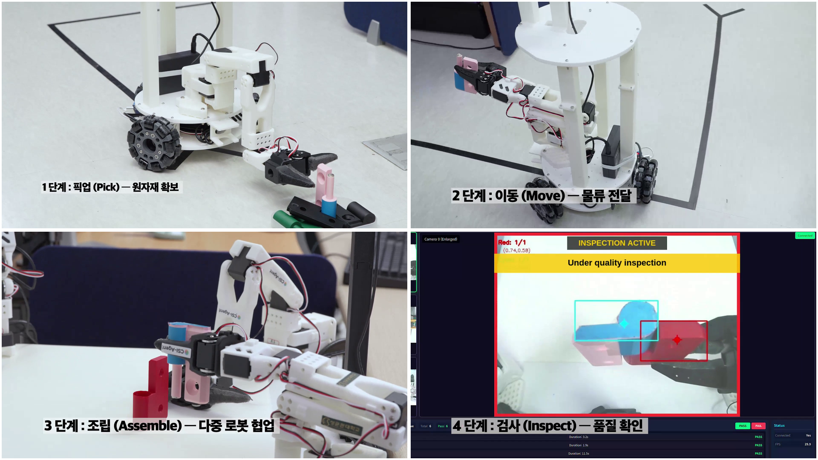
7
① Reinforcement Learning — Resource Management & Cloud Robotics
[RFM, VLM, VLA] Physical-AI PoC — Code-as-Policies Demo, RFM Fine-Tuning
Overview — Physical-AI Core-Technology PoC (MSIT / NIPA, 2025, researcher): the four-stage demo was recorded in Jan. 2026. The SO-101 work (Mar.–May 2026) is a separate effort toward human-to-robot transfer
Role: Participant in the PoC demo (pipeline structure design, LeRobot runs; jointly with the lab) and carried out the SO-101 work (encoder pretraining, data collection, fine-tuning, real-arm tests)
Demo: skill-based Code-as-Policies — The task sequence is fixed (pick → move → assemble → inspect) and the skills are predefined. For each skill, the prompt to Gemini (a VLM, vision-language model) carries a code skeleton written over the robot's perception and control primitives, and Gemini fills the skeleton with executable code offline; the filled skills form the library. At run time Gemini reads the camera frame, selects a skill, and that code drives the arms on LeRobot (LeKiwi's arm picks, two SO-101 arms assemble). The LeKiwi mobile base moves by line following and an inspection camera returns pass/fail (video at right). No learned policy is in the loop
SO-101: RFM (robot foundation model) encoder fine-tuning toward human-to-robot (H2R) transfer — The vision encoder was the part trained so that human videos could guide robot imitation learning: H2R was reproduced on public data (two ViT-B/16 encoders pretrained by masked autoencoding, on human and on manipulation videos, each as the ACT (Action Chunking with Transformers) backbone, compared offline with ImageNet pretraining). On the real arm, the vision encoders of the pretrained SmolVLA and π0.5 were then fine-tuned on LeRobot, action expert frozen, on teleoperated donut pick-and-place data (104 episodes, 45,553 frames). ACT on the same data was the baseline
  Models — ACT: CNN vision backbone + transformer encoder–decoder trained as a conditional VAE; SmolVLA: SmolVLM-2 vision-language backbone + flow-matching action expert; π0.5: PaliGemma-based VLM + flow-matching action expert
Real-arm result — On donut pick-and-place, 10 trials each at trained positions (in-distribution, ID) and new positions (out-of-distribution, OOD), reported as [ID, OOD]: ACT [70%, 40%], SmolVLA [90%, 50%], π0.5 [80%, 60%]. The gaps between policies are one or two trials of ten and the training budgets (steps, batch) differ, so no ranking or pretraining effect is claimed
Demo: offline skill code; camera → Gemini selects skill → LeRobot
PoC demo video (41 s): pick, move, assemble, inspect

Slide 8
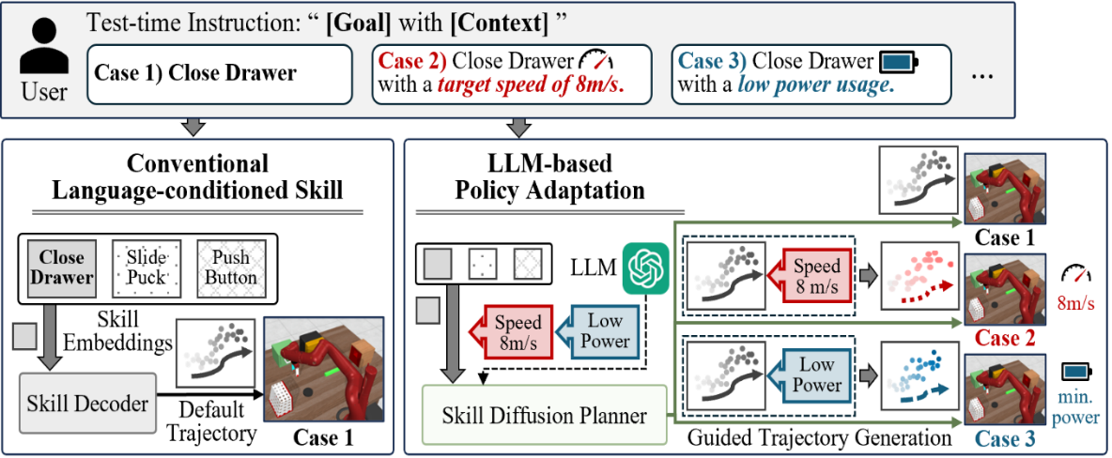
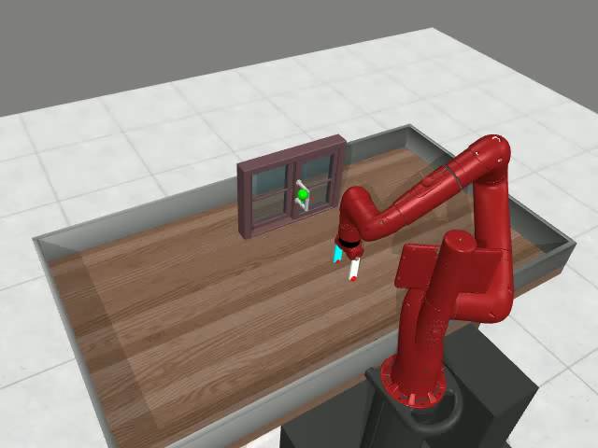
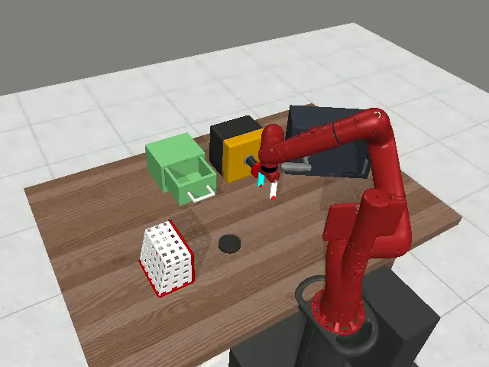
8
② Agentic AI — LLM Agents for System Operation (Robotics & V2G)
[Diffusion, Action Decoder] LDuS — LLM-Guided Skill Diffusion for Policy Adaptation
Overview — 2023–2024 · “LLM-based Skill Diffusion for Zero-shot Policy Adaptation,” NeurIPS 2024 Main Conference Track (second author)
Role: Leader — problem definition, algorithm design, architecture, experiment design; robot-task validation on Meta-World
Problem — A skill-based policy learned from expert data cannot adapt to a language-specified context unseen in training, and retraining for each context is expensive (left figure, Cases 2–3). Such a context is a changed environmental condition or a user requirement such as a target speed, low power usage, or a spatial constraint
Pretraining (skill learning) — On goal-annotated expert trajectories without context, a hierarchical skill model is trained: a VAE skill encoder maps an h-step state–action segment to a skill embedding, a skill prior predicts it from the state and the language goal encoded by CLIP (contrastive language–image pretraining), and a skill diffusion planner, a U-Net denoiser as in Diffuser, reconstructs the segment from the embedding. Sequential in-painting fixes the past states and actions into the generated trajectory, so the planner completes the rest at test time
Adaptation (zero-shot, no policy update) — In the manner of Code-as-Policies (the LLM writes executable code instead of acting directly), but for a loss function rather than the policy, GPT-3.5 turns the context into loss code, and the gradient of that loss guides every denoising step of the pretrained planner. GPT-4 judges contact from the camera frame to gate constraints that apply only while touching the object. A closed loop validates the code and the guided trajectory, regenerating faulty code and raising the guidance frequency until the context is satisfied
Result — LDuS adapts zero-shot to user constraints on how a task is done (speed, force, energy use, spatial bounds) never seen in training, with no policy update. Success rate / context reward vs. Diffuser+Guidance (same gradient guidance, hand-written loss): Meta-World speed constraints (10 goals) 94.6% / 87.4 vs. 76.4% / 69.8; multi-stage Meta-World (3 long-horizon goals) 84.0% / 82.0 vs. 36.7% / 45.9; a force constraint active only while touching the object, contact judged from the camera frame (2 goals, right figure) 93.1% / 63.5 vs. 1.4% / 33.0
LDuS: language context → LLM-generated loss code → guided trajectory generation
Manipulation task executions (Meta-World)

Slide 9
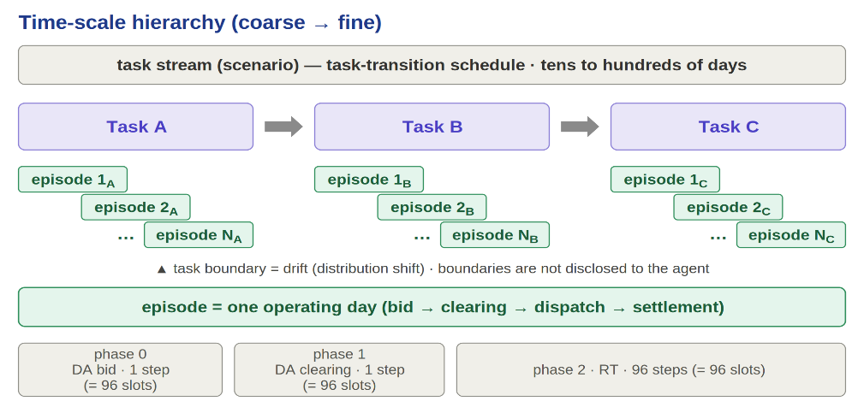
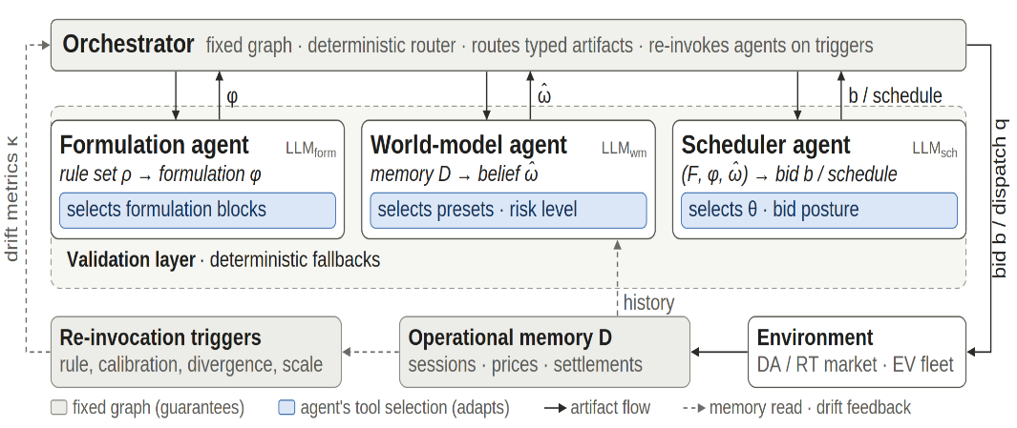
9
② Agentic AI — LLM Agents for System Operation (Robotics & V2G)
[RL Solver, LLM] AgentV2G — Agentic V2G Fleet Scheduling Under Drift
Overview — 2026 – present · Hyundai Motor · Kia V2X (vehicle-to-everything) project (Mar. 2026 – Mar. 2027)
Role: Leader — (full cover) problem definition, algorithm design, implementation, experiments; construction of the V2G fleet-operation environment
Problem — A V2G (vehicle-to-grid) charging-hub operator commits irreversible market bids before prices, cleared fractions, and vehicle behavior are known, all drifting over weeks of operation. An agent free to re-plan cannot be trusted to commit, while a fixed pipeline cannot follow the drift
Method — A static orchestration graph with dynamic tool selection (right figure): every operating day follows the same bid → clear → dispatch sequence, so the graph is fixed once, and each agent adapts only by re-selecting among verified tools where drift affects the estimates or rules
  Three role agents — A formulation agent derives the objective and constraints from the market rules and re-derives them when the rules change. A world-model agent maintains a belief state over the unobserved inputs (prices, clearing, sessions) from an operational memory and selects the risk level of its belief corrections. A scheduler agent produces every bid and schedule through an optimization engine (MILP, mixed-integer linear programming)
  The orchestrator re-invokes an agent when a deterministic drift metric flags a change and validates every emitted artifact (formulation, belief, schedule) through membership, bounds, and scale checks and falls back to deterministic defaults when a check fails. The objective is immutable within an episode, so no agent can relax the objective it is evaluated against
  RL solver — A SAC (soft actor–critic) policy over per-vehicle embeddings and their fleet mean, built to replace MILP in real-time dispatch
Evaluation — Day-ahead and real-time market scenarios on real SMP (system marginal price) and EV (electric vehicle) charging-session data, under Jeju pilot rules with EU and NEM (Australian National Electricity Market) presets; fleets of 1–1,000 EVs; a single open-weight LLM (Llama-3.1-8B-Instruct) without fine-tuning; the RL solver is benchmarked against MILP, rule-based, and oracle dispatch on 200-EV days. Metrics: episode-level operating quality and recovery under price, fleet-behavior, and market-rule drift, individually and combined (left figure)
  Scalability — A 10,000-EV day is scheduled in ≈54 s, within Hyundai Motor's 90 s limit (feedback loop disabled)
Task stream and operating-day episode structure
AgentV2G architecture: three role agents on a fixed graph

Slide 10
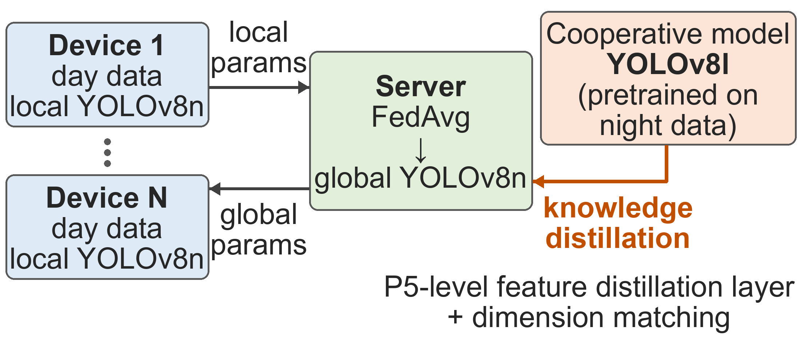
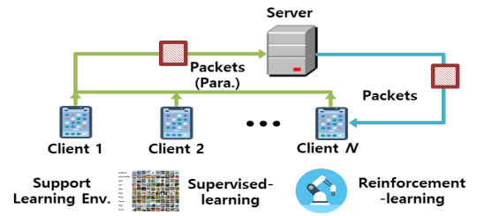
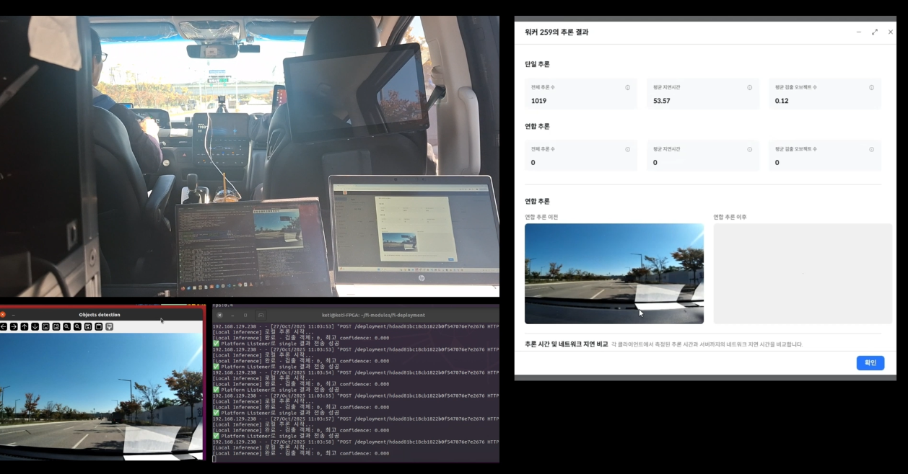

10
③ Systems Engineering — Federated Learning & Edge Deployment
[Federated Learning, Knowledge Distillation] Federated Edge Inference
Overview — Federated inference/learning framework across data-center and edge NPUs (neural processing units) · MSIT / IITP (Institute for Information & Communications Technology Planning & Evaluation), SW Computing Industry R&D (Apr. 2021 – Jun. 2025) · Delivered to Acryl Inc. (the consortium's industry partner) · Code released on GitHub at IITP's request
Role: Leader — problem definition, algorithm design, implementation, experiments, testbed
FL (federated learning) testbed built on the open-source Flower framework (right figure (a)) — The client side was extended with federated RL and per-client non-IID (non-independent, non-identically distributed) data composition; the learning-rate schedule, which Flower adjusts only per epoch, was made adjustable per round and set to cosine annealing; image-transform augmentation was added
  Result — The framework reproduces Google's FedAvg accuracy on CIFAR-10; the schedule and augmentation raise accuracy from 82% to 84%, and auxiliary open data (STL-10) to 86.1%; federated RL was verified on a 2D-navigation task
Cooperative federated learning with knowledge distillation (left figure) — A global YOLOv8n federated from the devices' daytime traffic-sign data generalizes poorly to night, and night data is assumed scarce on the devices. After each FedAvg aggregation, the server distills a cooperative large model (a YOLOv8l pretrained on night traffic-sign data) into the global YOLOv8n through a distillation layer on the backbone's P5-level features with a dimension-matching projection (the distillation layer was developed jointly with Acryl). Night images were synthesized with OpenCV in easy and hard modes from the daytime set that KETI (Korea Electronics Technology Institute) provided
  Result — Night-image accuracy reaches 80.1% (easy) and 36.6% (hard), 20 and 16 points above federated learning alone
Edge–server collaborative inference pipeline for real-time traffic sign recognition (2025; right figure (b): the partners' in-vehicle field test at Hwaseong, Gyeonggi) — The YOLO models and the inference system were deployed on Acryl's Jonathan server and the KETI NPU server
  The distilled YOLOv8n on the FPGA-based NPU (FPGA: field-programmable gate array) processes routine frames in real time. When a frame's confidence falls below 0.3 (e.g., at night or in rain), the next frame is forwarded to the server's YOLOv8l for federated inference, improving the detection of damaged or occluded signs on difficult frames
Cooperative Federated Learning with YOLO Models
NPU project: (a) embedded FL testbed · (b) in-vehicle field test

Slide 11
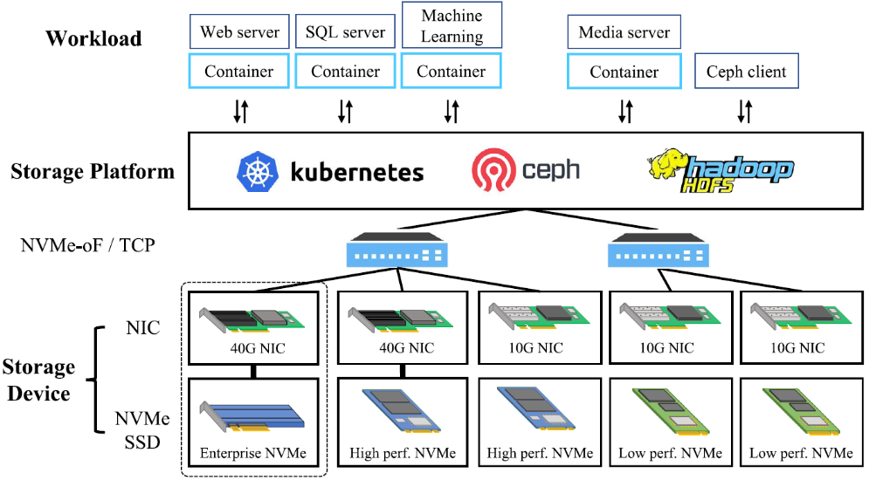
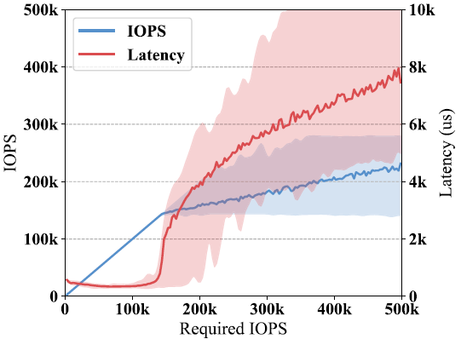
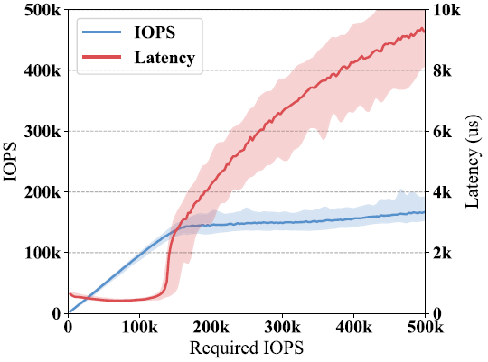
11
③ Systems Engineering — Pretraining Simulators & Surrogates
[Supervised Learning, Regression] NVMe-oF Storage Simulator with a DNN Surrogate
Overview — 2019–2021 · Samsung Electronics project (Aug. 2019 – Jul. 2022) · patents with Samsung: US 12,650,769 B2 (simulation), US 12,210,760 B2 (migration)
Role: Leader — problem definition, algorithm design, experiments
Purpose — To reproduce a disaggregated NVMe-oF (NVMe over Fabrics; here NVMe/TCP) cluster in software (NS-3-based) so that storage-management policies (RL policies included) can be tuned for mixed configurations of heterogeneous devices in a data center
Surrogate — FIO (flexible I/O tester) measures per-node serviced IOPS (I/O operations per second) and latency against required IOPS. A single DNN (deep neural network) surrogate spanning device specifications reproduces both responses (right figure: (a) measured vs. (b) estimated)
  Four configurations were profiled, from an RC500 SSD on 10 GbE to a Samsung PM1725a SSD on a 40 GbE NIC (network interface card). The surrogate takes a 15-bin histogram of the objects' required IOPS (1,000-IOPS bins) and is trained with an L-infinity loss on serviced IOPS and an L1 loss on latency, and its predicted responses are consistent with the FIO measurements
Configurable environment — Devices are organized under a storage platform that aggregates them in a two-level hierarchy, so that the environment is reconfigured from a system specification rather than rebuilt (left figure)
  A tier-level object-migration policy is evaluated across homogeneous and heterogeneous compositions of the measured devices under FIO-generated workloads (the scope covered by the migration-control patent)
(a) Measured performance pattern
(b) Estimated performance pattern
NVMe-oF disaggregated storage systems
A surrogate model example for NVMe-oF storage

Slide 12
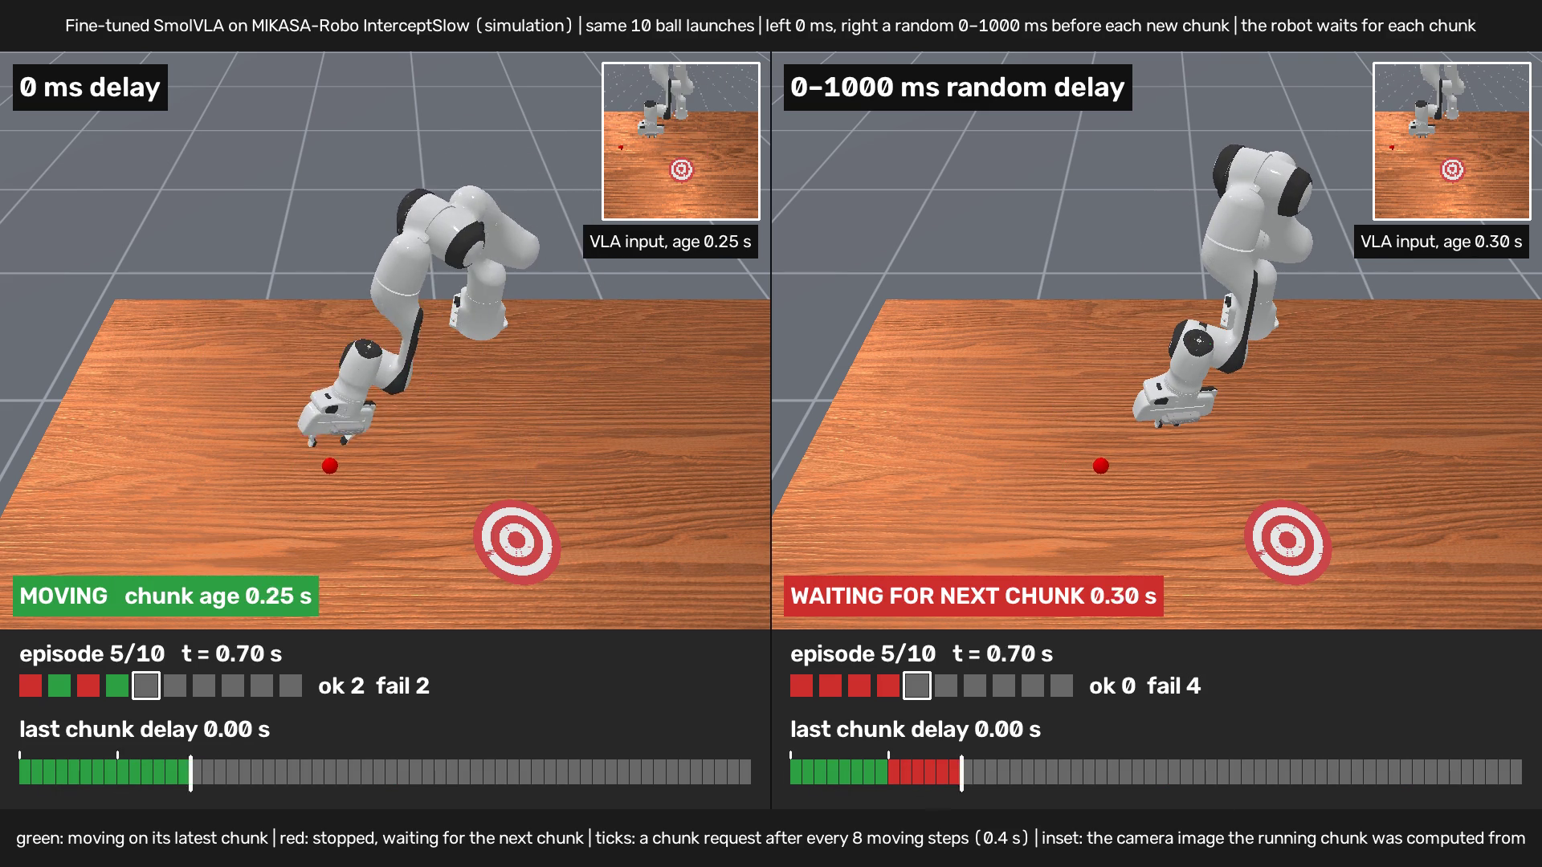
14
Ongoing Research
[RFM, VLA] Off-Board Robot Foundation Models — Serving Control Under Network Delay
Overview — Ongoing research (2026 – present) · follow-on to XferQoE · Collaborative-Intelligence Physical-AI SW-Platform project (MSIT / NIPA, Aug. 2026 – Dec. 2030, researcher)
Role: Leader — problem definition, experiments (research direction, experiment design, and analysis)
Target system — A robot foundation model (RFM) that a home or service robot cannot run at the control rate on board is served from an edge or cloud server. The observation uplink, the inference budget, and the action downlink then enter the control loop, and an action-chunking policy (π0.5 or SmolVLA, chunk length 50) executes several steps from one observation while the scene changes
Evidence (measured; rates in table) — Delay costs success or time: on static tabletop tasks, asynchronous execution (switching to the new chunk, no correction) lost success at 500 ms; synchronous execution (waiting for the new chunk) kept success but cut task throughput (successes per minute) by 35%. On a moving-ball task, both lost success and synchronous fell to 1.0% at 500 ms. Variable delay redrawn after the first chunk (uniform 0–500 or 0–1000 ms) kept the ordering of the two modes and did not differ significantly from fixed delay of equal mean
Prior work — On the policy side, real-time chunking (RTC, NeurIPS 2025), REMAC (ICLR 2026), and Legato (RSS 2026) correct asynchronous chunk execution for inference delay; on the network side, ComVLA (GLOBECOM 2026) fits the visual-token budget of a VLA (vision-language-action model) to the channel capacity and treats transmission delay as negligible. The runs above use neither correction nor token control
Proposed work — Extend XferQoE to the RFM serving path: ① pretrain an RL serving controller in S-Sim on QoS components that do not depend on the RFM, transfer it to the real link through the same three network environments as on page 6, and adapt it to the served RFM by refitting only its objective weights to the robot's task outcomes; upstream of the remote RFM it reads the link state (bandwidth, jitter, queue) and jointly sets observation size, inference budget, and request interval; ② train a lightweight module on the frozen RFM, supervised or by RL, to report each chunk's valid length (actions still usable under delay) and uncertainty, to be adapted alongside the controller. A possible extension is to fine-tune the RFM itself with policy-gradient RL (e.g., RLOO or GRPO) on task-success rewards gathered under network delay
Success rate without correction (LIBERO 100 · MIKASA 200 episodes)
Task and execution | No delay | 250 ms fixed | 0–500 ms variable | 500 ms fixed | 0–1000 ms variable
Static tabletop (LIBERO) · async | 97% | 89% | 88% | 80%* | 88%
Static tabletop (LIBERO) · sync | 97% | 97% | 96% | 93% | 97%
Moving ball (MIKASA) · async | 55.5% | 41.0%* | 45.5% | 32.0%* | 38.0%*
Moving ball (MIKASA) · sync | 55.5% | 7.5%* | 10.5%* | 1.0%* | 3.0%*
Moving ball: 0 ms vs. 0–1000 ms delay, sync
sonny0714.github.io/demo_video_robot/moving-ball-delay.html
* p < 0.01 vs. no delay, paired McNemar test · variable = uniform random delay, redrawn per request · LIBERO: π0.5, replan every 20 steps · MIKASA: fine-tuned SmolVLA, replan every 8 steps

Slide 13
15
Summary and Contact
Contact — Youngseok Lee · yslee.gs@gmail.com · scholar.google.com/citations?user=GhwtxtgAAAAJ
① Reinforcement Learning — RL policies for resource management and cloud robotics: a meta-RL rate controller and a bandwidth-allocation policy that transfer to new objectives and environments with little or no retraining (XferQoE · Repot), and a SAC dispatch policy for V2G fleets (AgentV2G)
② Agentic AI — AgentV2G uses LLM agents to turn market rules into solver-ready objectives and constraints for V2G operation, with a SAC policy for real-time dispatch; LDuS uses an LLM to turn user requirements into executable loss-function code and validate code and trajectories in a feedback loop for skill adaptation
③ Systems Engineering — Both approaches are implemented and validated on purpose-built simulators, surrogate models, and testbeds; five systems built with the same engineering were delivered to Samsung Electronics ×2, Polaris AI, Acryl, and ADD
Selected publications and patents (links)
Type | Title | Venue · Registration | Link
Paper · top-tier | XferQoE: QoS-to-QoE transfer for adaptive rate control | IEEE INFOCOM 2027 · first author under review | —
Paper · top-tier | LLM-based skill diffusion for zero-shot policy adaptation (LDuS) | NeurIPS 2024 Main Conference Track · second author | NeurIPS
Paper · SCIE | Repot: Transferable reinforcement learning for quality-centric networked monitoring in various environments | IEEE Access, vol. 9, 2021 · first author | DOI
Paper · SCIE | Gemma: Reinforcement learning-based graph embedding and mapping for virtual network applications | IEEE Access, vol. 9, 2021 · second author | DOI
Paper · SCIE | Continual prediction of bug-fix time using deep learning-based activity stream embedding (DASENet) | IEEE Access, vol. 8, 2020 · first author 33 citations | DOI
Patent · first inventor | Graph Embedding-Based Virtual Network Mapping Method | KR 10-2629731 (2024) US 12,047,250 B2 (2024) | KR · US
Patent · first inventor | Network Monitoring System | KR 10-2574070 (2023) US 12,556,492 B2 (2026) | KR · US
Patent · with Samsung | Object Storage System, Migration Control Device, and Migration Control Method | US 12,210,760 B2 (2025) | US
Patent · with Samsung | Simulation Method and Modeling Method | US 12,650,769 B2 (2026) | USPTO
Patent · with Samsung | Electronic Apparatus, System for Internet-of-Things Environment and Control Method Thereof | US 10,742,742 B2 (2020) | US

