Slide 1
ppLayoutTitle
Text(2)
  For ppLayoutTitle

Slide 2
ppLayoutText
Text(2)
  For ppLayoutText

Slide 3
ppLayoutTwoColumnText
Text(2)
  For ppLayoutTwoColumnText
Text(3)
  For ppLayoutTwoColumnText

Slide 4
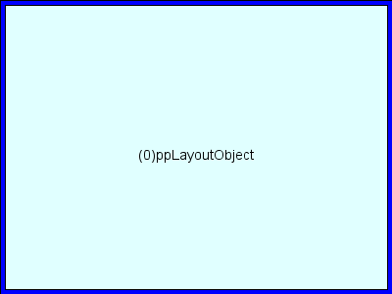
ppLayoutObject

Slide 5
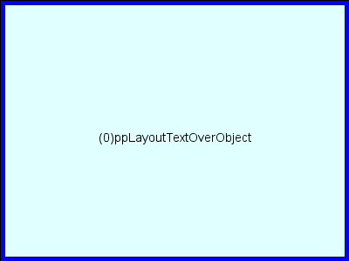
ppLayoutTextOverObject
Text(2)
  For ppLayoutTextOverObject

Slide 6
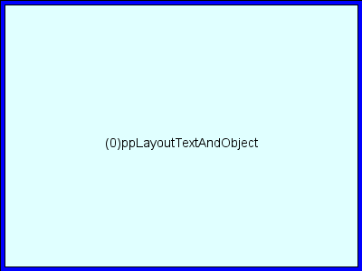
ppLayoutTextAndObject
Text(2)
  For ppLayoutTextAndObject

Slide 7
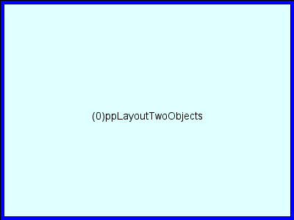
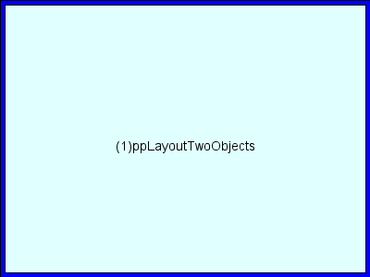
ppLayoutTwoObjects

Slide 8

ppLayoutObjectAndText
Text(3)
  For ppLayoutObjectAndText

Slide 9
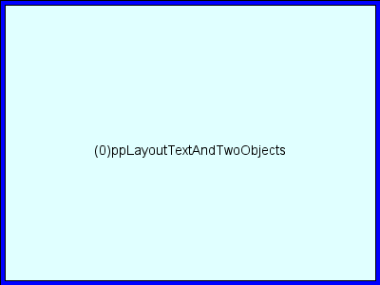
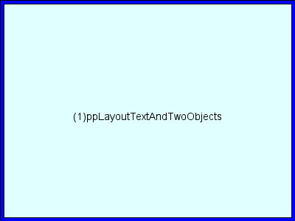
ppLayoutTextAndTwoObjects
Text(2)
  For ppLayoutTextAndTwoObjects

Slide 10
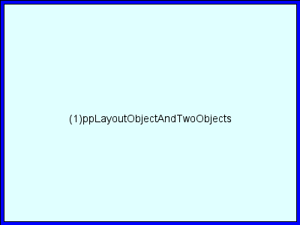
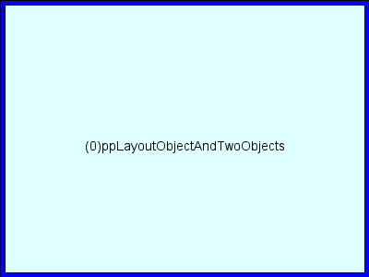
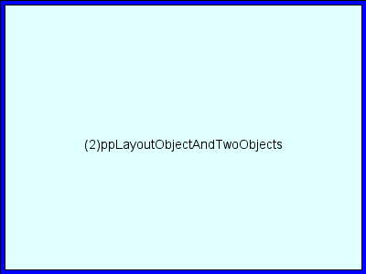
ppLayoutObjectAndTwoObjects

Slide 11
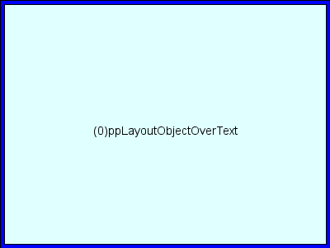
ppLayoutObjectOverText
Text(3)
  For ppLayoutObjectOverText

Slide 12

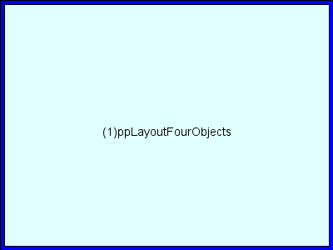
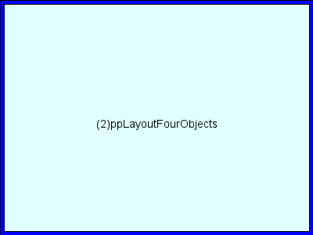

ppLayoutFourObjects

Slide 13
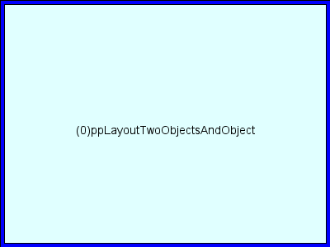

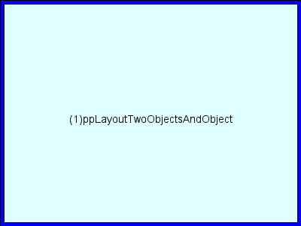
ppLayoutTwoObjectsAndObject

Slide 14
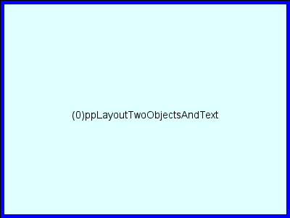
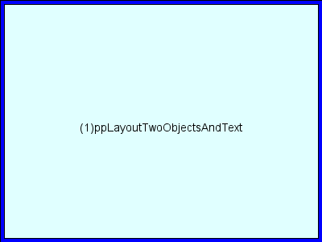
ppLayoutTwoObjectsAndText
Text(4)
  For ppLayoutTwoObjectsAndText

Slide 15
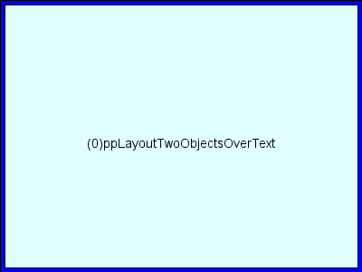
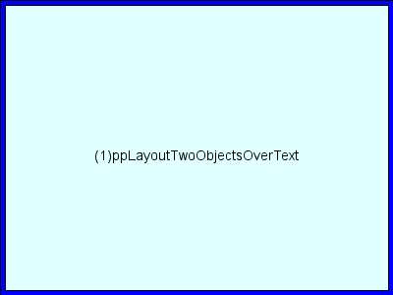
ppLayoutTwoObjectsOverText
Text(4)
  For ppLayoutTwoObjectsOverText

Slide 16
ppLayoutTable

