Slide 1
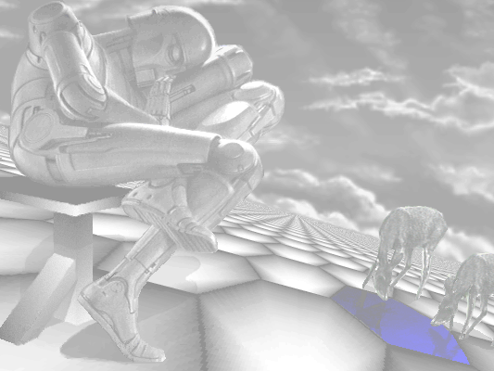
The Foundation Series
Isaac Asimov

Slide 2
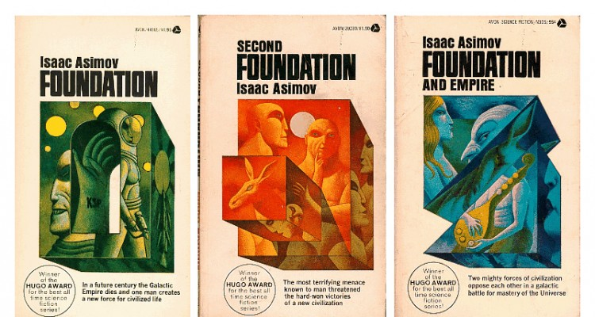
"Best All-Time Series" in 1966
Psychohistory
  Hari Seldon's Invention
R. Daneel Olivaw
  Humanity's Protector

Slide 3
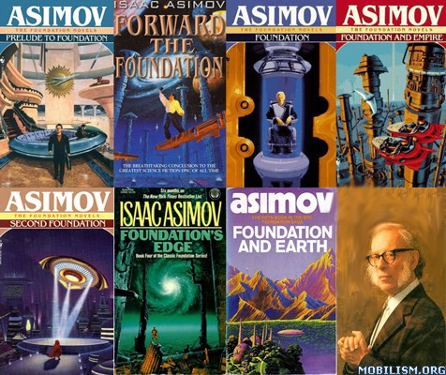
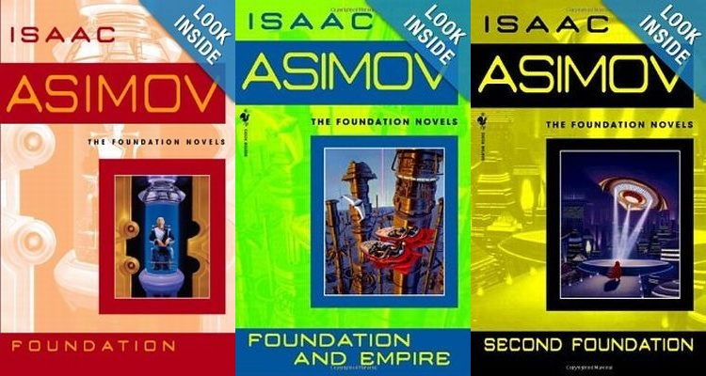
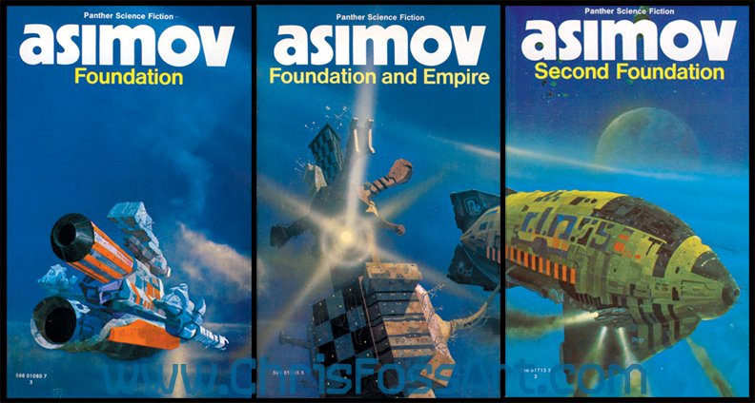
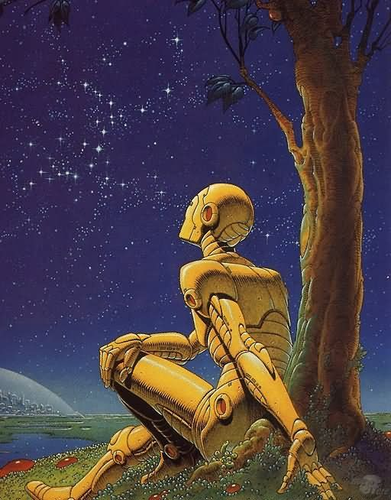
Two Prequels, Two Sequels, Many Reprints

