Slide 1
Sample Optimization
Cardboard Box
ParametricSoln v0.2.1
by: Charlie Taylor
March 06, 2023

Slide 2
PRIOR TO MAXIMIZE OPTIMIZATION
ParametricSoln: Cardboard Box
====================== OPTIMIZATION DESIGN VARIABLES =======================
name value minimum maximum
L 12 1 20 Length of Cardboard (in)
h 4 1 6 Height of Box (in)
Figure of Merit: Box Volume (Volume) = 64 cuin <== Maximize
========================== OPTIMIZATION CONSTRAINTS =========================
name value minimum maximum
sysMass 0.2 0 0.5 Box Mass
============================================================================

Slide 3
AFTER MAXIMIZE OPTIMIZATION
ParametricSoln: Cardboard Box
====================== OPTIMIZATION DESIGN VARIABLES =======================
name value minimum maximum
L 19.6667 1 20 Length of Cardboard (in)
h 3 1 6 Height of Box (in)
Figure of Merit: Box Volume (Volume) = 246 cuin <== Maximize
========================== OPTIMIZATION CONSTRAINTS =========================
name value minimum maximum
sysMass 0.5 0 0.5 Box Mass
============================================================================

Slide 4
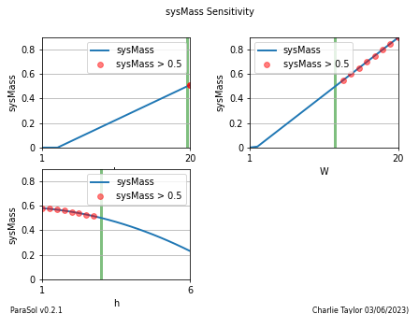
Sensitivity Plot

Slide 5
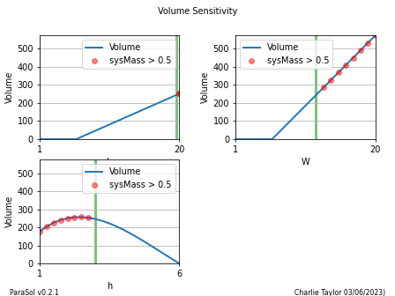
Sensitivity Plot

Slide 6
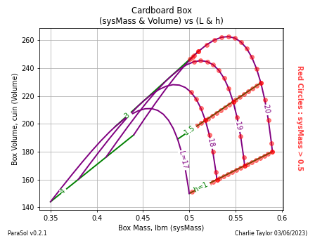
Box Volume, cuin (Volume)

Slide 7
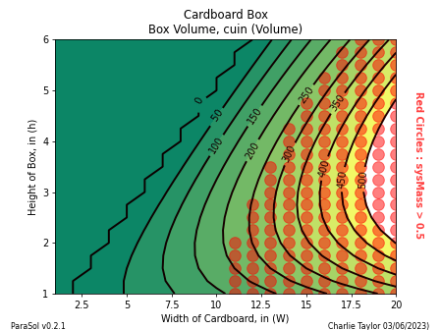
Box Volume, cuin (Volume)

Slide 8
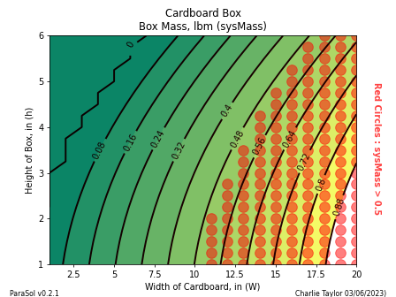
Box Mass, lbm (sysMass)

Slide 9
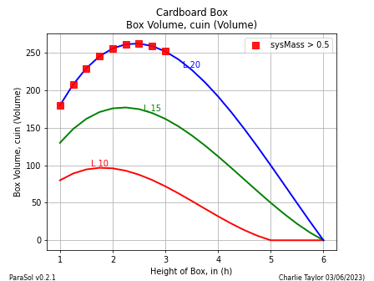
Box Volume, cuin (Volume)

Slide 10
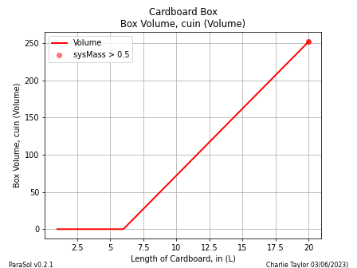
Box Volume, cuin (Volume)

