Slide 1
DATA SCIENCE
MINI PROJECT
Made by-
DATA WHISPERERS
M.Adithya Vardhan
Prithvi.V
Daksha Singhal

Slide 2
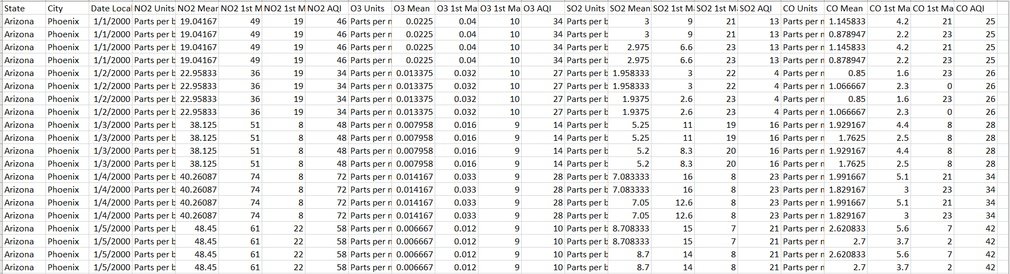
ABOUT OUR DATA
The data set is based on the study of air pollution of Phoenix City in Arizona State from the year 2000 to 2008.
The dataset has 11030 columns and 25 rows

Slide 3
TYPE OF DATA
TEXT
State
City
Unit of measurement of 4 gases
NUMERIC
Mean
AQI
1st Max Value
1st Max Hour
DATE/TIME
Local Date

Slide 4





DATA CLEANING

Slide 5
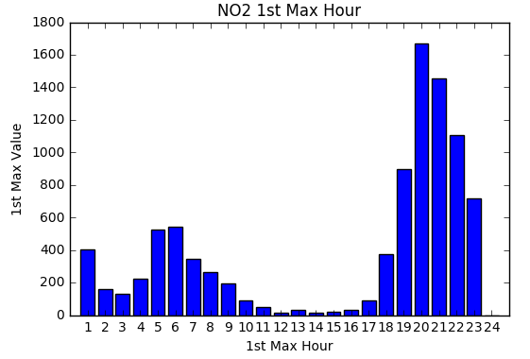
Bar Graph
During Night time
Mode is 1650
Mean is 1000
During Day time

Slide 6
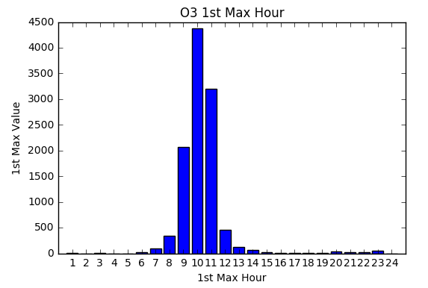
Bar Graph
Mode is 4500
Mean is 3000

Slide 7
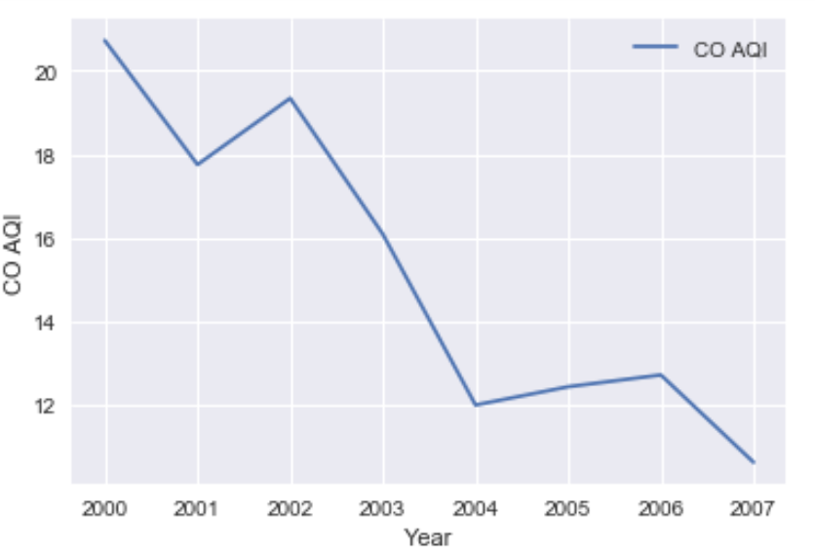
Line Graph
32% decreases
Notes:
CO
Over the past decade, the U.S. has decreased annual carbon dioxide emissions by nearly 800 million tons.
This is by far the most of any country in the world, and is primarily a result of shifting coal-fired power to natural gas and renewables
Coal’s contribution to total electricity generation decreased from 50% to 30%;
• Natural gas’s contribution to total electricity generation increased from 19% to 34%

Slide 8
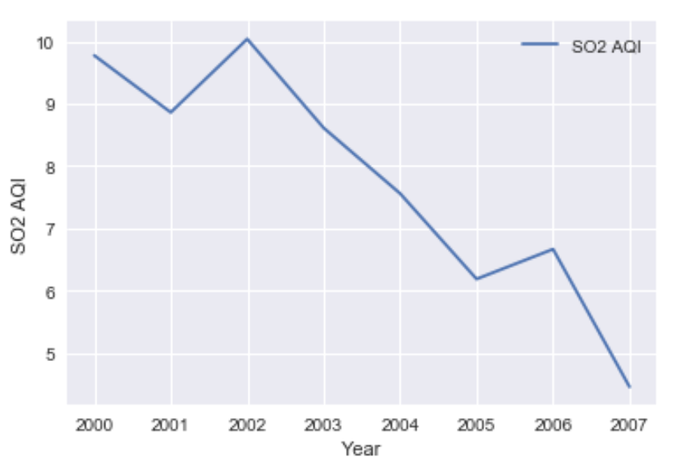
Line Graph
38% decreased

Slide 9
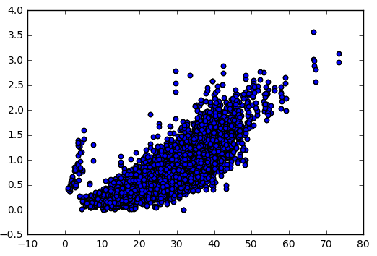
SCATTER PLOT
From the graph we concluded, that the source of the emission of
Carbon monoxide and
Nitrogen dioxide is the same.
CO Mean
NO2 Mean

Slide 10
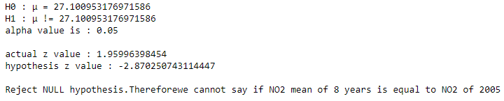


HYPOTHESIS TESTING
We wanted to check if the mean of the emission in the year 2005
Was equal to the 27.1
Therefore, We took a double ended tail Hypothesis.
The Alternate Hypothesis or the $H_{1}$ != The mean of ${NO}_{2}$ emission is not equal to 27.1.
The null Hypothesis or the $H_{1}$=The mean of ${NO}_{2}$ emission is equal to 27.1.
The alpha value is taken as 0.05.

Slide 11
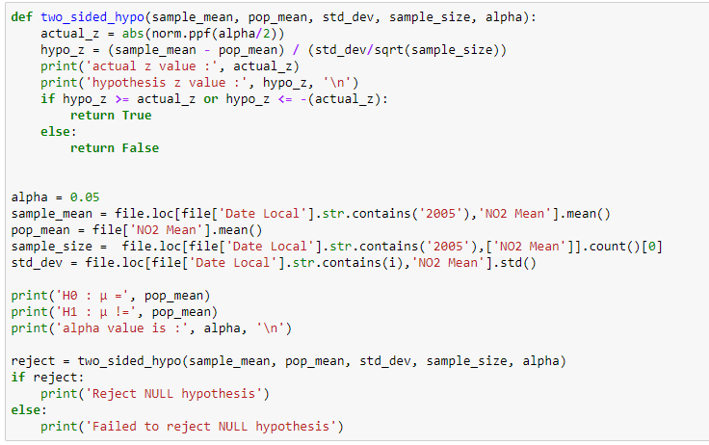
HYPOTHESIS TESTING

Slide 12
THANK YOU

