Slide 1
Fraud & Anomaly Detection
Cause-first framework using real data, no synthetic labels.

Slide 2
Cause-First Hypothesis
Three root-cause branches before modeling.
Account takeover / identity compromise
Unauthorized transfer / capital outflow
AML network / mule-account pattern

Slide 3
Framework
4 phases, 11 steps: foundation -> EDA/labels -> ML/matrix -> dashboard/xAI.
Phase 1: clean data, four baseline groups, Customer 360 rolling 30/60/90 days
Phase 2: strategic EDA, IQR thresholding, dynamic root-cause rules, weak labels
Phase 3: RandomForest prevention model and Rule + ML action matrix
Phase 4: dashboard, protected amount, SHAP xAI and natural-language reason codes

Slide 4
Data Insights
EDA is now driven by risk lift, heatmaps, and interaction charts.
Root-cause x hybrid-decision heatmap
IQR breach lift versus normal baseline
Time, network and Customer 360 risk maps

Slide 5
Key Metrics
1,418,030 transactions scored; 109,155 High/Critical.
Prevention coverage vs weak labels: 100.0%
False-positive rate at high threshold: 0.00%
Confusion matrix and protected amount are reported for business impact, not only model accuracy.

Slide 6
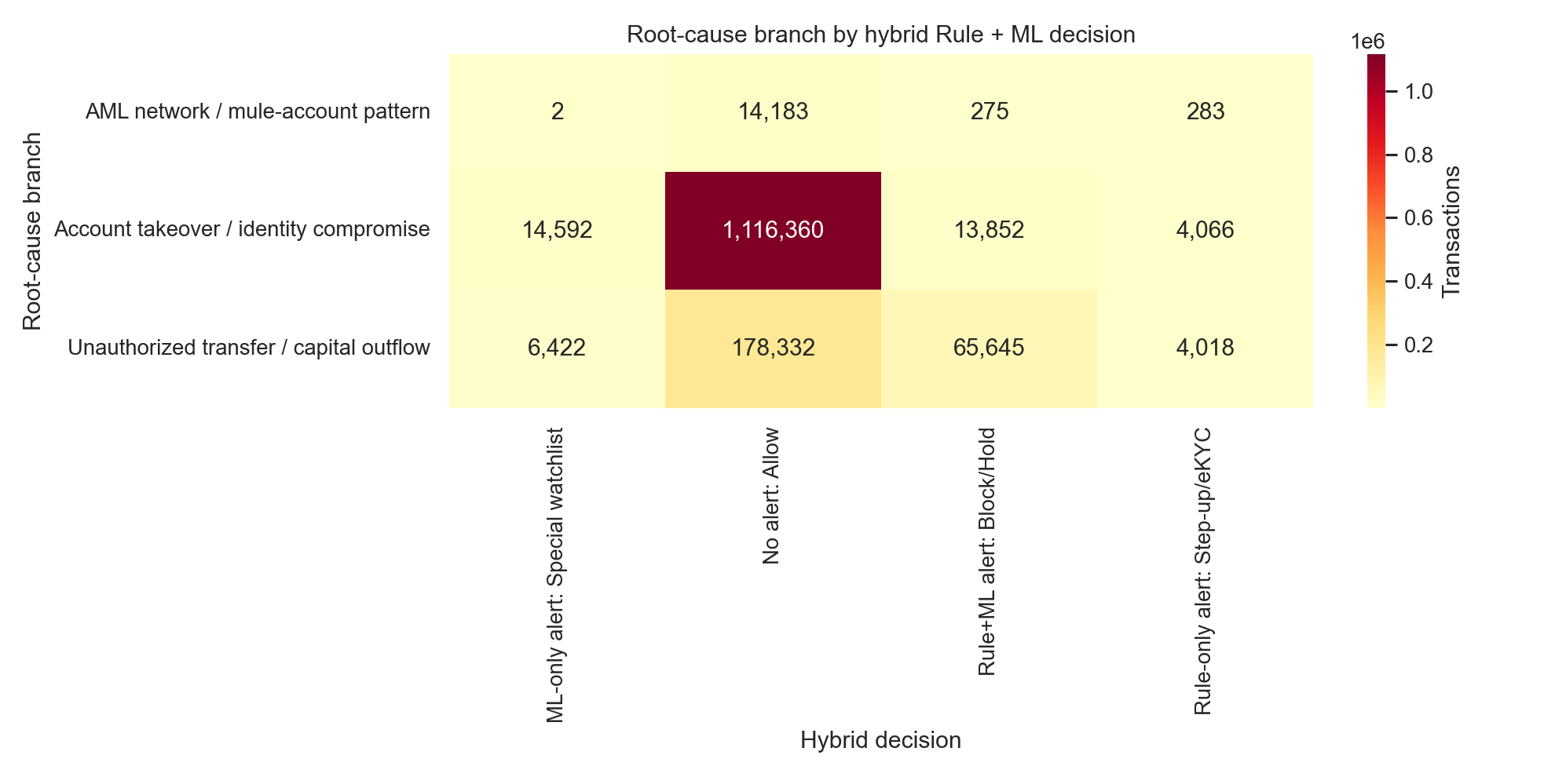
Root-Cause x Hybrid Matrix

Slide 7
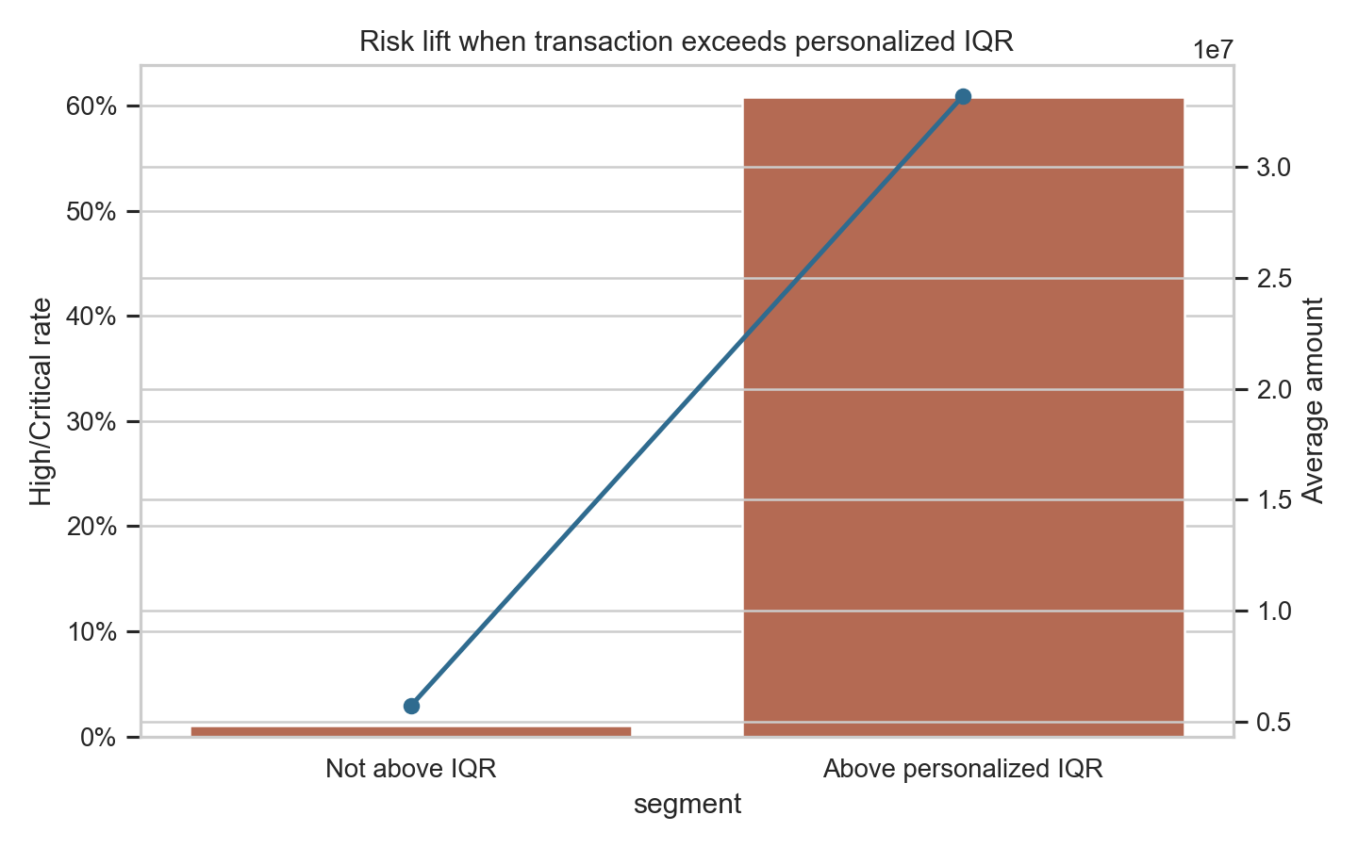
IQR Breach Lift

Slide 8
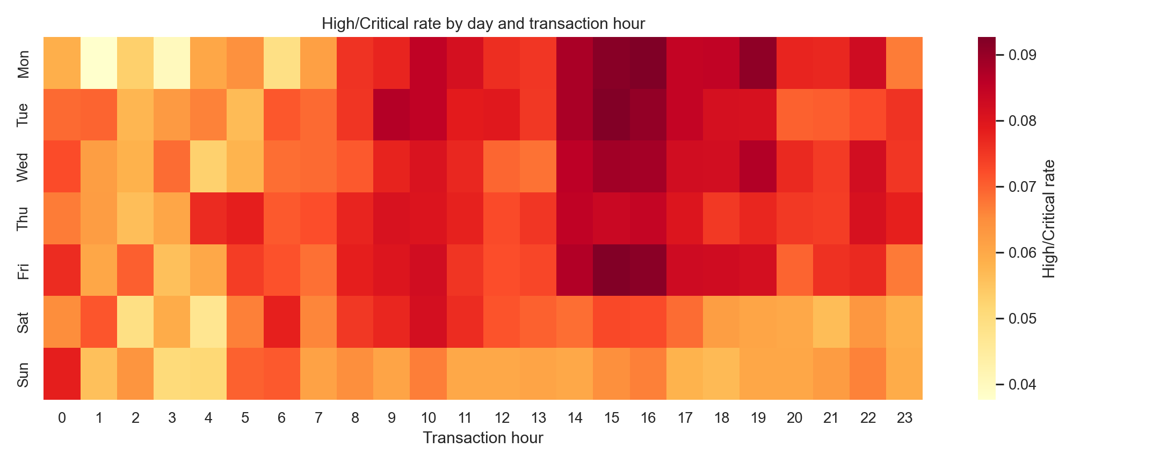
Time Risk Heatmap

Slide 9
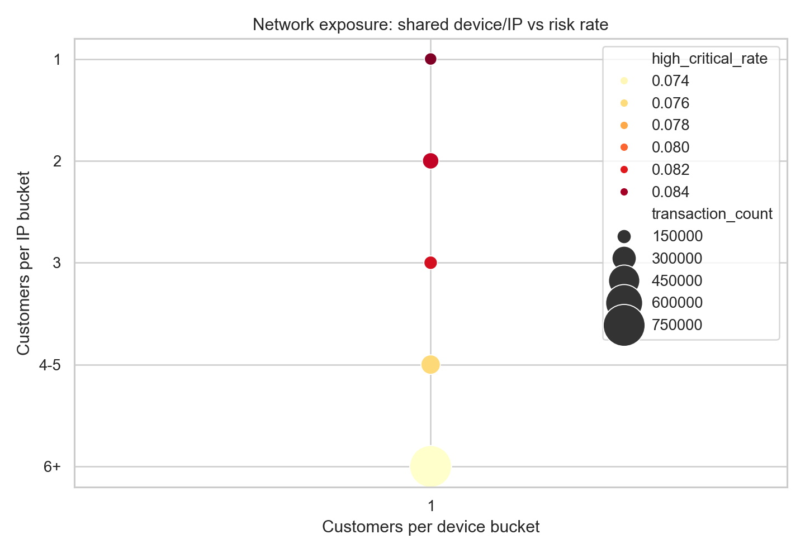
Network Exposure

Slide 10
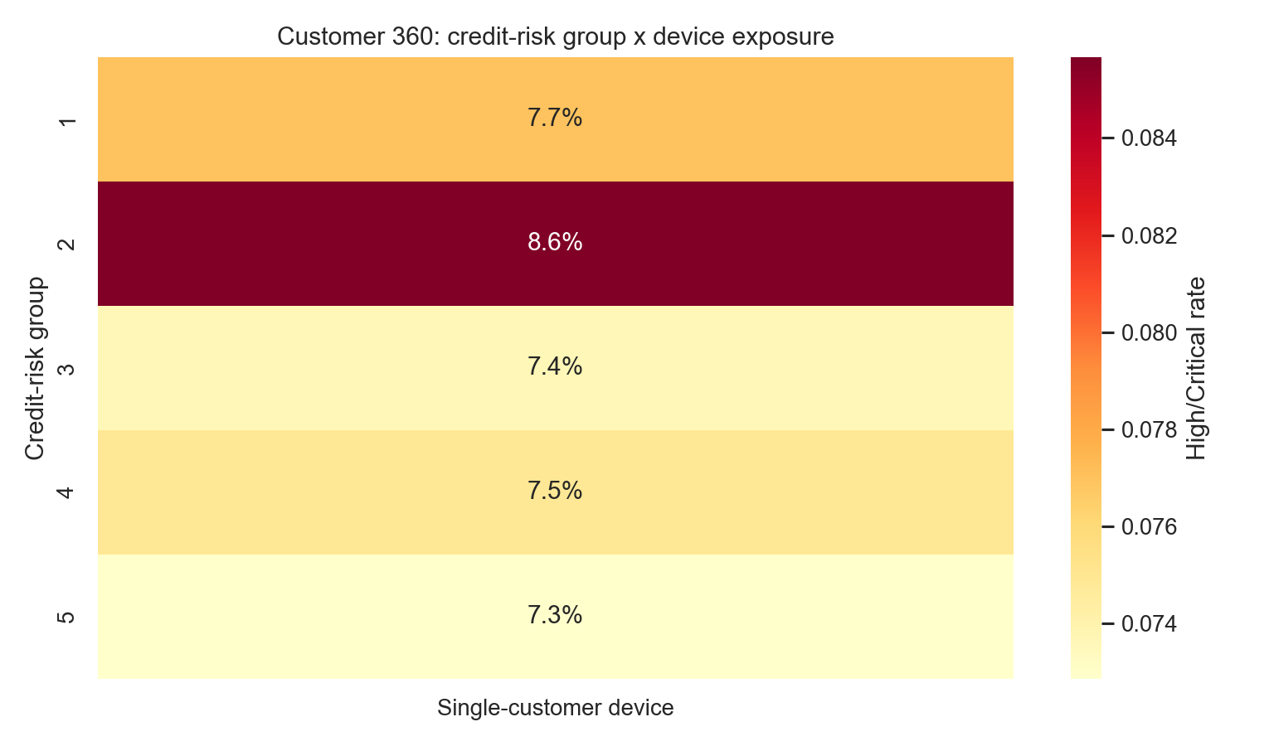
Customer 360 Risk Map

Slide 11
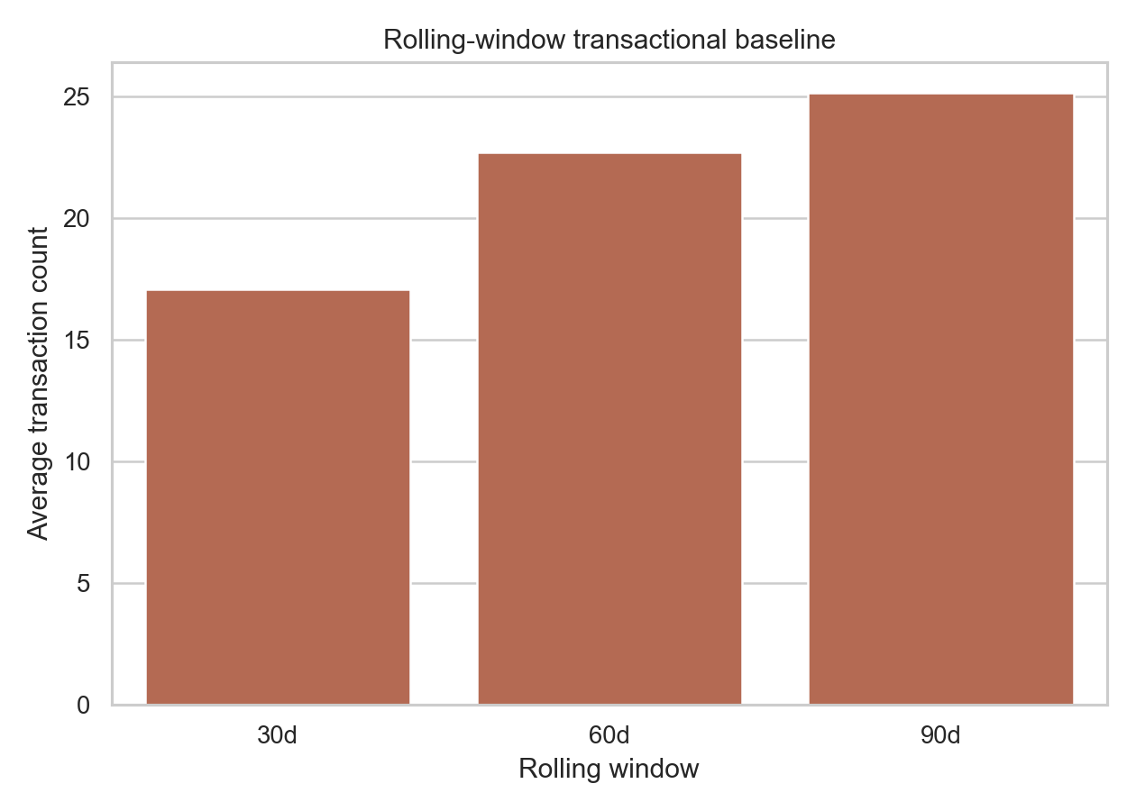
Customer 360 Rolling Baseline

Slide 12
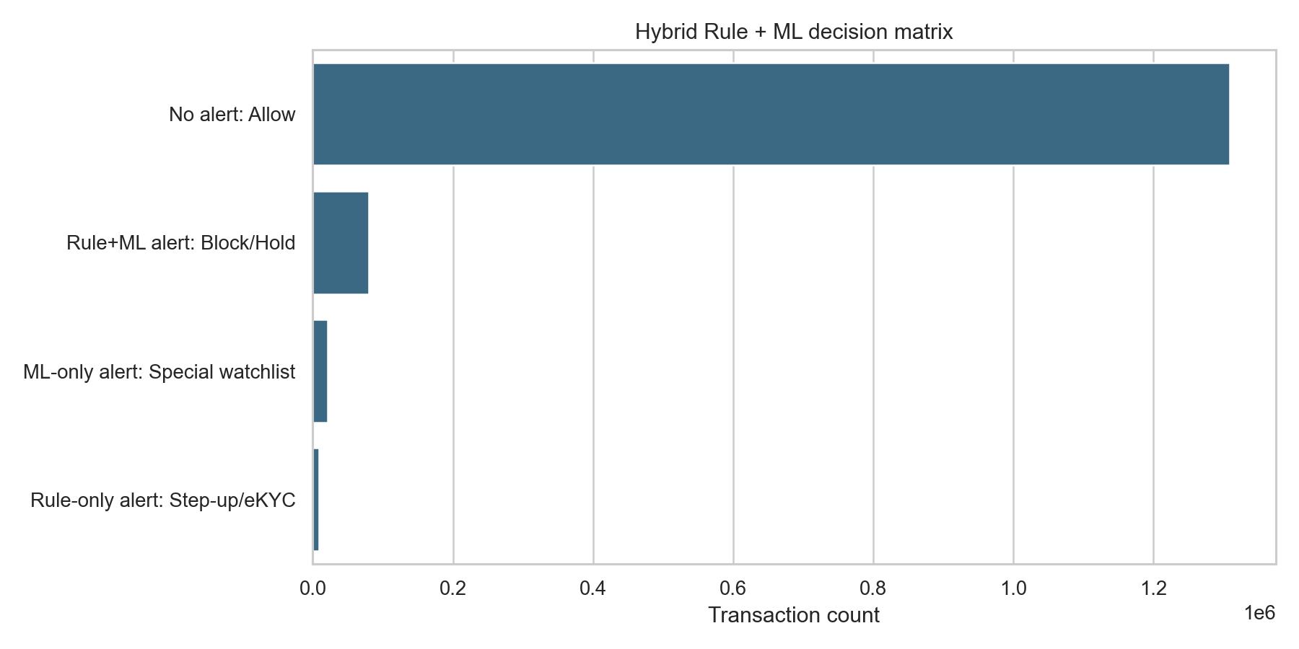
Hybrid Decision Matrix

Slide 13
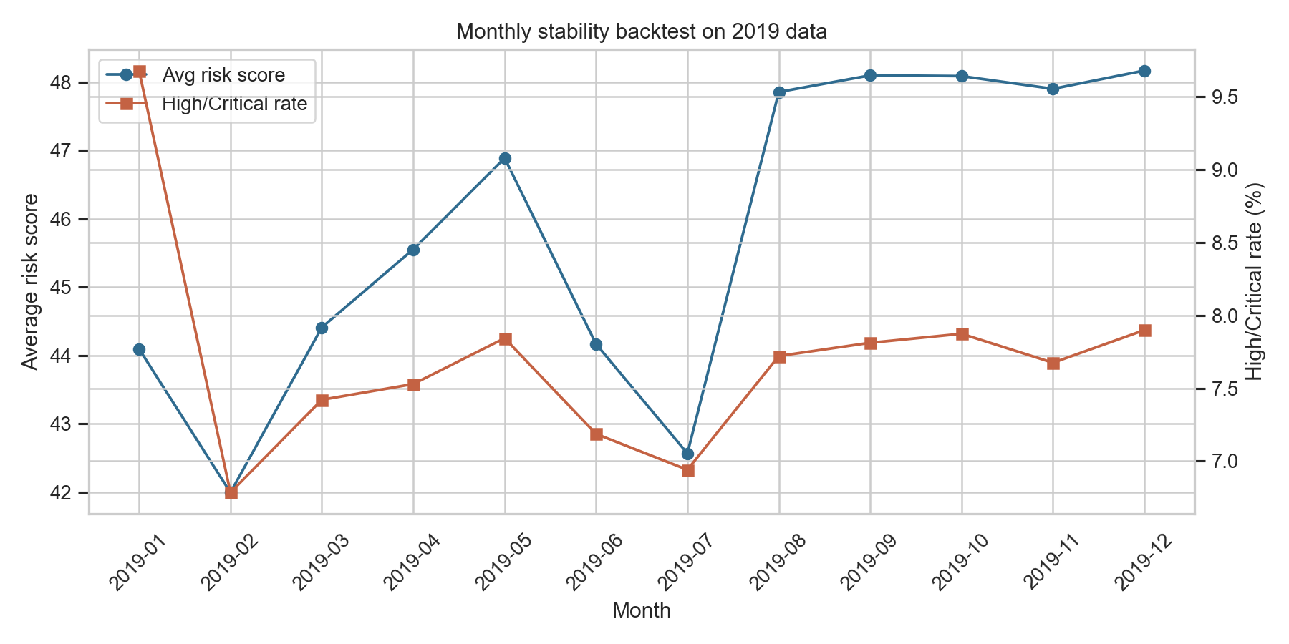
Temporal Stability

Slide 14
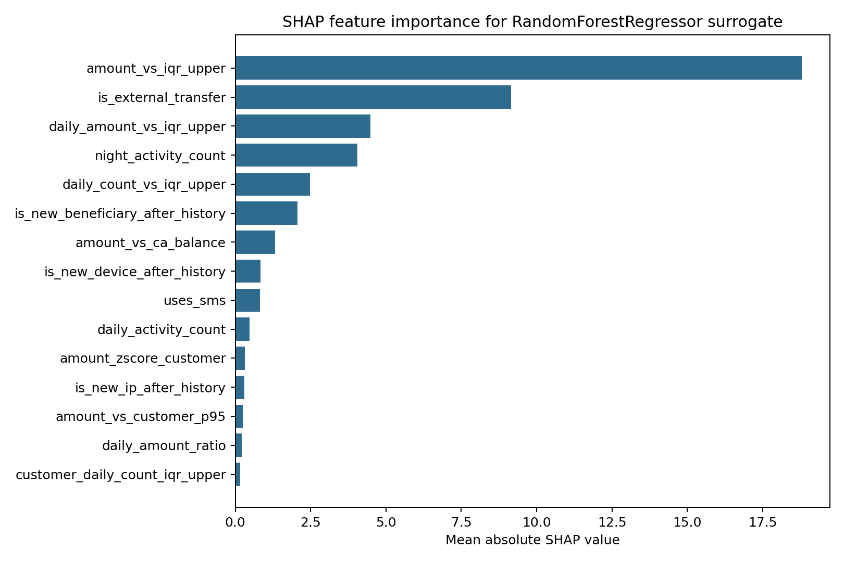
SHAP Explainability

