Slide 1
ActiveMQ Master/Slave Cluster
Broker Name | Home Path | Openwire Port | Web Port | Data Path
broker-1 | ..\master_slave\broker-1 | 61816 | 8861 | ..\data
broker-2 | ..\master_slave\broker-2 | 61826 | 8862 | ..\data

Slide 2
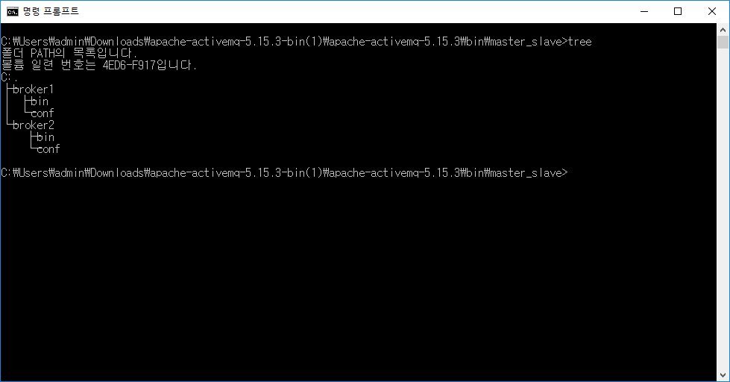

Slide 3
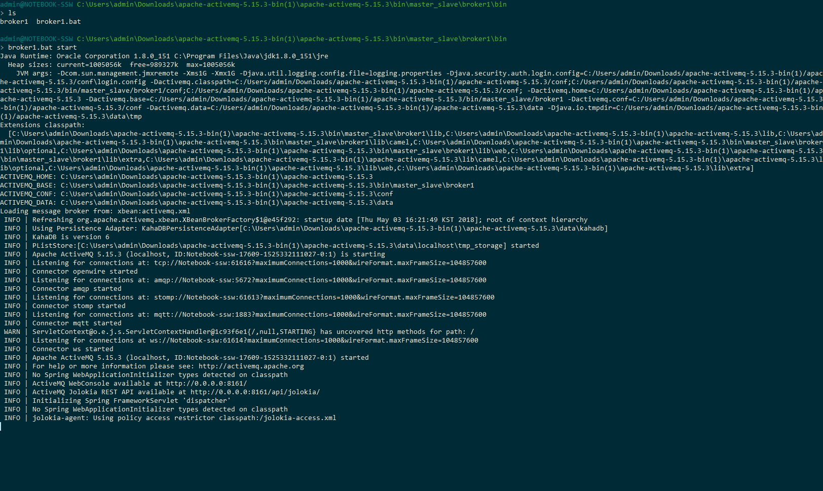
Master : openwire port = 61816), web console port =8861

Slide 4
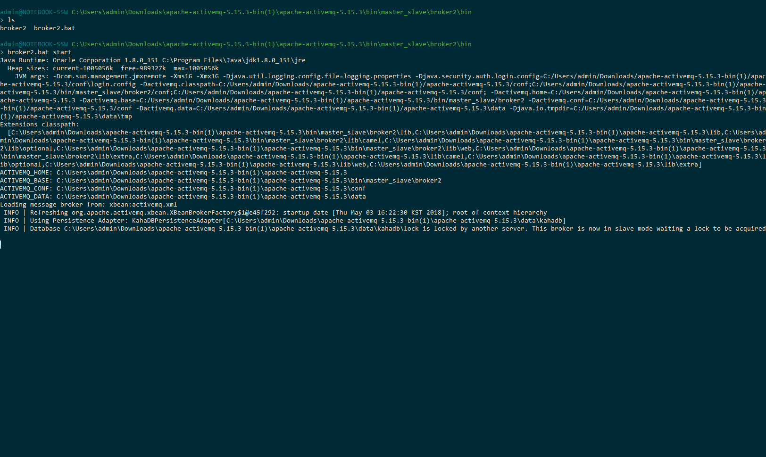
Slave : openwire port = 61826, web console port = 8862

Slide 5
ActiveMQ Static Network Cluster
Broker Name | Home Path | Openwire Port (activemq.xml) | Web Port (jetty.xml) | Data Path (broker-*.bat)
broker-1 | ..\static\broker-1 | 61816 | 8861 | ..\data
broker-2 | ..\static\broker-2 | 61826 | 8862 | ..\data
broker-3 | ..\static\broker-3 | 61516 | 5161 | \broker-3\data

Slide 6
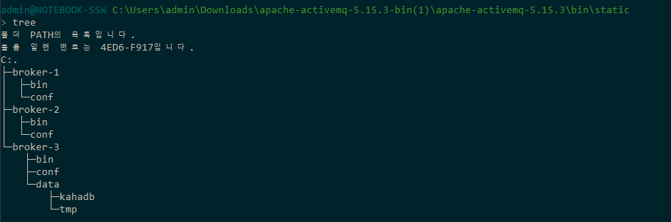

Slide 7
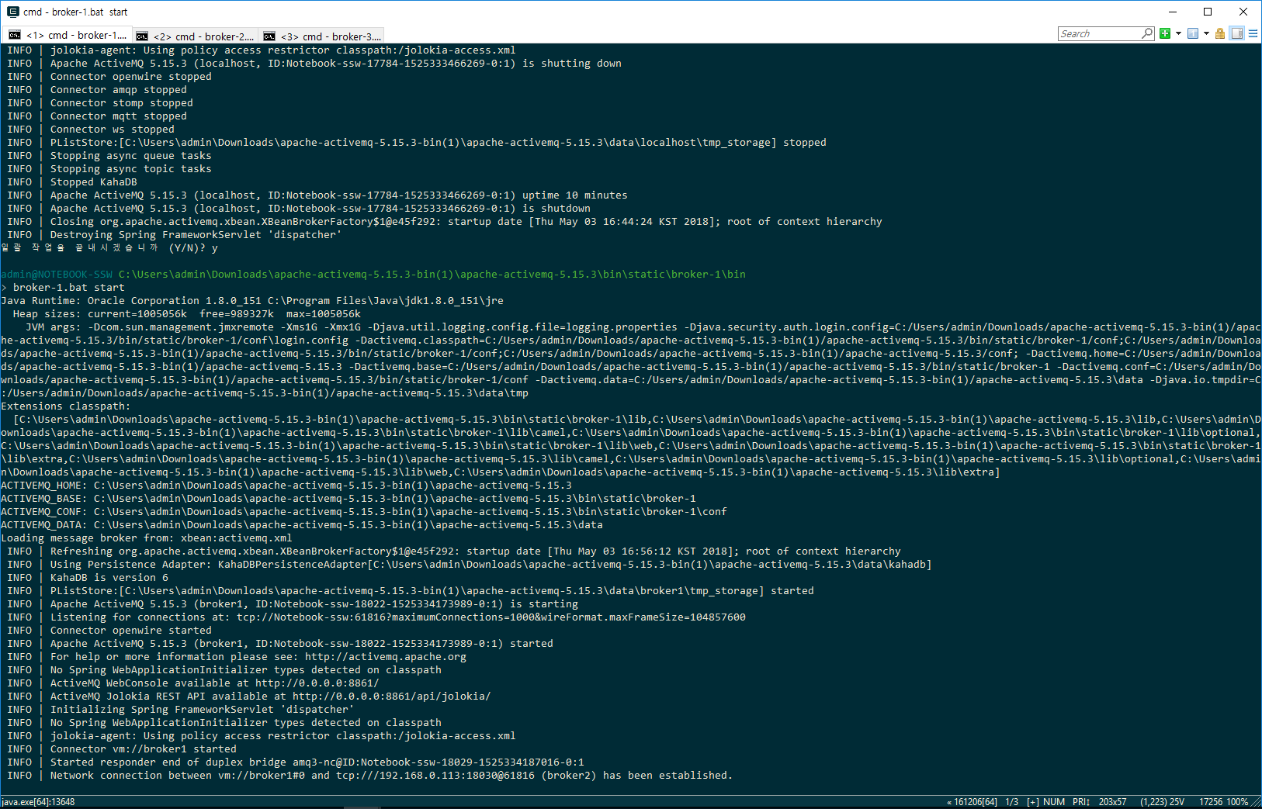
Broker-1 : openwire port = 61816, web console port =8861

Slide 8
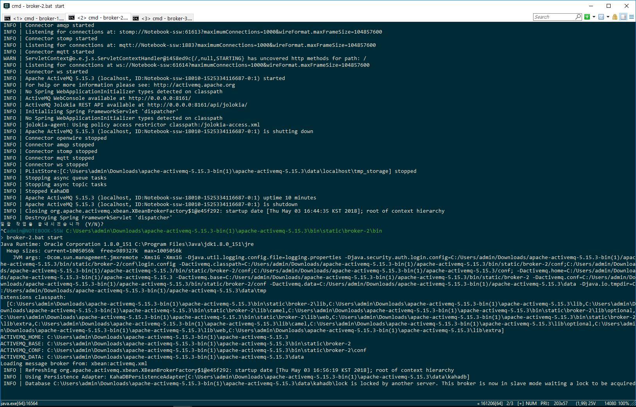
Broker-2 : openwire port = 61826, web console port =8862

Slide 9
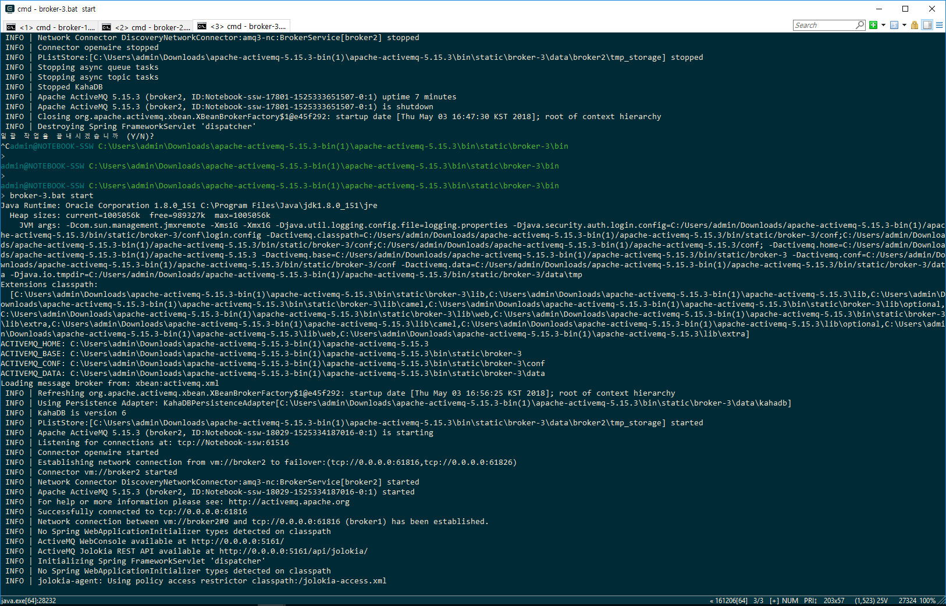
Broker-3 : openwire port = 61826, web console port =8862

Slide 10
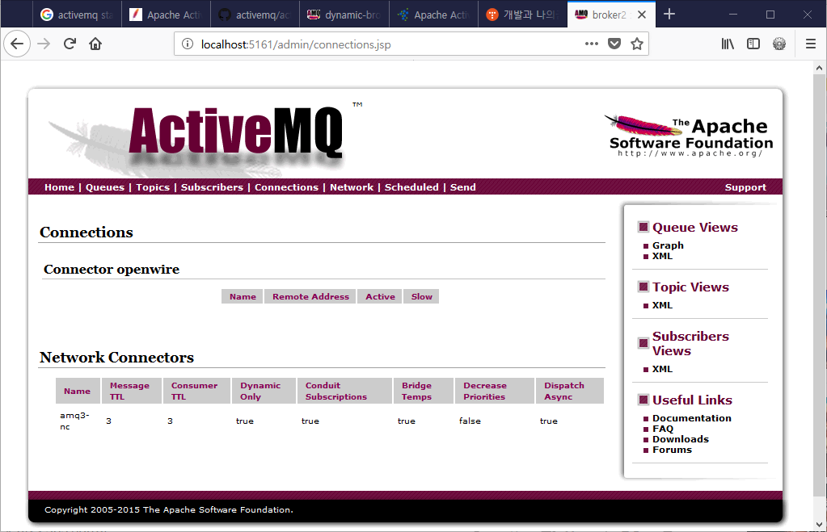

Slide 11
ActiveMQ Dynamic Network Cluster
Broker Name | Home Path | Openwire Port (activemq.xml) | Web Port (jetty.xml) | Data Path (broker-*.bat)
broker-1 | ..\cluster\dynamic-broker-1 | 61626 | 8163 | \broker-1\data
broker-2 | ..\cluster\dynamic-broker-2 | 61636 | 8164 | \broker-2\data
broker-3 | ..\cluster\dynamic-broker-3 | 61646 | 8165 | \broker-3\data

Slide 12
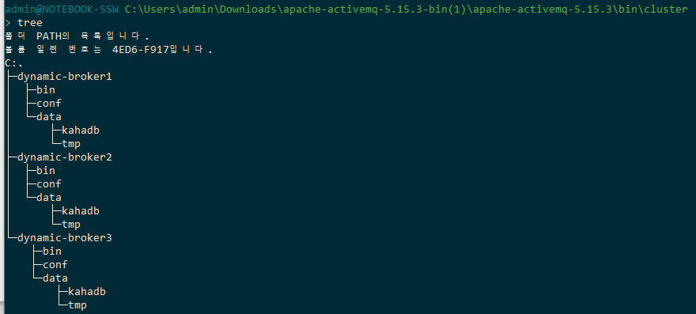

Slide 13
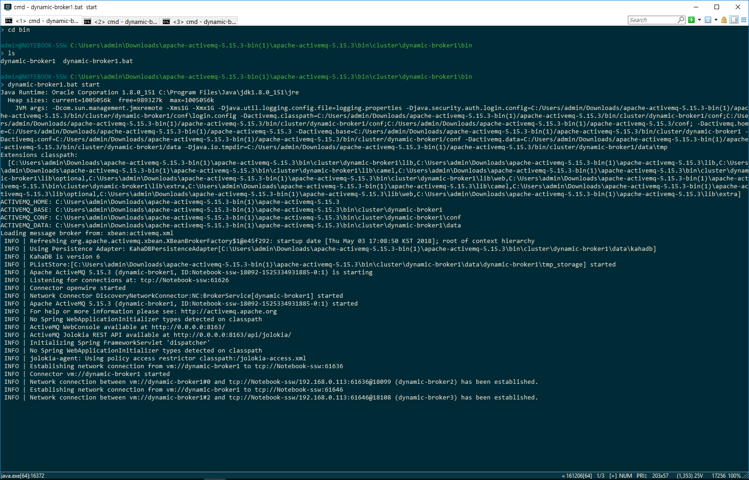
Broker-1 : openwire port = 61626, web console port =8163

Slide 14
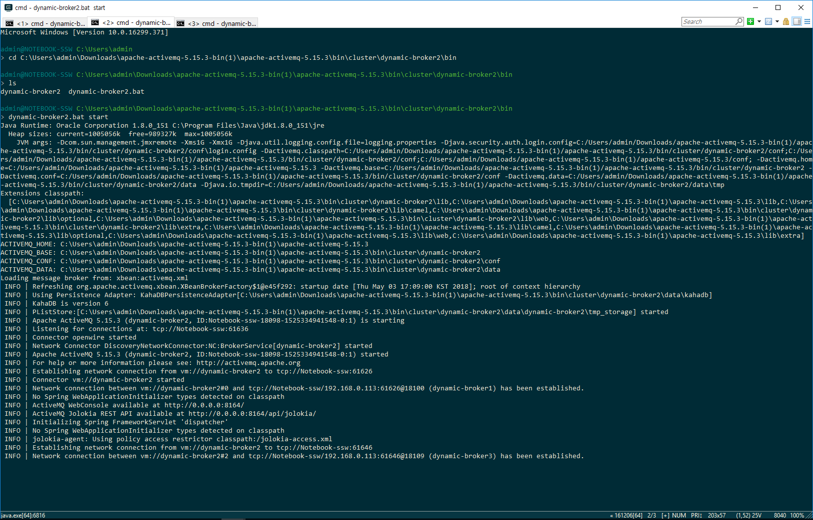
Broker-2 : openwire port = 61636, web console port = 8164

Slide 15
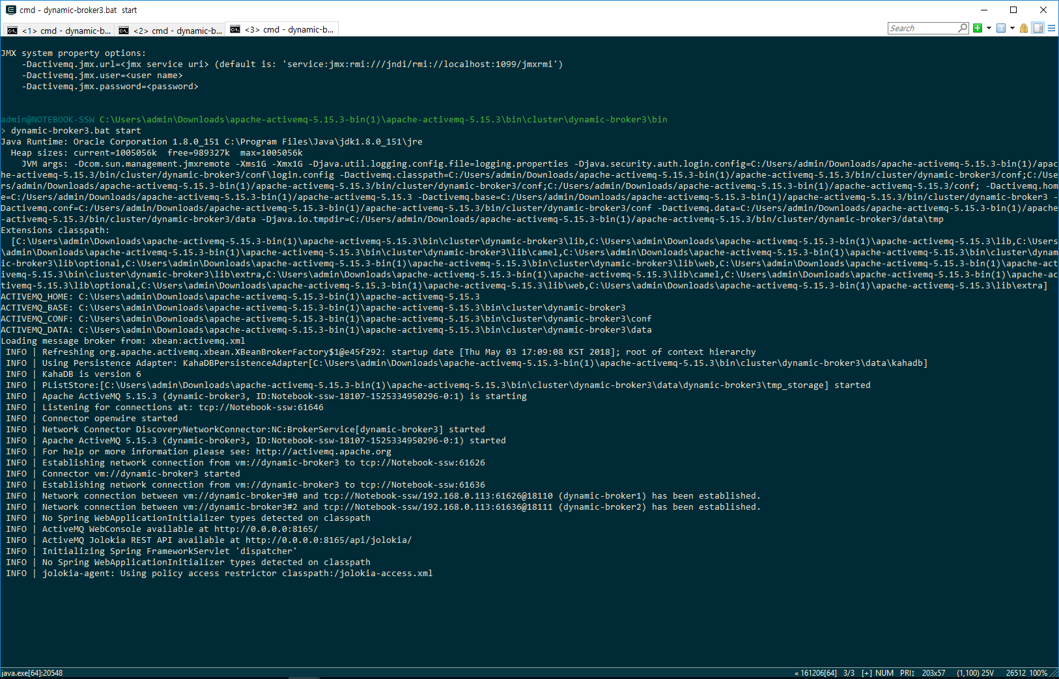
Broker-3 : openwire port = 61646, web console port = 8165

Slide 16
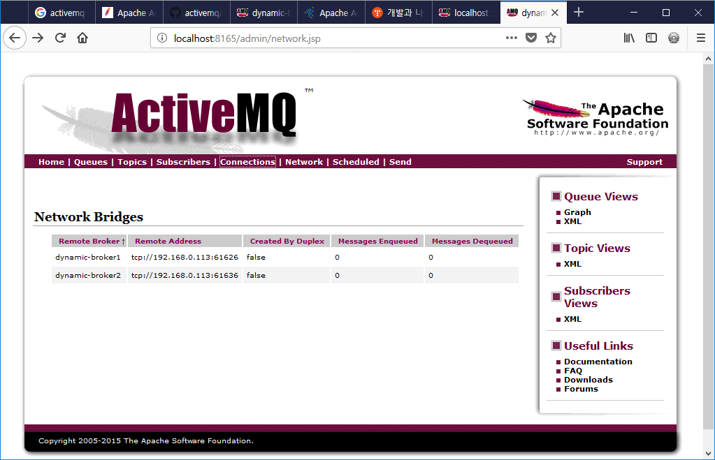

Slide 17
