Slide 1
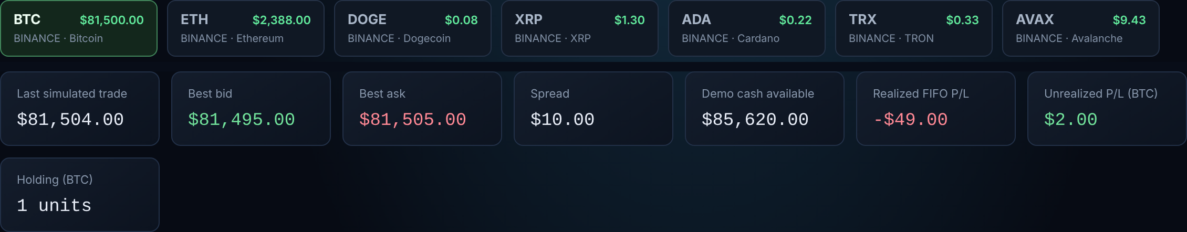
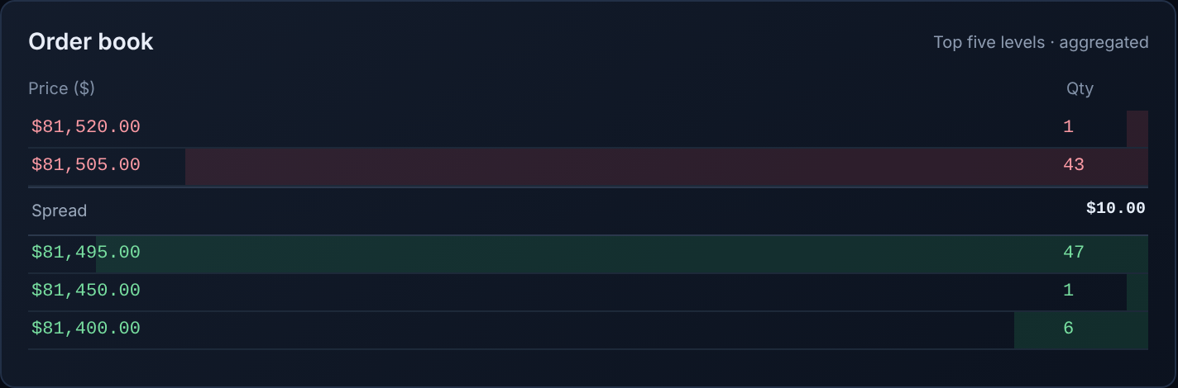
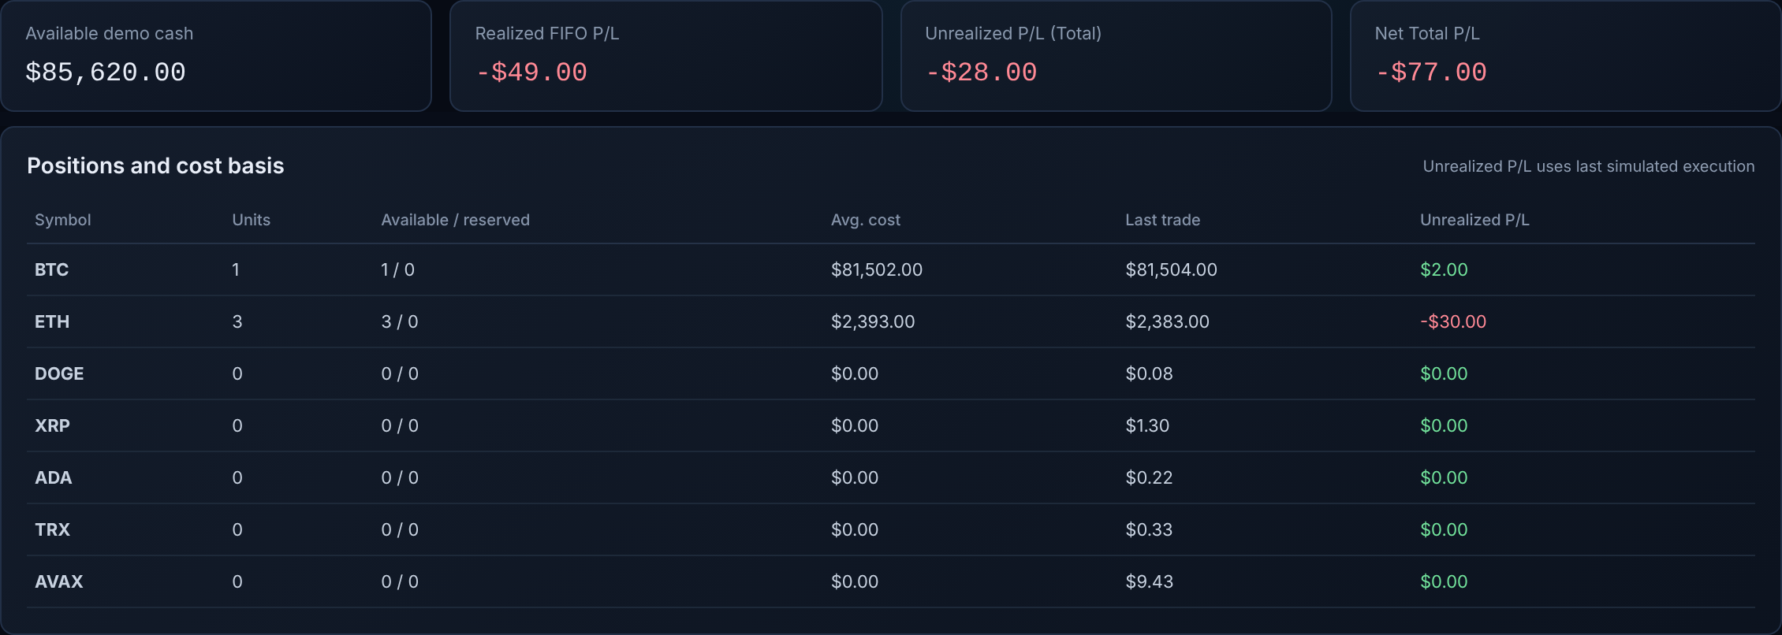
PRICETIME
DATA STRUCTURES – LAB · PROJECT PRESENTATION
From the PriceTime app
Multi-Cryptocurrency Paper Trading Platform
Course: Data Structures – Lab
Department of Computer Science and Engineering
N. Lakshman Reddy
Aditya Sampara
CSE · PRN 25070721038
CSE · PRN 25070721057
Faculty Guide: Dr. Rakesh Salakapuri
Genuine screens from a local development build (demo data).
Notes:
LAKSHMAN. Good morning. We are N. Lakshman Reddy and Aditya Sampara from Computer Science and Engineering, Symbiosis Institute of Technology, Hyderabad. Our guide is Dr. Rakesh Salakapuri. Our Data Structures Lab project is PriceTime, a multi-cryptocurrency paper trading platform. The screens on the right are from our own application running with demo data.

Slide 2
Problem Statement
1
Real cryptocurrency trading is risky for beginners; mistakes cost real money.
Problem: plain array of orders
$101
$97
$103
$99
$96
$102
2
An order book must keep orders organised by price and by arrival time.
Best price means scanning all n orders: O(n).
3
Plain arrays and variables need a full scan to find the best price or the next order.
PriceTime: BST of price levels + FIFO list
$98
orders at one price (FIFO)
4
We need a safe, simulated price-time priority environment that uses demo funds only.
$97
$99
#1
#2
#3
Best price = walk to max/min: O(log L) on average.
L = number of distinct price levels, n = number of orders. Orders are matched by price first, then by arrival time.
Aim: a paper-trading engine built from classic data structures.
Notes:
LAKSHMAN. Real crypto trading is risky for beginners, so we wanted a safe practice environment. The core problem is organisation: an exchange must keep every order sorted by price and, inside one price, by arrival time. If orders sit in a plain array or a few variables, finding the best price means scanning everything. PriceTime solves this with a binary search tree of price levels and a first-in-first-out list at each level, in a simulated price-time priority market with demo funds only.

Slide 3
Objectives and Scope
Objectives (measurable)
Implemented
Out of scope
Match orders by price priority, then FIFO time priority, for limit and market orders.
Limit and market orders
Partial fills and cancel
Self-trade and funds checks
Portfolio and FIFO P&L
Search and sort reports
CSV order replay
Sign-in with JWT
Real money or real exchange orders
Live prices driving the matcher (Binance is display only)
Self-balancing tree (AVL, Red-Black)
A C implementation (repo is TypeScript)
Order types beyond limit and market
1
Build the engine from a BST, doubly linked list, stack, singly linked list and circular list.
2
Give each new account $500,000 of demo cash to trade 7 coins with FIFO profit and loss.
3
Pass the automated test suite: 41 of 41 tests pass.
4
Notes:
LAKSHMAN. Our four measurable objectives are on the left: price-time matching, a set of classic data structures inside the engine, a demo trading experience with five hundred thousand dollars of demo cash, and a test suite that passes forty-one of forty-one tests. On the right, implemented scope is in green. Out of scope is in amber, and we state it plainly: no real money, no real exchange orders, no self-balancing tree, only limit and market orders, and the project is written in TypeScript rather than C.

Slide 4
Data Structures Selected and Justification
Data structure | Application in PriceTime | Main advantage | Complexity
Binary search tree | One node per price level; bids use the maximum, asks the minimum | Best price without scanning every level | Avg O(log L), worst O(L)
Doubly linked list / FIFO queue | Orders resting at one price, head = first in | Enqueue, fill and cancel in constant time | O(1)
Stack (linked) | Audit trail of SUBMIT and CANCEL actions | Newest action available instantly | push, peek O(1)
Singly linked list | Trade tape: each execution appended at the tail | Append without shifting | append O(1)
Circular linked list | Ring of the last 20 trade prices; tail.next = head | Fixed memory, oldest price overwritten | append O(1)
Sorted array + binary search | orders[] kept in id order; findOrder uses binary search | Fast lookup for cancel | find O(log n)
BST: one node per bid price
Doubly linked list: FIFO at one price
Circular list: last 20 trade prices
$98
1st
2nd
3rd
next / prev
p1
p2
p3
p4
best bid = rightmost node
$97
$99
head
tail
tail.next → head
Notes:
LAKSHMAN. This is the most important slide. Each structure was chosen for a specific job and each one is in our code. The binary search tree keeps one node per price level, so the best bid is simply the rightmost node and the best ask the leftmost. Inside a price level, orders sit in a doubly linked list used as a first-in-first-out queue, so enqueue, fill and cancel are constant time. A linked stack records submit and cancel actions. A singly linked list is the trade tape. A circular list holds the last twenty trade prices for a moving average, and a sorted array with binary search finds an order by id. L is the number of price levels. The tree is not self-balancing, so its worst case is O of L.

Slide 5
System Architecture and Order Flow
1 Web UI
2 Authentication
3 Trading interface
4 Order submission
React + TypeScript (Vite)
Neon Auth sign-in; JWT checked with jose
Order ticket, order book, trade tape
POST /api/orders; Zod validation
request reaches the server (Hono API on Node.js)
5 Matching engine
6 Data structures
7 Trade execution
8 Database
9 Portfolio, reports
Book rebuilt from event log; price-time matching
BST, FIFO list, tape, ring, stack
Settlement in one transaction
Neon Postgres, mf_* tables
Positions, FIFO P&L, search, sort
Checks on each order
Engine state
Display only
Zod input (400), self-trade (409), funds or units (422)
Book is rebuilt per request from mf_order_events under a Postgres advisory lock
Binance ticker and TradingView chart never feed the matcher
Notes:
ADITYA. This is the flow of one order. The user signs in through Neon Auth and uses the trading interface in our React app. The order ticket sends the order to our Hono API, where it is validated with Zod. The server takes a Postgres advisory lock, rebuilds the order book for that coin from the stored event log, checks for self-trade and for enough demo funds, and then calls the matching engine. The engine uses the data structures on the previous slide. Trades are settled in one database transaction, and the portfolio and reports pages read the results. The Binance ticker and TradingView chart are display only; they never feed the matcher.

Slide 6
Core Algorithms and Logic
Price-time matching (pseudocode)
Real code: PriceLevel.unlink (orders resting at one price)
while order.remaining > 0:
best = BST min (buy) / max (sell)
if none or price not crossing: stop
qty = min(remaining, head.qty)
trade at best.price; append tape
if head filled: unlink head
if level empty: delete BST node
if LIMIT and remaining > 0:
insert level; enqueue at tail
unlink(order: Order) {
if (order.prev) order.prev.next = order.next;
else this.head = order.next;
if (order.next) order.next.prev = order.prev;
else this.tail = order.prev;
this.quantity -= order.remaining; this.orderCount--;
order.prev = undefined; order.next = undefined; order.level = undefined;
}
Source: apps/api/src/engine/orderBook.ts (line breaks added; code unchanged).
Pointer manipulation: cancel order B from the middle
Implementation language
Before
A
B
C
TypeScript. The repository has no C source.
Pointers are object references: prev, next, head, tail.
Memory is garbage-collected: no malloc or free.
After
A
B
C
B detached
Notes:
ADITYA. The matching loop is on the left. For an incoming order we take the best opposite price from the tree: the minimum of the asks for a buy, the maximum of the bids for a sell. For a limit order we stop if the prices do not cross. Otherwise we fill against the head of the FIFO list at that price, always at the resting order's price, remove filled orders, and delete the tree node when its level is empty. Whatever is left of a limit order is inserted into the tree and joins the tail of the queue. In the middle is real code from our repository, the unlink method. To cancel order B we make A point to C and C point back to A, then clear B's own links. That is constant time. One honest point: our repository is TypeScript and contains no C code. Pointers here are object references and memory is garbage-collected, so there is no malloc or free.

Slide 7
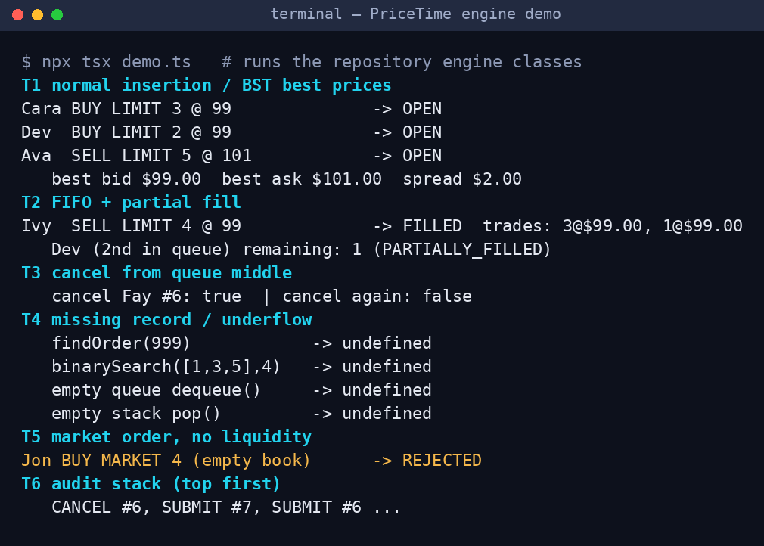
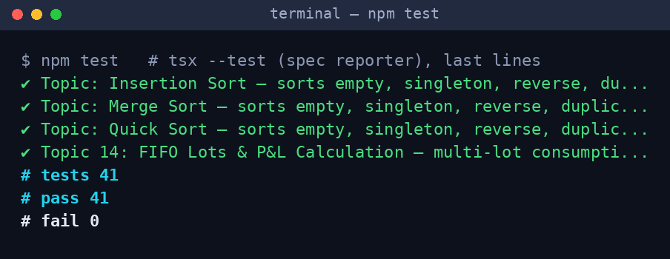
Test Cases and Demonstration
ID | Test case | Input | Expected output | Result
T1 | Normal insertion | Buy 3@99, Buy 2@99, Sell 5@101 | Best bid $99, best ask $101 | Pass
T2 | FIFO and partial fill | Sell 4@99 against Cara 3, Dev 2 | Fills 3 then 1; Dev has 1 left | Pass
T3 | Cancel from middle | Cancel order #6, then again | true, then false | Pass
T4 | Missing record, empty | findOrder(999); dequeue and pop on empty | undefined each time | Pass
T5 | Market, no liquidity | Buy MARKET 4 on an empty book | Status REJECTED | Pass
T6 | Audit stack | Read stack after T1 to T3 | Newest action on top | Pass
Verified, not illustrative: T1 to T6 are the output of a real run of the repository engine. The terminal images are renders of that captured output. The repository's own suite: 41 tests, 41 pass, 0 fail.
Notes:
ADITYA. We tested with a script that runs the repository's own engine classes, plus the repository's test suite. The terminal images are rendered from real captured output. Test one inserts buy and sell limit orders; the best bid is ninety-nine dollars and the best ask one hundred and one. Test two is the key FIFO test: a sell of four at ninety-nine fills Cara's three first, then one from Dev, leaving Dev with one. Test three cancels an order from the middle of a queue and cancelling again returns false. Test four checks missing records and empty structures return undefined rather than crashing. Test five shows a market order with no liquidity is rejected. Test six reads the audit stack. The full suite shows forty-one tests, forty-one pass, none fail. These are verified results from our run, not mock-ups.

Slide 8
Complexity and Performance Analysis
Operation | Structure / algorithm | Best | Average | Worst | Space
Best bid / ask | BST maximum / minimum | O(1) | O(log L) | O(L) | O(1)
Add / delete price level | BST insert / delete | O(1) | O(log L) | O(L) | O(1)
Enqueue, fill, cancel order | Doubly linked list | O(1) | O(1) | O(1) | O(1)
Push action, append trade or price | Stack, singly and circular lists | O(1) | O(1) | O(1) | O(1)
Register order in orders[] | findIndex scan + splice | O(n) | O(n) | O(n) | O(1)
Find order by id | Binary search (linear scan on a miss) | O(1) | O(log n) | O(n) miss | O(1)
Search report rows | Linear search | O(1) | O(n) | O(n) | O(1)
Sort: bubble (early exit), insertion | Comparison sorts | O(n) | O(n²) | O(n²) | O(1)
Sort: selection | Comparison sort | O(n²) | O(n²) | O(n²) | O(1)
Sort: merge (stable) | Divide and conquer | O(n log n) | O(n log n) | O(n log n) | O(n)
Sort: quick (middle pivot) | Divide and conquer | O(n log n) | O(n log n) | O(n²) | O(log n)
Theory vs measurement
Memory and pointer safety
Limitations
Table = analysis, not timing. One local replay of 2,000 orders: BST + list 62.5 ms, plain array 12.2 ms. An observation, not a speed claim.
Garbage-collected TypeScript: no malloc or free. Head, tail, prev and next are checked; unlink clears the removed node's links.
BST is not balanced: sorted prices give O(L). Book is rebuilt per request. A findOrder miss scans linearly.
Notes:
ADITYA. This table is theoretical analysis. L is the number of price levels and n the number of orders. The tree gives constant best case, logarithmic average, and linear worst case, because our tree is not self-balancing. List operations are constant time. Registering an order in the sorted array is linear because it scans and splices. Binary search is logarithmic, but if the id is not found we fall back to a linear scan, so a miss costs O of n. Sorting results follow the textbook values, for example bubble sort with early exit is O of n best case and O of n squared otherwise, merge sort uses O of n extra space. Separately, we ran one local replay of two thousand orders: BST plus list took about sixty-two milliseconds and a plain array about twelve. That is a single observation on our machine, not a claim that either is faster; at this size the array's constant factors dominate. Memory is garbage-collected, so we do not call malloc or free.

Slide 9
Conclusion and Future Scope
What we built and learned
Future scope (not implemented)
A working paper-trading platform: price-time matching, demo funds, FIFO profit and loss, reports.
The BST finds the best price; the linked list at each price keeps first-come-first-served order and cancels in O(1).
Tape, ring and stack are linked structures; 41 of 41 tests pass.
Lesson: list ends and empty-book cases need careful pointer updates and explicit tests.
Self-balancing tree (AVL or Red-Black) for a guaranteed logarithmic worst case.
Keep the order book in memory between requests instead of rebuilding it from the event log.
Port the core structures to C with manual memory management (malloc and free).
How the engine and the structures work together
Order arrives
BST gives best price
Head of FIFO list is filled
Tape + ring record trade
Settlement saves result
Notes:
LAKSHMAN. To conclude: we built a working paper-trading platform whose matching engine is made from classic data structures. When an order arrives the tree gives the best price, the head of the FIFO list at that price is filled first, the tape and ring record the trade, and settlement saves the result. We learned that pointer updates at the ends of a list and empty cases need careful handling and explicit tests. ADITYA. Future scope, which is not implemented: a self-balancing tree for a guaranteed logarithmic worst case, keeping the book in memory between requests, and porting the core structures to C with manual memory management.

Slide 10
References
PriceTime source repository. github.com/sonstellar969/PriceTime (engine: apps/api/src/engine/).
E. Horowitz, S. Sahni, S. Anderson-Freed, Fundamentals of Data Structures in C, 2nd ed., Silicon Press, 2008.
Y. Langsam, M. J. Augenstein, A. M. Tenenbaum, Data Structures Using C and C++, 2nd ed., Prentice Hall, 1996.
Node.js documentation: Test runner. nodejs.org/api/test.html
TypeScript documentation. typescriptlang.org/docs
Hono web framework documentation. hono.dev/docs
PostgreSQL documentation: Advisory locks (explicit locking). postgresql.org/docs/current/explicit-locking.html
Neon documentation (Postgres, Neon Auth). neon.com/docs
Thank you · Questions?
N. Lakshman Reddy (PRN 25070721038)
Aditya Sampara (PRN 25070721057)
Notes:
BOTH. These are our references: our repository, two data-structures textbooks, and the official documentation of the tools. Thank you. We are happy to take questions.

