Slide 1
BOOLEAN FUNCTION PROPERTIES

Slide 2
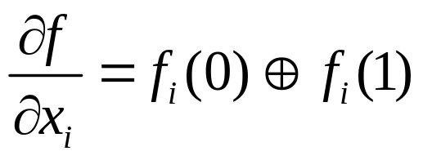
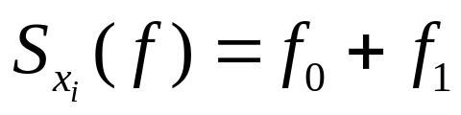
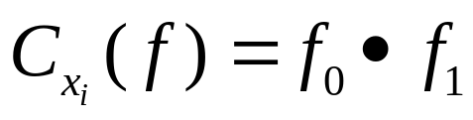
Three Special Functions
The “Boolean Difference” (or Boolean Derivative) indicates under what conditions f is sensitive to changes in the value of x_{i} and is defined as:
The “Smoothing Function” of a Boolean function represents the component of f that is independent of x_{i} and is defined as:
The “Consensus” of a Boolean function represents f when all appearances of x_{i} are deleted and is defined as:
Smoothing is also called MAX, Consensus is also called MIN.
This is different consensus than one discussed before

Slide 3
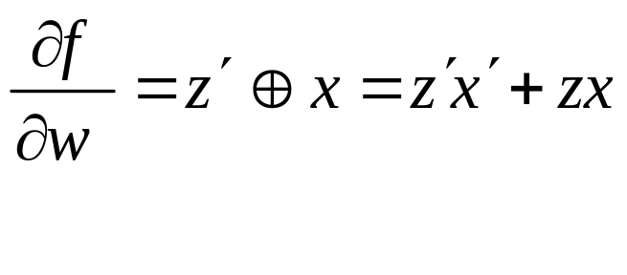
Boolean Difference
The “Boolean Difference” (or Boolean Derivative) indicates whether f is sensitive to changes in the value of x_{i} and is Defined as:
Note: f_{i}(1) means that function f is evaluated with x_{i} = 1. This is the “x_{i} –residue”, also written as f_{xi} . The “x′_{i} –residue” sets x_{i} = 0, also written as f_{x′i}.
Example
f(w,x,y,z) = wx + w′ z′ , find values of x and z to sensitize circuit to changes in w. f_{w} = x , f_{w′} = z′
z=x=1 or z=x=0 will sensitize circuit to changes in w

Slide 4
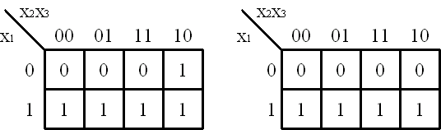
Consensus Function
The “Consensus” of a Boolean function represents f when all appearances of x_{i} are deleted and is defined as:
This is an Instance of Universal Quantification, ∀
C_{f} ⊆ f
EXAMPLE f={10-, -10, 111} f₀={1--} f₁={--0, 1-1}
C_{f}={1-0, 1-1} (we calculate cofactors about x₂)
0
1
1

Slide 5
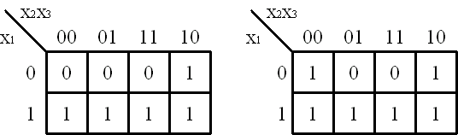
Smoothing Function
The “Smoothing Function” of a Boolean function represents the component of f that is independent of x_{i} and is Defined as:
This is an Instance of Existential Quantification, ∃
EXAMPLE f={10-, -10, 111} f₀={1--} f₁={--0, 1-1}
S_{f}={1--, --0, 1-1} (about x₂)

Slide 6
Unateness

Slide 7
Unateness of Boolean Functions
Single-Rail Logic to Minimize Pins and Interconnect
f is “positive unate” in a dependent variable x_{i} if x′_{i} does not appear in the sum-of-products representation
f is “negative unate” in a dependent variable x_{i} if x_{i} does not appear in the sum-of-products representation
f is “vacuous” in a dependent variable x_{i} if neither x_{i} nor x′_{i} appears in the sum-of-products representation (otherwise it is “essential”)
f is “mixed” or “binate” in variable x_{i} if it is not possible to write a sum-of-products representation in which x_{i} or x′ do not appear

Slide 8
Unateness
Example: of variable types
f(w,x,y,z) = wxy + w′ x′
Variable Classification
        Essential wxy
        Vacuous z
        Positive yz
        Negative z
        Binate wx

Slide 9
Self – Dual Functions

Slide 10

Self-Dual Functions
Recall that the dual of a Function, f(x₁, x₂, …, x_{n}) is:
f ^{d} = f(x₁, x₂, …, x_{n})
If f = f ^{d}, f is said to be a “self-dual” function
EXAMPLE of self-dual function
f=x y ∨ y z ∨ z x f ^{d}= x y ∨ y z ∨ z x
f ^{d}=(x ∨ y) (y ∨ z)(z ∨ x)= x y ∨ y z ∨ z x
∴ f is a “self-dual” function
Theorem: There are different self-dual functions of n variables

Slide 11
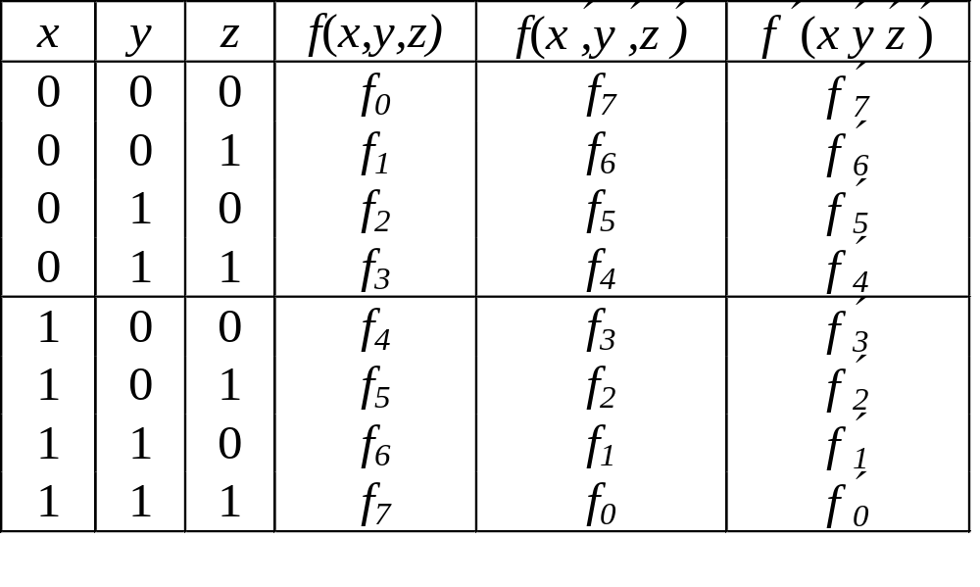
Self-Dual Functions
Consider a General 3-variable Self-Dual Function:
Note the Symmetry about the Middle Line for f(x,y,z) and f(x′,y′,z′)
Symmetry is an Important Property
Theorem: A function obtained by assigning a self-dual function to a variable of a self-dual function is also self-dual
f (x,y,z ) g(a,b,c) x←g( a,b,c ) f ( g( a,b,c ),y,z )
If f ( x₁, x₂, …, x_{n} ) = f ( x₁, x₂, …, x_{n} ), then f is “self-anti-dual”
EXAMPLE of self-anti-dual function f ( x, y ) = x ⊕ y
^

Slide 12
Monotone and Unate Functions
A “Monotone Increasing” function is one that can be Represented with AND and OR gates ONLY - (no inverters)
Monotone Increasing functions can be Represented in SOP form with NO Complemented Literals
Monotone Increasing functions are also known as “Positive Functions”
A “Monotone Decreasing” function is one that can be Represented in SOP form with ALL Complemented literals – Negative Function
A function is “Unate” if it can be Represented in SOP form with each literal being Complemented OR uncomplemented, but NOT both
EXAMPLES of monotone and unate functions
f(x,y,z)=x y + y z - Monotone Increasing (Unate)
g(a,b,c)= a′c′ +b′ c′ - Monotone Decreasing (Unate)
k(A, B, C)= A′ B + A′ C - Unate Function
h(X, Y, Z)= X′ Y + Y′ Z - Unate in variables X and Z
- Binate in variable Y

Slide 13
Symmetric Functions

Slide 14
Symmetry
If a function does not change when any possible pair of variables are exchanged it is said to be “totally symmetric”
2^{n+1} symmetric functions of n variables
If a function does not change when any possible pair of a SUBSET of variables are exchanged, it is said to be “partially symmetric”
Symmetric functions can be synthesized with fewer logic elements
Detection of symmetry is an important and HARD problem in CAD
There are several other types of symmetry – we will examine these in more detail later in class
EXAMPLES of totally symmetric and partially symmetric functions
f(x,y,z) = x′y ′z + xy ′z ′ + x ′yz ′ - Totally Symmetric
f(x,y,z) = x ′y ′z + x ′yz ′ + xyz - Partially Symmetric (y,z)

Slide 15
Total Symmetry Theorem
Theorem: (Necessary and Sufficient)
If f can be specified by a set of integers {a₁, a₂, ..., a_{k}} where 0≤ a_{i} ≤n such that f = 1, when and only when a_{i} of the variables have a value of 1, then f is totally symmetric.
Definition: {a₁, a₂, ..., a_{k}} are a-numbers
Definition: A totally symmetric function can be denoted as S_{a1a2,...,ak} (x₁, x₂, ..., x_{n}) where S denotes “symmetry” and
the subscripts, a₁, a₂, ..., a_{k,} designate a-numbers and (x₁, x₂, ..., x_{n}) are the variables of symmetry.

Slide 16
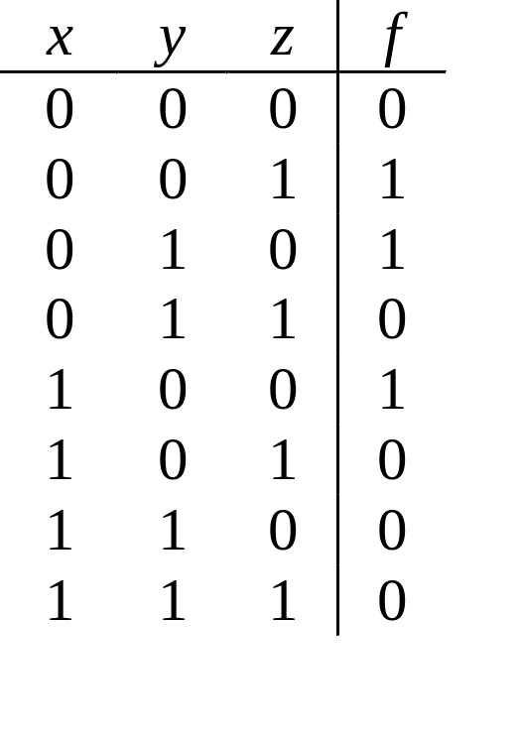
a-number Example
Consider the function:
S₁(x,y,z) or S₁³
Then this function has a single a-number = 1
The truth table is:

Slide 17
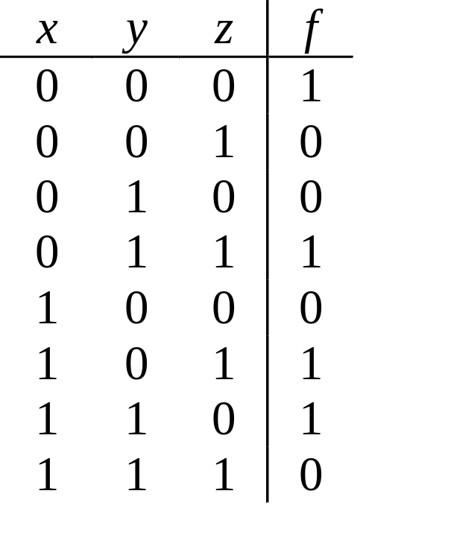
Another a-number Example
Consider the function:
S_{0,2}(x,y,z)
Then this function has two a-numbers, 0 and 2
The truth table is:

Slide 18
Properties of a-numbers of symmetric functions
Let:
M ≡ a set of a-numbers
N ≡ a set of a-numbers
A ≡ the universal set of a-numbers
S_{M}(x₁, x₂, ..., x_{n}) + S_{N}(x₁, x₂, ..., x_{n}) = S_{M∪N}(x₁, x₂, ..., x_{n})
S_{M}(x₁, x₂, ..., x_{n}) • S_{N}(x₁, x₂, ..., x_{n}) = S_{M ∩ N}(x₁, x₂, ..., x_{n})
S_{M}(x₁, x₂, ..., x_{n}) = S_{A-M}(x₁, x₂, ..., x_{n})
S_{N}(x₁, x₂, ..., x_{n}) = x₁• S_{Ň}(0, x₂, ..., x_{n}) + x₁• S_{Ň} (1, x₂, ..., x_{n})
where each a_{i}∈N is replaced by a_{i}-1∈Ň
S_{N}(x₁, x₂, ..., x_{n}) = S _{N′} (x₁, x₂, ..., x_{n})
where each a-number in N is replaced by n-1

Slide 19
Properties (continued)
Examples:
S₃(x₁, x₂, x₃) + S_{2,3}(x₁, x₂, x₃) = S_{2.3} (x₁, x₂, x₃)
S₃(x₁, x₂, x₃) • S_{2,3}(x₁, x₂, x₃) = S₃ (x₁, x₂, x₃)
S₃(x₁, x₂, x₃) ⊕ S_{2,3}(x₁, x₂, x₃)
= S₃(x₁, x₂, x₃) • [S_{2,3}(x₁, x₂, x₃)]′ + [S₃ (x₁, x₂, x₃)] ′ • S_{2,3}(x₁, x₂, x₃)
= S₃(x₁, x₂, x₃) • S_{0,1}(x₁, x₂, x₃) + S_{0,1,2} (x₁, x₂, x₃) • S_{2,3}(x₁, x₂, x₃)
= S₂(x₁, x₂, x₃)
x₁′ S₂(x₂ , x₃) + x₁ S₁(x₂ ′, x₃ ′) = x₁′ S₂(x₂ , x₃) + x₁ S₂₋₁(x₂, x₃)
= x₁′ S₂(x₂ , x₃) + x₁ S₁(x₂, x₃) = S₂ (x₁, x₂, x₃)

Slide 20
Complemented Variables of Symmetry
Let:
f(x₁, x₂, x₃) = x₁′ x₂ ′ x₃ ′ + x₁x₂ ′ x₃ + x₁ ′ x₂x₃
This function is symmetric with respect to:
{x₁, x₂, x₃ ′}
OR
{x₁ ′, x₂ ′, x₃}

Slide 21
Identification of Symmetry

Slide 22
Identification of Symmetry
Naive Way:
If all variables are uncomplemented (complemented):
  Expand to Canonical Form and Count Minterms for Each Possible a-number
  If f = 1 all minterms corresponding to an a-number, then that a-number is included in the set
Question:
  What is the total number of minterms that can exist for an a-number to exist for a function of n variables?

Slide 23
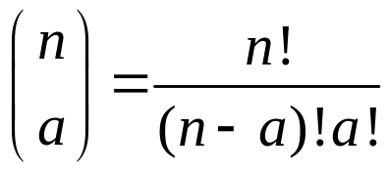
Identification of Symmetry
Naive Way:
If all variables are uncomplemented (complemented):
  Expand to Canonical Form and Count Minterms for Each Possible a-number
  If f = 1 all minterms corresponding to an a-number, then that a-number is included in the set
Question:
  What is the total number of minterms that can exist for an a-number to exist for a function of n variables?

Slide 24
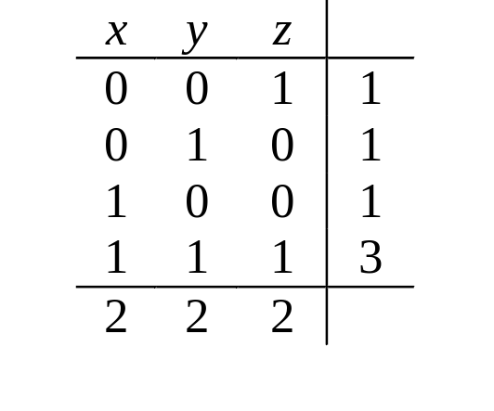
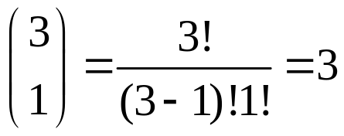
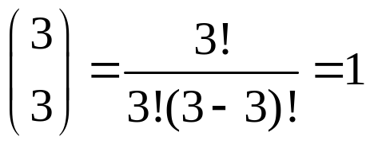
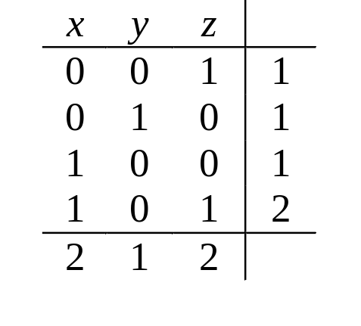
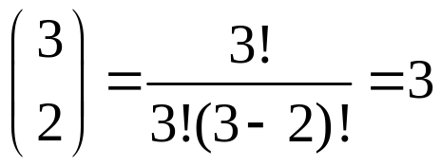
Identification of Symmetry Example
f=∑(1, 2, 4, 7) - Canonical Form – Sum of Minterms - Symmetric
g=∑(1, 2, 4, 5) - Canonical Form – Sum of Minterms – NOT Symmetric

Slide 25
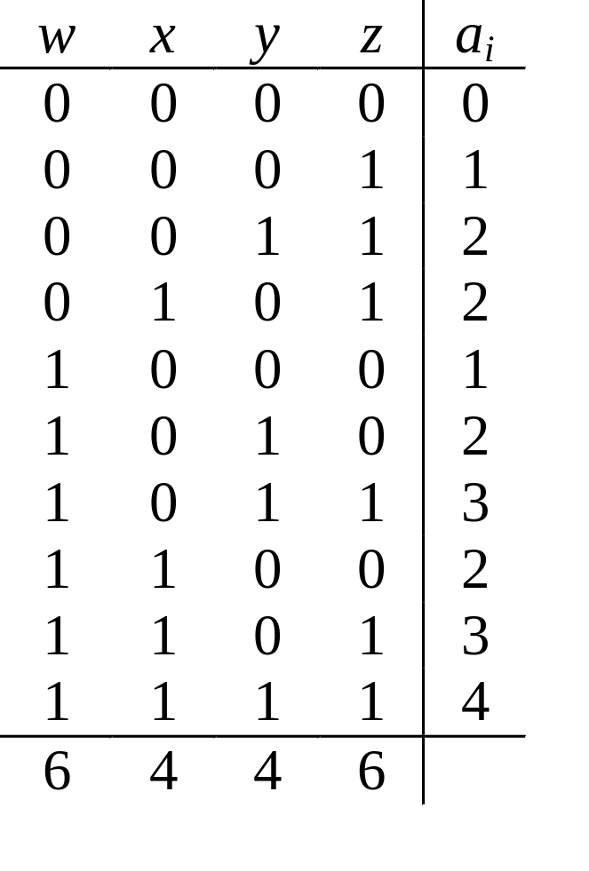
Identification of Symmetry Example 2
f(w,x,y,z)=∑(0,1,3,5,8,10,11,12,13,15)
Column Sums are not Equal
Not Totally Symmetric
What about the function:
f(w, x, y, z)

Slide 26
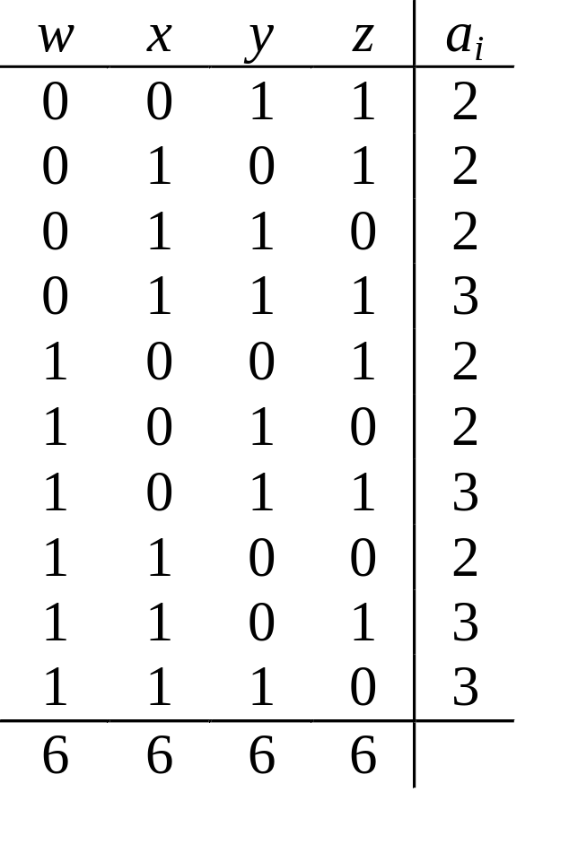
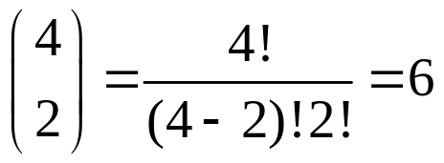
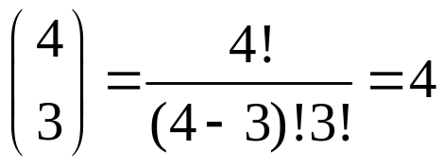
Identification of Symmetry Example 2
f(w,x,y,z)=∑(3,5,6,7,9,10,11,12,13,14)
S_{2,3}(w, x, y, z)
ALSO
S_{1,2} (w, x, y, z)

Slide 27
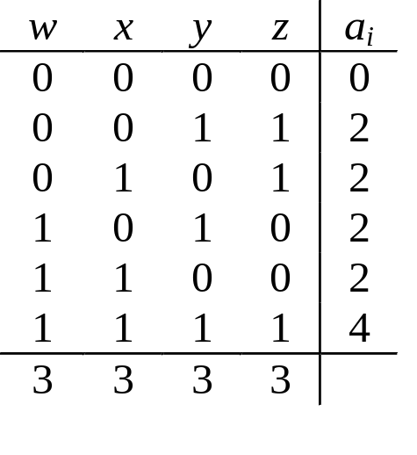
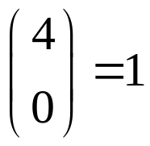
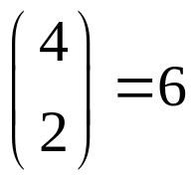
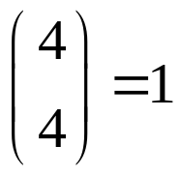
Column Sum Theorem
THEOREM:
The Equality of All Column Sums is NOT a Sufficient Condition for Detection of Total Symmetry.
PROOF:
We prove this by contradiction. Consider the following function:
f(w, x, y, z) = ∑(0,3,5,10,12,15)
Clearly, it is NOT symmetric since a=2 is not satisfied, however, all column sums are the same.
NOT Totally Symmetric!!!

Slide 28
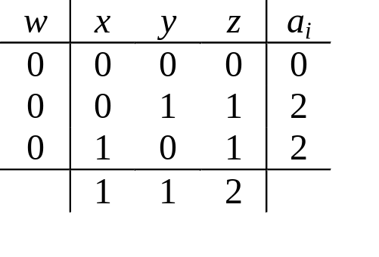
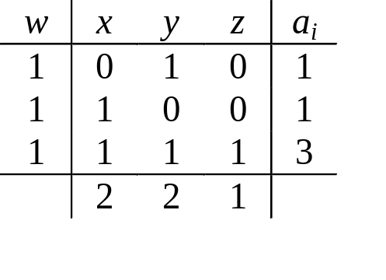
Column Sum Check
Recall the Shannon Expansion Property
  All co-factors of a symmetric function are also symmetric
  When column sums are equal, expand about any variable
  Consider f_{w} and f_{w’}
Cofactors NOT symmetric since column sums are unequal
However, can complement variables to obtain symmetry
{x′, y′} OR {z′}

Slide 29
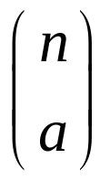
Total Symmetry Algorithm
Compute Column Sums
  if >2 column sum values → NOT SYMMETRIC
  if =2 compare the total with # rows
    if same complement columns with smaller column sum
    else NOT SYMMETRIC
  if =1, compare to ½ # of rows
    if equal, go to step 2
    if not equal, go to step 3
Compute Row Sums (a-numbers), check for correct
values
  if values are correct, then SYMMETRY detected
  if values are incorrect, then NOT SYMMETRIC

Slide 30
Total Symmetry Algorithm (cont)
Compute Row Sums, check for correct numbers
  if they are correct → SYMMETRIC
  else, expand f about any variable and go to step 1 for each cofactor

Slide 31
Threshold Functions

Slide 32
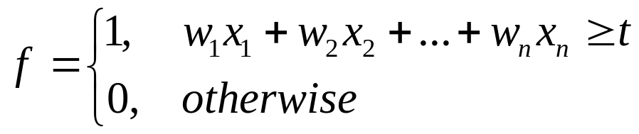
Threshold Functions
DEFINITION
Let (w₁, w₂, …, w_{n}) be an n-tuple of real-numbered weights and t be a real number called the threshold. Then a threshold function, f, is defined as:
x₁
w₁
x₂
w₂
t
f
w_{n}
x_{n}

Slide 33
Threshold Functions
EXAMPLE (2-valued logic)
A 3-input majority function has a value of 1 iff 2 or more variables are 1
Of the 16 Switching Functions of 2 variables, 14 are threshold functions (but not necessarily majority functions)
w₁ = w₂ = -1 t = -0.5 f = x₁' • x₂'
All threshold functions are unate
Majority functions are threshold functions where n = 2m+1, t = m+1,
w₁ = w₂ =…= w_{n} = 1, majority functions equal 1 iff more variables are 1 than 0
Majority functions are totally symmetric, monotone increasing and self-dual

Slide 34
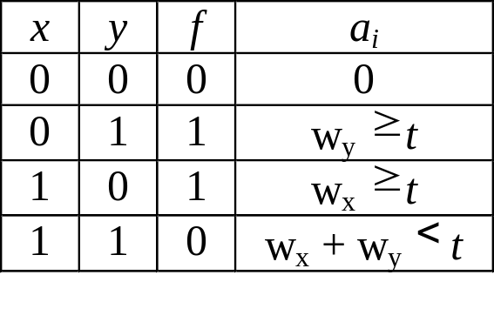
Threshold Functions
Is f(x,y) = x′y + xy′ a threshold function?
No, since no solution to this set of inequalities.
However, two threshold functions could be used to achieve the same result.

Slide 35
Relations Among Functions
All Functions
Unate
Monotone
Threshold
Self-Dual
Majority

Slide 36
Universal Set of Functions

Slide 37
Universal Set of Functions
If an arbitrary logic function is represented by a given set of logic functions, the set is “Universal ” or “Complete”,
Def: Let F = {f₁, f₂ , . . . . , f_{m} } be a set of logic functions. If an arbitrary logic function is realized by a loop-free combinational network using the logic elements that realize function f_{i} (i = 1, 2, . . .,m), then F is universal.
Theorem:
Let M₀ be the set of 0-preserving functions,
M₁ be the set of 1-preserving functions,
M₂ be the set of self-dual functions,
M₃ be the set of monotone increasing functions, and
M₄ be the set of linear functions.
Then, the set of functions F is universal iff
F  M_{i} (i = 0,1, 2, 3, 4).

Slide 38
Universal Set of Functions
Definitions:
0-Preserving – a function such that f (0, 0, . . . ,0) = 0
1-Preserving – a function such that f (1, 1, . . . ,1) = 1
Self-Dual – a function f such that f = f ^{d} = f ′ (x′₁, x′ ₂, …, x ′ _{n})
Monotone Increasing – a function that can be represented with AND and OR gates ONLY - (no inverters)
Linear Function – a function represented by
= a₀ ⊕ a₁x₁ ⊕ a₂x ₂ ⊕ … ⊕ a_{n}x_{n}
where a_{i} = 0 or 1.
EXAMPLES
Single function examples F = {(xy)′ } and F = {x′ y′ }

Slide 39
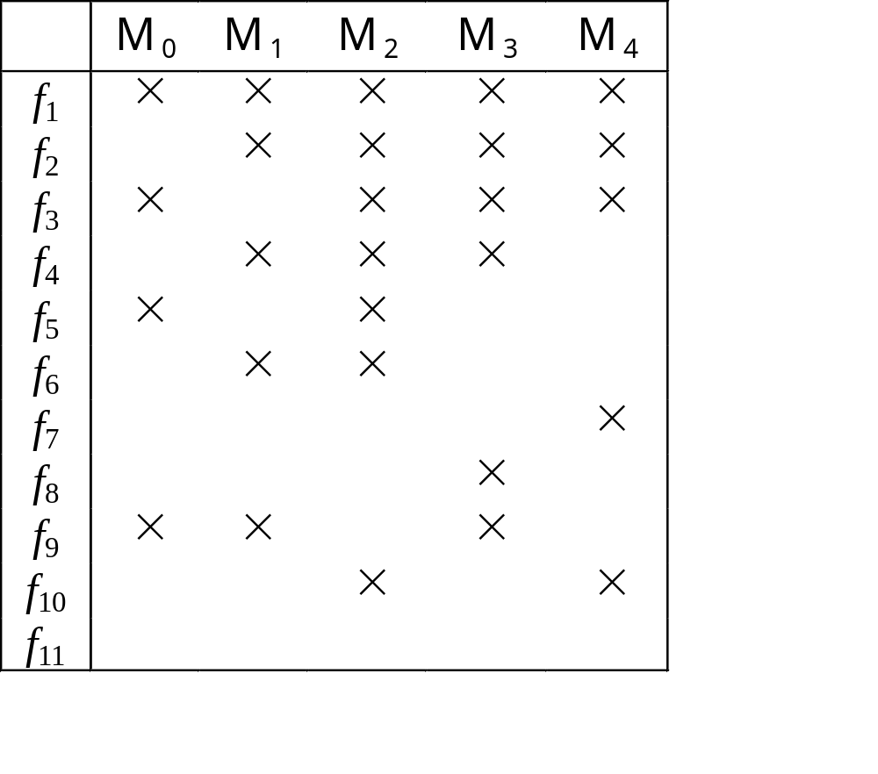
Minimal Universal Set
Let f ₁= x′ y′ , f ₂= xy′ , f ₃= x+ y′ , f ₄= x ⊕ y, f ₅= 1, f ₆= 0, f ₇= xy+ yz+xz,
f ₈= x ⊕ y ⊕ z, f ₉= x′ , f ₁₀= xy, f ₁₁= x
Examples of Minimal Universal Sets:
{f ₁}, {f ₂, f ₃}, {f ₂, f ₅}, {f ₃, f ₄}, {f ₃, f ₆}, {f ₄, f ₅ , f ₇}, {f ₅, f ₆ , f ₇, f ₈}, and {f ₉, f ₁₀},

Slide 40
Equivalence Classes of Logic Functions
2^{2n} logic functions of n variables
Much fewer unique functions required when the following operations are allowed:
(1) Negation of some variables – complementation of inputs
(2) Permutation – interchanging inputs
(3) Negation of function – complementing the entire function
If an logic function g is derived from a function f by the combination of the above operations, then the function g is “NPN Equivalent” to f. The set of functions that are NPN-equivalent to the given function f forms an “NPN-equivalence class”.
Also possible to have NP-equivalence by operations (1) and (2)
P-equivalence by (2) alone, and N-equivalence by (1), alone.

Slide 41
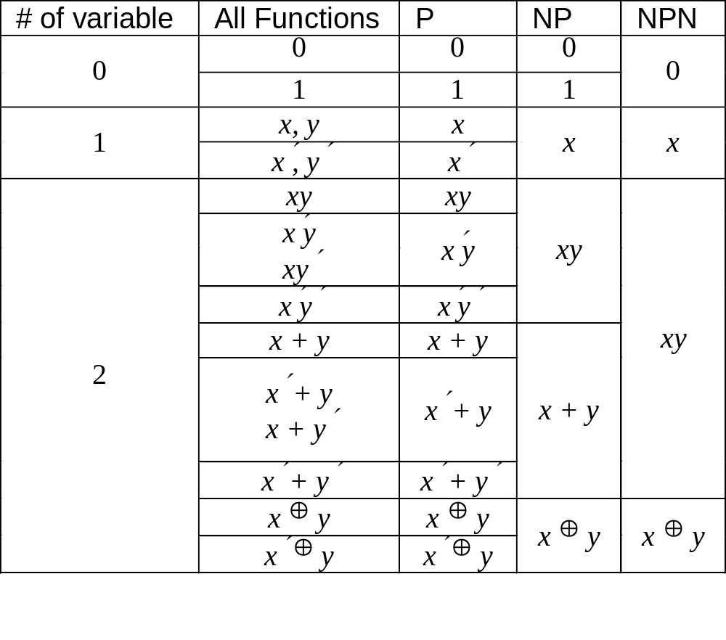
Classification of Two-Variable Functions

Slide 42
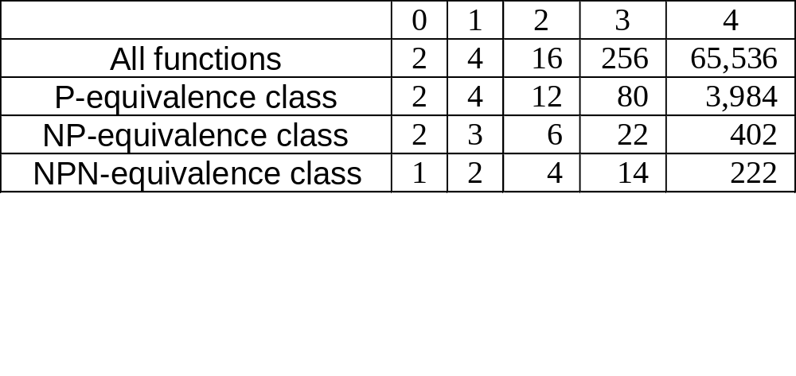
Number P-, NP-, and NPN-Equivalence Classes
NP-equivalence useful for double rail input logic
NPN-equivalence useful for double rail input logic, where each logic element realizes both a function and its complement

Slide 43
To remember and solve
Boolean Difference
Smoothing function
Consensus function
Unateness of Boolean Functions
Self-Dual Functions
Identification of Symmetry
Threshold Functions
Universal Set of Functions
NPN classification
Classification of 2 variable functions
Classification of 3 variable functions
The concept of equivalence classes
Invent regular symmetric structures for symmetric and threshold functions.

