Slide 1
Background on what we just published
Original idea with disjunctive form is to take a Boolean function f, decompose it into its minterms, then:
f = minterm_1 + minterm_2 + minterm_3
The most basic is to look at minterm_1, see how many NOR2 gates it requires, then look at minterm_2 etc. Then count how many of these minterms are offending (higher than a predefined N number of gates that cells can contain.
Introduced the idea of using optimization with the exact synthesis database
Check all patterns
f_1 = minterm_1 + minterm_2 and f_2 = minterm_3
f_1 = minterm_1 and f_2 = minterm_2 + minterm_3
…
Then check number offending terms for these combinations.

Slide 2
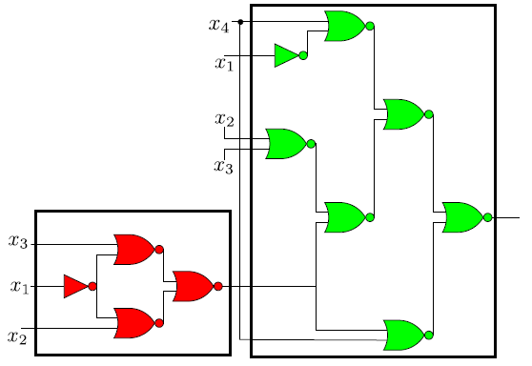
Background on what we just published
Then we also had the partitioning idea:
[Note, perhaps we want to save all other realizations that are of equal number of gates to the optimal design. Since my understanding is that we are calculating these exhaustively anyway.]
Since there are multiple possible such circuits, some may be better for partitioning!

Slide 3
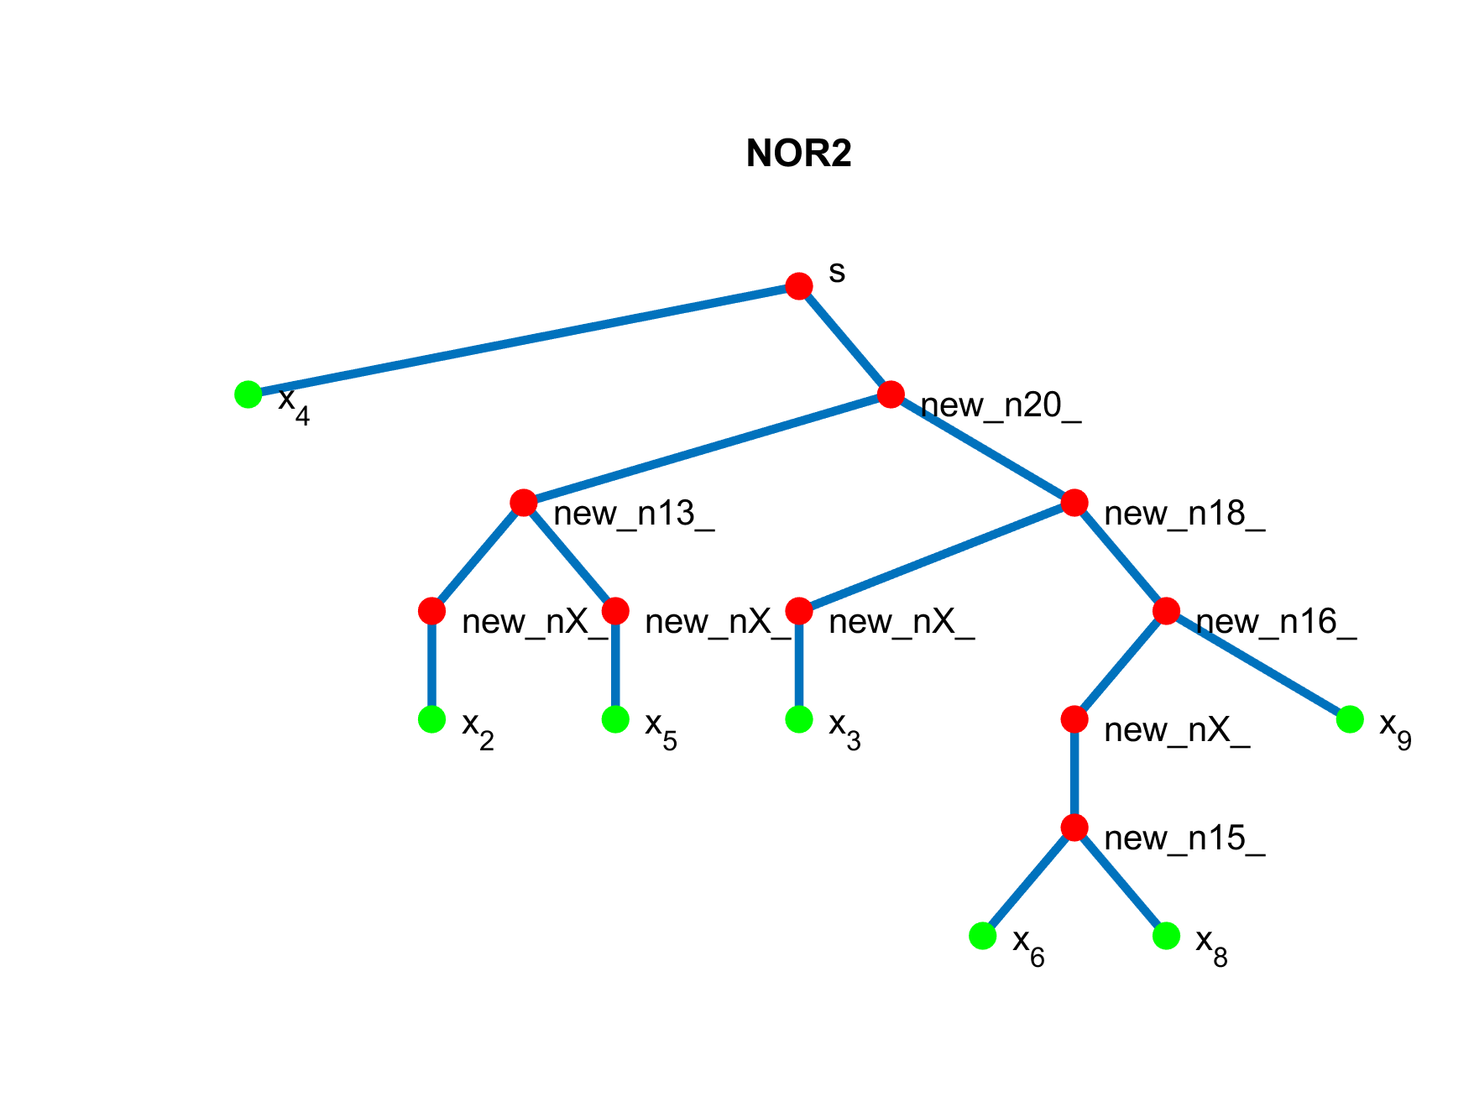
1)Extending Boolean paper to account for more inputs
Need a starting base (for now, ABC) ➔ If you know of other similar software, please let me know!
Basically each look-up now of a minterm or combined minterms will be sub-optimal, but the idea of the disjunctive form still applies.
Input (some Verilog file):
module rca2 (x_2, x_3, x_4, x_5, x_6, x_8, x_9, s);
//-------------Input Ports Declarations-----------------------------
input x_2, x_3, x_4, x_5, x_6, x_8, x_9;
//-------------Output Ports Declarations-----------------------------
output s;
//-------------Logic-----------------------------------------------
assign s = ((x_2 & x_5) | (x_3 & (x_6 | x_8 | x_9))) & (~x_4);
endmodule
Take input, parse and make it processable in MATLAB

Slide 4
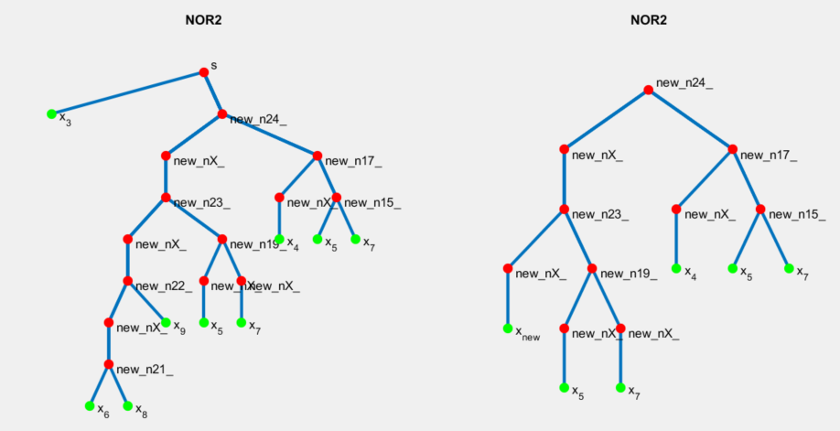
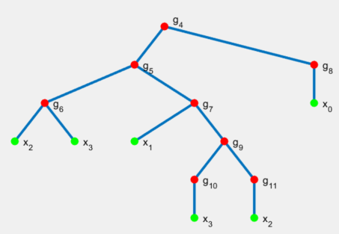
1) Extending Boolean paper to account for more inputs
10 gates
Note that this node was simplified to have 4 inputs!
Looking at the right structure, there exists a simpler form to form from the database.
This can be quite powerful as this tree on the left has many substructures that can be simplified.
➔ This can improve these ABC and related algorithms on the fly. [Other applications?]
8 gates

Slide 5
1) Extending Boolean paper to account for more inputs
Algorithm to produce that result
Preprocessing:
Create a “subtree” of inputs 4 or less by truncating at the top and bottom
Evaluate the tree “binary” id.
Check the database to see if the gate number is less than current
save information if it is, the move onto next possible subtree
For very large tree, there could be multiple subbing at once and then, probably the order matters! Need to develop some systematic way of testing all of them or narrow it down?
At the end, need to reattached the “truncated” pieces back to recover original tree.

Slide 6
1) Extending Boolean paper to account for more inputs
Overall algorithm:
Take initial BF
Find disjunctive form
Exact synthesis library
Test all combinations [From MATLAB]
Reduce gate numbers from obtained output
Select best result based on criteria
Interfacing
ABC/Other algorithms
Use result to do partitioning + DNF design
Key point #1: This works for any input > 4. We can find many examples where this could be useful.
Key point #2: We can make large circuits “more” optimal (good for this but also in general for synthesis). Does the idea I propose in the previous slide exist elsewhere?
Any other idea that we could do for, say another ACS synthetic biology paper? Or should we target a more synthesis oriented journal?

Slide 7
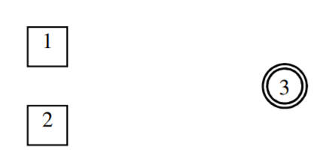
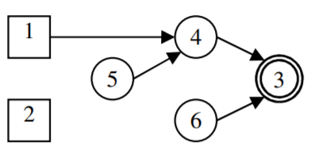
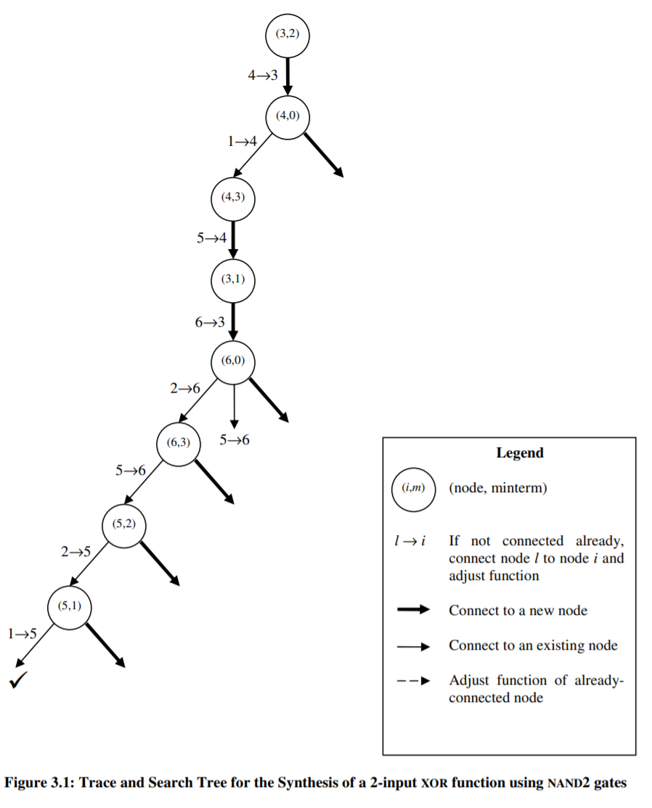
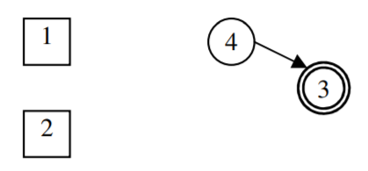
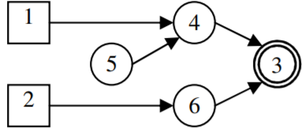
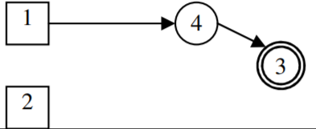
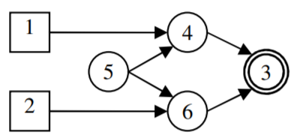
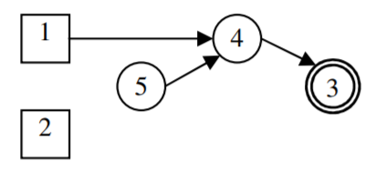
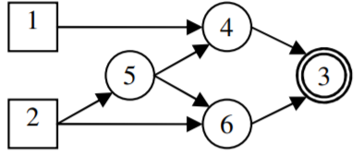
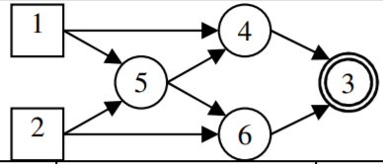
2) Exact synthesis algorithm

Slide 8
2) Exact synthesis algorithm
Questions:
How does the algorithm know what is the next element to test when it gets to the end?
Can we unroll this recursion into an iteration? [GPU has a limit to how “deep” this recursion can go/do we know what the tree profile is before reaching the end?]
What is the memory consumption when the tree becomes large?
Are there ways to truncate this tree faster than testing whether current gate cost > current_minimum?
For a given calculation, how much information needs to be saved? [Important to know if GPU implementation is possible]
Is the use of library necessary? How hard would it be to rewrite the software in C without the libraries to handle directed graphs etc.?

Slide 9
Building blocks of optimal circuits
Optimal control with changing parameters (noisy or different between patients)
Profile likelihood

