Slide 1
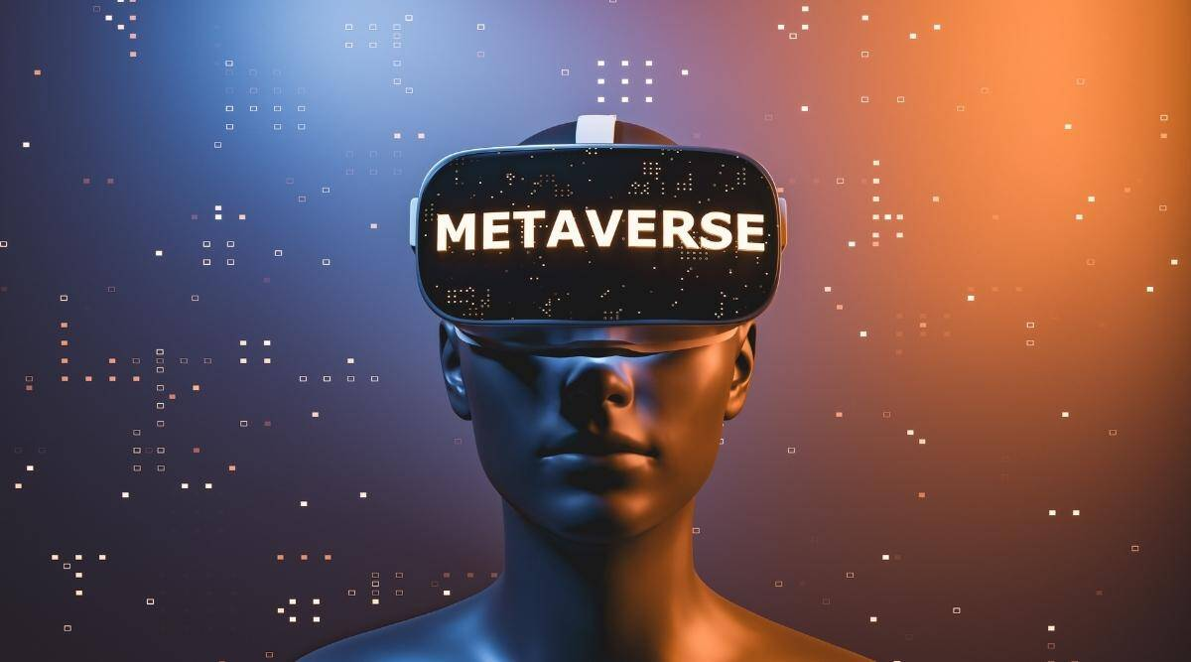
Name :- Abhiraj
Class :- VII-D
School:- DPS Jaipur

Slide 2
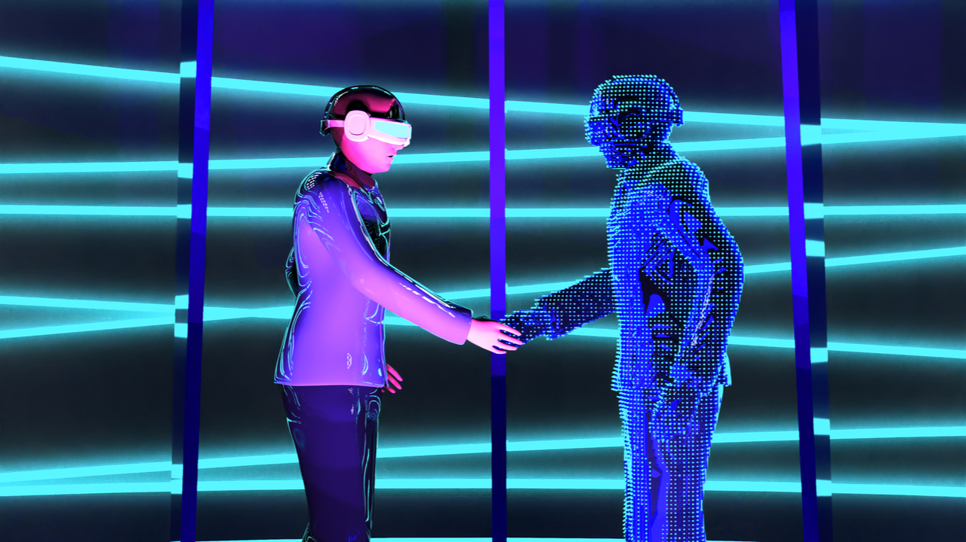
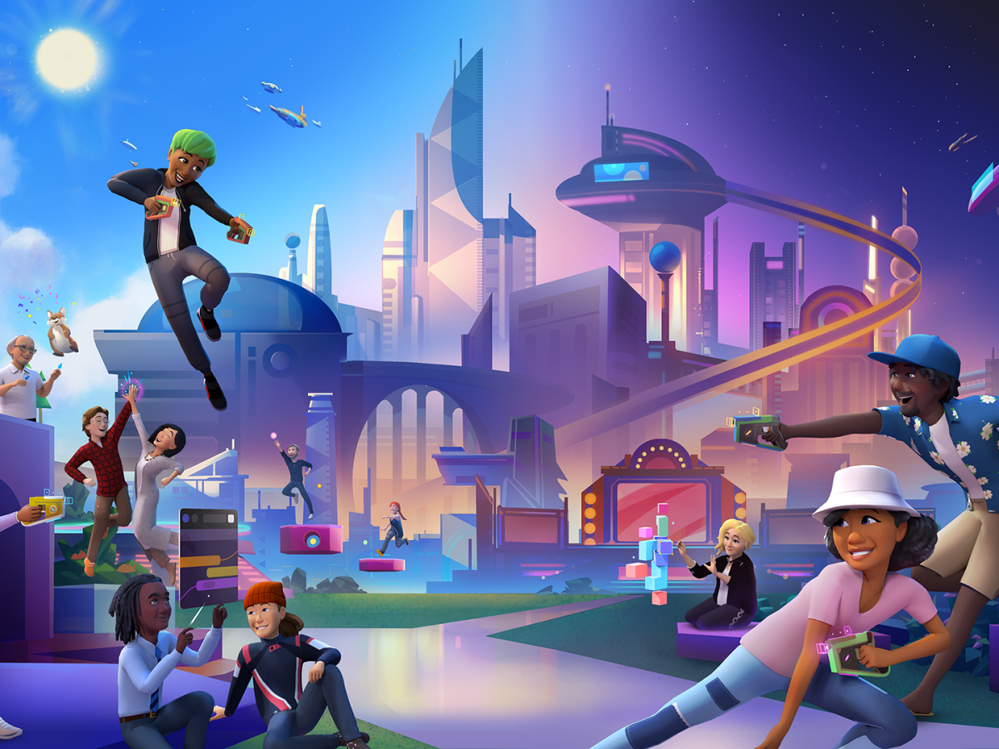
What is “Metaverse??”
Metaverse is a virtual world in which VR(Virtual Reality) and AR(Augmented reality) is used to go in a virtual world.
The user is represented as an avatar and can communicate with other avatars(user).

Slide 3
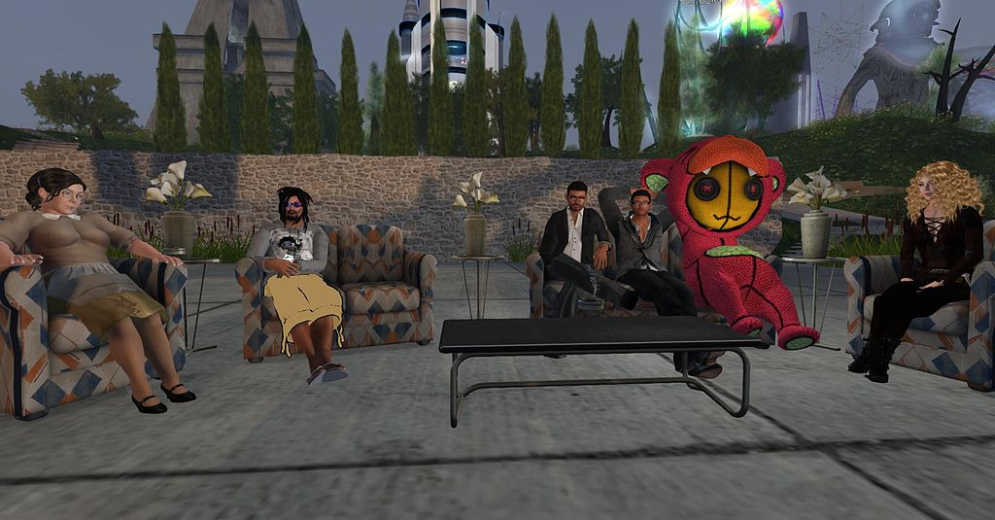
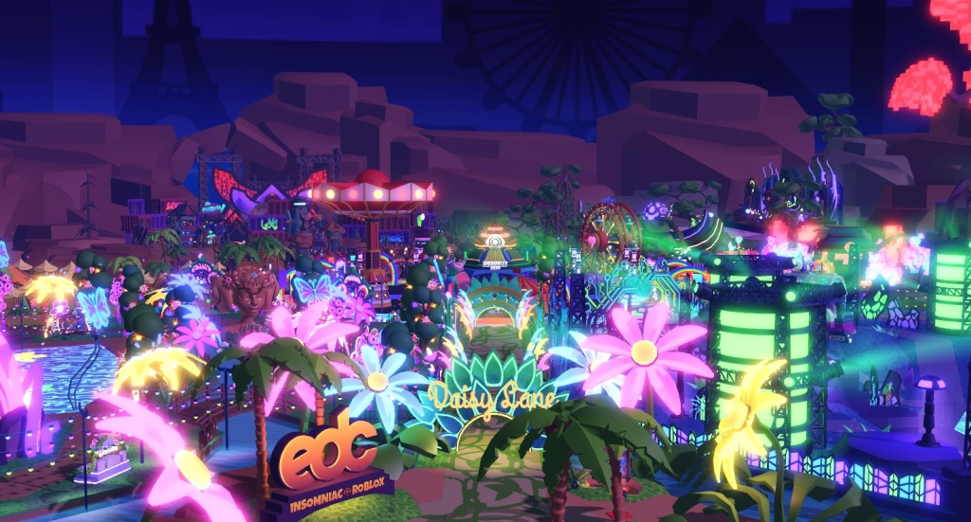
The implementation of “Metaverse”
The first ever implementation of metaverse was present in the game “Second Life”
Nowadays a lot of games like Roblox , Minecraft uses the metaverse
Metaverse is also used in various movies like the Free Guy , Matrix , Avatar etc
A screenshot of Second Life
The Roblox Metaverse

Slide 4
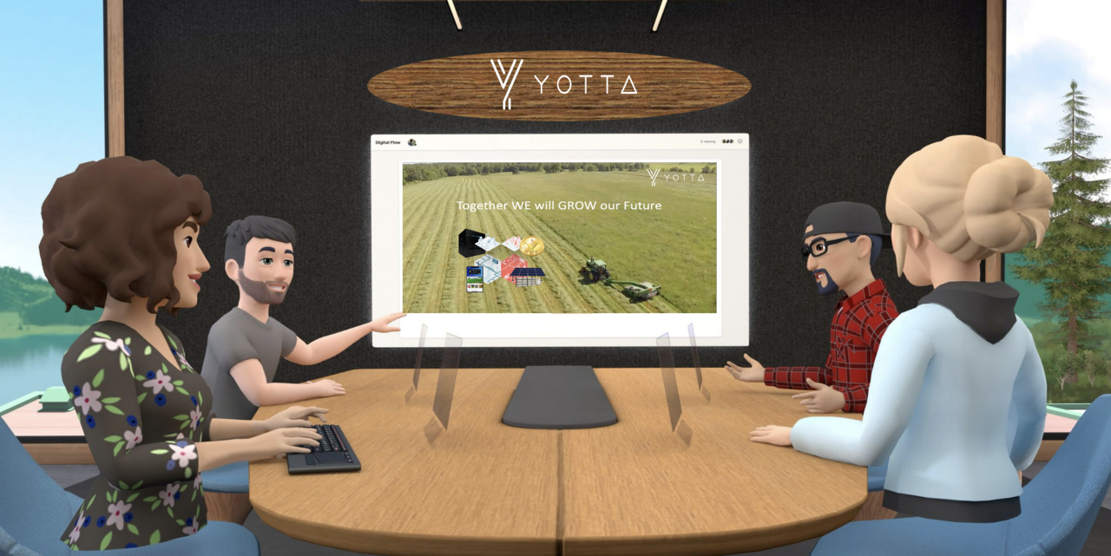
Metaverse in education
Metaverse can be used to learn a lot of things without buying a lot of books etc..
We can perform scientific experiments without being harmed.
You can get the benefits of going to school by staying in home.

Slide 5
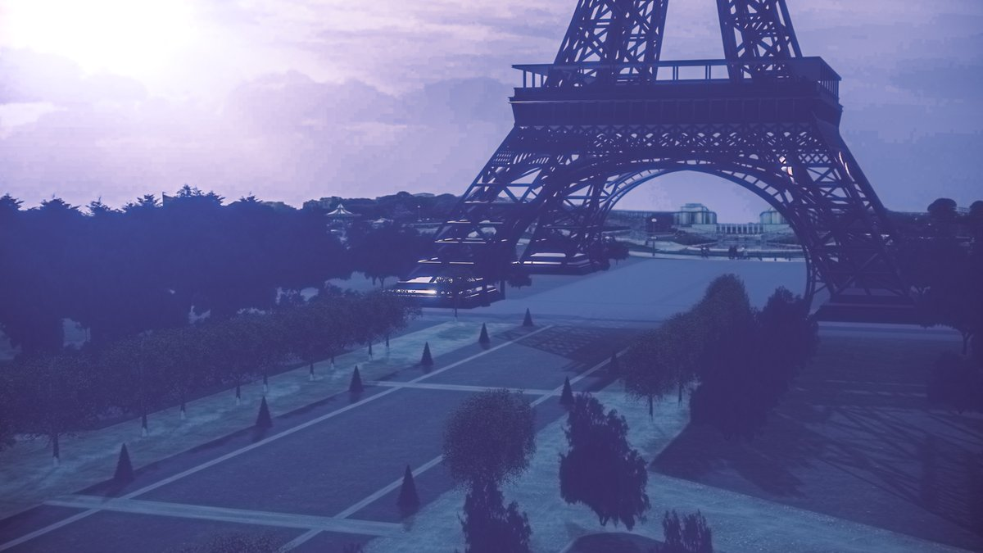
Uses of metaverse:-
Metaverse can be used to test new and upcoming technologies without anyone being harmed.
Metaverse can be used to visit places that we have never been before without the use of VISA , other currencies etc...
Through the resouces available in metaverse one can invent new/useful things and make our lives easier
Eifel Tower in VRChat

Slide 6
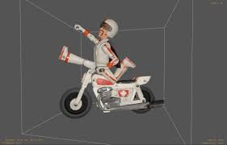
Technologies required in Metaverse:-
USD(Universal Scene Description):- It is the 3D Computer graphics used to create objects for the metaverse.
GItf:- It is the technology used to render 3D Models efficiently in seconds.
A USD Model of a bike

Slide 7
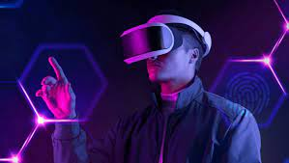
Problems faced in metaverse:-
Many people can get addicted to the metaverse and refuse to go back to the normal universe
A persons account can get hacked very easily and he can be arrested in the metaverses or even his account can be suspended.
Malicious programs can be created and executed and that may alter the workings on the metaverse.
A person addictred in the metaverse

Slide 8
Thank You and have a nice day!

