Slide 1
Bayes Classification

Slide 2
Naïve Bayes Algorithm
Classification, Estimation, Prediction
Used for large data set
Very easy to construct
Not using complicated iterative parameter estimations
Often does surprisingly well
May not be the best possible classifier
Robust, Fast, it can usually be relied on to

Slide 3
Naïve Bayes algorithm Reasoning
New information arrived
How to classify Target?
Target | Attribute 1 | Attribute 2 |  |  |  |  |  | Attribute n
… | … | … | .. | … | … | .. | .. | ..
.. |  |  |  |  |  |  | .. | ..
… |  |  |  |  |  |  | .. | …
Training Set
Target | Attribute 1 | Attribute 2 |  |  |  |  |  | Attribute n
 | a1 | a2 |  |  |  |  |  | an
Missing

Slide 4

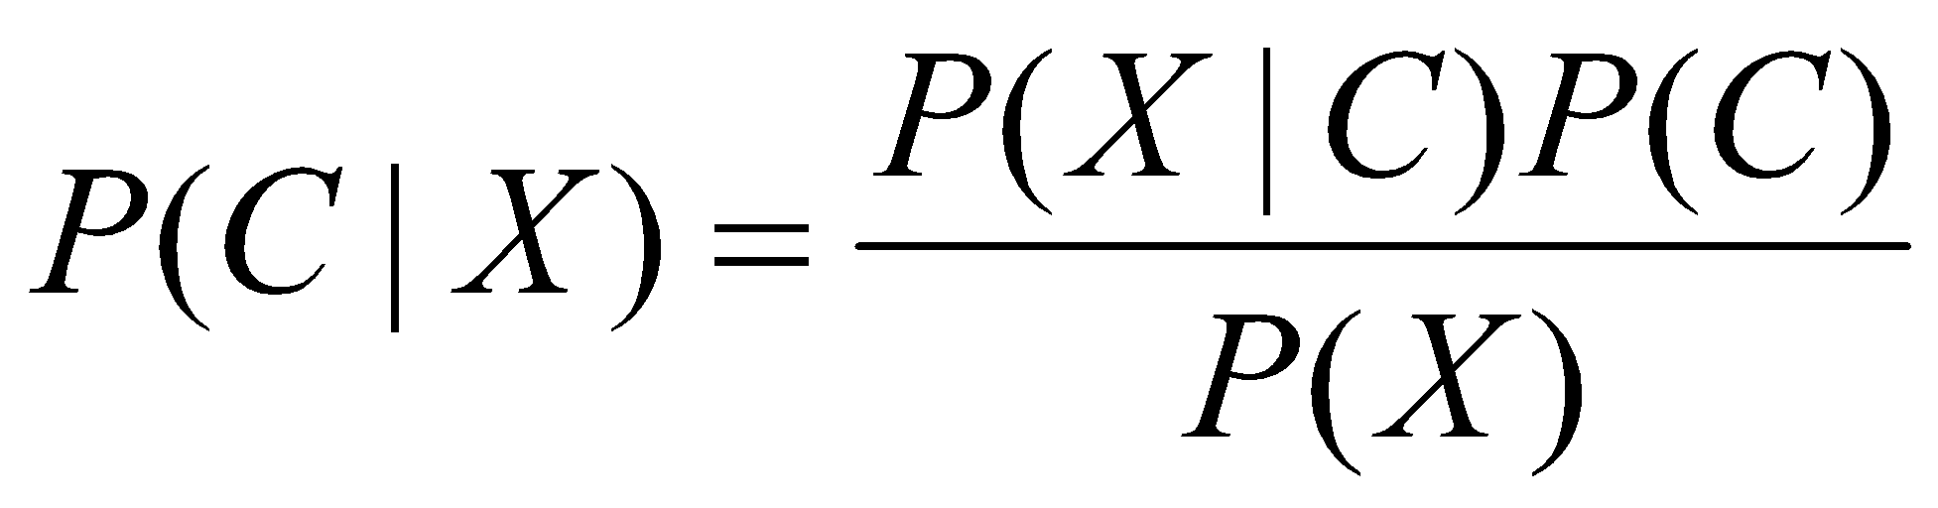
Bayes’s rule
(Reverent Thomas Bayes 1702-1761)
He set down his findings on probability in "Essay Towards Solving a Problem in the Doctrine of Chances" (1763), published posthumously in the Philosophical Transactions of the Royal Society of London

Slide 5
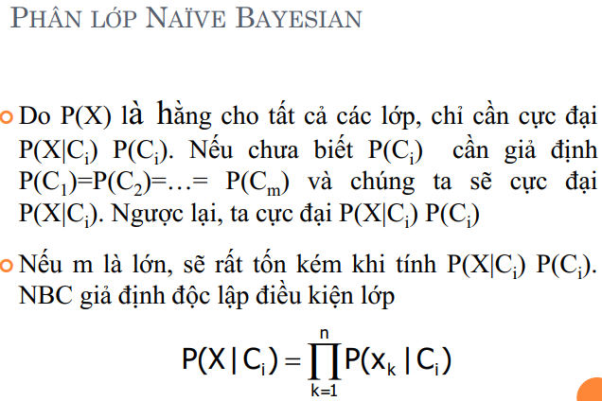

Slide 6
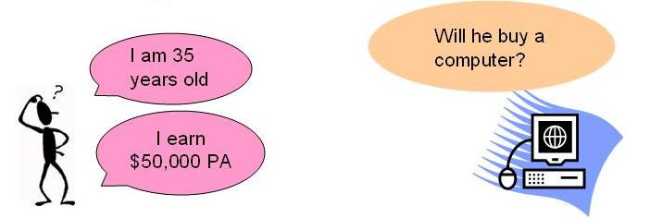
Naïve Bayes Discrete Target Example
 | Age | Income | Student | Credit | Target Buys Computer
1 | Youth | High | No | Fair | No
2 | Youth | High | No | Excellent | No
3 | Middle | High | No | Fair | Yes
4 | Senior | Medium | No | Fair | Yes
5 | Senior | Low | Yes | Fair | Yes
6 | Senior | Low | Yes | Excellent | No
7 | Middle | Low | Yes | Excellent | Yes
8 | Youth | Medium | No | Fair | No
9 | Youth | Low | Yes | Fair | Yes
10 | Senior | Medium | Yes | Fair | Yes
11 | Youth | Medium | Yes | Excellent | Yes
12 | Middle | Medium | No | Excellent | Yes
13 | Middle | High | Yes | Fair | Yes
14 | Senior | Medium | No | Excellent | No
Attributes = (Age=youth, Income=medium, Student=yes, Credit_rating=fair)
P(Attributes, Buys_Computer=Yes) =
P(Age=youth|Buys_Computer=yes) * P(Income=medium|Buys_Computer=yes) *
P(Student=yes|Buys_Computer=yes) * P(Credit_rating=fair|Buys_Computer=yes) * P(Buys_Computer=yes)
=2/9 * 4/9 * 6/9 * 6/9 * 9/14 = 0.028
Attributes = (Age=youth, Income=medium, Student=yes, Credit_rating=fair)
P(Attributes, Buys_Computer=No) = P(Age=youth|Buys_Computer=no) *
P(Income=medium|Buys_Computer=no) * P(Student=yes|Buys_Computer=no) *
P(Credit_rating=fair|Buys_Computer=no) * P(Buys_Computer=no)
=3/5 * 2/5 * 1/5 * 2/5 * 5/14 = 0.007

Slide 7
Naïve Bayes Discrete Target - Example
Attributes = (Age=youth, Income=medium, Student=yes, Credit_rating=fair)
Target = Buys_Computer = [Yes | No] ?
P(Attributes, Buys_Computer=Yes) =
P(Age=youth|Buys_Computer=yes) * P(Income=medium|Buys_Computer=yes) *
P(Student=yes|Buys_Computer=yes) * P(Credit_rating=fair|Buys_Computer=yes) * P(Buys_Computer=yes)
=2/9 * 4/9 * 6/9 * 6/9 * 9/14 = 0.028
P(Attributes, Buys_Computer=No) = P(Age=youth|Buys_Computer=no) *
P(Income=medium|Buys_Computer=no) * P(Student=yes|Buys_Computer=no) *
P(Credit_rating=fair|Buys_Computer=no) * P(Buys_Computer=no)
=3/5 * 2/5 * 1/5 * 2/5 * 5/14 = 0.007
⬄ P(Buys_Computer=Yes | Attributes) > P(Buys_Computer=No| Attributes)
Therefore, the naïve Bayesian classifier predicts Buys_Computer = Yes for previously given Attributes

Slide 8
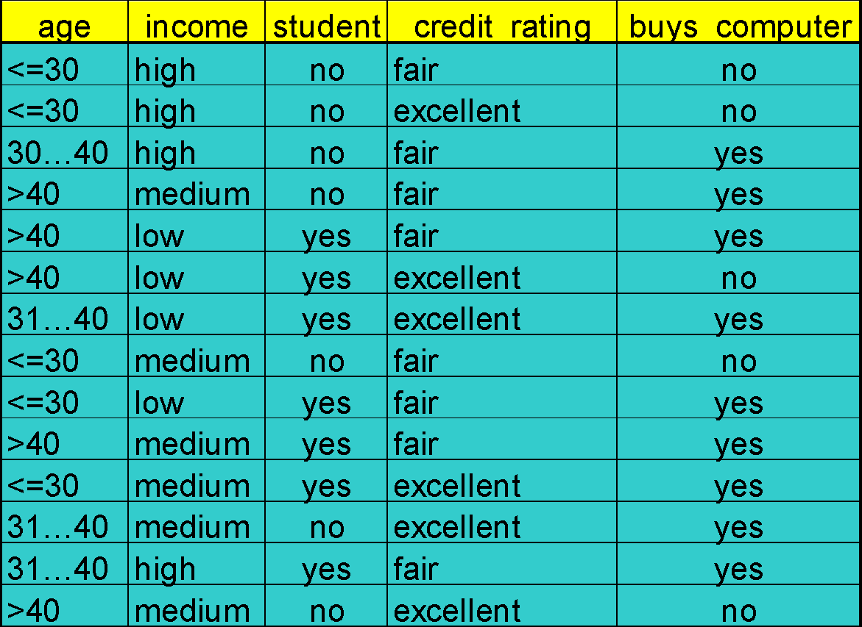
Example (15 minute)
Class:
C1:buys_computer=‘yes’
C2:buys_computer=‘no’
Data sample:
X =
(age<=30,
Income=medium,
Student=yes
Credit_rating=Fair)

