Slide 1
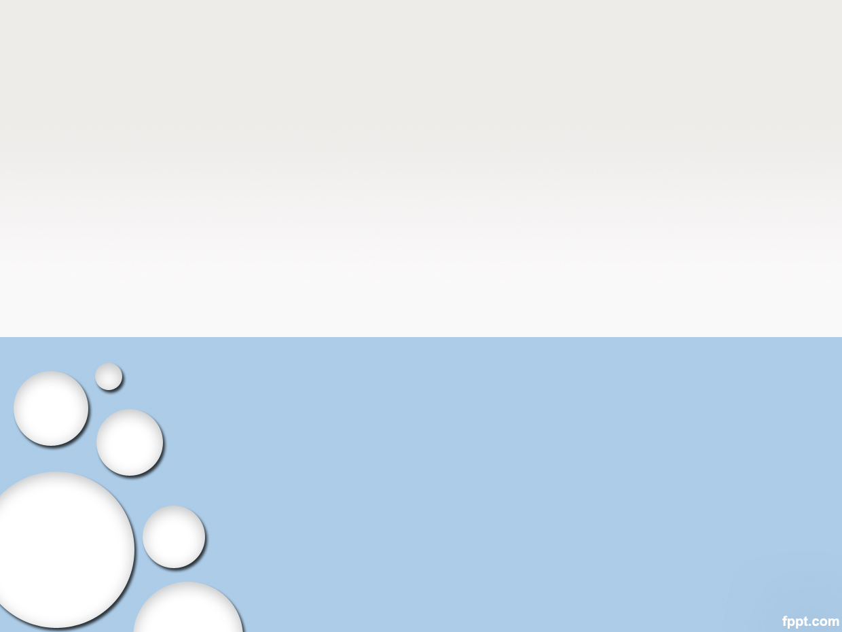
SW PROCESS

Slide 2
Example: System as below
2
Develop an Android application which can answer the Fortune Teller (Boi Toan) based on User Zodiac (Cung Hoang Dao).
After User receive result, User can choose to send Email the result to another person or User himself.
Notes:
2

Slide 3
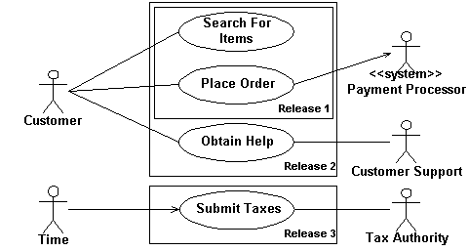
Use Case diagram
3
Component:
Actor (Customer, Customer Support): User which can use system
Use case (Search For Items): System provide functionality to each Actor.
Notes:
3

Slide 4
Use Case specification
4
Provide the Flow of each Use Case:
Example: Use Case “Search For Items”
Step | Actor | Description
Normal Flow
1 | Customer | Select on Search text box, Typing a Word to search
2 | Customer | Click Search button
3 | System | Will display Loading icon during search
4 | System | When search finished, result is displayed as List
Alternative Flow
3a | System | If User type invalid Characters (* ?), system display Error message
4a | System | If no search result, message “No Result” is displayed
3a mean Abnormal result at Step 3
Notes:
4

