Slide 1
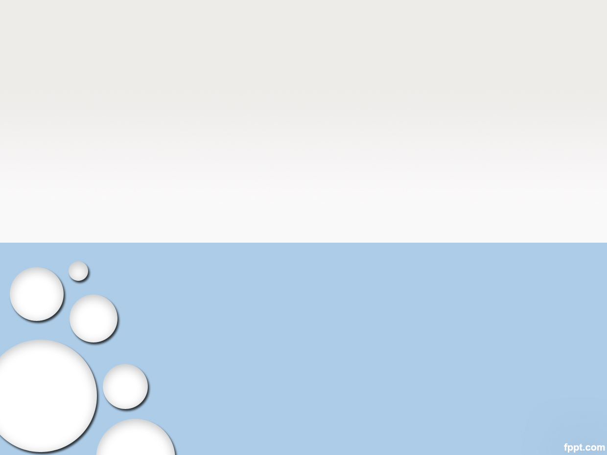
SW PROCESS

Slide 2
Outline
Introduction
Defining Web Service Contract
Check Compatibility
Evaluate Services
Implementation
Conclusion

Slide 3
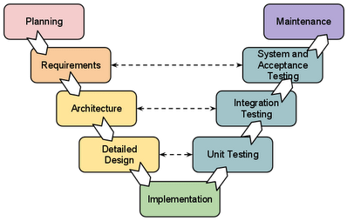
V Model (or Waterfall model)
3
V Model:
Use Case diagram
System Test Specification
Use Case Specification
May be Removed
GUI Design
Unit Test Specification (can Skip)
Software Design
Question&Answer sheet
Coding Rules
Notes:
3

Slide 4
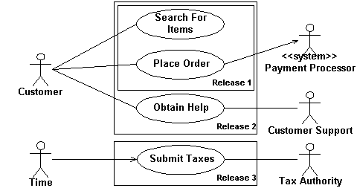
Use Case diagram
4
Component:
Actor (Customer, Customer Support): User which can use system
Use case (Search For Items): System provide functionality to each Actor.
Notes:
4

Slide 5
Use Case specification
5
Provide the Flow of each Use Case:
Example: Use Case “Search For Items”
Step | Actor | Description
Normal Flow
1 | Customer | Select on Search text box, Typing a Word to search
2 | Customer | Click Search button
3 | System | Will display Loading icon during search
4 | System | When search finished, result is displayed as List
Alternative Flow
3a | System | If User type invalid Characters (* ?), system display Error message
4a | System | If no search result, message “No Result” is displayed
3a mean Abnormal result at Step 3
Notes:
5

Slide 6
Web services
6
Web services take Web-applications to the next level
By using Web services, your application can publish its functions or messages to the rest of the world.
Allows different applications from different sources to communicate with each other.
WSDL is an XML format for describing and locating Web services, de facto language for writing Web service contracts.
Drawbacks:
WSDL only defines a basic set of functional requirements for Services, specifically as they apply to Web Services.
WSDL does not define non-functional requirements such as security, transactionality, process, commerce, reliability...
Notes:
6

Slide 7
Web services
7
Web services take Web-applications to the next level
By using Web services, your application can publish its functions or messages to the rest of the world.
Allows different applications from different sources to communicate with each other.
WSDL is an XML format for describing and locating Web services, de facto language for writing Web service contracts.
Drawbacks:
WSDL only defines a basic set of functional requirements for Services, specifically as they apply to Web Services.
WSDL does not define non-functional requirements such as security, transactionality, process, commerce, reliability...
Notes:
7

Slide 8
Example: System as below
8
Develop an Android application which can answer the Fortune Teller (Boi Toan) based on User Zodiac (Cung Hoang Dao).
After User receive result, User can choose to send Email the result to another person or User himself.
Notes:
8

