Slide 1

SW PROCESS

Slide 2
Outline
V Model
Requirement Step
Design
Coding
System Test
Trial Project

Slide 3
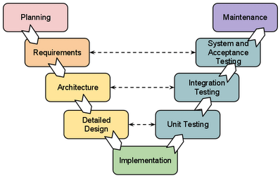
V Model (or Waterfall model)
3
V Model:
Use Case diagram
System Test Specification
Use Case Specification
May be Removed
GUI Design
Unit Test Specification (can Skip)
Software Design
Question&Answer sheet
Coding Rules
Notes:
3

Slide 4
Outline
V Model
Requirement Step
Design
Coding
System Test
Trial Project

Slide 5
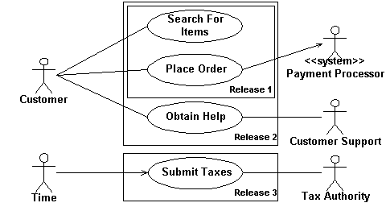
Use Case diagram
5
Component:
Actor (Customer, Customer Support): User which can use system
Use case (Search For Items): System provide functionality to each Actor.
Notes:
5

Slide 6
Use Case specification
6
Provide the Flow of each Use Case:
Example: Use Case “Search For Items”
Step | Actor | Description
Normal Flow
1 | Customer | Select on Search text box, Typing a Word to search
2 | Customer | Click Search button
3 | System | Will display Loading icon during search
4 | System | When search finished, result is displayed as List
Alternative Flow
3a | System | If User type invalid Characters (* ?), system display Error message
4a | System | If no search result, message “No Result” is displayed
3a mean Abnormal result at Step 3
Notes:
6

Slide 7
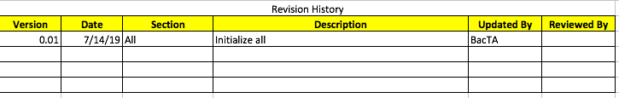
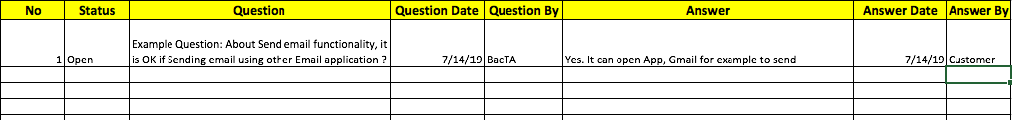
About Q&A
7
About Revision History: the table describe the History qua tat cac Version cua document (Qua Trinh)
Q&A: Can describe Question, Answer, Date and Status (Open or Close; Close mean Answer is OK).
Notes:
7

Slide 8
Outline
V Model
Requirement Step
Design
Coding
System Test
Trial Project

Slide 9
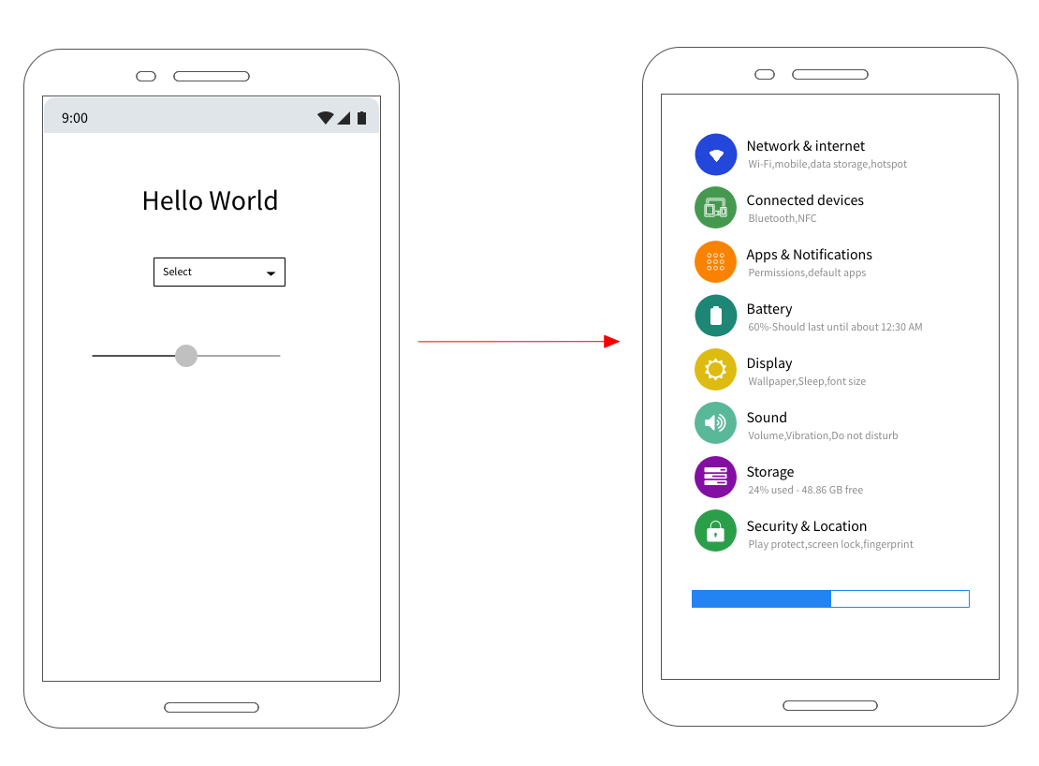
GUI Design
9
In initial phase, we can use some Application to draw the GUI Fast, so we can (1) confirm with Customer/ or (2)can imagine whole application/ also (3)used for System Testing.
Example using simple Wired Frame app
Notes:
9

Slide 10
SW Design
10
Class diagram: https://www.visual-paradigm.com/guide/uml-unified-modeling-language/what-is-class-diagram/
Sequence diagram: https://www.visual-paradigm.com/guide/uml-unified-modeling-language/what-is-sequence-diagram/
Notes:
10

Slide 11
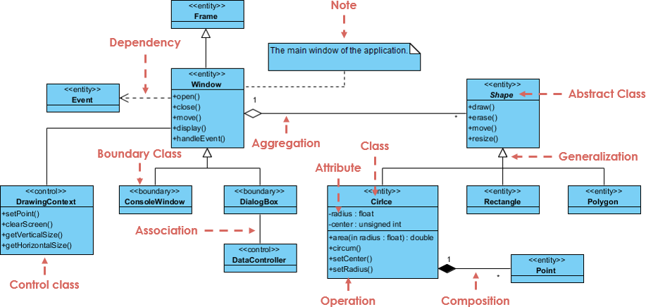
SW Design (2)
11
Class diagram:
Notes:
11

Slide 12
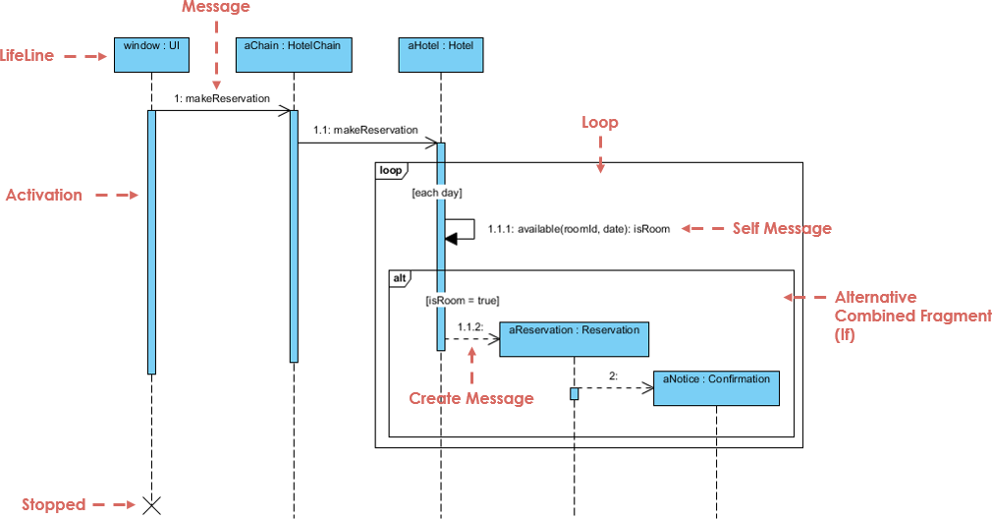
SW Design (3)
12
Sequence diagram:
Notes:
12

Slide 13
Outline
V Model
Requirement Step
Design
Coding
System Test
Trial Project

Slide 14
Coding Rules
14
Android standard:
https://source.android.com/setup/contribute/code-style
Some Java coding rules, can refer if have time:
https://google.github.io/styleguide/javaguide.html
Notes:
14

Slide 15
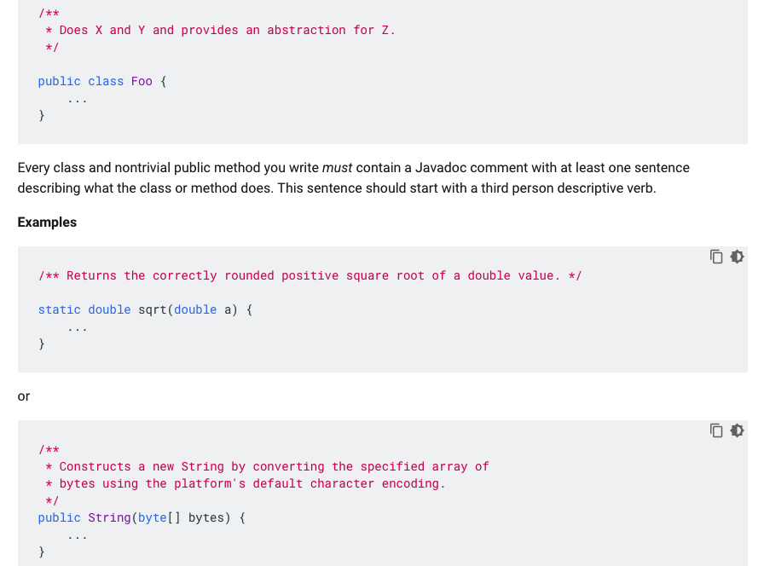
Coding Rules (2) Special Notes
15
Code must have comments for each function, each special code:
Notes:
15

Slide 16
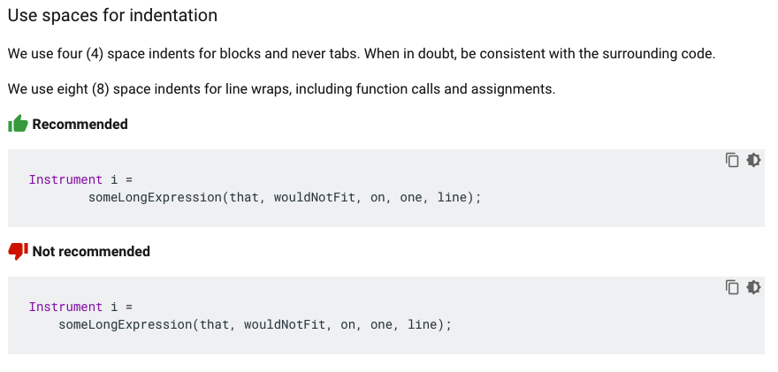
Coding Rules (3) Special Notes
16
Indent using 4 Spaces. Each line of text in your code should be at most 100 characters long
When New Line (Xuong dong), using 8 Spaces
Notes:
16

Slide 17
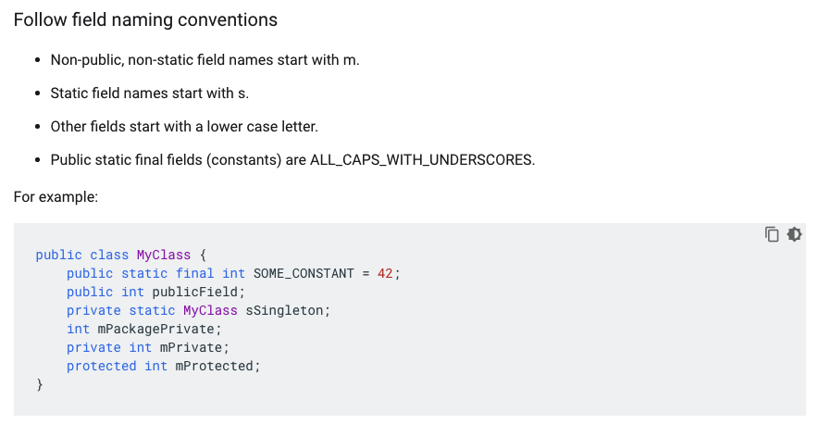
Coding Rules (4) Special Notes
17
Naming prefix for Class member:
Notes:
17

Slide 18
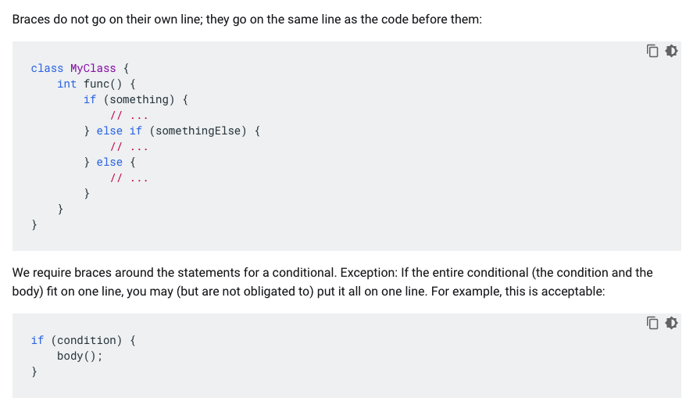
Coding Rules (5) Special Notes
18
Bracket (“{”) on same line. Always use {}, even Only 1 Line
Notes:
18

Slide 19
Outline
V Model
Requirement Step
Design
Coding
System Test
Trial Project

Slide 20
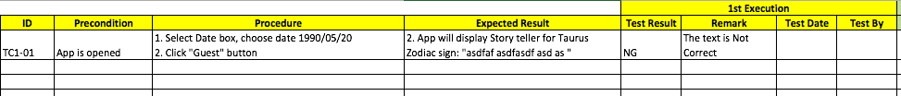
System Test Specification
20
We write Test Spec based on GUI design and Use Case specification
Precondition: Tiền điều kiện, cần có trước khi chạy test
Procedure: Các bước chạy lần luợt
Expected Result: Kết quả mong muốn với từng Step chạy
Test Result...: Kết quả từng lần chạy
Notes:
20

Slide 21
Outline
V Model
Requirement Step
Design
Coding
System Test
Trial Project

Slide 22
Example: System as below
22
Develop an Android application which can answer the Fortune Teller (Boi Toan) based on User Zodiac (Cung Hoang Dao).
After User receive result, User can choose to send Email the result to another person or User himself.
Notes:
22

