Slide 1
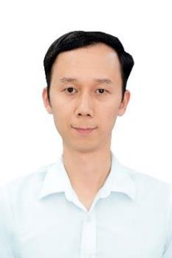
Résumé – Son Tran Ngoc
Education
Main focus / (key) technical skills
1999 – 2004 Hanoi University of Science and Technology
Degree: Engineer
2004 – 2006 Hanoi University of Science and Technology
Degree: Master
2005 – 2015 Certificates: RHCE, RHCT, RHCSA, MCSE, MCSA, MCITP, MCT, CCNA, CCNP, CEH, GCP Associate Cloud Engineer, GCP Professional Cloud Architect, AWS Certified Solutions Architect Associate
Main focus: DevOps/SRE
OS: CentOS, Ubuntu, Windows Server
Virtualization: VMWare, KVM
Container/ Orchestration : Docker, Docker Compose, Kubernetes
Logging: Prometheus, Grafana
IaC: Terraform, Ansible
Cloud: Google Cloud
CI/CD: Jenkins, GitLab-CI
Source code management: Git
Networking: OSI, TCP/IP
Web server: Apache, Nginx, Kong
Application: Golang app, Java app
Database: MySQL, PostgreSQL, Redis
Business / Professional Experience
05/2021 – Present: DevOps Engineer, NTTData VDS
12/2018 – 04/2021: VinID (Vingroup), DevOps/SRE, Hanoi
02/2007 – 11/2017: DTT, Lead of System Engineer, Hanoi
02/2006 – 02/2007: CMC SI, System Engineer, Hanoi
02/2005 – 01/2006: Vietsoftware, Linux System Engineer, Hanoi
06/2004 – 02/2005: Tecapro, Technical Specialist, Hanoi
Projects & Assignments (extract)
DevOps Engineer for SKY project: Build up and maintain the Google infrastructure with Terraform and Ansible codes using CI/CD Jenkins pipelines.
DevOps for VinID Digital Financial Services: Ekyc, Credit Scoring, Risk Engine, Lending Service.
Migrating the PeopleCare wallet system to VinID System. Implementing network and middleware systems of the T24 transaction core system of VinID.
  Doing DevOps for many microservices in VinID with Google Cloud, Kubernetes and Gitlab CI with high performance: Service Platform (The core of profiling and authenticating VinID's client users), Ticketing, Voucher and Money Transfer...
  Responsibilities to design, setup, configure, maintain,troubleshoot DTT's Open Egov Platforms for Public Sectors such as: Da Nang, Ha Noi, MOT, MOH, MOJ…
  Training RedHat courses
Industry Know-how
E-govement Platform
Digital Financial Services
Training
<number>

