Slide 1
Robust Multi-objective Iterative Learning Control
Tong Duy Son
Promoters
Prof. Jan Swevers
Prof. Goele Pipeleers
September 2016

Slide 2
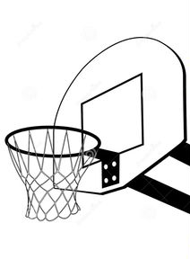


1st try

Slide 3
2nd try

Slide 4
3rd try

Slide 5
1. perform
2. analyze
3. do again (and better)
3rd try

Slide 6



Repetitions
1. perform
2. analyze
3. do again (and better)

Slide 7
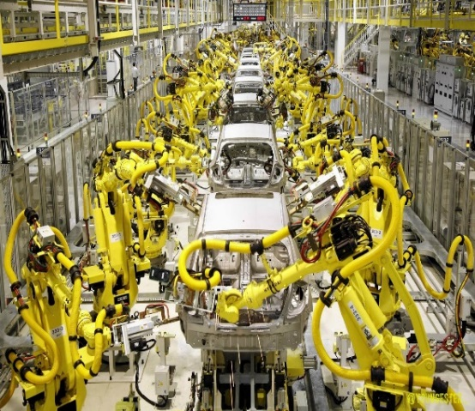
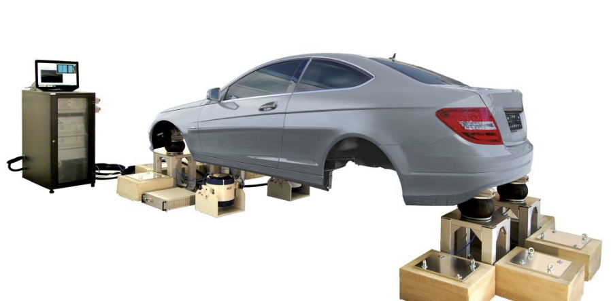

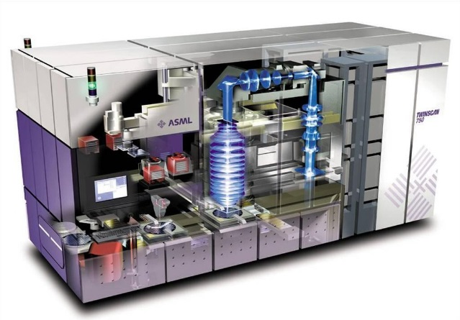
Repetitions in industry
vehicle testing
industrial robots
batch processes
semiconductor

Slide 8
Repetitions in industry
control system
vehicle testing
industrial robots
batch processes
semiconductor

Slide 9
Challenges
Goal of this thesis
Improve the control system
Exploit ‘repetition’
Improvements in
Robustness
Precision
Fast
Energy efficiency

Slide 10
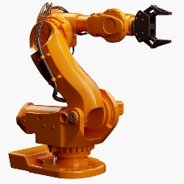
Sketch of Control
Consider a robot arm in a factory
input
desired output
Desired output: pick an object from A to B
Question: What input should you apply?

Slide 11

Sketch of Control
knowledge of the system!
input
desired output
$$y=f(x,u)$$
Desired output: pick an object from A to B
Question: What input should you apply?

Slide 12

Sketch of Control
Feedback
FeedbackController
$$y=f(x,u)$$
Feedforward
Feedforward Controller

Slide 13
Sketch of Control
Feedback
Model uncertainty
Disturbance
Transient response, lag
Non-minimum phase
Feedforward
Highly dependent on accuracy of the model
Disturbance has to be known

Slide 14

Sketch of Control
Feedback
Model uncertainty
Disturbance
Transient response, lag
Non-minimum phase
feedforward
feedforward
feedback
feedback
Feedforward
no control
no control
Highly dependent on accuracy of the model
Disturbance has to be known

Slide 15

Sketch of Control
Feedback
Model uncertainty
Disturbance
Transient response, lag
Non-minimum phase
feedforward
feedback
Feedforward
no control
Highly dependent on accuracy of the model
Disturbance has to be known

Slide 16




Repetitions in industry
same task and same performance
hundreds to thousands times a day

Slide 17
Revisit: Challenges
Goal of this thesis
Improve the control system
Exploit ‘repetition’
Iterative learning control (ILC): improves control performance by incorporating information from previous trials

Slide 18
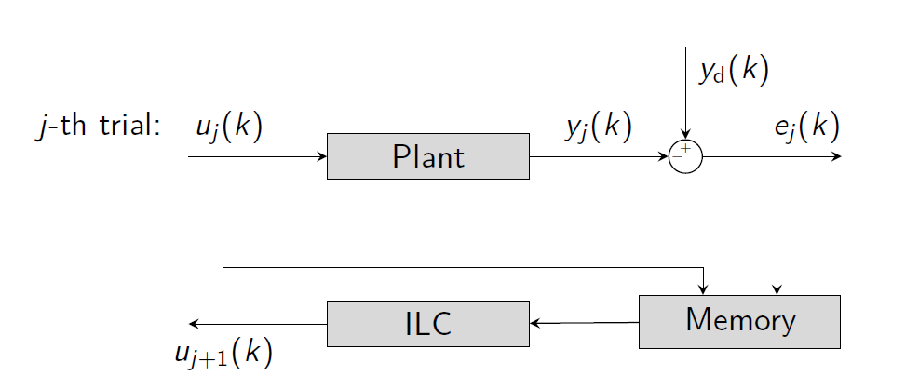

Iterative Learning Control (ILC)
${u_{j+1}}^{}= {Q(u}_{j}+L e_{j}$)
Iterative learning control (ILC): improves control performance by incorporating information from previous trials

Slide 19
Main contributions
Multi-objective frequency domain ILC
Lifted system ILC: analysis and synthesis
Robust norm-optimal ILC

Slide 20
Main contributions
Multi-objective frequency domain ILC
Lifted system ILC: analysis and synthesis
Robust norm-optimal ILC

Slide 21
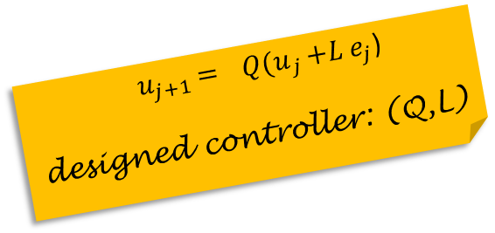
Introduction (1)
${ u}_{j+1} = { Q(u}_{j}+L e_{j}$)
designed controller: (Q,L)
Most ILC designs reply on a two-step sequential problem formulation and the design procedures are usually heuristic:
Design L then design Q:
L as model-inversion or phase-lead type
Q as a low-pass filter: depends on designed
Design Q then design L:
design Q
find L that optimize the learning speed
Iterate the previous 2 designs
The design is not optimal while costly and time consuming!

Slide 22




Introduction (2)
Hard to incorporate multi-objective intuitively
Robustness (unmodeled dynamics, uncertain parameter…)
Robustness vs tracking performance
Unknown: robustness and tracking performance vs learning speed
have 1 month training have 4 year training (i.e. for Olympic): more difficult attempts
Input constraints
Trade-offs between the objectives

Slide 23
Methodology
Design Q, L simultaneously using optimization
Accounts for the trade-off designs
Approach:
First, specify the desired performance, input constraints, and robustness conditions. Next, design ILC controller (Q, L) to optimize the convergence (learning) speed with the given specifications
minimize convergence speed
Q,L
subject to robust performance
robust convergence
input constraints

Slide 24
Methodology
Design Q, L simultaneously using optimization
Accounts for the trade-off designs
Approach:
First, specify the desired performance, input constraints, and robustness conditions. Next, design ILC controller (Q, L) to optimize the convergence (learning) speed with the given specifications
minimize convergence speed
Q,L
subject to robust performance
robust convergence
input constraints
non-convex,
hard to solve!

Slide 25
Methodology
Design Q, L simultaneously using optimization
Accounts for the trade-off designs
Approach:
First, specify the desired performance, input constraints, and robustness conditions. Next, design ILC controller (Q, L) to optimize the convergence (learning) speed with the given specifications
minimize convergence speed
Q,L
subject to robust performance
robust convergence
input constraints
non-convex,
hard to solve!
reformulated as
a linear program

Slide 26
Advantages (1)
multi-objective
optimality
Multi-objective
computation
intuition
flexibility

Slide 27
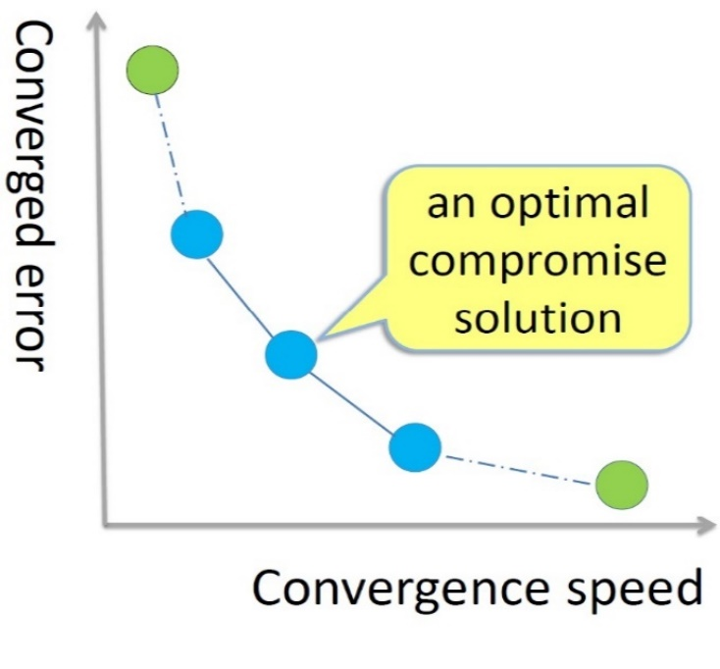
Advantages (1)
multi-objective
optimality
Multi-objective
computation
and their trade-offs:
convergence speed
input constraints
robust convergence
robust performance
intuition
flexibility
Notes:
aa

Slide 28
Advantages (2)
multi-objective
optimality
Optimality
computation
no 2-step and heuristic design
(Q, L) is simultaneously generated using optimization
noncausal ILC controller
intuition
flexibility
Computation
reliable as a result of a linear program

Slide 29
Advantages (4)
multi-objective
optimality
Flexibility
computation
controller type: FIR, IIR, PID...
different objectives:
intuition
flexibility
minimize tracking performance
Q,L
subject to convergence speed
robust convergence
input constraints
no parametric model is required, only FRFs
continuous and discrete
selecting interested frequencies: i.e. for noise and disturbance rejection.

Slide 30
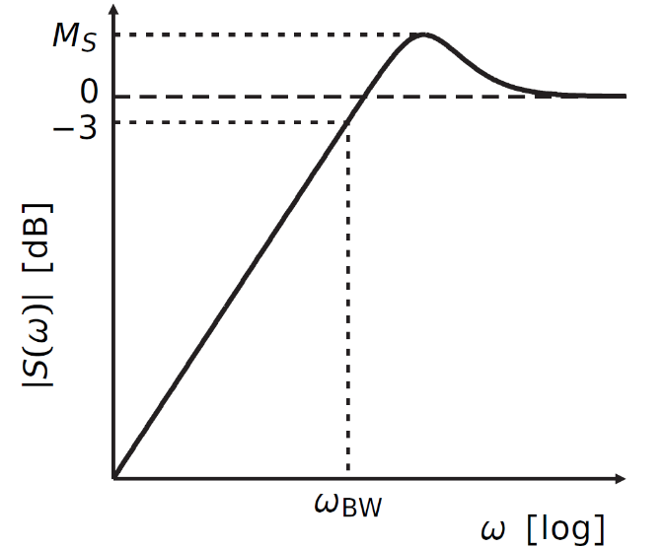
Advantages (5)
multi-objective
optimality
computation
Intuition
Use conventional control system terminologies: sensitivity function, bandwidth
intuition
flexibility

Slide 31
Advantages (5)
multi-objective
optimality
computation
Intuition
Use conventional control system terminologies: sensitivity function, bandwidth
intuition
flexibility
Automated design possible
system model (FRFs)
Multi-objective
ILC algorithm
ILC controller
(and learning speed)
performance specs. (bandwidth)

Slide 32
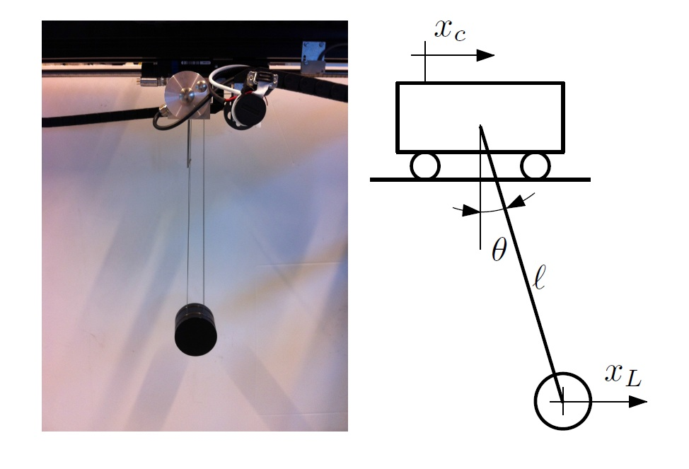
Control Development
Simulation & Experimental Validation
Validation
Validate the proposed ILC designs: simulations and experiments
Validate the multi-objective trade-offs
Compare with existing designs

Slide 33
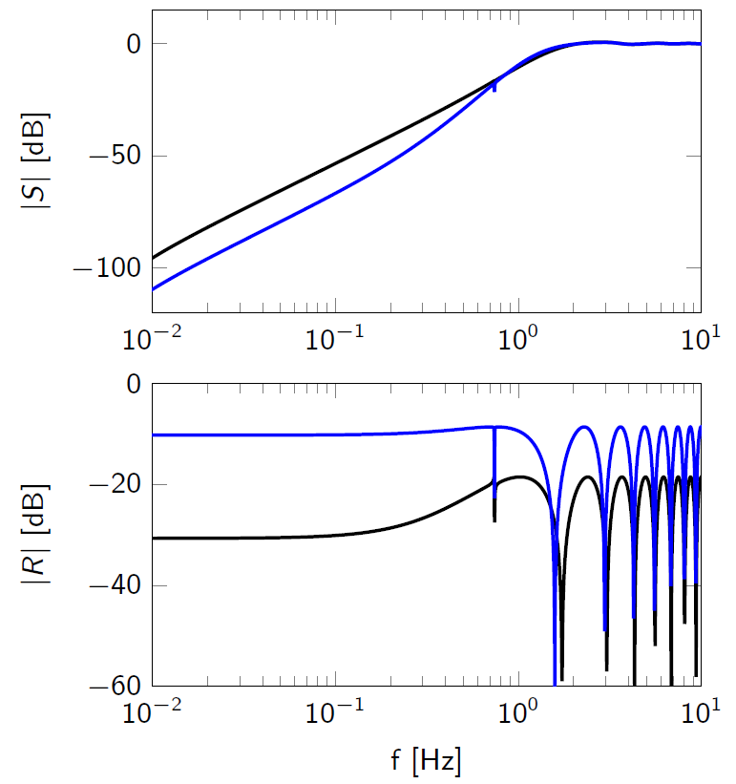
Control Development
Simulation & Experimental Validation
Validation
tracking performance function (sensitivity function)
convergence (learning) speed function

Slide 34
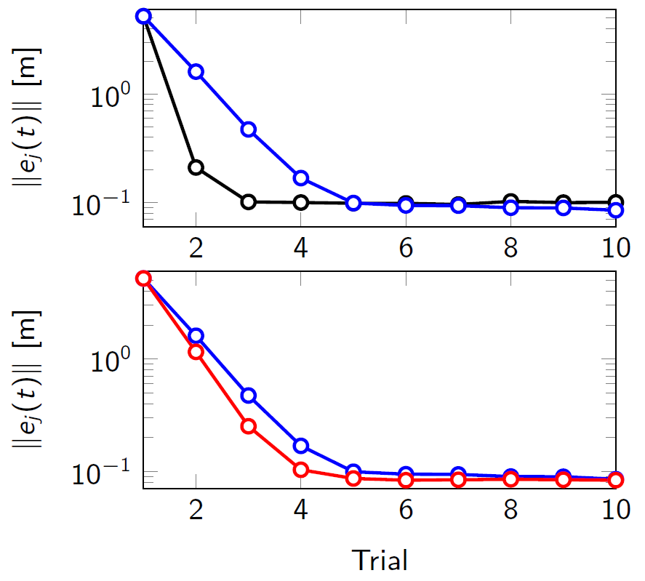
Control Development
Simulation & Experimental Validation
Validation
convergence speed vs
tracking performance with
2 different designs
convergence speed vs
input constraints
red: no constraint

Slide 35

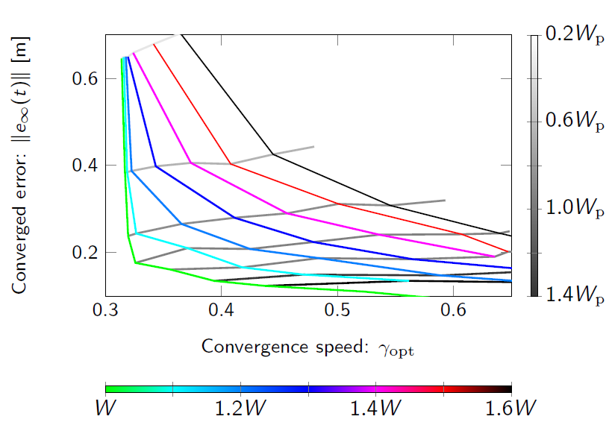
Validation: trade-off designs
Control Development
Simulation & Experimental Validation
Select the desired controller:
desired tracking performance
desired learning speed
level of uncertainty

Slide 36
Main contributions
Multi-objective frequency domain ILC
Lifted system ILC: analysis and synthesis
Robust norm-optimal ILC

Slide 37

Introduction
${ u}_{j+1} = { Q(u}_{j}+L e_{j}$)
designed controller: (Q,L)
Consider multiple objectives as previous,
but investigate time domain using lifted system representation
of finite trial length.
(Q,L) are matrix variables
Study robust analyses
Proposes ILC syntheses (designs)

Slide 38

Robustness
Robust monotonic convergence and robust performance analyses
an LMI (or BMI) problem
i.e. $\left[\begin{matrix}∗ & ∗ \\ ∗ & ∗\end{matrix}\right]≽0$
Both unstructured and structured uncertainty are considered

Slide 39
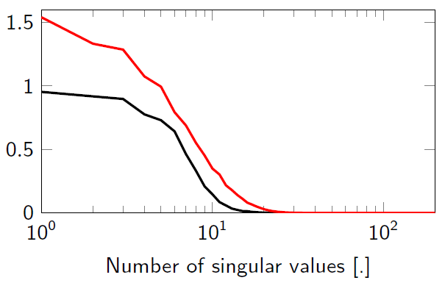
Synthesis
${ u}_{j+1} = { Q(u}_{j}+L e_{j}$)
designed controller: (Q,L)
(for short/moderate trial lengths)
Synthesis I: Optimize convergence speed
Synthesis II: Optimize tracking error
minimize convergence speed
L
subject to an LMI problem
minimize tracking error
Q
subject to an LMI problem

Slide 40
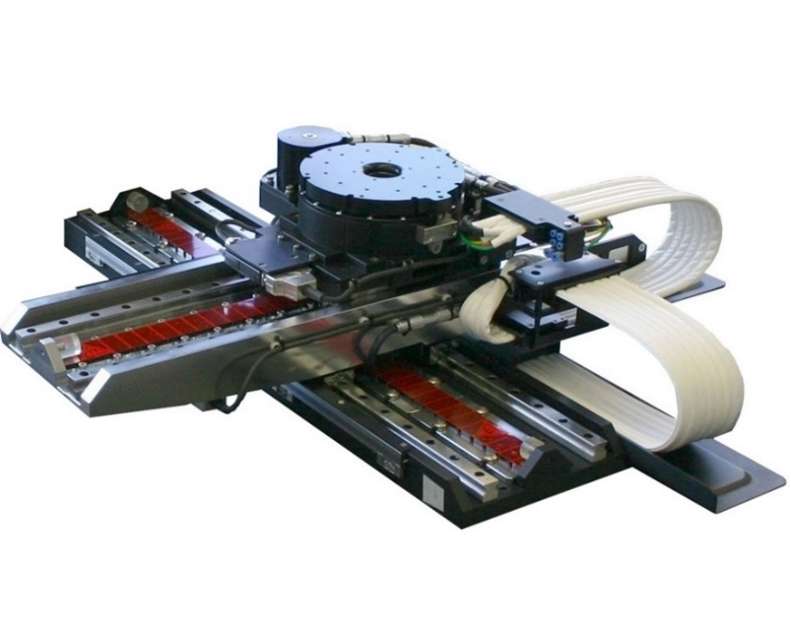
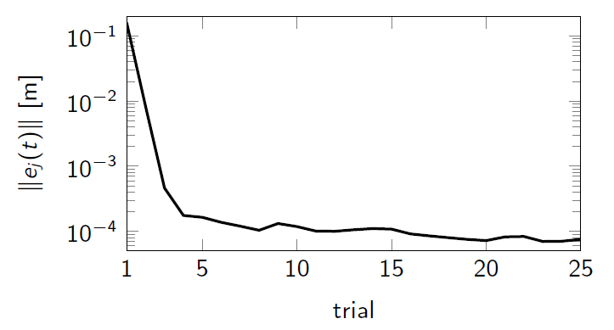
Control Development
Simulation & Experimental Validation
Validation
XY-wafer stage with linear motor

Slide 41
Main contributions
Multi-objective frequency domain ILC
Lifted system ILC: analysis and synthesis
Robust norm-optimal ILC

Slide 42



Introduction
Norm-optimal ILC is an efficient way to design the optimal ILC input:
$J\left(u_{j+1}^{}\right)$ is the cost function w.r.t the nominal model (no uncertainty model is accounted)
analytical solution (noncausal, time-varying controller)
has to sacrifice a lot tracking performance to obtain robustness
minimize
$$J\left(u_{j+1}^{}\right)$$
$$u_{j+1}^{}$$

Slide 43







Methodology
obtain both robustness and high tracking performance
deal with input constraints
efficient computation
Approach:
optimize the worst-case cost function:
minimize sup
$$J\left(u_{j+1}^{}, ∆\right)$$
$$u_{j+1}^{}$$
$$∆ ∈ℬ_{∆}$$
subject to input constraints
$$J\left(∆\right)$$
$$J_{nom}$$
$$J_{wc}$$
$$∆$$

Slide 44
Methodology
obtain both robustness and high tracking performance
deal with input constraints
efficient computation
Approach:
optimize the worst-case cost function:
minimize sup
$$J\left(u_{j+1}^{}, ∆\right)$$
$$u_{j+1}^{}$$
$$∆ ∈ℬ_{∆}$$
non-convex
problem
subject to input constraints
$$J\left(∆\right)$$
$$J_{nom}$$
$$J_{wc}$$
$$∆$$

Slide 45


Methodology
obtain both robustness and high tracking performance
deal with input constraints
efficient computation
Approach:
optimize the worst-case cost function:
minimize sup
$$J\left(u_{j+1}^{}, ∆\right)$$
$$u_{j+1}^{}$$
$$∆ ∈ℬ_{∆}$$
non-convex
problem
subject to input constraints
minimize
$$J_{dual}\left(u_{j+1}^{},γ_{j+1}^{}\right)$$
$u_{j+1}^{}$, $γ_{j+1}^{}$
reformulated as
a convex problem
subject to input constraints

Slide 46





Advantages
obtain robustness w.r.t. cost function (proved):
$J\left(u_{j+1}^{}\right) ≤J_{wc}≤J\left(u_{j}^{}\right)$
deal with input constraints
efficient computation
high tracking performance?
$$J\left(∆\right)$$
$$J_{nom}$$
$$J_{wc}$$
$$∆$$

Slide 47

Advantages
obtain robustness w.r.t. cost function (proved):
$J\left(u_{j+1}^{}\right) ≤J_{wc}≤J\left(u_{j}^{}\right)$
high tracking performance?
Considering the same cost function:
if the classical norm-optimal ILC diverges, the proposed robust ILC still converges.
if the classical norm-optimal ILC converges, the robust ILC also converges to similar tracking performance but with lower convergence speed

Slide 48
Advantages (cont.)
deal with input constraints
efficient computation
the selection of weight matrices is not critical as other norm- optimal ILC designs.
the proof of the equivalence to an adaptive norm-optimal ILC (trial-varying controller) can be used to avoid solving optimization if needed (i.e. when convergence is already obtained).

Slide 49
Control Development
Simulation & Experimental Validation
Validation
Validate the proposed ILC designs: simulations and experiments
Compare with classical (robust and non-robust) norm-optimal ILC: accurate model, inaccurate model

Slide 50
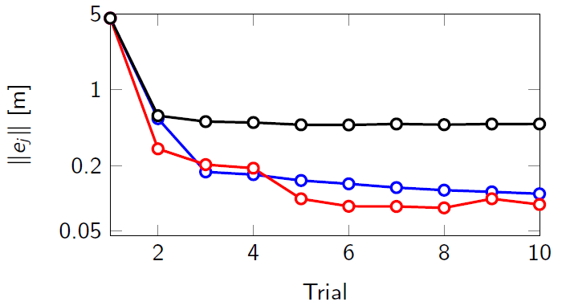
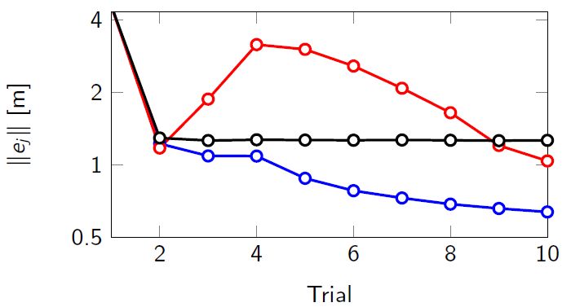
Control Development
Simulation & Experimental Validation
Validation
Validate the proposed ILC designs: simulations and experiments
Compare with classical (robust and non-robust) norm-optimal ILC: accurate model, inaccurate model
accurate model
red: classical norm-optimal ILC
blue: proposed ILC
black: other robust design
inaccurate model

Slide 51
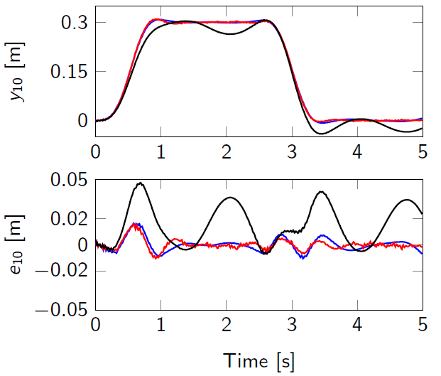
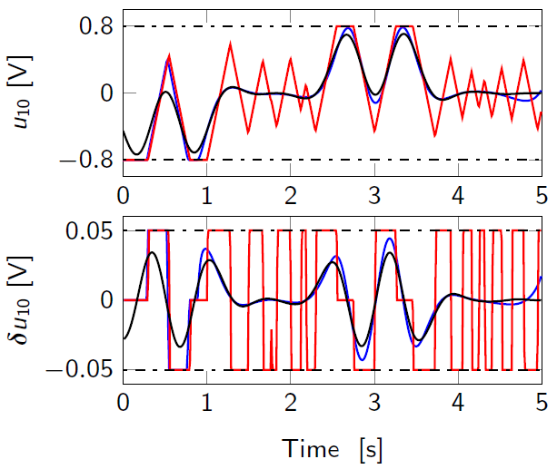
Control Development
Simulation & Experimental Validation
Validation
Validate the proposed ILC designs: simulations and experiments
Compare with classical (robust and non-robust) norm-optimal ILC: accurate model, inaccurate model
accurate model

Slide 52
Main contributions
Multi-objective frequency domain ILC
Lifted system ILC: analysis and synthesis
Robust norm-optimal ILC

Slide 53
Summary
Robust ILC: robustness and high tracking performance, frequency and time domain
Multiple objectives and their trade-offs
Efficient computation
Extensive simulation and experimental validations:
guideline to select the suitable controller

Slide 54
Future works
Multivariable (MIMO) systems
Different classes of uncertainty modelling
Robust ILC nonlinear optimization
ILC for different purposes: energy optimal, time-optimal…
Applications (human in the loop, distributed systems…)

Slide 55

Thank you!
More detailed information: https://tongduyson.github.io/publication.html

Slide 56
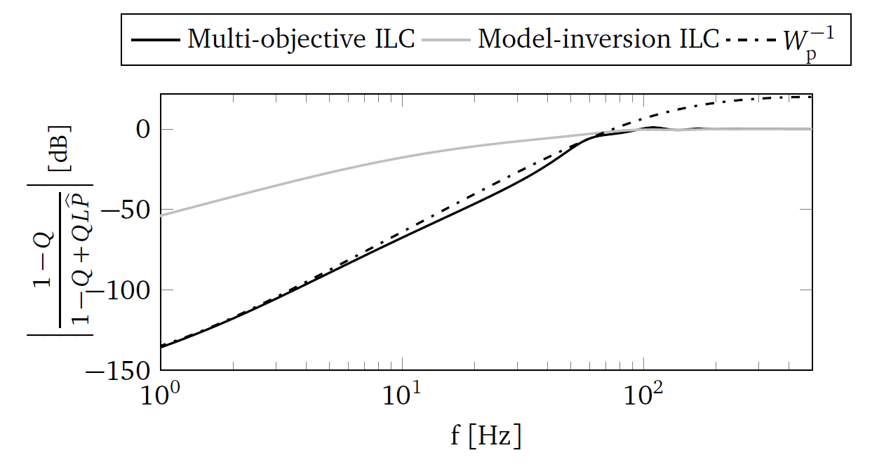
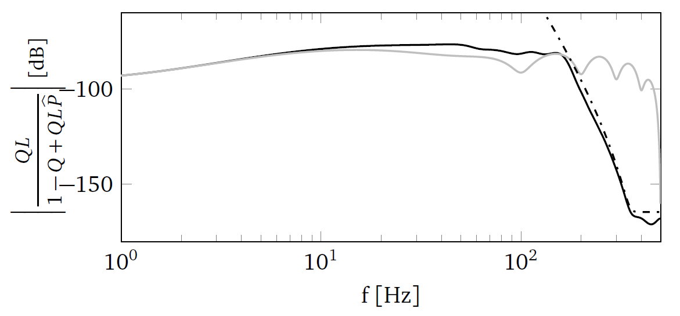
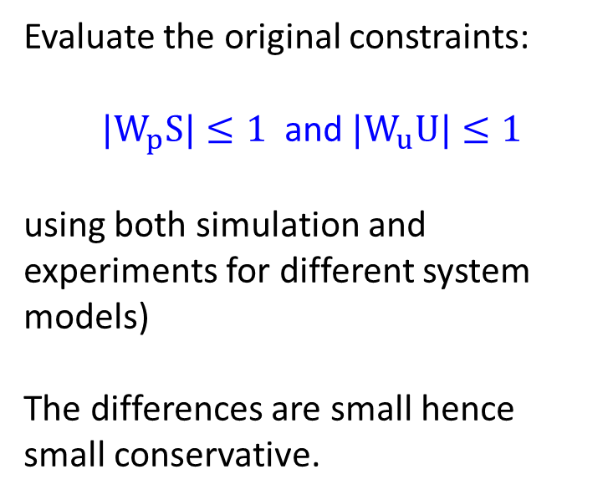
Conservative: small
Evaluate the original constraints:
${|W}_{p}S|≤1$ and ${|W}_{u}U|≤1$
using both simulation and experiments for different system models)
The differences are small hence
small conservative.
page 69 (thesis)

Slide 57
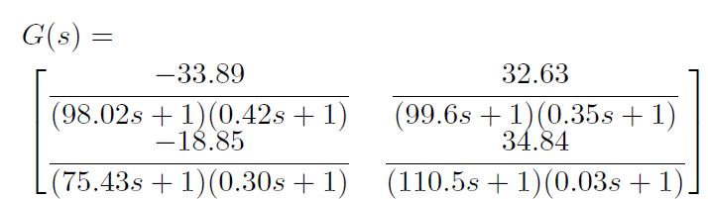
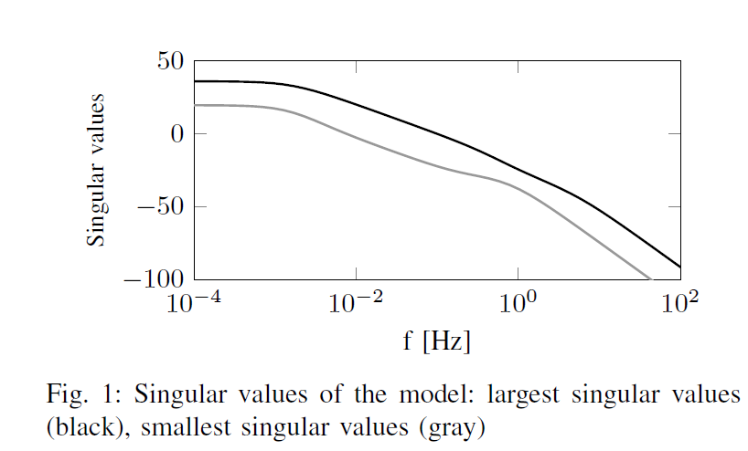
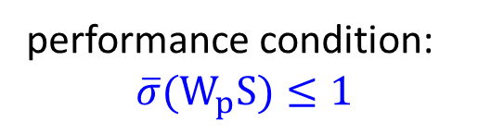
(near) Future works
Multivariable (MIMO) systems
performance condition:
${\overline{σ}(W}_{p}S)≤1$

Slide 58
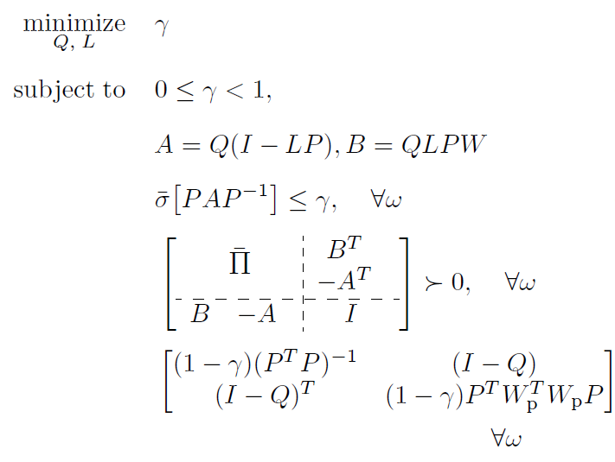
(near) Future works
Formulate as a convex (LMI) problem: efficient computation

Slide 59
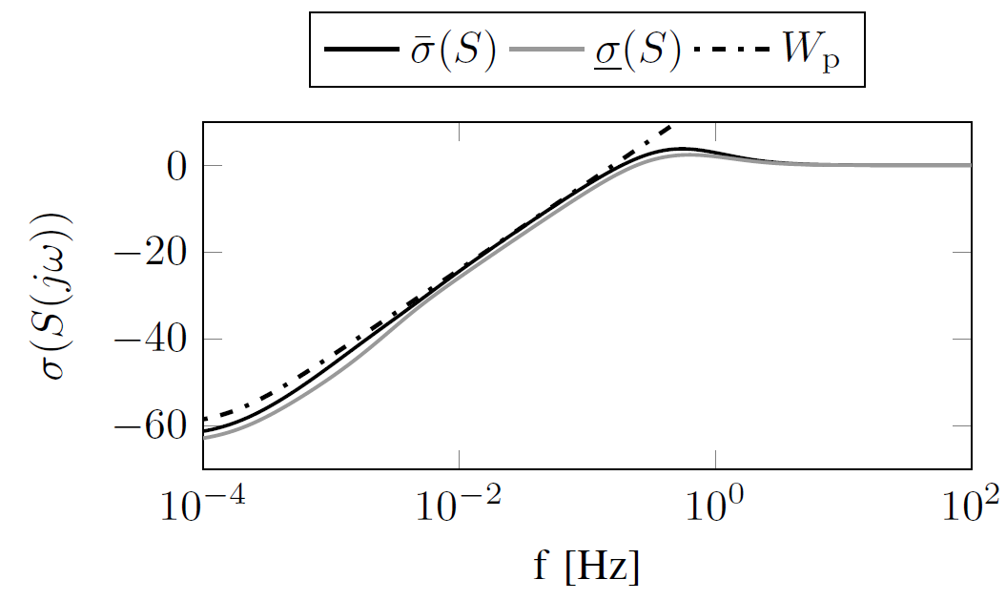
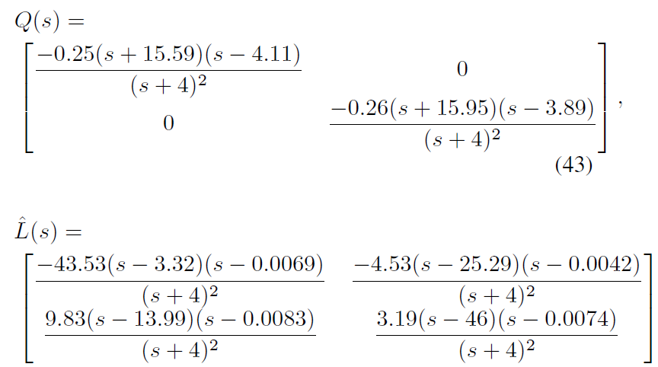
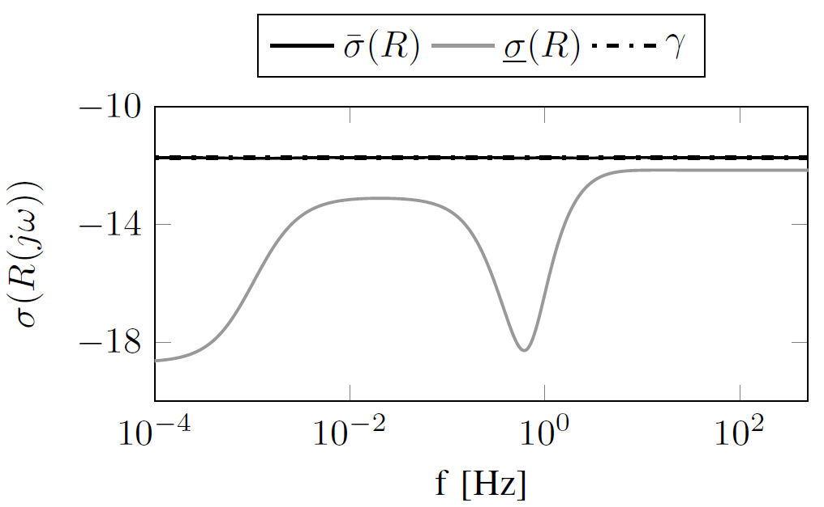
(near) Future works
2-order controllers generated from
the optimization problem:

Slide 60
ILC literature: short recap
ILC achieves high performance in various applications
Robustness
is crucial to ILC analysis and design
robust convergence: tracking error decreases in the trial domain despite of model uncertainty
robust performance: converged (steady-state) error
Designs
heuristic processes: costly, time consuming, and not optimal
hard to handle multiple objectives and system constraints

