Slide 1
OPC-UA Solutions
What real world problems can be solved with UA?
Jim Luth
OPC Foundation Technical Director

Slide 2






The Plant : a Complex Environment with many opportunities for standards for interoperability
Plant
Servers
Other
Computing
Devices
hours
PLANT INFORMATION NETWORK - Ethernet
min
Personal Computer
Network Manager
Archive
Replay Module
Area Servers
Plant
Network
Modules
Control Stations
Additional
CN Modules
Application
Module
History
Module
secs
Fiber Optics
Network
Gateway
Network
Gateway
CONTROL NETWORK
PLC
Gateway
1 sec
Subnetwork Gateway
Network
Interface
Module
Control Network
Extenders
Other Data
Hiway Boxes
PLC
Other
Subsystems
msec
Multifunction
Controller
Logic Manager
Process
Manager
Subnetwork
Extended
Controller
Basic
Controller
CONTROL NETWORK
Advanced
Process
Manager
Advanced
Multifunction
Controller
sec
LocalProcessors
Transmitters
Smartine
Transmitters
Asynchronous Processing
Multiple Interfaces
Mission Critical
How To Manage Changes?
Complex Information Flows
Multi-vendor
Proprietary

Slide 3
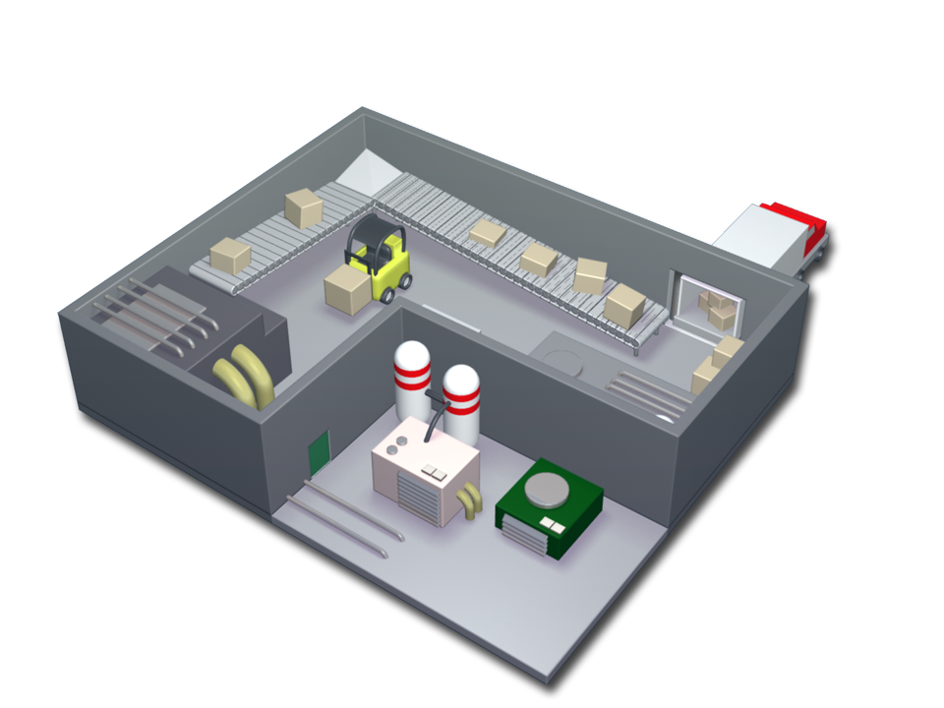
Numerous Incompatible Protocols
DDE
HART
RS-232
UNICODE
Lonworks
802.3
V.35
Interbus
ProfiBus
DNS
CC-Link
Bluetooth
IPsec
RS-485
TCP
OAGIS
DeviceNet
CAN
Kerberos
ControlNet
CORBA
RS-422
DHCP
netDDE
BAPI
EBCDIC
HTTP
SOAP
SNMP
802.11
DeviceLogix
COM
IPX
FIPIO
ANSI
USB
FieldBus
AS-I
Industrial
Ethernet
RS-423
CANopen
DCOM
.NET Remoting
OPC-HDA
ARP
OPC-A&E
XML
WMI
OLE
Firewire
Modbus
IPv6
802.1x
IPv4
UDP
OPC-DA
FDI
RARP
J1939
ICMP
Ethernet
FTP
Notes:
With so many protocols and standards--some of which work together, some which do not, and all of which need to be configured properly--you can literally lose sight of the manufacturing process

Slide 4
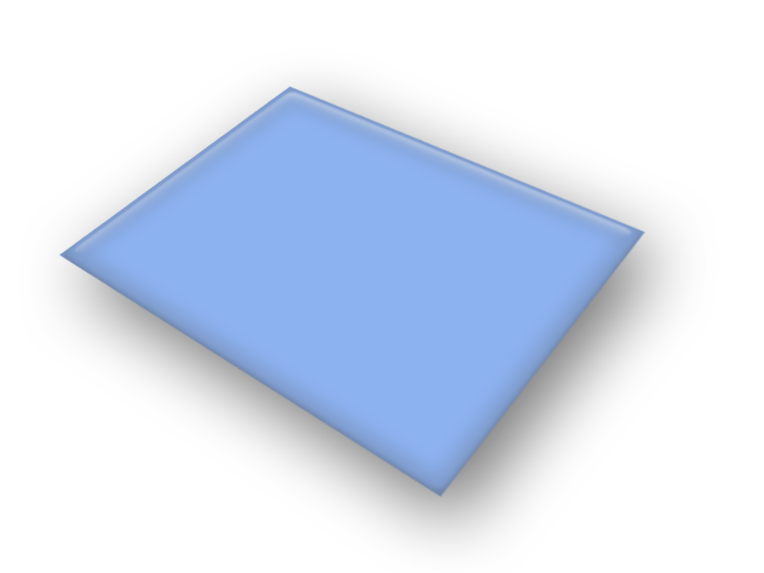
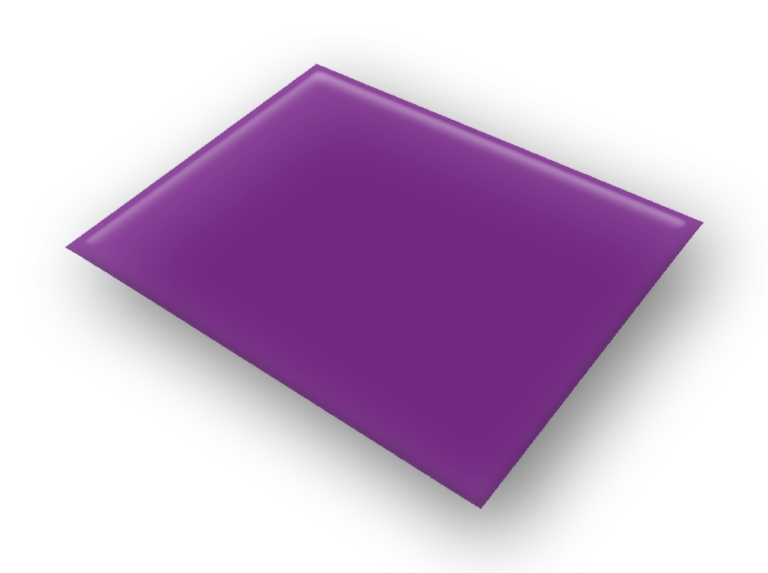


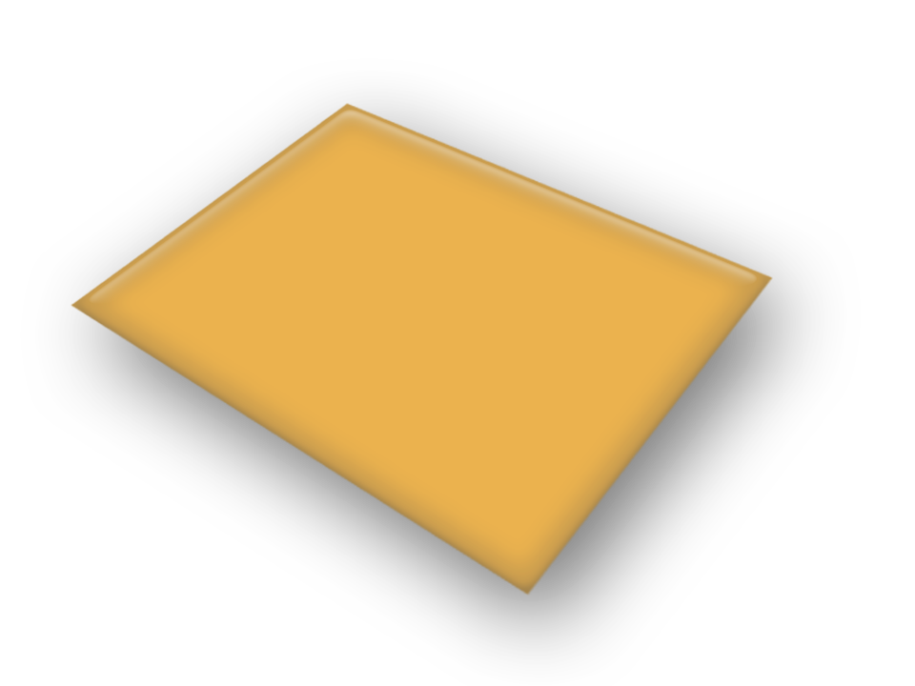

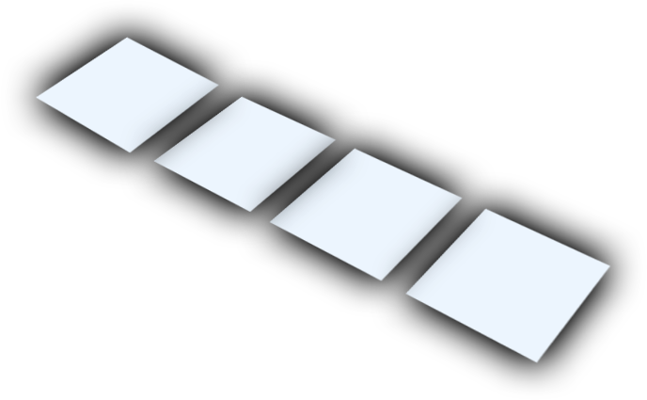
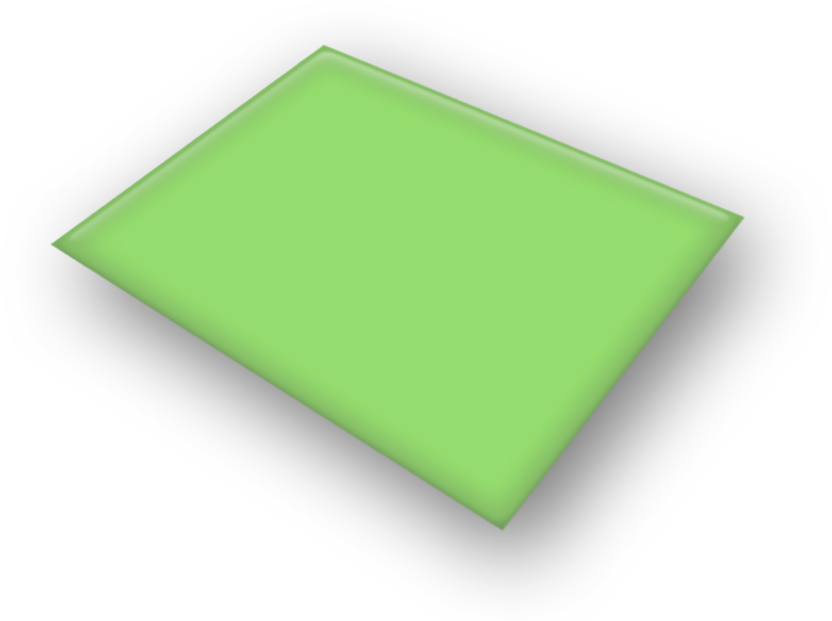


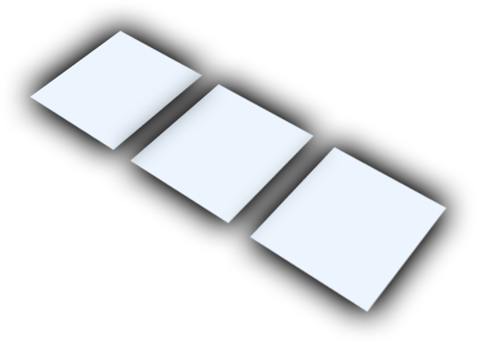
Numerous Incompatible Tiers
ERP
WIP
tracking
SCADA
CRM
cell
controllers
PDM
SCE
process
history
sensors
production
planning
continuous
controllers
product
genealogy
material
dispatch
area
controllers
SCP
PLM
field
networks
resource
management
NC
controllers
time
and
attendance
HMI
DCS
valves
quality
systems
production
planning
batch
controllers
discrete
controllers
robots
NC
machines
R&D
maintenance
management
operator
interfaces
performance
measurement
Facility/Plant
process
monitoring
Enterprise
Section/Area
transmitters
Equipment
Cell
Station
Notes:
Viewed another way, the plant’s information architecture explodes into multiple tiers, each of which has its own class of devices, its own class of applications, and its own way of representing, storing, and communicating data.

Slide 5
New features in Unified Architecture
Highlight of some features new to UA that were not available in previous OPC interfaces…

Slide 6



New Communications Underpinnings
Based on standards for the Web
  XML, WSDL, SOAP, WS-*
WS-Policy negotiates protocol and encoding
WS-SecureConversation provides secured sessions
Optimized for the Intranet
  OPC Binary encoding over TCP

Slide 7
OPC Interface Unification
SOA (Service Oriented Architecture)
Single set of Services
  Query, Read, Write, Subscribe…
Named/Typed relationships between nodes.
Alarms
&
Events
Data
Access
Historical
Data
Access
Commands
Complex
Data
UA Server
The UA Server embodies the functionality of existing OPC Servers using
a single set of services

Slide 8


New Security Model
UA Clients present credentials to UA Servers (x509 certs on both sides).
UA Servers require authentication and authorization.
  Access control can be fine-grained down to the property level.
Optional message signing and encryption.

Slide 9
New Complex Data Features
Tells clients how to parse structured data
Allows use of XML Schemas for describing XML data
Defines OPC Binary data description language that uses XML to describe binary data structures
Allows client to access device specific data descriptions (e.g. Fieldbus Foundation OD)

Slide 10
Designed to expose models
Vendor Information Model
Information Model Specifications
IEC, ISA, MIMOSA …
DA
A&E
HDA
CMDs
OPC Information Model
OPC UA Base Services
All Necessary Services
Clients written to just the base can still discover and access all data from the derived layers!

Slide 11
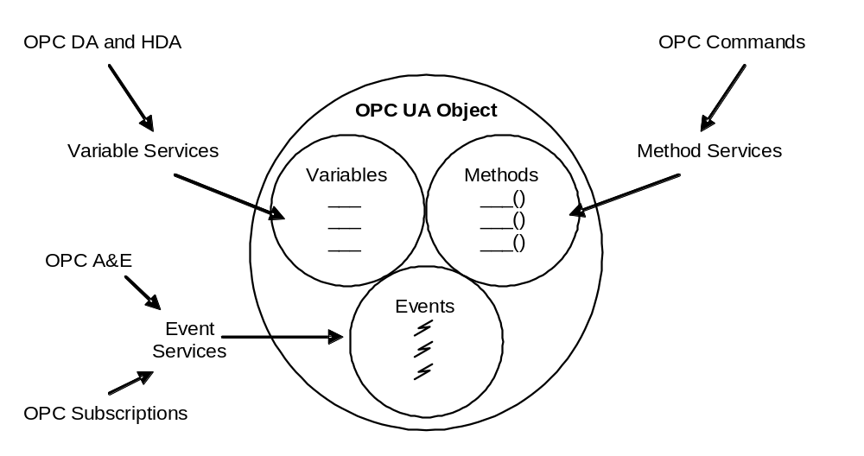
Unified Object Model

Slide 12
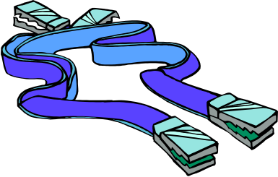
Robustness
Subscription Update Features
  Keep-alive (heartbeat) messages
    Allows clients to detect a failed server or channel
  Sequence Numbers in each update message
    Allows client re-sync to obtain missed messages
  Decouples callback channel from notification mechanism, allowing callback channel to be reset without loss of data
Redundancy Features
  Designed for easy (optional) redundancy of both Clients and Servers
    e.g. re-sync request can be sent to a backup server

Slide 13
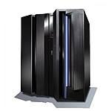
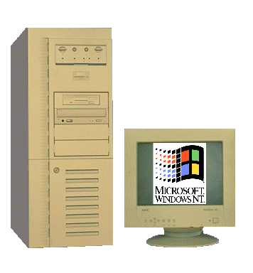
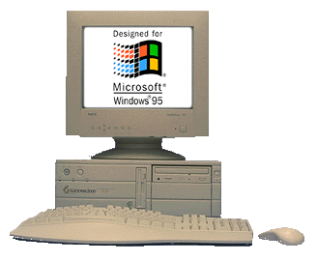
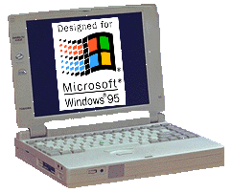

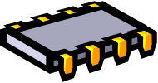
UA Scalability
Standard internet protocols allow cross-platform communication
Mainframe
devices portables desktops servers clusters mainframes
Server
Cluster
Server
Desktop
PC
Portables
Multiple UA APIs
  C/C++
  JAVA
  Microsoft .NET
Controllers
Embedded
Systems

Slide 14
Existing OPC Features Retained
Address Space visibility through browsing & query
Efficient report-by-exception communication
Similar base information models for easy adapters
DA
A&E
HDA
CMDs
OPC Information Model

Slide 15
Solutions
Example Problems Solved
with UA Solutions…

Slide 16
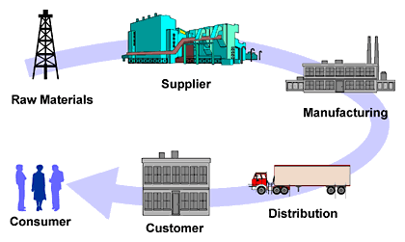
Remote Access
PROBLEM: I need fast, secure remote access to data via the internet to my supply chain partner.
SOLUTION: OPC-UA using HTTP and UA Binary encoding

Slide 17
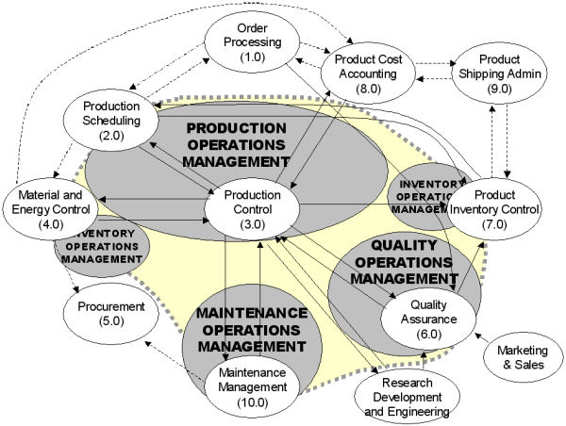
ISA S95 Modeled Plant
PROBLEM: I modeled my plant using ISA S95 and I want the metadata in the model available as well as the real-time data.
SOLUTION: OPC-UA is designed to expose model metadata and there will be a UA companion spec. for S95

Slide 18


OPC in device
PROBLEM: I want to supply an OPC interface to my device without the use of an external Windows PC
HMI
OPC UA
Server
OPC COM
Server
SOLUTION: OPC-UA is cross-platform and embeddable

Slide 19
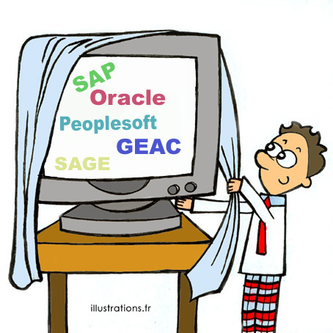


Java based ERP
PROBLEM: My Java based ERP system needs data from MES and the factory floor
SOLUTION: OPC volunteers are creating a UA communication stack and API in Java

Slide 20
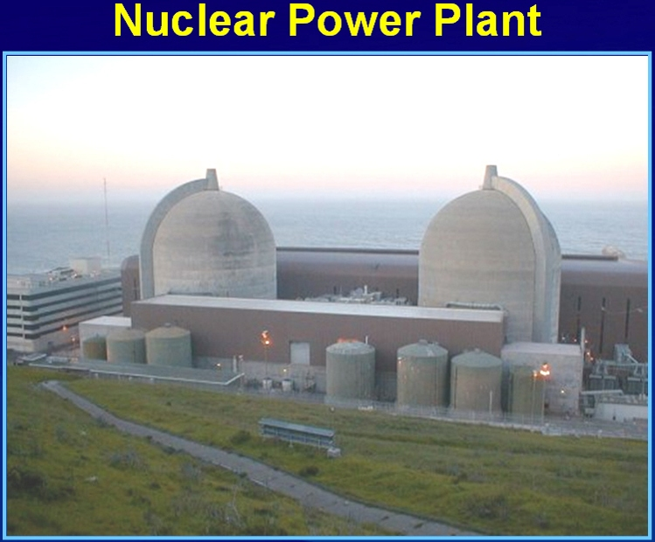
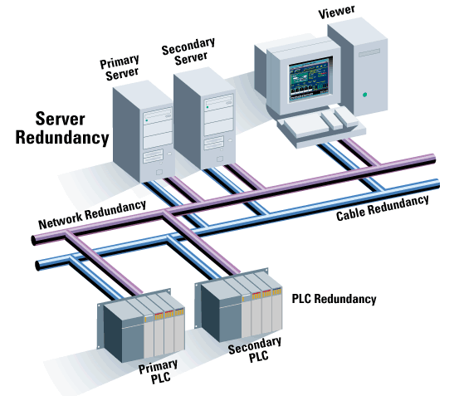
Redundancy
PROBLEM: EDF needs redundancy in nuclear applications
SOLUTION: UA defines how redundancy is done for consistency between all UA applications

Slide 21
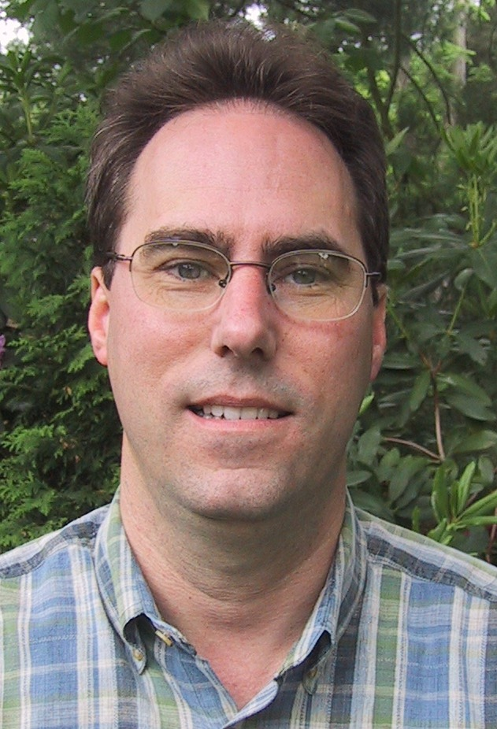

Questions?
Jim Luth
OPC Foundation Technical Director
Jim.Luth@opcfoundation.org

