Slide 1
OPC-UA Example
A typical UA example?
Jim Luth
OPC Foundation Technical Director

Slide 2
UA Excels in Many Domains
Manufacturing
Process Control
Building Automation
Transportation
Asset Management
MES
ERP
Logistics
Supply Chain
Retail
Financial
…
No "Typical" UA App!

Slide 3
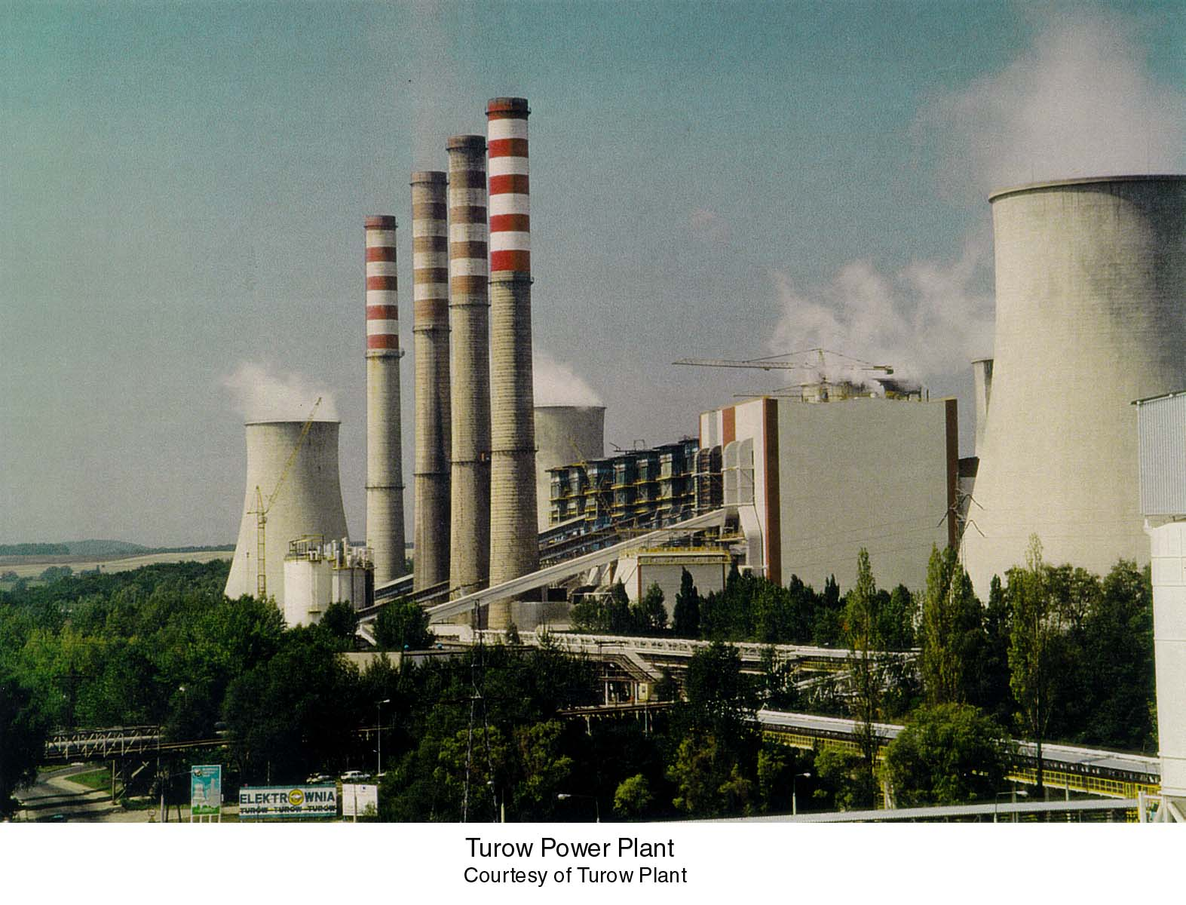
Power Boiler Application

Slide 4
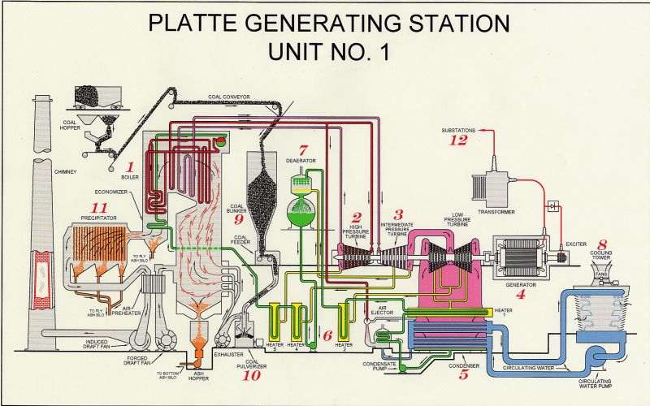
Boiler Basics

Slide 5
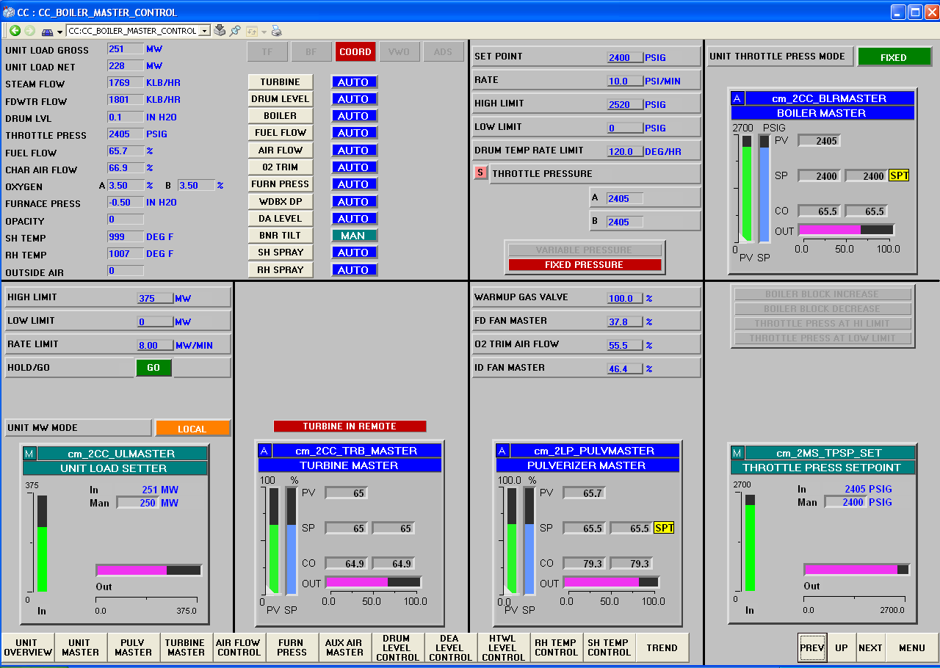
Boiler Master Graphic

Slide 6
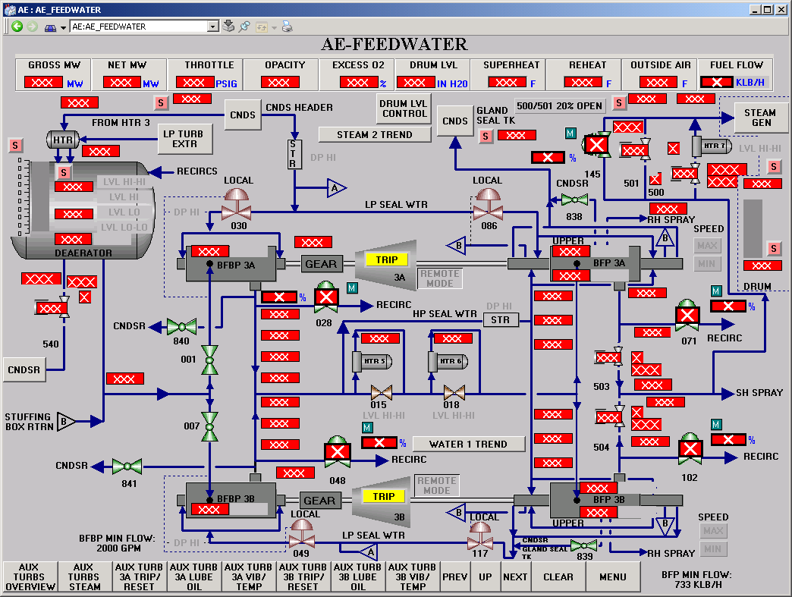
Feedwater Graphic

Slide 7
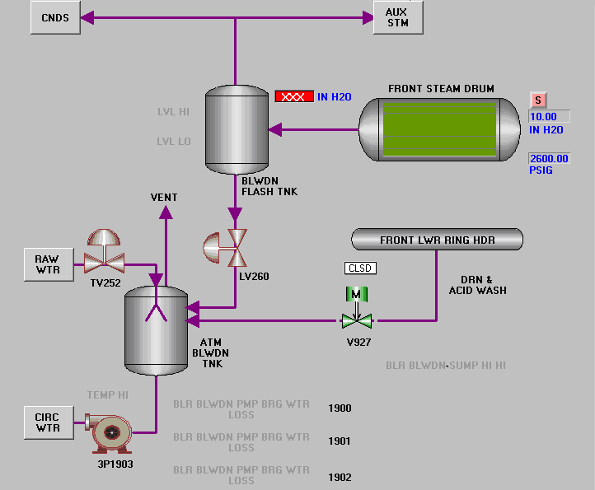
Boiler Drum Graphic

Slide 8
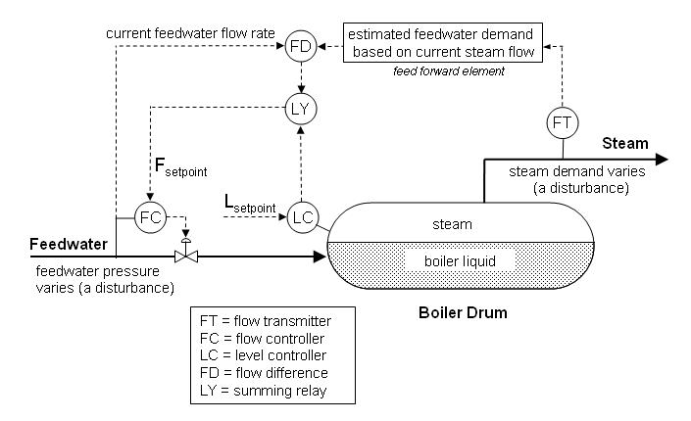
Drum Control P&ID

Slide 9

OPC-DA Address Space
Boiler1
  Coal Handling
  Combustion
  Cooling
  Feedwater
    Condenser
    Deaerator
    Drum
      CC1001
      FC1001
        SP
        PV
        OUT
      LC1001
      FT1001
      FT1002
      LI1001
  Turbine
Where are the Alarms?
Where is the metadata about the loop?
How do I find the maintenance record for the valve?
Do I have a spare flow transmitter in stock? Where do I order one?

Slide 10
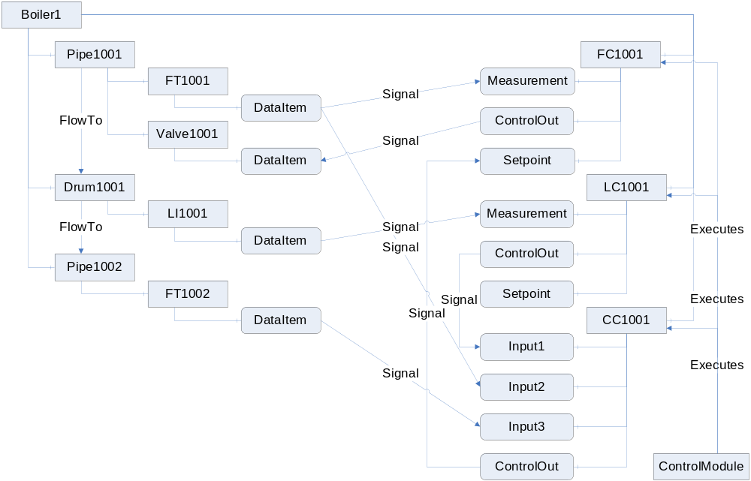
UA Notation

Slide 11


Questions?
Jim Luth
OPC Foundation Technical Director
Jim.Luth@opcfoundation.org

