Slide 1
OPC-UA Architecture
OPC just keeps getting better…
Jim Luth
OPC Foundation Technical Director

Slide 2
OPC Unified Architecture Motivation
DCOM
retires
Internet
.NET
new
Communication
architecture
OPC-UA
Better
Integration
(DA, HDA, AE)
More Areas of
Application
(MES, ERP)
Service
Oriented

Slide 3
Enterprise Integration
Asset
Management
Production
Control
Inventory
Management
Purchasing
OPC
UA
HMI
Visualization
OPC
Today
Control
Systems
SCADA

Slide 4
Industry-Standard interOperability, Productivity & Collaboration
Corporate Enterprise
OPC Unified Architecture
Manufacturing, Production and Maintenance
OPC Unified Architecture
Adv.
Control
OPC
HMI
MES
SCADA
OPC
Batch
OPC
PC-Based Control
OPC
PLC
DCS
Industrial Networks
Data
Acquisition
??.......??

Slide 5


OPC Unified Architecture Base
Architecture
  Integration of DA, A&E, Commands, Complex Data, and Object Types
Designed for Federation
  abstract data/ information from the plant floor, through information models, and up to enterprise systems
Information Modeling
  development and deployment of standard information models to address industry domains specifics
Complex Data
  OPC Standard & Domain & vendor specific…..

Slide 6
OPC Unified Architecture Base
Security
  Collaboration, Development & Reference
Enterprise Integration
  OPC UA standard messaging system
Robustness / Reliability Designed & Built in….
  NO Failures
  Sequence numbers, keep-alives, resyncing, and support for redundancy
Commands
Companion Standards
  Industry groups define what OPC Unified Architecture “transports”

Slide 7



OPC-UA Fundamentals
Based on standards for the Web
  XML, WSDL, SOAP, WS-*
WS-Policy negotiates protocol and encoding
WS-SecureConversation provides secured sessions
Optimized for the Intranet
  OPC Binary encoding over TCP

Slide 8
OPC Interface Unification
SOA (Service Oriented Architecture)
Single set of Services
  Query, Read, Write, Subscribe…
Named/Types relationships between nodes
Alarms
&
Events
Data
Access
Historical
Data
Access
Commands
Complex
Data
UA Server
The UA Server embodies the functionality of existing OPC Servers using a single set of services

Slide 9
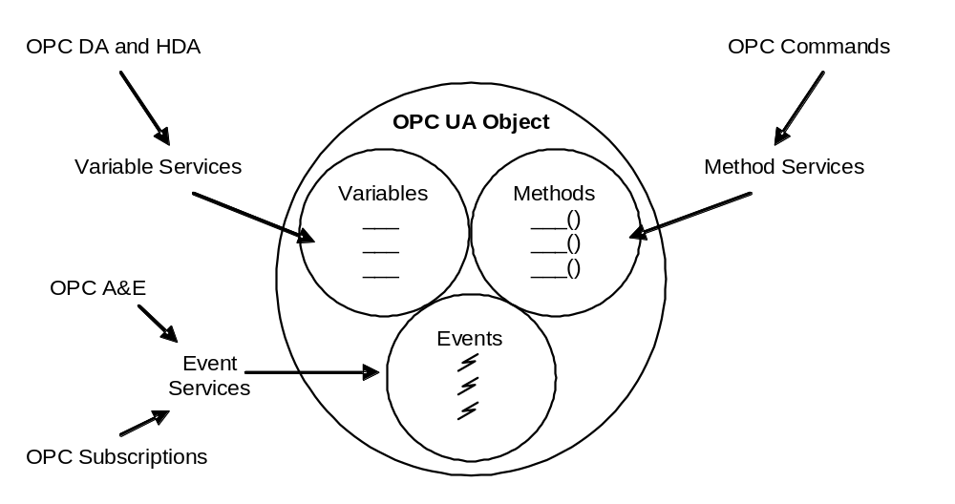
Unified Object Model

Slide 10
OPC-UA Address Space
Root
Fieldbus
Sensor Bus
Areas
Pressure
Xmitter
Valve
Area 1
Full Mesh – Network Model
Unlimited Named/Typed Relationships
“Views” are used to present hierarchies

Slide 11
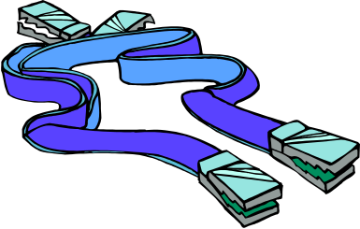

Robustness
Subscription Update Features
  Keep-alive (heartbeat) messages
    Allows clients to detect a failed server or channel
  Sequence Numbers in each update message
    Allows client re-sync to obtain missed messages
  Decouples callback channel from notification mechanism, allowing callback channel to be reset without loss of data
Redundancy Features
  Designed for easy (optional) redundancy of both Clients and Servers
    e.g. re-sync request can be sent to a backup server

Slide 12


Security
UA Clients present credentials to UA Servers (x509 certs on both sides).
UA Servers require authentication and authorization.
  Access control can be fine-grained down to the property level.
Optional message signing and encryption.

Slide 13
Communication Layering
API
.NET (WCF) Version
Portable C/C++ Version
Java Version
Tool or
Language
Dependent
(e.g. .NET)
Proxy /
Stubs
WSDL / SOAP
or TCP / Binary
Services Binding
Scalable Platform Independent Messaging Model
Abstract UA Model
Specification
Business Model, Adaptable to
Platform Independent Messaging Models (e.g. WSDL)

Slide 14
UA Server Chaining
UA
Client
UA
Client
Enterprise
Semantics
“Aggregating” UA Servers extract and process data from lower level “Device” UA Servers.
Data is recast using different information models appropriate for the clients at the higher level.
“Aggregating” UA Servers extract and process data from lower level “Device” UA Servers.
Data is recast using different information models appropriate for the clients at the higher level.
Enterprise Network
UA
Server
UA
Client
UA
Client
Operations Network
Process
Semantics
UA
Server
UA
Server
UA
Client
UA
Client
Plant Floor
Network
Device
Semantics
UA
Server
UA
Server

Slide 15
OPC Address Space Today
Root
Fieldbus
Sensor Bus
Areas
Pressure
Xmitter
Valve
Area 1
Pure Hierarchy
Parent/Child Relationships Only

Slide 16
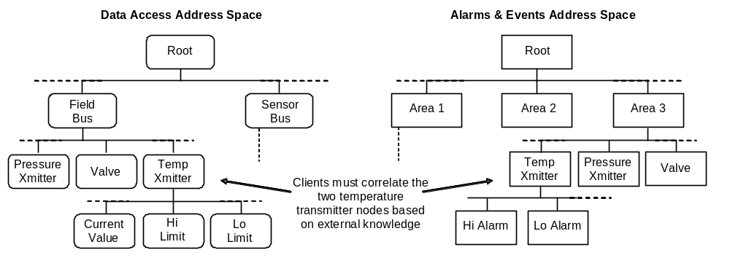
Data Items and Alarms Today

Slide 17
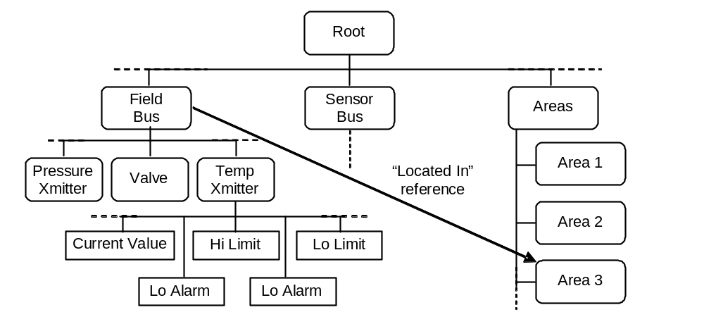
UA Coherent Address Space

Slide 18
UA Coherent Address Space
Integrated data and alarms

Slide 19
Object Classes and Instances
Top Layer
Relationship
Top
Complex Data
Base Types
Schema
Type
Layer
Instantiation
(between layers)
Subclassing
(Inherit
ance)
Data Type
Reference
Standard and
System
-
defined
Other relation- ship such as “contained”, “operated by”, “controls”, etc.
Data Type
Definitions
Instance Layer

Slide 20
Complex Data Features
Tells clients how to parse structured data
Allows use of XML Schemas for describing XML data
Defines OPC Binary data description language that uses XML to describe binary data structures
Allows client to access device specific data descriptions (e.g. Fieldbus Foundation OD)

Slide 21
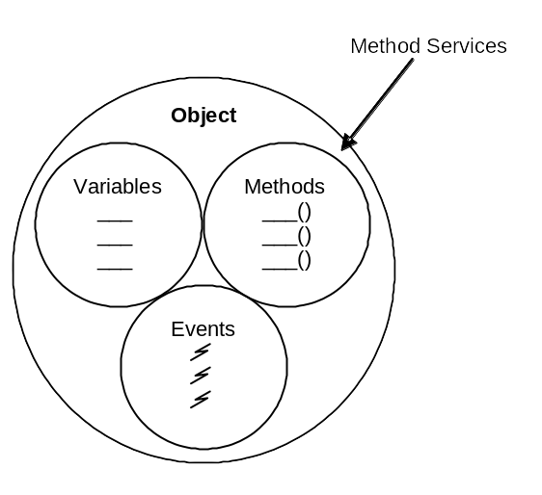
Methods vs. Programs
Programs built on top of Methods
Programs represent executable components of objects , e.g.,
  DownloadProgram(Name, InitState)
  MonitorNetwork (From, Till, Interval)
Execution time may vary from milliseconds to indefinitely
Asynchronous invocation is non-blocking
Results are returned using notifications
The client can control the execution
Methods part of UA Base
Synchronous invocation similar to blocking function calls.
  AckAlarm()

Slide 22
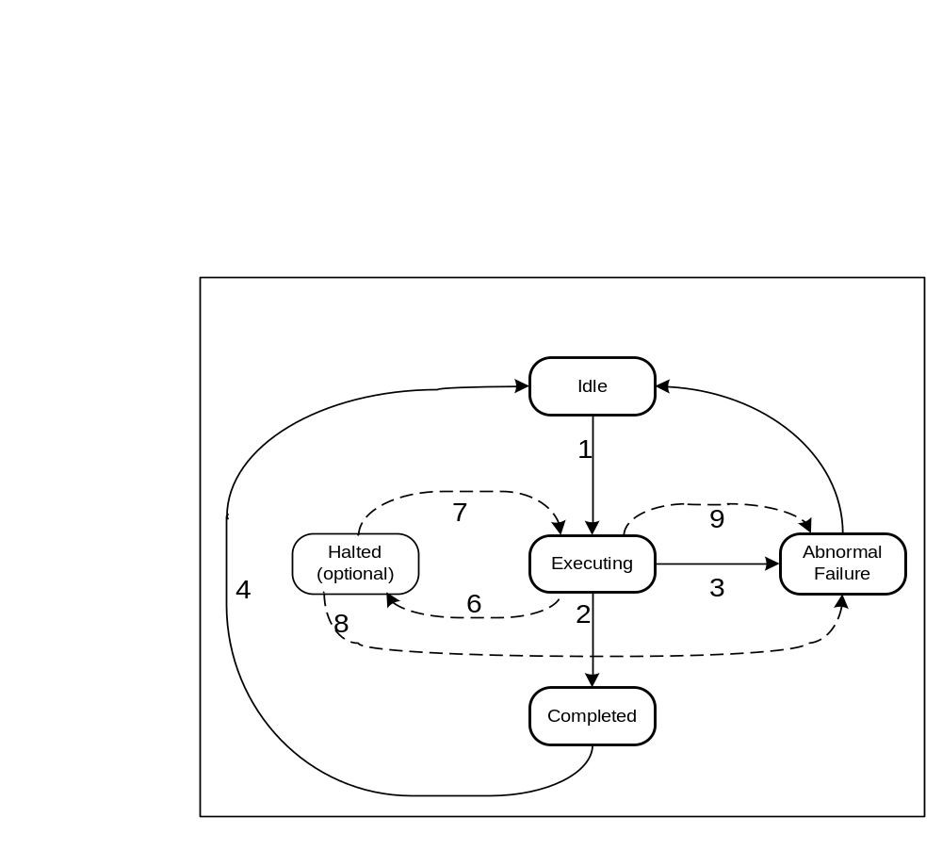
Programs can have State
State Machine
UA defines the basic state machine
State transitions may cause notifications
Opening
Sub-states can be defined in particular for the executing state
Executing
Sending
3
2
Closing

Slide 23
Scalability
OPC UA “Server Profiles” defined to allow servers with different capability levels
Client can discover server profile
Profiles and wrappers defined for migrating existing servers to UA
More capable profiles also defined

Slide 24
Server Diagnostics
Standard “Server” node defined in address space
Standard diagnostic data items defined for the server, such as “SubscriptionCount”
Server specific diagnostics can be added, with semantics defined by object type definitions

Slide 25
UA Services
Common services support DA, A&E and HDA operations
Protocol independence
Timeless durability
Integrated with the UA Data Model
Partitioned into Service Sets

Slide 26
UA Service Sets
Discovery Service Set
  FindServers, GetEndpoints, RegisterServer
Secure Channel Service Set
  Open & Close Channel
Session Service Set
  Create, Close, Activate
Node Management Service Set
  Add & Delete Objects and References
View Service Set
  Browse, BrowseNext, BrowseProperties

Slide 27
UA Service Sets (2)
Query Service Set
  QueryFirst, QueryNext
Attribute Service Set
  Read, Write, ReadHistory, UpdateHistory
Method Service Set
  Call
Monitored Item Service Set
  Create / Modify / Delete
Subscription Service Set
  Create / Modify / Delete, Publish, Republish, Transfer

Slide 28
Specification Layering
Vendor Information Model
Information Model Specifications
IEC, ISA, MIMOSA …
DA
A&E
HDA
CMDs
OPC Information Model
OPC UA Base Services
All Necessary Services
Clients written to just the base can still discover and access all data from the derived layers!

Slide 29
Base UA Specifications
Part 1 – Concepts
  A short white-paper like overview of UA
Part 2 – Security
  A non-normative introduction to the threats and countermeasures
Part 3 – Address Space Model
  Building block constructs of UA (Nodes, Objects, Events …)
Part 4 – Services
  Service methods exposed by UA Servers and called by UA Clients
Part 5 – Information Model
  UA defined objects (e.g. Diagnostic Object, Audit Events)
Part 6 – Mappings
  Details that allow implementation on current technology (e.g. WS)
Part 7 – Profiles
  Defines conformity groups for implementation and certification

Slide 30
UA Information Model Specifications
Part 8 – Data Access
  Adds OPC-DA constructs (e.g. Quality, Timestamp … )
Part 9 – Alarms and Conditions
  Adds stateful Alarms and Conditions
Part 10 – Programs
  Adds long running executable entities
Part 11 – Historical Access
  Adds HDA and Historical Events constructs
Part 12 –Discovery
  Details about UA Discovery Servers and interaction with UA apps

Slide 31


Questions?
Jim Luth
OPC Foundation Technical Director
Jim.Luth@opcfoundation.org

