Slide 1
Collaboration
Major Standard Organizations Count On UA
Thomas J. Burke
OPC Foundation President & Executive Director
Notes:
1)Why they use UA (guest speaker of mayor organization) 2)Coexistence with other Ethernet standards (Profinet) 3)Complement with one another (how and what) 4)Roadmap with others 5)Address space Model allows easy adoption of information models

Slide 2
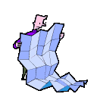
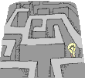


Motivation Behind Collaboration
What’s The Value Behind Multiple Competing Standards?
  Developing Standards That Are Not Worth The Paper They’re Printed On?
  Unsuccessful And Very Limited Adoption
  Zero Interoperability
  Unhappy Vendors
  Unhappy End-users
  Unhappy Standards Organizations
OPC Value Proposition
  Eliminate Confusion Between Multiple Standards
  Facilitate Resolution Of Overlapping Multiple Standards
  Facilitate Other Standards Being Successfully Adopted
  Facilitate Other Standards Being Certified
  Plug-n-Play Not Plug-n-Pray

Slide 3
Standards/ Collaboration
– What Is This About?
MIMOSA
OpenO&M – Joint work by MIMOSA, OPC & ISA-95 to integrate operations and maintenance information
ISA Standards
  ISA-95 – Enterprise/Control System Interface Standard, Parts 3 & 4 define MES Functions
  ISA-99 – Control System Cyber-Security Standard
  OMAC – Open Modular Architecture Controls group standardizing packaging machinery interfaces
WBF
  BatchML – XML Schemas based on ISA-88
  B2MML – XML Schemas based on ISA-95
OPC – DCOM and XML interfaces. New Web Services Unified Architecture (UA) under development
MIMOSA – Asset Mgt and Maintenance Mgt Schema, Meta Data and Interfaces
OPC
WBF
OMAC
BatchML
ISA
ISA-99
ISA-95
OpenO&M
MFG JWG
B2MML
Relationship
OpenO&M Relationship

Slide 4

Partnership / Collaboration
- Interoperability Strategy
Collaboration with ISA (S88, S95, S99)
Collaboration with MIMOSA
Partnership with ISA
Collaboration with IEC
Collaboration with OAGi
Collaboration with EDDL
Collaboration with FDT
Collaboration with PLCOpen
Partnership/Collaboration with automation.com
Collaboration with MS MUG & NAMUR
Partnership with OPCconnect.com
Collaboration with …… (stay tuned)

Slide 5
Who’s Who?
OPC Collaboration from the collaborative’ organization viewpoint - the details…
  EDDL
  FDT

Slide 6
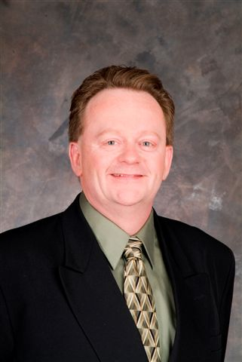


Questions?
Thomas J. Burke
OPC Foundation President
& Executive Director
Thomas.Burke@opcfoundation.org

