Slide 1
Device Integration and OPC Unified Architecture
Jeff Harding
Director, System Software Architecture
Nestor Camino
Architect, Fieldbus Technology Development

Slide 2
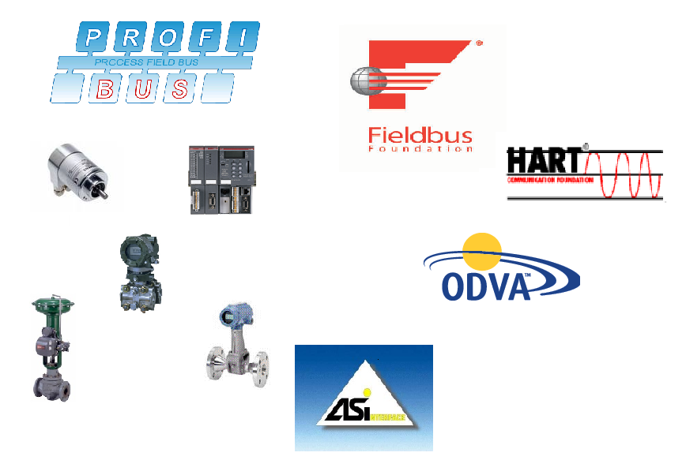
Field Instrument Protocols
Many different types of instruments
Many different protocols for instrument communication

Slide 3

Field Instrument Organizations
Four organizations providing field device information
  HART Communication Foundation
  Fieldbus Foundation
  PNO – PROFIBUS
  FDT Group

Slide 4
EDDL
EDDL - Electronic Device Description Language
  Descriptive characteristics of a device
  Graphical elements for device maintenance and configuration
Specified by the Instrument Protocol foundations
  Foundation Fieldbus
  HART Communication Foundation
  PNO - PROFIBUS
Required for instrument certification by the respective foundations
Foundations working to establish a common EDDL standard
  ECT – “EDDL Cooperation Team”
  IEC standard

Slide 5
FDT- Group
The FDT specifications define a standard interface for integrating vendor provided software applications into system and workshop environments
  Descriptive characteristics of a device
  Graphical application for device maintenance and configuration
Organization established by system and instrument vendors
  Used in both Process as well as Factory Automation
  Provides integration for instruments not part of the EDD based foundations
  IEC standard for the interfaces

Slide 6
EDDL – Data Description
The EDDL provides a description
  Device
  Block
  Parameters
#define LINEAR 0
VARIABLE trans1_temperature_unit
{
LABEL [digital_units];
HELP [temperature_unit_help];
CLASS CONTAINED;
HANDLING READ & WRITE;
TYPE ENUMERATED (2)
{
DEFAULT_VALUE 32;
{ 32, [degC], [degC_help] },
{ 33, [degF], [degF_help] },
{ 34, [degR], [degR_help] },
{ 35, [Kelvin], [Kelvin_help] }
IF (trans1_sensor_type == LINEAR)
{
{ 36, [mV], [mV_help] },
{ 37, [Ohm], [Ohm] },
{ 39, [mA], [mA_help] },
}
}
}

Slide 7
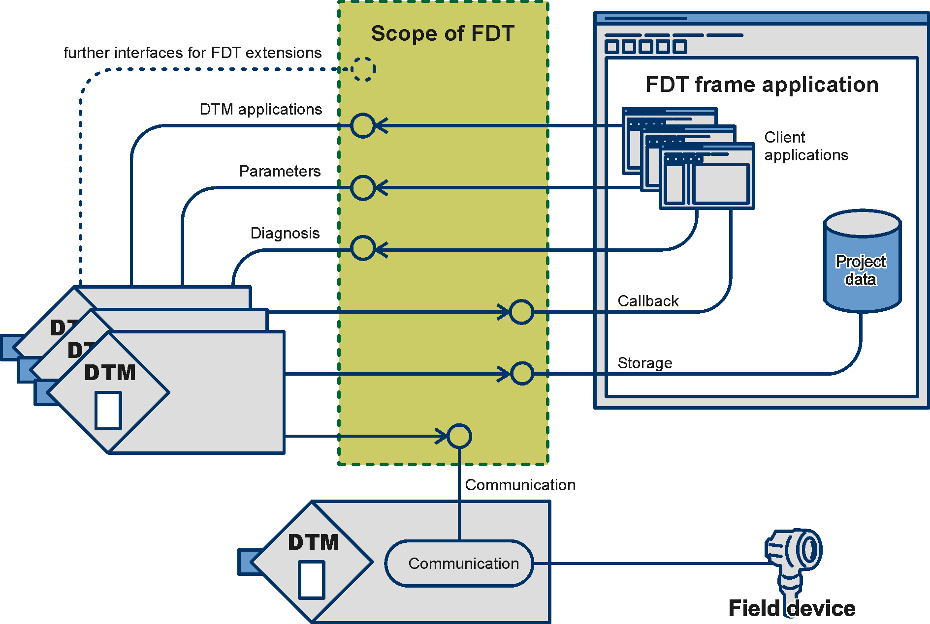
FDT – Device Applications
Vendors provide Device Type Managers
  Information about the device
  Information about the blocks
  Information about the parameters
COM Interface
  User Interface
    applications
  API non-UI data

Slide 8
OPCUA Unification
OPCUA provides a common view of the field instruments up to the enterprise level
  Product data e.g. identification, I/O description, certifications
  Diagnostic data e.g. device status information, events and alarms
  Process data e.g. measurement data, set point Parameters e.g. unit, upper/lower limits
  Maintenance data e.g. classification, description, spare parts, tools for maintenance
Uses EDDL or FDT information

Slide 9
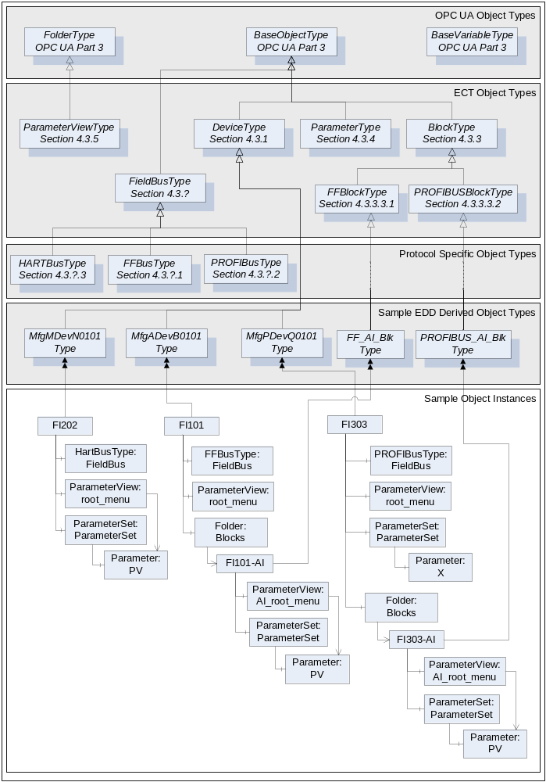
OPCUA Device Object Model

Slide 10
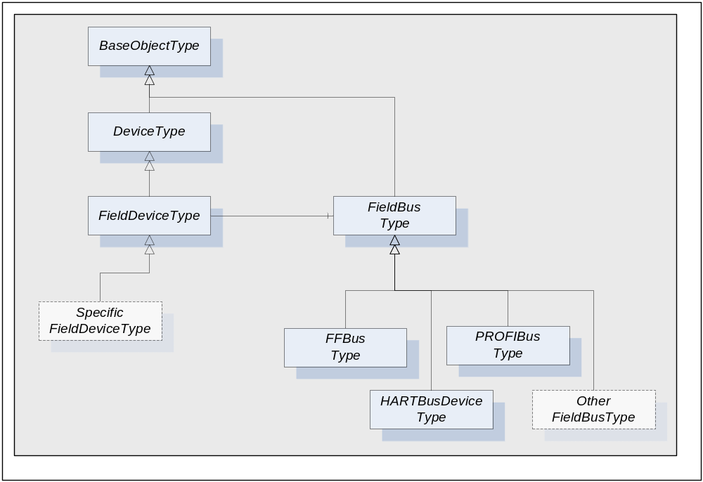
OPCUA Device Object Model
Definition for a device
  Expandable
  Bus Protocol
    as an
    extension

Slide 11
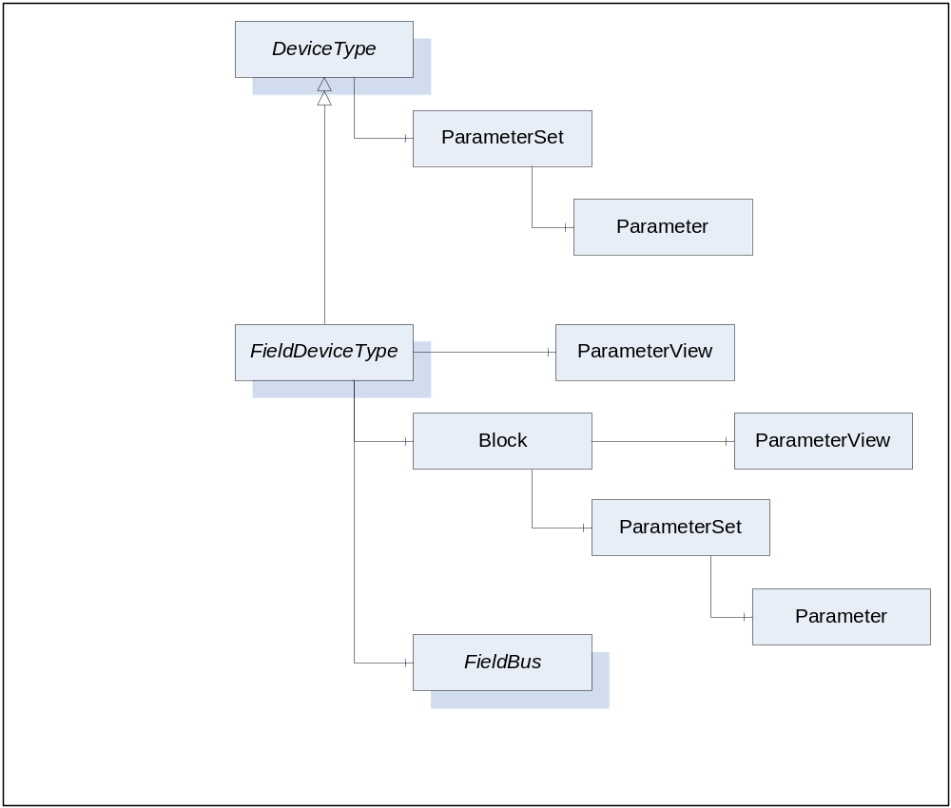
OPCUA Device Object Model
Device Types contain
  Device information
  Blocks
  Parameters
Information from EDDL
Information from FDT

Slide 12
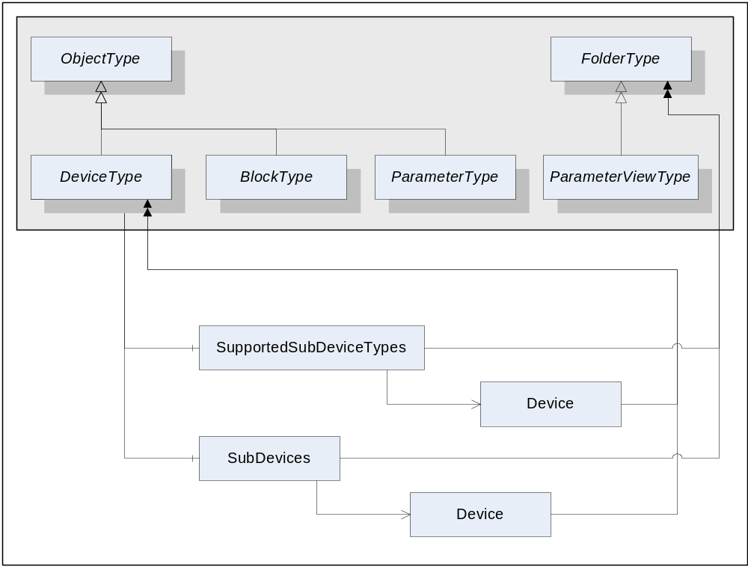
OPCUA Device Object Model
Device Types can contain other devices.
Modules are modeled as a device

Slide 13
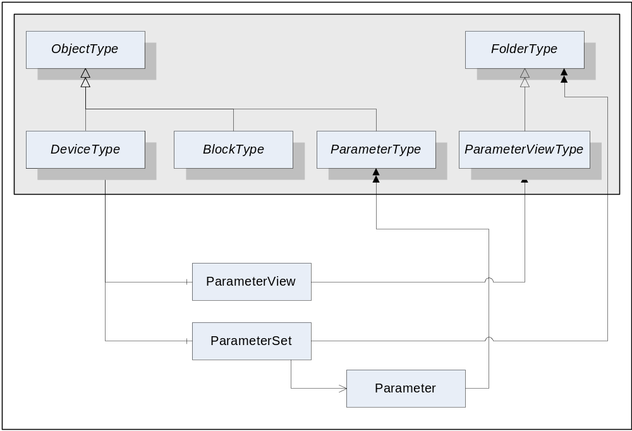
OPCUA Device Object Model
Device and Block Types contain folders to group parameters
Parameter folders created from device descriptions
Parameter folders created by clients – OPCUA Mesh Architecture

Slide 14
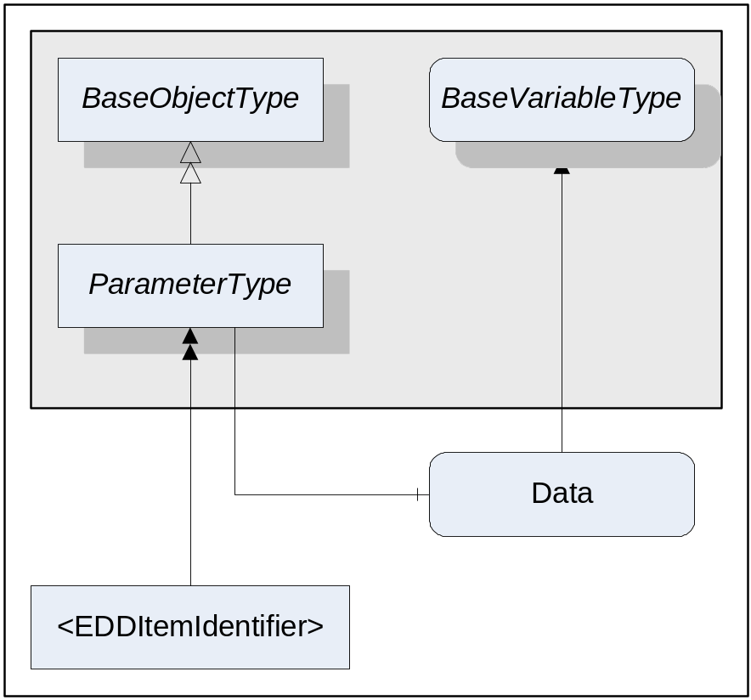
OPCUA Device Object Model
Descriptive information in EDDL used to create namespace
#define LINEAR 0
VARIABLE trans1_temperature_unit
{
LABEL [digital_units];
HELP [temperature_unit_help];
CLASS CONTAINED;
HANDLING READ & WRITE;
TYPE ENUMERATED (2)
{
DEFAULT_VALUE 32;
{ 32, [degC], [degC_help] },
{ 33, [degF], [degF_help] },
{ 34, [degR], [degR_help] },
{ 35, [Kelvin], [Kelvin_help] }
IF (trans1_sensor_type == LINEAR)
{
{ 36, [mV], [mV_help] },
{ 37, [Ohm], [Ohm] },
{ 39, [mA], [mA_help] },
}
}
}

Slide 15
OPCUA Device Object Model
Descriptive information provided by FDT used to create namespace
<DtmItemInfo fdt:id="1" fdt:name="PV" fdt:dataType="float" itemType="standard">
<fdt:SemanticInformation semanticId="CMD3B5" applicationDomain="FDT_HART"/>
<ItemKind itemKind="analogInput"/>
<UnitDescription>
<ItemReference fdt:idref="2"/>
</UnitDescription>
<RangeDescriptions>
<RangeDescription>
<LowerRangeDescription>
<ItemReference fdt:idref="4"/>
</LowerRangeDescription>
<UpperRangeDescription>
<ItemReference fdt:idref="3"/>
</UpperRangeDescription>
</RangeDescription>
</RangeDescriptions>

Slide 16
OPCUA Device Object Model
Servers can use information from EDDL and FDT to create the namespace
Object model is abstracted
  It is not EDDL
  It is not FDT
Object model supports extensions
  Protocol specific information
  EDDL specific information
  FDT specific information

Slide 17
OPCUA FDI Unification
FDI – Field Device Integration
  ECT members participate
  FDT members participate
  OPCUA members participate
Define a common infrastructure
  Device semantics
  Device applications for maintenance and diagnostics
Retain full functionality of existing EDD applications
Retain full functionality of existing FDT applications
OPCUA becomes the communication infrastructure
  One object model for device information
  Use of OPCUA for maintenance and diagnostic applications

Slide 18
OPCUA FDI Unification
OPCUA becoming the infrastructure for field device information
OPC cooperating with multiple organizations to define common semantics for the OPCUA models
OPCUA becoming the infrastructure for device alarms and events
OPCUA from the field instruments to the enterprise

Slide 19

Questions?
Jeff Harding
Director, System Software Architecture
ABB Automation Products Division
Jeff.Harding@US.ABB.com
Nestor Camino
Architect, Fieldbus Technology Development
Invensys Process System
Nestor.Camino
  @ips.invensys.com

