Slide 1
Alarms & Conditions
Eventing in UA
Jeff Harding
Director, System Software Architecture

Slide 2
Outline
Concepts
Conditions
Acknowledgeable Conditions
Dialogs
Alarms
Reference Types
Type Model extensions
Condition grouping
Subscription

Slide 3
Concepts
Alarms and Conditions Extend Base UA Eventing Model
  Conditions are not just transient.
  Conditions always exist in some current state
  Conditions may also exist in the address space
Alarm and Condition Model Uses UA State Machine
  UA Defines Standard State Machines for Alarm and Conditions
  Standard State Machines are extensible

Slide 4
Conditions
Condition state machine
  Defines base enable/disable state
Condition subtypes defined
  Extended by the specification
  Can be extended by vendors
Each state transition results in a Condition Event.
Disabled
Enable

Slide 5
Acknowledgeable Conditions
Extends Enable State of Condition Type
Defines two Acknowledge State Machines
  Basic Acknowledge model
  Acknowledge with Confirmation model
  Extendable by Vendors
Disabled
Enabled
Acknowledged
Unconfirmed
Confirmed
UnAcknowledged

Slide 6
Acknowledgement Conditions (Continued)
Basic Acknowledge State Model
  Two States defined
  Acknowledge method
Confirmed Acknowledge State Model
  Adds Sub State to the Acknowledged state
  Defines Confirmation step to the model
  Adds Confirm Method
Acknowledged
Acknowledge Method
Ack
By
Server
UnAcknowledged
Acknowledged
Confirm Method
Unconfirmed
Confirmed
Confirmed
by Server
Ack
By
Server
Acknowledge Method
UnAcknowledged

Slide 7
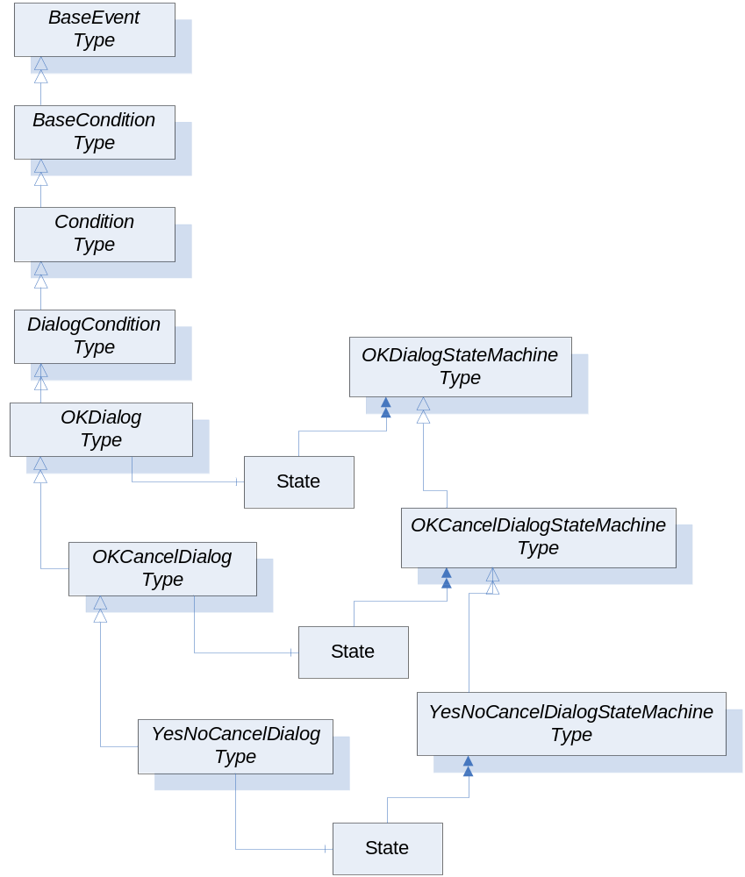
Dialogs
Extends Condition Type
  Used by a Server to request user interaction
  Three types defined in UA
  Extendable by Vendors
OK Dialog
  Ok method
OK Cancel Dialog
  OK and Cancel methods
Yes No Cancel Dialog
  Ok, Cancel and No methods

Slide 8
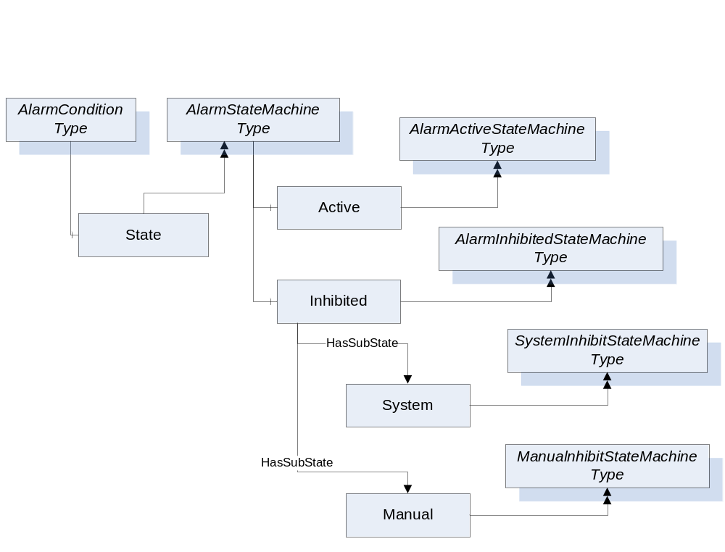
Alarms
Disabled
Extends Condition Type
Defines Active State Machine
  Extended by derived Alarm types
Defines Inhibited State Machine
  Used for Filtering
  Multiple Inhibit State machines defined
Enabled
InActive
Active
Inhibited
UnInhibited
Acknowledged
Unconfirmed
Confirmed
Unacknowledged

Slide 9
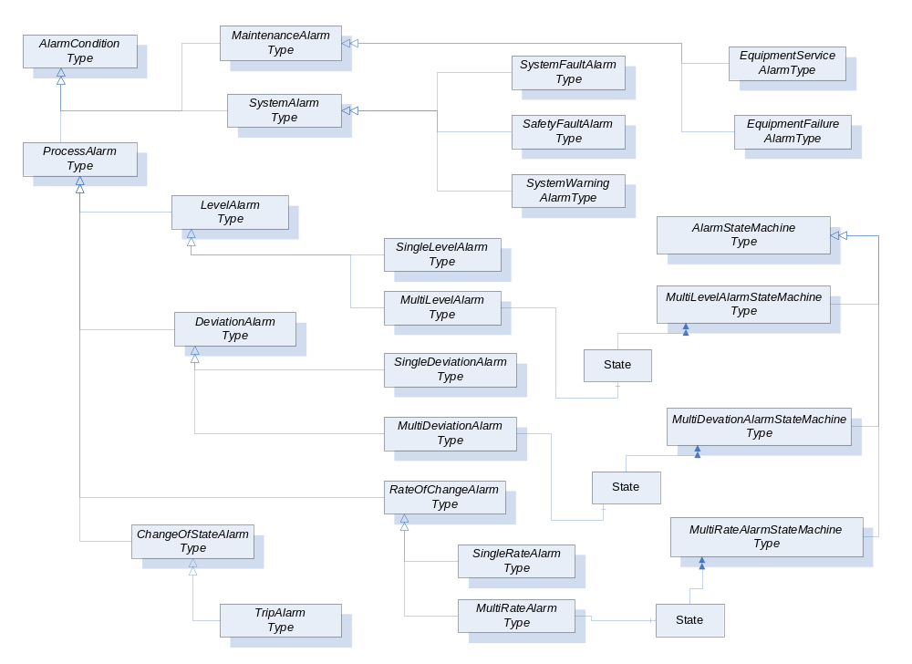
Alarms Types

Slide 10
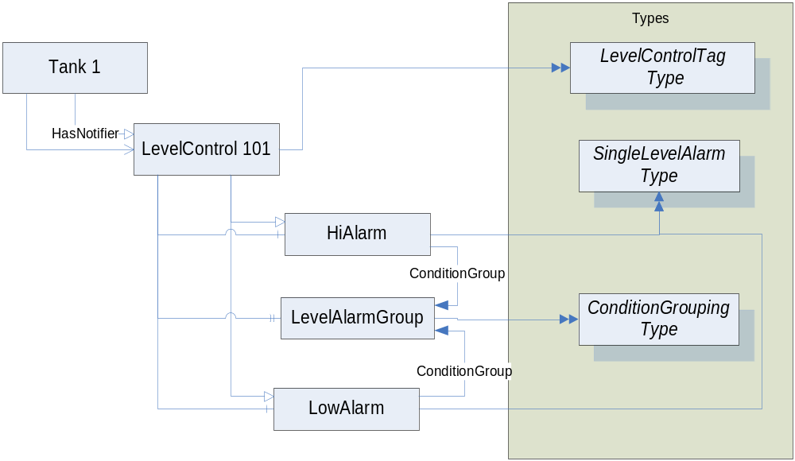
Reference Types
Eventing reference types
  HasNotifier
  HasEventSource
Grouping Conditions
  Alternate approach to Multi-*Alarms
  GroupsConditions Reference Type

Slide 11
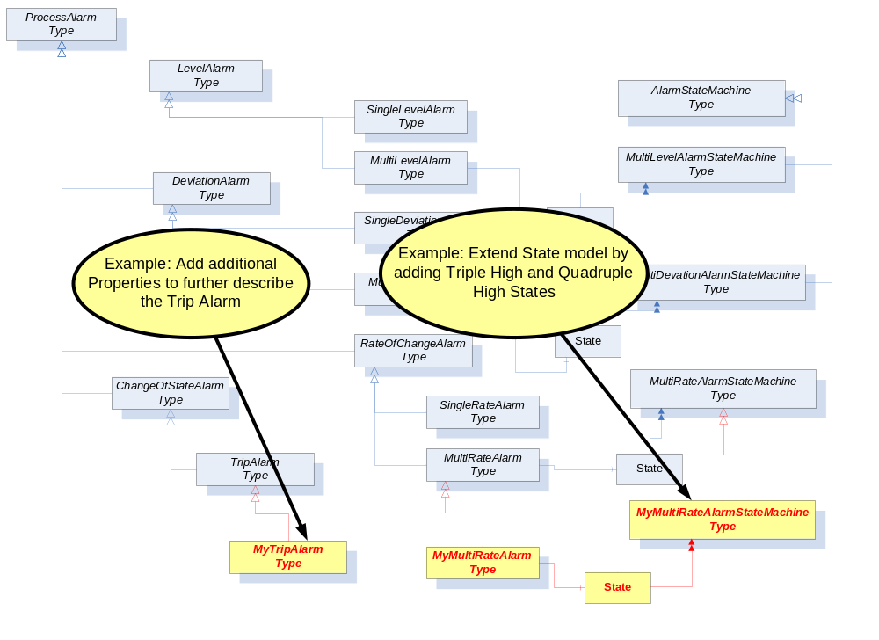
Type Model Extensions (Examples)

Slide 12
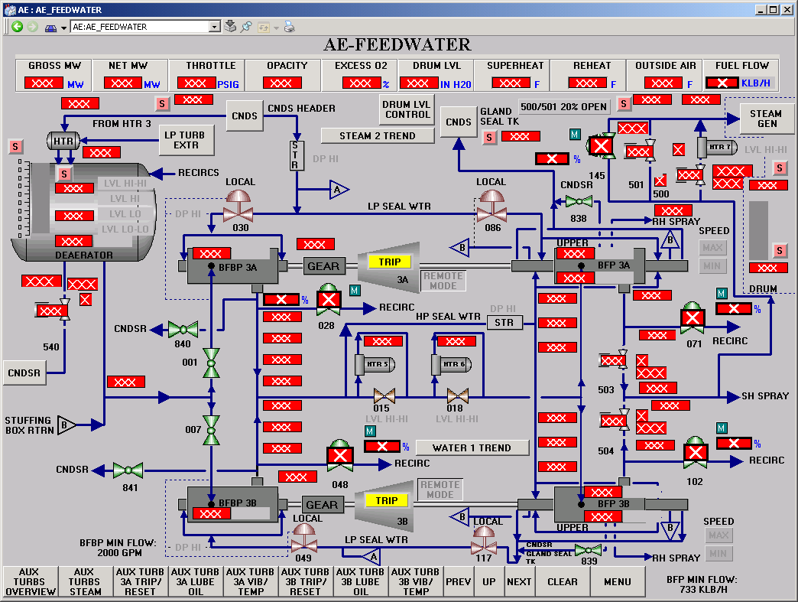
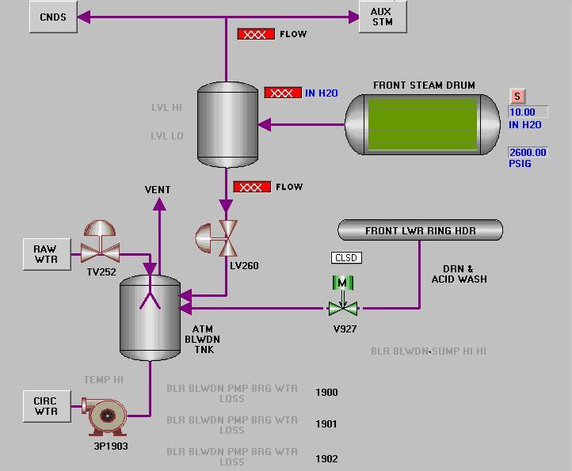
Subscribe to Events of the Drum Control
Event Notifier
DRUM LVL
Notes:
Motivate a client that needs to subscribe to drum control data (Graphic display needs some data, different intervals etc.)

Slide 13
Condition Subscription
Conditions use Event Subscription
Refresh method used to retrieve existing conditions
Retain status bit
  Server sets to indicate the condition
    Will be included in a refresh
    Should be retained by the client
  Server resets to indicate client can discard

Slide 14

Subscription
Assumption
  Connected to Server (Secure Cannel + Session)
  Subscription created
  NodeId of Object with Notifier is known (Browse, Query, etc.)
Use Case: Add Monitored Items for Alarm Display
CreateMonitoredItems()
Per Item:
Monitoring Mode
  Reporting
Sampling Interval
Discharge Oldest
Filter
  Selection List
  Where Clause
DRUM LVL
Reporting
Interval = 1s
Subscription
EventId,
EventType,
SourceNode,
SourceName,
Time,
Message,
Severity,
Retain,
State.Acknowledged.CurrentStateDisplayName,
State.Active.CurrentStateDisplayName,
State.Inhibited.CurrentStateDisplayName,
…
and
>
OfType
Severity
400
(Severity > 400) and OfType(ProcessAlarmType)
ProcessAlarmType
Notes:
Explain how a subscription can be used (add Items and triggering) use the drum control example for motivation
MonitoringMode:
DISABLED The item being monitored is not sampled or evaluated, and Notifications are not generated or queued. Notification reporting is disabled.
SAMPLING The item being monitored is sampled and evaluated, and Notifications are generated and queued. Notification reporting is disabled.
REPORTING The item being monitored is sampled and evaluated, and Notifications are generated and queued. Notification reporting is enabled.
When do I need triggering?!?
Alarms – what else?

Slide 15




Client State Synchronization
Client
Create
MonitoredItems()
Refresh()
Publish()
Publish()
Server
Request existing Conditions
Send Notification
Existing Conditions
Any new Conditions
Waits for Conditions

Slide 16

Questions?
Jeff Harding
Director, System Software Architecture
ABB Automation Products Division
Jeff.Harding@US.ABB.com

