Slide 1
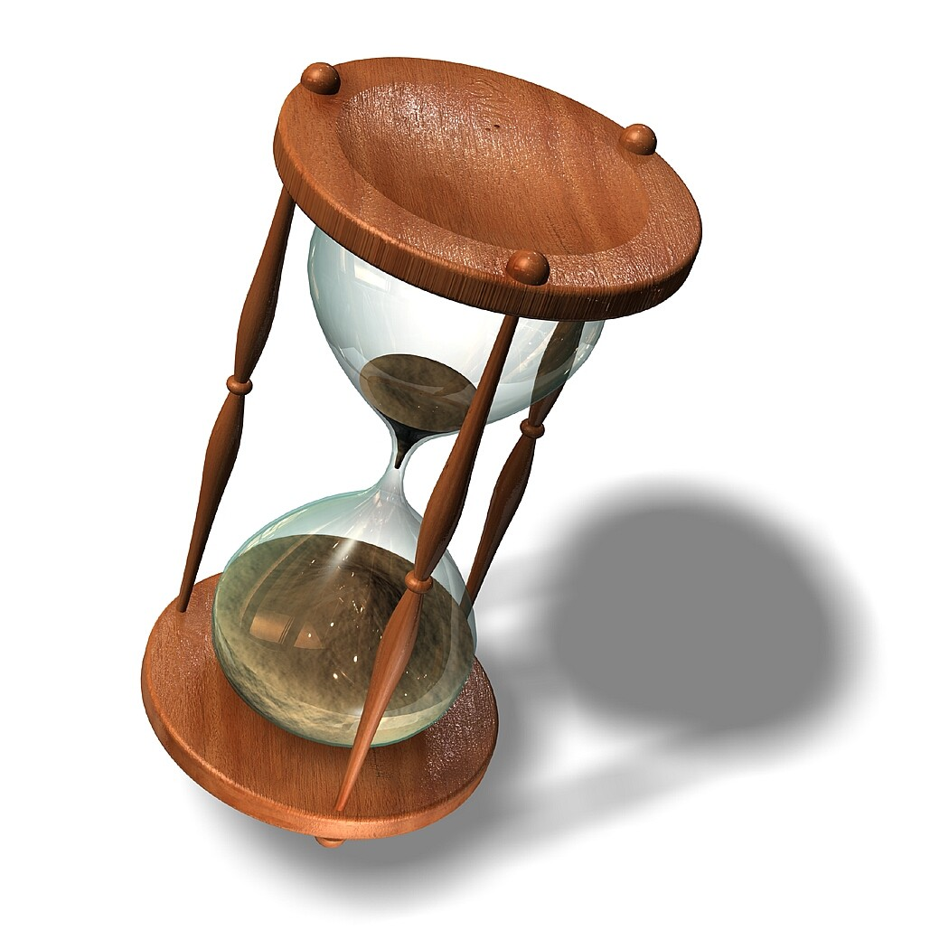
OPC UA – Historical Access
Historical Data and Events in UA
Eric Murphy, P.Eng (Alberta)
OPC HDA Committee Chair
MatrikonOPC
Notes:
Final version 1.02

Slide 2
Outline
Defining History
  What is OPC UA Historical Access
Integrating History
  History is Integral to UA
Finding History
  Address Space
Configuring History
  Information Model
Accessing History
  Historical Data
  Historical Events

Slide 3

Defining History – OPC UA HA
Leverage Past History
  Flexibility (Read Raw, Processed, AtTime)
  Ability to Update (Modify, Delete)
  Standard Aggregates
Defining Future History
  Better Integration with other Specifications
  Streamline Interfaces
  Access to Event based History
  Expanded Information Model
Notes:
One definition of History would be “An accounting of what has come before”
So when determining what should be included in OPC UA Historical Access, we looked into the past…

Slide 4
Integrating History – Part of the Core
Core Specification Parts
Access Type Specification Parts
Part 1 - Concepts
Part 8 – Data Access
Part 2 – Security Model
Part 9 – Alarms and Conditions
Part 3 – Address Space Model
Part 10 - Programs
Attributes
Part 11 – Historical Access
Part 4 – Services
HistoricalData parameters
HistoricalEvent parameters
Aggregate Definitions
HistoryServerCapabilities
Attribute / Subscription Services
View / Query Services
StatusCodes
Part 5 – Information Model
ServerCapabilities
Part 6 – Service Mappings
Part 7 – Profiles
Notes:
Commonalities with other Access Type specifications that where separate in OPC HDA
Browsing: Part 3 Address Space – Attributes and Part 4 Services – View Services
Quality: Part 4 – Status Codes
Configuration: Part 5 – Server Capabilities

Slide 5
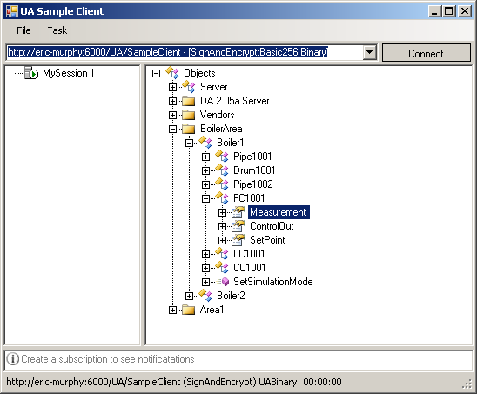
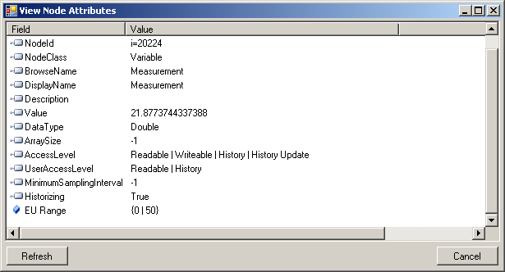
Finding History - Address Space
History for any Object, Variable, Property or View
  Variable Node
    Access Level Attribute
      HistoryRead, HistoryWrite
    User Access Level Attribute
      HistoryRead, HistoryWrite
  View / Object Nodes
    Event Notifier Attribute
      HistoryRead, HistoryWrite
  Includes Configuration Nodes
  Includes Historical Annotations
Flexibility in the browse model

Slide 6
Finding History - Terms
Historical UA Terms
  HistoricalNode – A HistoricalNode is a term used to represent any Object, Variable, Property or View in the AddressSpace for which a client may read and/or update historical data or events.
  HistoricalDataNode – A HistoricalDataNode represents any Variable or Property in the AddressSpace for which a client may read and/or update historical data.
  HistoricalEventNode – A HistoricalEventNode represents any Object or View in the AddressSpace for which a client may read and/or update historical events.

Slide 7
Configuring History – Information Model
All Key Server History Settings Found in One Place
HistoryServerCapabilities Object
  AccessHistoryDataCapability
  AccessEventsCapability
  MaxReturnValues
  TreatUncertainAsBad
  PercentDataBad
  PercentDataGood
  SteppedInterpolationMode
  InsertDataCapability
  ReplaceDataCapability
  UpdateCapability
  DeleteRawCapability
  DeleteAtTimeCapability
  HistoryAggregates
History Type
Data Handling
Modifying Capabilities
Supported Aggregates

Slide 8
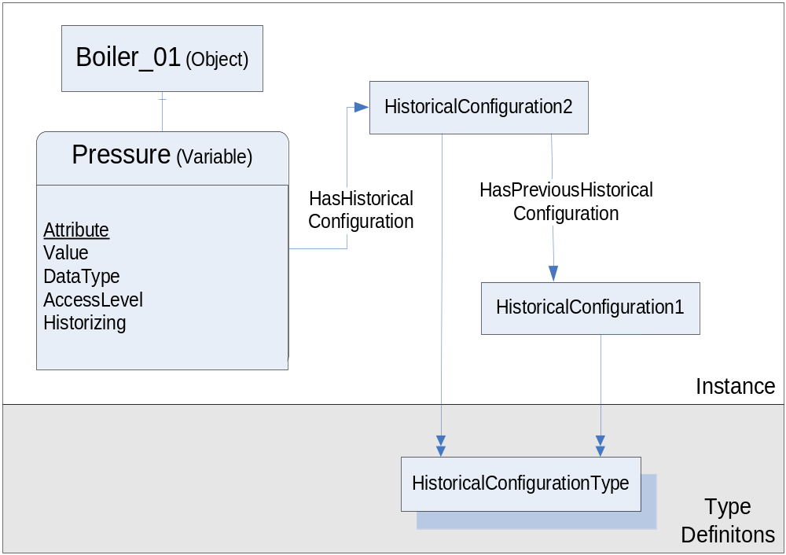
Configuring History - Historical Model
HistoricalConfiguration
  Stepped
  Definition
  MaxTimeInterval
  MinTimeInterval
  ExceptionDeviation
  ExceptionDeviationFormat
  StartTime
  EndTime
HistoricalEventConfiguration
  GeneratesEvents
Supports Node level granularity of configuration
Supports history of configuration setting – History of History

Slide 9
Accessing History - Services
HistoryRead (Attribute Service)
  Extensible Parameter allows multiple data request formats
    Raw
    Processed (Standard Aggregates)
    AtTime
    Modified
    Events
HistoryUpdate (Attribute Service)
  Extensible Parameter allows multiple data request formats
    Insert
    Replace
    Update (Insert and/or Replace)
    Delete (Raw, Processed, Modified)
    Events (Insert or Delete)
CreateMonitoredItem (MonitoredItem Service)
  Supports Aggregate Filter to subscribe to Aggregate data.

Slide 10

Accessing History - Consistency
Similar to Accessing ‘Current’ Values
  Requests
    Request Header
    Nodes To Read
    Timestamps To Return
  Response
    Result Codes
    Status Codes
    Diagnostic Information
  Extensible Parameters dictate functionality
  Supports Continuation Points
Notes:
Mention some of the key parameters passed / returned in the service calls.
Extensible parameters and continuation points are interesting.

Slide 11
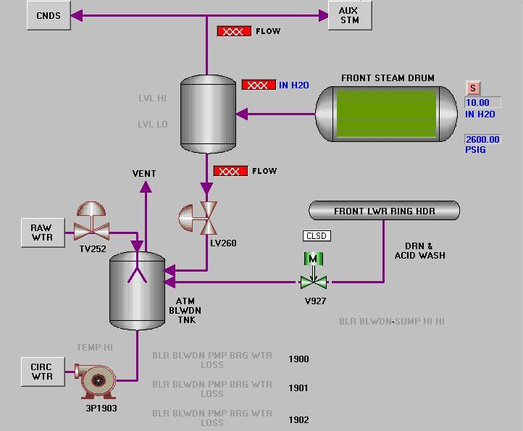

Accessing History – Historical Data
Extensible Parameter dictates functionality
HistoryRead()
historyReadDetails
TimestampToReturn = SERVER
releaseContinuationPoints = TRUE
NodesToRead[]
Extensible Parameter:
RAW
startTime = Jun 24, 2007 12:00:00
endTime = Jun 25, 2007 12:00:00
numValuesPerNode = 100
returnBounds = FALSE
Extensible Parameter:
PROCESSED
startTime = Jun 24, 2007 12:00:00
endTime = Jun 25, 2007 12:00:00
resampleInterval = 1 hour
aggregateType = AVERAGE
FALSE
LI1001
LI1001
continuationPoint
( Initial Request – Processed Data )
( Initial Request – Raw Data )
( Follow up Request )
FT1001
FT1001
continuationPoint
FT1002
FT1002
continuationPoint
Notes:
- key parameters passed into services
- Extensible parameter – Different parameter for different functionality.
- continuationPoint. Server supplies continuationPoints when needed, client has option to use them or not. Control over data returned.

Slide 12
Accessing History – Historical Events
Use Case: History of Level Alarms
HistoryRead()
Extensible Parameter:
EVENTS
startTime = Jun 24, 2007 12:00:00
endTime = Jun 25, 2007 12:00:00
numValuesPerNode = 100
filter = <Event Filter>
historyReadDetails
TimestampToReturn = SERVER
releaseContinuationPoints = TRUE
NodesToRead[]
Event Filter:
  selectClause:
  whereClause
LI1001
EventId, EventType, SourceNode,
SourceName, Time, Message, Severity, Retain,
State.Acknowledged.CurrentStateDisplayName,
State.Active.CurrentStateDisplayName,
State.Inhibited.CurrentStateDisplayName,
  …
and
>
OfType
Severity
400
ProcessAlarmType
Notes:
Reading Historical Events is exactly the same, with different Extensible parameter.
Event Filter is the same format as used in Monitored Items.

Slide 13

Summary
History is Integrated within OPC UA
All key functionality of existing History specification
Historical Data and Historical Events
Powerful Historical Information Model
We’re Making History with OPC UA ☺

Slide 14


Questions?
Eric Murphy, P. Eng.
Advanced Systems Design
MatrikonOPC
eric.murphy@matrikonopc.com
http://blog.matrikonopc.com

