Slide 1
Scalability and Profiles
Paul Hunkar
Director of Certification for the OPC Foundation
Consultant Engineer, ABB Process Automation

Slide 2
Overview
Scalability and Profiles
  What is Scaleable in UA?
  How do you Manage the scalability?
  How do Clients and Servers figure out what is supported
  How do Compliance Tests Test Provided Functionality
    Server
    Client
  What is a Profile
  What is a Conformance Unit?
  What Profile and Conformance Units exist?

Slide 3
Scalability and UA
Scalability – Small System to Large System
  Inherently in data model
  Support for types
    Extensible
Scalability – Functionality Many Options
  Historical Support
  Alarm Support
  Program Support
  Transport Support
  Security Support
How do you determine what is available?
Answer - Profiles

Slide 4
Scalability - Profiles
What is a profile?
  A grouping of testable units that describe a piece of functionality.
    A testable unit is termed a Conformance Unit.
  Profiles are given names and are well defined.
  Profiles are published.
    With the UA Software (certificates)
    Via OPC WEB site
OPC UA Profiles
  Exist for Servers.
  Exist for Clients.
  Detailed in Part 7 of the specification
  Maintained in OPC Database

Slide 5
Scalability - Profiles
Conformance Units
  Individual items that are tested as a unit - Examples include
    Individual Services
    Specific Transports
    Specific Security Options
    Specific Data Models (or parts of a data model)
  Conformance units are grouped to form Profiles
  A Conformance Unit may exist in more then one Profile
  Conformance units are described as part of a Profile
  Conformance units are Link to Test cases

Slide 6
Conformance Units - Common
Secure Channel Services
Session Services
Node Management Services
View Services
Query Services
Attribute Services
Method Services
MonitoredItem Services
Subscription Services
Discovery
Base Interaction
Security Information
Address Model
Data Access Model
Alarm & Conditions Model
Historical Access Model
Program Model
Redundancy
Auditing

Slide 7
Specific Conformance Units
Base interaction
  Transports
    UA TCP Support
    SOAP/HTTP Support
  Encoding
    XML
    UA Binary
  Security
    UA Security
    WS-Security

Slide 8
Scalability - Profiles
Certificates exchanged that describe supported profiles
  Certificates include level of compliance achieved
    None
    Self tested
    Certified tested
  Can be multiple
    Profile can overlap
    Could be non-related
  Can be industry specific
    OPC Foundation provides
    Other Organization could also provide (i.e. EDDL)

Slide 9
Scalability - Profiles
Profiles can nested
  A Profile may be built on top of another profile
  It may include multiple underlining Profiles
  It may add additional Conformance Units
  Allow for easy creation of Industry specific profiles
Profile Testing will be automated
  Will track passed Conformance units
  Run tests associated with additional Conformance units only
  Testing will include required configuration

Slide 10
Potential Profiles
Functionality specific profiles
  Historian
  Alarming
  DA Wrapped Server
  HDA Wrapped Server
  A&E Wrapped Server
Industry specific profiles
  Embedded device
System Specific
  UA Binary Support

Slide 11
Potential Profiles
System Specific
  Soap/HTTP + XML + WS-Security
  Soap/HTTP + UA Binary + WS-Security
  Soap/HTTP + UA Binary + UA Security
  UA TCP + UA Binary + UA Security

Slide 12
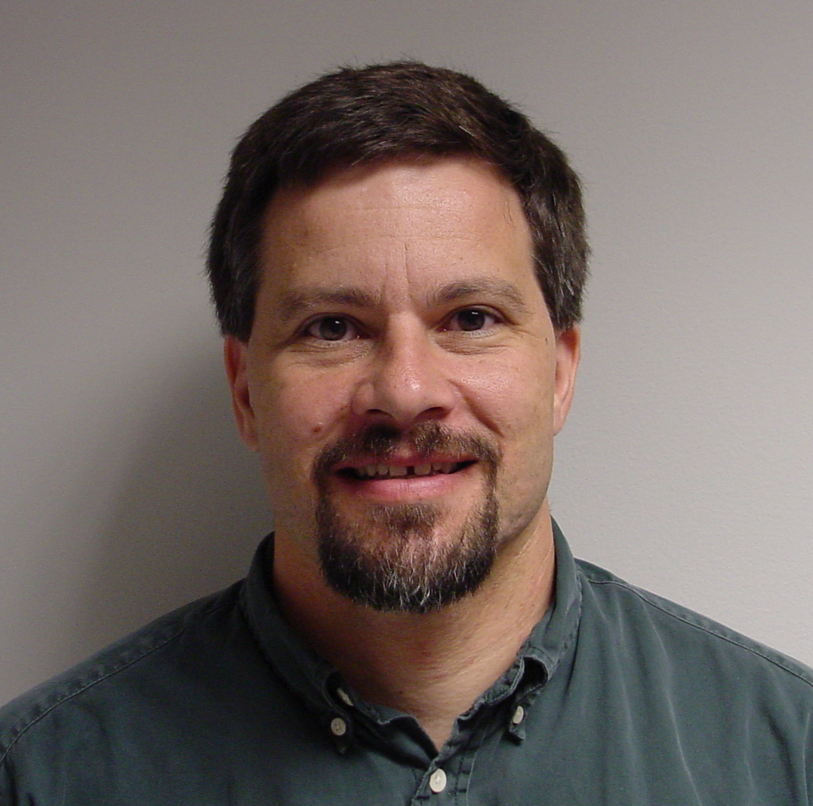
Questions?
Paul Hunkar
Consultant Engineer
ABB Automation Products Division
Paul.Hunkar@US.ABB.com

