Slide 1
UA and EDDL Demo
How the Things Come Together
Ronaldo Duarte
Smar

Slide 2
Content
How to access EDD information
How to expose EDD information
Demonstration of an OPC UA server able to access and expose EDD information

Slide 3

How to access EDD information?
FF Configurator
OPC UA Server
OPC UA Client
FF Device
H1
Driver
OPC UA
Client Application
OPC UA
Server Application
(OPCF/SMAR)
Address
Space
EDD
Diagnostic
UA Programmers I/F
(OPCF)
UA Programmers I/F
(OPCF)
OPC UA
Core
Technology
OPC UA “Stack”
OPCEA
OPC UA “Stack”
OPCEA
SOAP
SOAP
TCP or HTTP
TCP or HTTP
OPC UA
Protocol
Ethernet/
Internet
OPC UA
Protocol

Slide 4
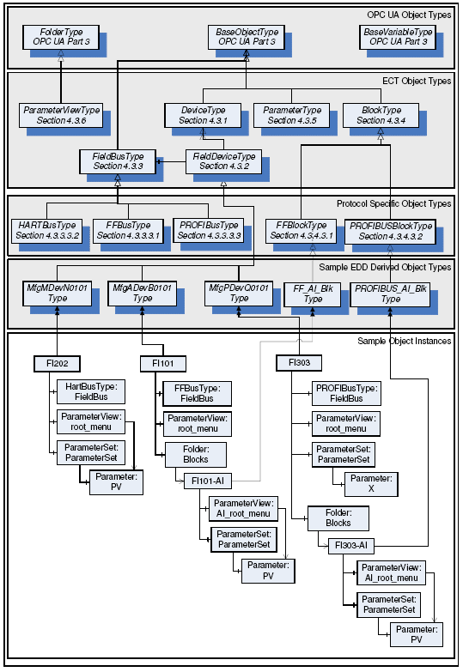
Overview of the EDDL information model

Slide 5
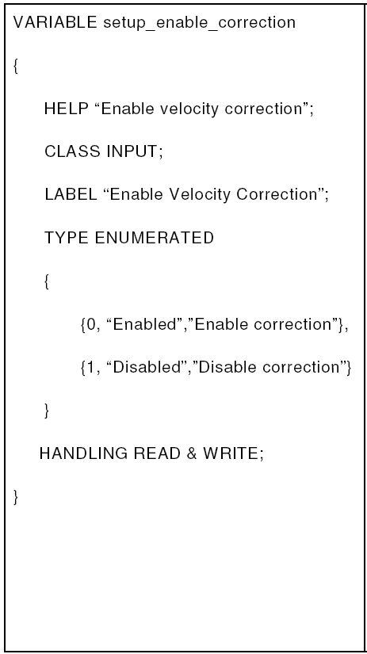
How to expose EDD information?
OPC UA Server Namespace
(Mapping shown is for example only)
EDDL
Mapping
Process
Field Device | Object
Block | Object
Parameter value | DataVariable
Menu | Folder
Parameter Collection | Folder
Mapping
Rules
EDDL Information
Model
Specification
(FF-690)
EDD
File

Slide 6
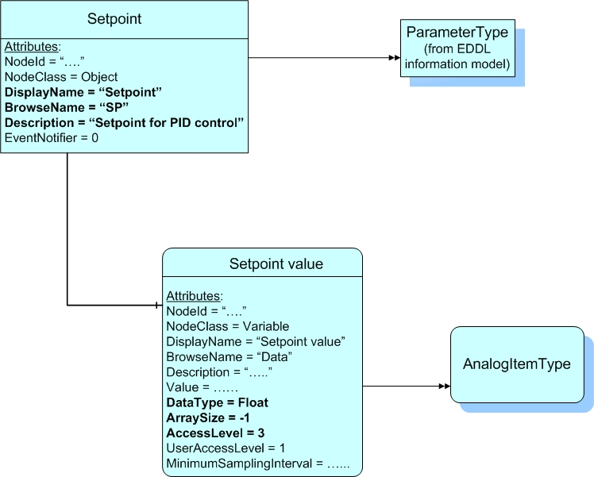
Representing an EDDL VARIABLE using the UA object model
VARIABLE LABEL
VARIABLE IDENTIFIER
VARIABLE HELP
VARIABLE TYPE
VARIABLE HANDLING

Slide 7
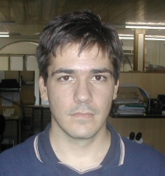

Questions?
Ronaldo Duarte
Software Engineer
ronaldotd@smar.com.br
Smar Electronics Development Division
+55 16 3946 3516
Sertãozinho – São Paulo - Brazil

