Slide 1
Demonstration
Cross Platform, Functional and Running
Matthias Damm ascolab
Paul Cameron Kepware
Rudolf Griessl ICONICS

Slide 2
Content
Demonstration shows
  Cross Operating System Interoperability
  Cross Language and Development Environment Interoperability
  OPC UA is Functional and Running
OPC UA Full Mesh Browser
  Integrated with OPC UA 3D Graphical Client
  .NET based UA Client from ICONICS
OPC UA on PLCs
  UA Server on Allen Bradley ControlLogix from Kepware
  UA Server on TwinCAT PLC from BECKHOFF
  Both UA Servers are based on ANSI C and C++
UA on a Linux Box
  Cross platform OPC UA development based on ANSI C and C++

Slide 3

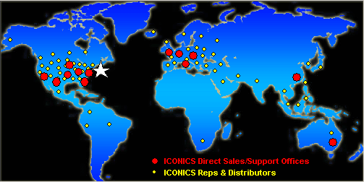
Introducing ICONICS
ICONICS Delivers Leading-Edge Software Solutions
  Hardware Independent
Turning Data into Competitive Advantage
  Manufacturing Intelligence
  Automation
  Visualization
  Interoperability
5,000+ Customers Worldwide
  70% of Fortune 500
Worldwide Network
  150 Sales Channels
  300 Systems Integrators
200,000 Licenses Installed Since 1986
ICONICS Offices and Sales Channels
Notes:
We are a software company; all we do is develop and market software, and that means we can focus on being the very best in our space. We are hardware independent, so we connect to every data source naturally. We were the first Microsoft Gold Certified Independent Software Vendor Partner in our in industry, and we work very closely with Microsoft to maximize use of their tools so your company can employ them for competitive advantage. All ICONICS software tools are open, scaleable and modular for maximum flexibility and economy.
Over the past twenty years, ICONICS has deployed over 200,000 licenses through our systems integration partners throughout virtually every industry. Whether it is process or discreet, ICONICS tools provide rich visualization, alarm management, real-time information management

Slide 4
OPC UA Full Mesh Browser
Written from the ground up in .NET
Designed for both 32 bit and 64 bit Operating Systems
Visualize address space in multiple ways; many ways to perform browsing:
  Tree
  Grid
  Graphical Mesh
  Breadcrumb bar Vista “like” view
  (Favorites View)
  (History)
Provides real-time updates of address space
Auto Discovery of OPC UA Servers

Slide 5
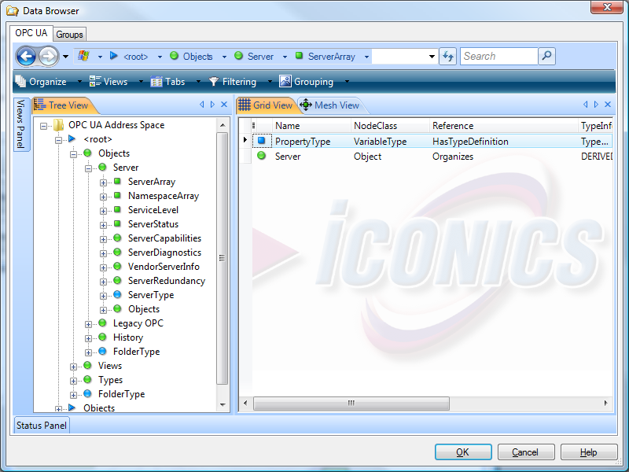
UA Browser – Tree View and Grid View
Internet Explorer 7 look and feel
Grid View
Tree View

Slide 6
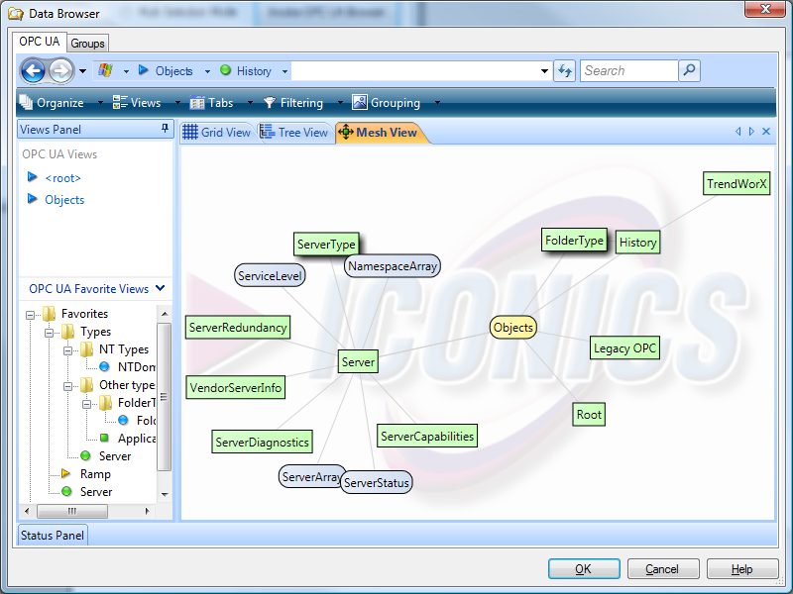
UA Browser – Mesh View
Graphical Mesh View
Favorite View

Slide 7
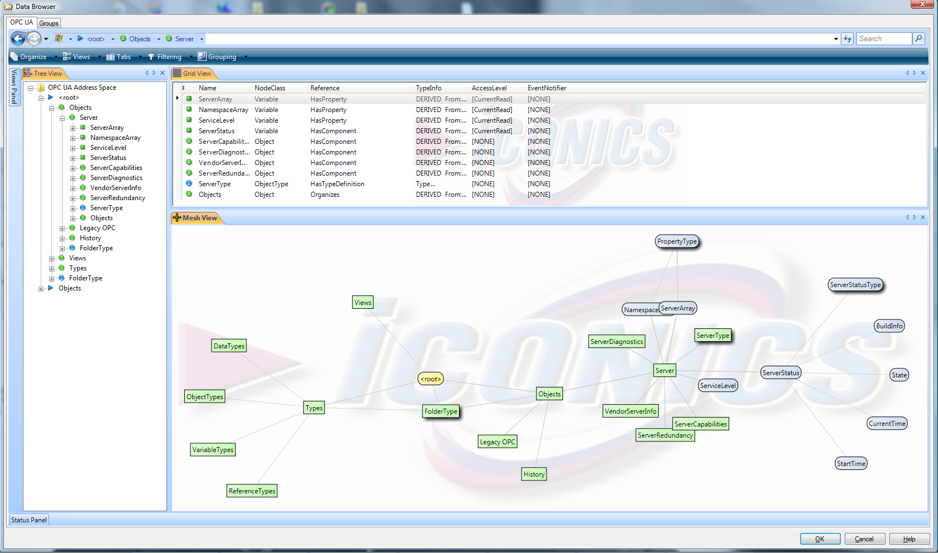
UA Browser – Advanced Layout

Slide 8
OPC UA Toolkit
Designed for both 32 bit and 64 bit Operating Systems
Written in C#
Wizards for creating UA servers, rapid UA development
Web enabled configuration
Support for online changes
Support for concurrent multi-user configuration
Support for configuring multiple servers at the same time
Automatic creation of WCF web services
Includes Modbus OPC UA Server
Total Compliance with OPC UA

Slide 9
Demo
Demo

Slide 10

Introducing Kepware
About Kepware
  Communications based company focused on providing connectivity to plant floor equipment
  Founded in 1994, based in Portland Maine
  OPC Foundation Member since 1997
  Participant of several OPC Working Groups, including the OPC UA Early Adopter Group
KEPServerEx
  1 OPC Server – 100+ Communications Protocols
  Supports OPC Data Access 1.0, 2.05a and 3.0
  Integrating OPC UA utilizing the ANSI C Stack developed by the Early Adopter Group

Slide 11
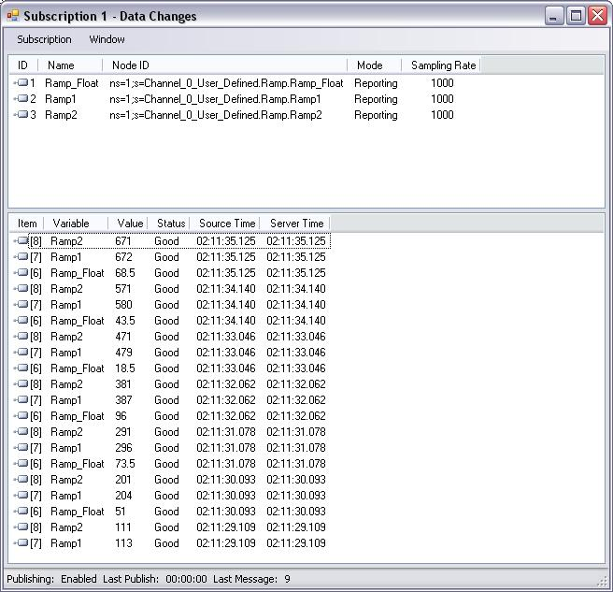
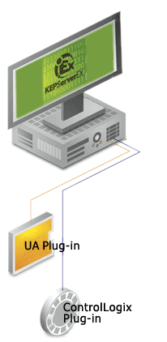
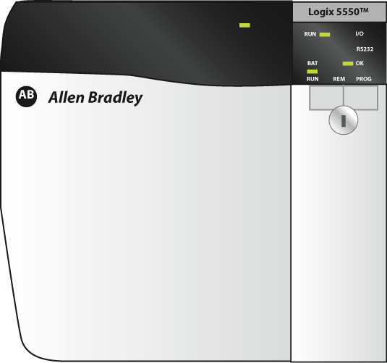

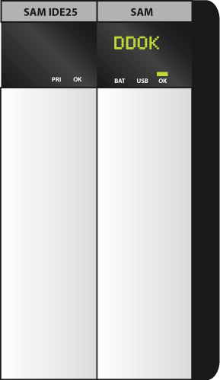
Kepware OPC UA Server
OPC UA Client (.NET stack)
OPC UA Server (C-stack)
ControlLogix

Slide 12
Demo
Demo

Slide 13
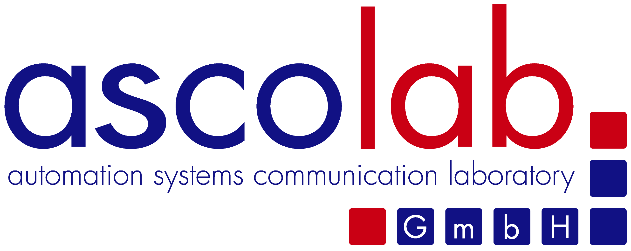
Introducing ascolab
About ascolab
  Providing manufacturer and industry independent consulting, design and development services regarding OPC based solutions
  Active in OPC Certification since the beginning
  Development and maintenance of the CTT (Compliance Test Tools)
  Development and IOP support for OPC Analyzer and Client self certification
  Prototyping of a OPC Test Lab
OPC Unified Architecture
  From the very first beginning ascolab is part of the core development group of OPC UA
  Our team is involved in the specification work and we are the lead development group of the ANSI C Communication Stack developed in the Early Adopter group.
  We are providing OPC UA Jump Start training and consulting
  We are providing cross platform ANSI C SDK and C++ SDK for UA Server development

Slide 14



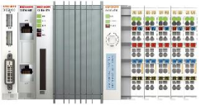
UA on a PLC - Experience
Implementation by BECKHOFF
  UA Server directly on device (PLC + Motion Control)
    By default no UA configuration necessary
    Address space is always consistent with PLC programm / device
  Server : C++ UA code
    Easy to compile : VS2005
    C++ to support various CPU platforms and various OS:
      X86 with Microsoft XP embedded XP
      X86 with Microsoft CE
      XScale with Microsoft CE
Experience
  It just works…
  High performance

Slide 15

UA on a PLC : Roadmap
UA on PLC: Roadmap (BECKHOFF)
  Today:
    OPC DA widely accepted for data exchange
    Read / write access to PLC variables
    OPC DA act as transport layer
    Alarm handling, historical data etc in upper levels
  Soon:
    UA for data exchange (PLC variables)
    Goal: no configuration of UA server
    fully integrated into device
    UA as THE generic access to device
    - Diagnostic : CPU temperature
    - Setup: Timezone / TimeServer
    - Functionality: Up/Download PLC-Code
    - …
MES
SCADA
UA Client
UA TCP
PLC
UA Server
TwinCAT PLC
PLC
UA Server
TwinCAT PLC

Slide 16
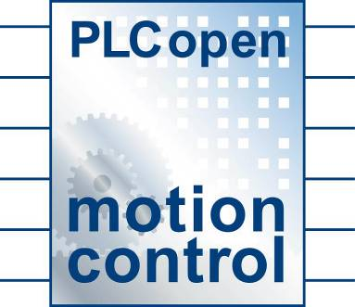
UA on a PLC - Roadmap
UA on PLC (Common)
  Today
    PLC to PLC communication (horizontal)
      Legacy driver
      High effort for configuration
      Low knowledge of comunication protocols for different PLC systems
  Soon
    Massive implementations on PLCs
    End customers saving money for extra “OPC“-PC, save time for setup
    PLCopen :
      History :Defined Funktionsblocks for e.g. Motion Control
      Same FB Functionsblock interface for different PLC platforms
      Future : Define “PLCopen UA“ FBs for communication !

Slide 17
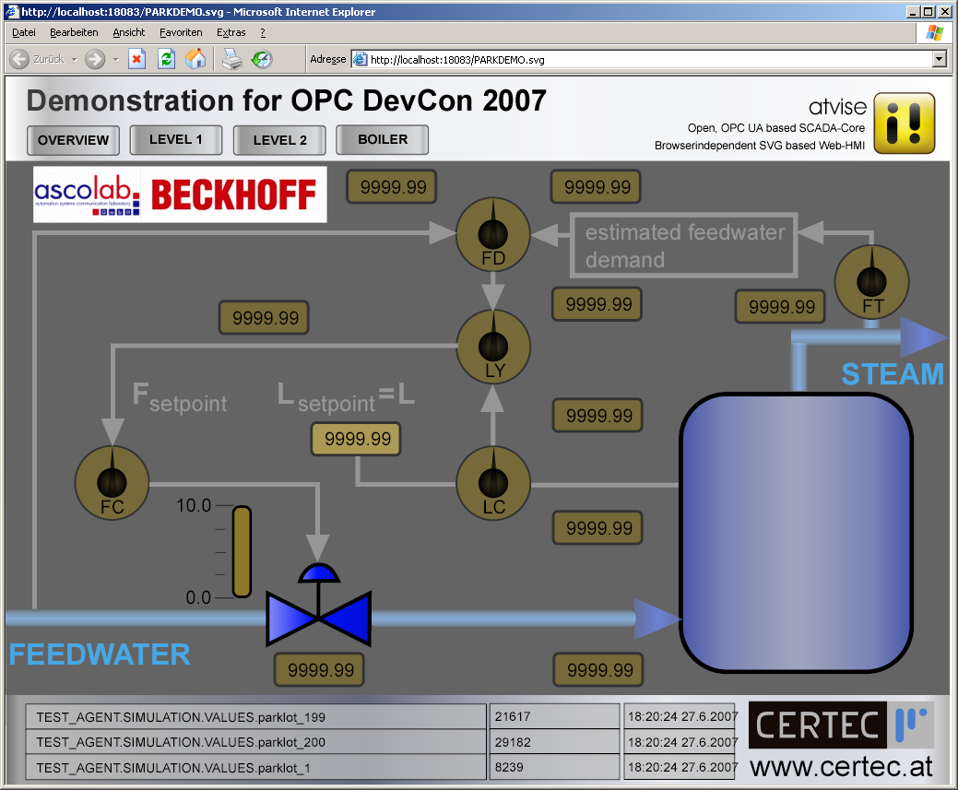
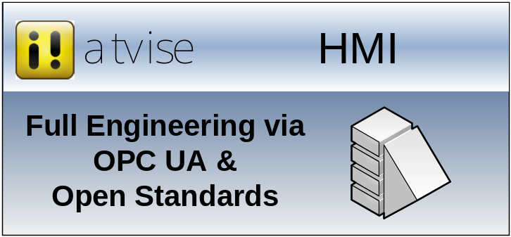


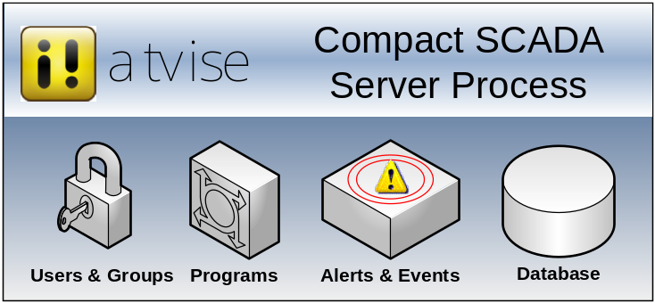
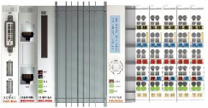


atvise – Open Standards SCADA
Scalable Vector
Graphics (SVG)
Visualization
for all Browser
Engineering
DA & Events
HDA
OPC UA
OPC UA
PLC
OPC UA
a product by
www.certec.at

Slide 18


UA on Linux - Motivation
Unix /Linux is widely used for enterprise applications
Linux is for free, open source, highly customizable
Real Multitasking and Multi-user System
Soft Real Time capabilities of kernel 2.6.x for time critical applications
I/O bound scheduling for less latency
Free development tools
Compiler, IDE, Debugger, Profiler, etc.
To demonstrate : OPC UA is OS independent
Notes:
Unix is widely used and accepted. Linux is the successor of many Unix solutions.
Mature server functionality out of the box wiht Linux: Networking, Redundancy, Scalability, LoadBalancing, RAID, Backup, ...
Easy to use and administer with powerfull Shells as BASH.

Slide 19
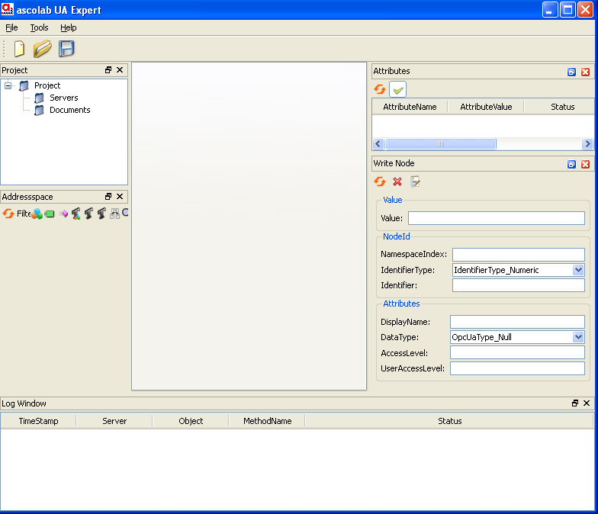
Cross Platform Demo
Windows XP
  Web based HMI -> PLC
  .NET Client -> LINUX Server
  C++ Client -> PLC, LINUX
  UA Expert
LINUX
  ANSI C based demo server
  C++ based demo server
  Same code base for Windows and LINUX
  C++ Client UA Expert -> PLC
  Same code base for Windows and LINUX
PLC
  UA Server on BECKHOFF PLC
  UA Server on Allen Bradley PLC
Windows XP
HMI
UA Client
UA Client
ANSI C
UA Server
LINUX
C++
UA Server
UA Client
PLC
PLC
UA Server
UA Server
TwinCAT PLC
ControlLogix

Slide 20
Demo
Demo

Slide 21
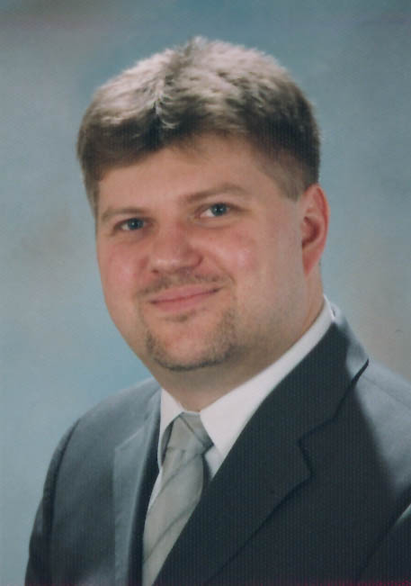



Questions?
Matthias Damm
Executive Director, ascolab GmbH
matthias.damm@ascolab.com I
Paul Cameron
Senior Software Engineer, Kepware
paul.cameron@kepware.com I
Rudolf Griessl
Senior Development Engineer, ICONICS
rudolf@iconics.cz (.com) I

