Slide 1
Performance
Paul Hunkar
Director of Certification for the OPC Foundation
Consultant Engineer, ABB Process Automation

Slide 2
Performance Testing - Goals
Compare different UA profiles
  Soap/HTTP + XML + WS-Security
  Soap/HTTP + UA Binary + WS-Security
  UA TCP + UA Binary + UA Security
Compare different setups
  Enable Full Security
  Disable Full Security
Compare different data types
Compare local and remote communication
Compare with COM/DCOM-based OPC DA

Slide 3
Performance Testing - Issues
Issues
  Not all Profiles are available
  Not all option available
    Fixed Security parameters
  Code not optimized – Thus Only relative Numbers
  Test Environments
    C# Code
    ANSI “C” Code
    Java Not Tested

Slide 4
What was tested
Transport related issues
  Using Soap/HTTP transport tested
  XML verse UA Binary payload
    with WS-Security vs with out WS-Security
  Using UA Binary payload tested
    Soap/HTTP verse TCP transports
Data type Issues
  Doubles
  Integer
  Strings
  Large Strings
Existing OPC-DA Comparison
  UA Binary on TCP vs COM
  UA Binary on TCP vs DCOM

Slide 5
Performance Testing - Expectations
UA Binary encoding faster than XML
Small notifications less efficient than large
Small data types faster than large ones
Local operation faster than network
COM-based OPC DA faster than OPC UA
TCP transport faster than HTTP

Slide 6
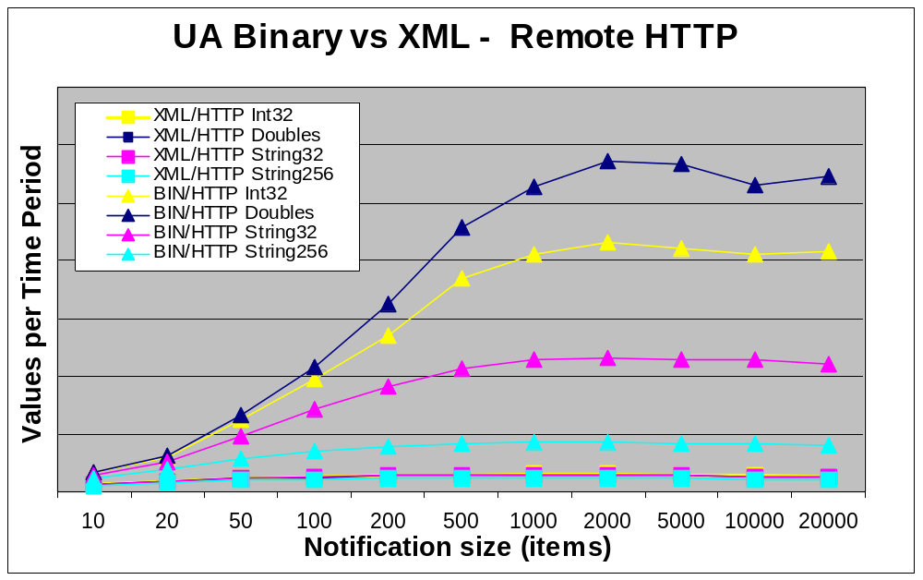
Relative Performance

Slide 7
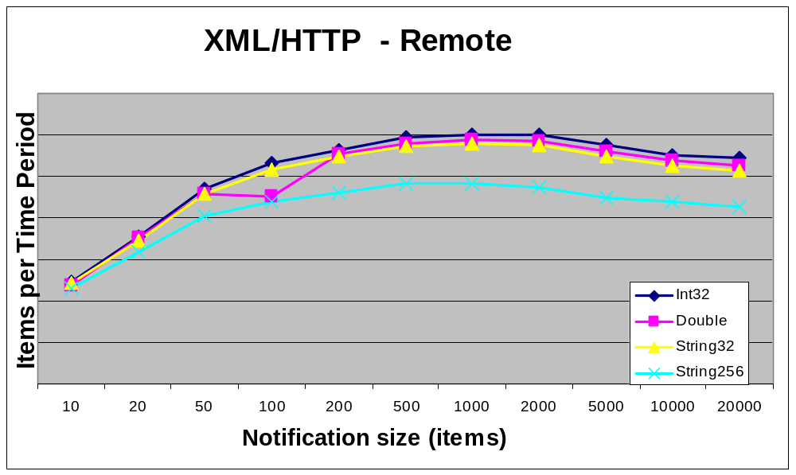
Relative Performance

Slide 8
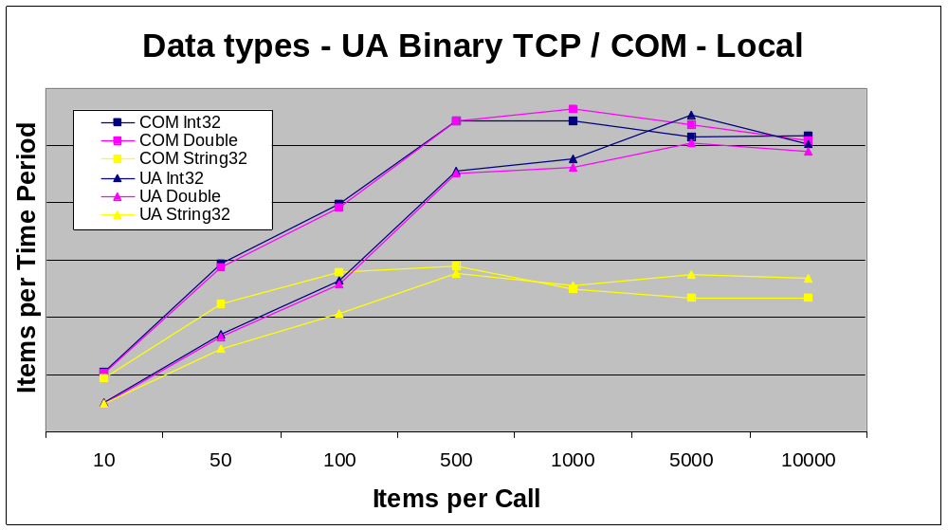
Relative Performance

Slide 9
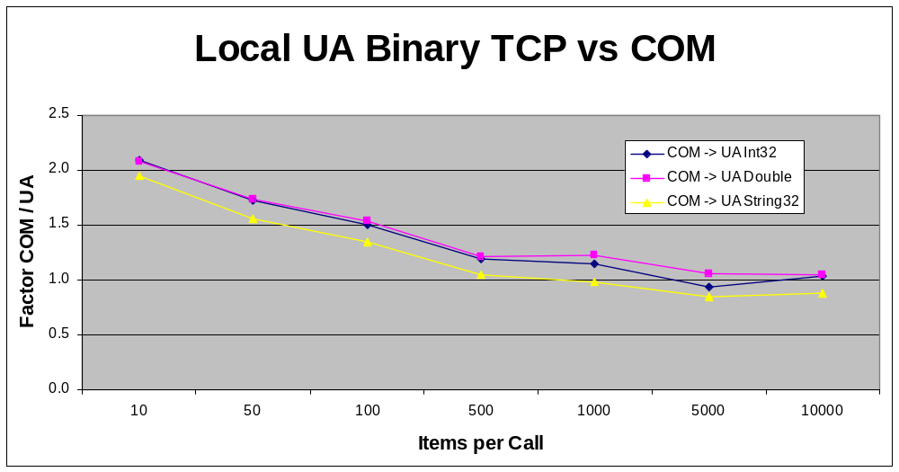
Relative Performance

Slide 10
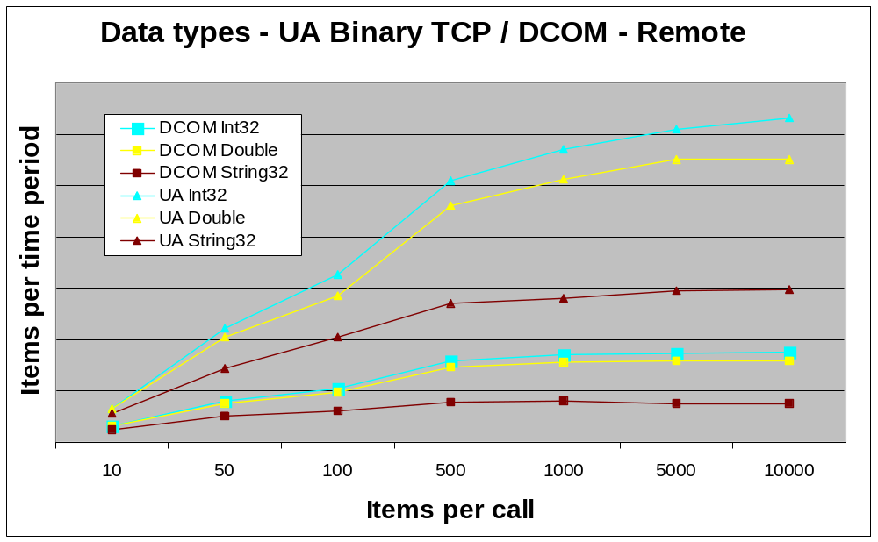
Relative Performance

Slide 11
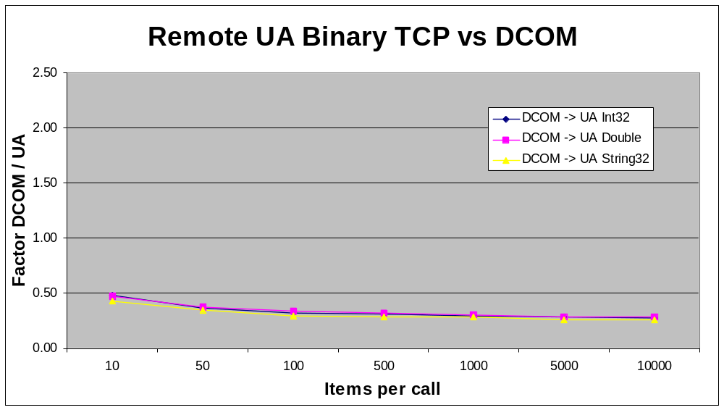
Relative Performance

Slide 12
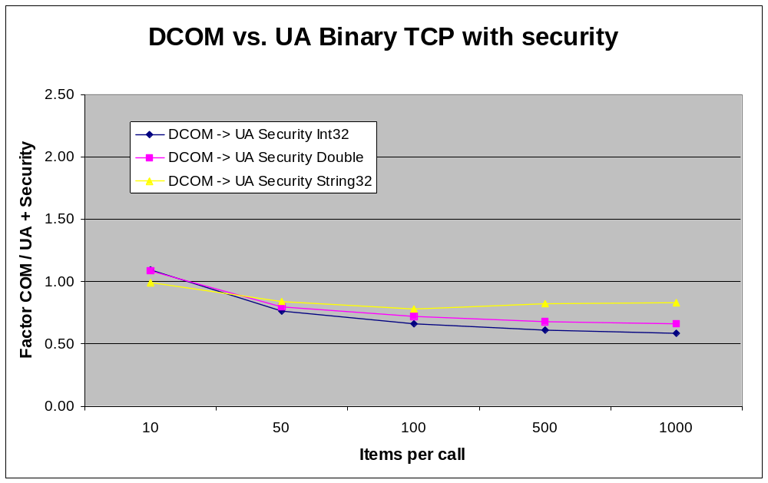
Relative Performance

Slide 13
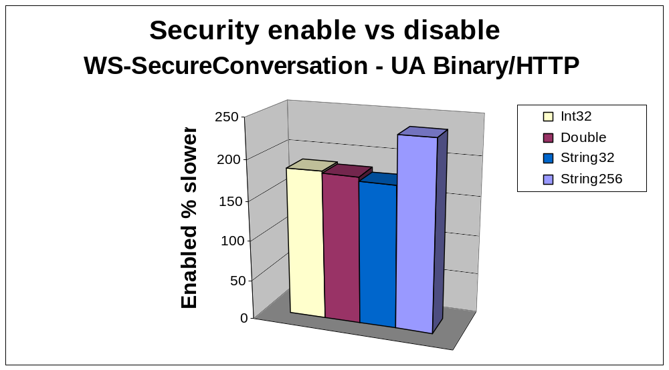
Relative Performance

Slide 14
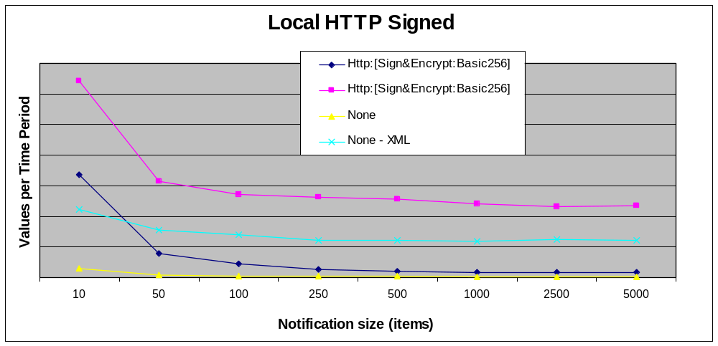
Relative Performance

Slide 15
Performance Summary
UA Binary over TCP is between 2x-4x faster than DCOM, depending on packet size.
UA Binary over TCP is Comparable to COM for larger data sets, but half the speed for small packets
UA Binary over TCP with UA Security (Encryption) is comparable to DCOM with out any security
UA Binary is 4x - 20x times Faster then XML over HTTP depending on data types and message sizes
Data types make little difference using XML over HTTP
XML over HTTP with WS-SecureConversation is 2x-4x slower than XML over HTTP without WS-SecureConversation

Slide 16

Questions?
Paul Hunkar
Consultant Engineer
ABB Automation Products Division
Paul.Hunkar@US.ABB.com

