Slide 1
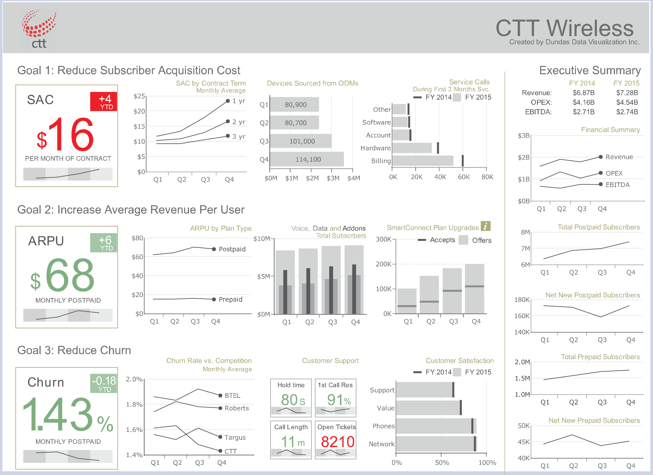
Chapter 27 Case Study
Telecom Operator
Executive
Dashboard
Dashboard design for executive decision-making
Presenter:
Tran Nguyen My Anh
Course:
Data Visualization / Dashboard Design
Source:
The Big Book of Dashboards
, Chapter 27

Slide 2
Scenario and Business Context
Who uses it?
•
Executives and senior management at a telecom
company.
•
Used in management, board, or stakeholder
meetings.
•
The goal is executive-level monitoring, not deep
interactive analysis.
What must it answer quickly?
•
Is the company on track against strategic goals?
•
Which metrics are improving or worsening?
2 / 13

Slide 3
Dashboard Design Logic
The dashboard is structured around four information zones
•
Row 1:
Reduce Subscriber Acquisition Cost
.
•
Row 2:
Increase Average Revenue Per User
.
•
Row 3:
Reduce Churn
.
•
Right column:
Executive Summary
for finance and subscriber status.
3 / 13

Slide 4
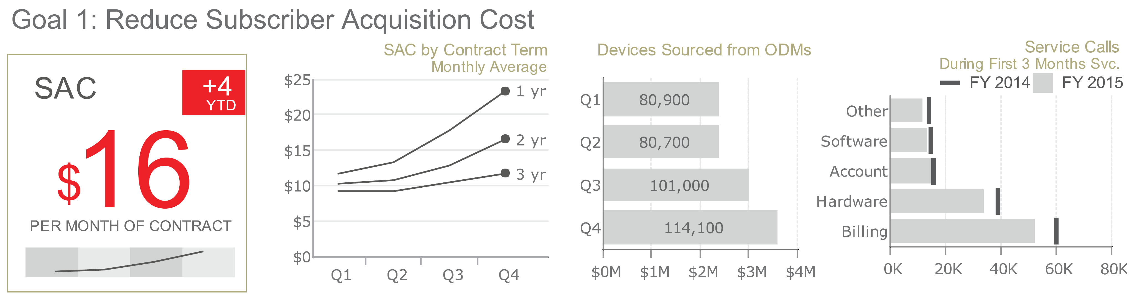
Goal 1: Reduce SAC
Status
Drivers
Operational signal
•
$16
/month of contract.
•
Contract term changes cost.
•
Service calls show burden.
•
+4 YTD
above benchmark.
•
ODM device mix adds pressure.
•
Target lines show FY2014 gap.
4 / 13

Slide 5
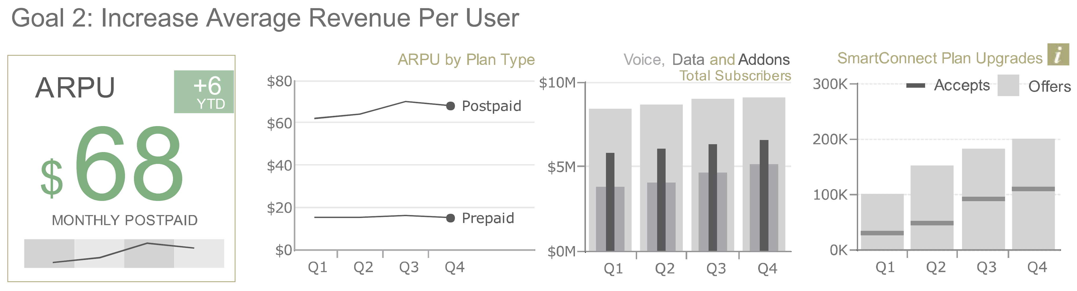
Goal 2: Increase ARPU
Status
Revenue mix
Conversion
•
$68
monthly postpaid.
•
Postpaid/prepaid split.
•
Offers compared with accepts.
•
+6 YTD
revenue lift.
•
Add-ons show contribution.
•
Gaps show upgrade room.
5 / 13

Slide 6
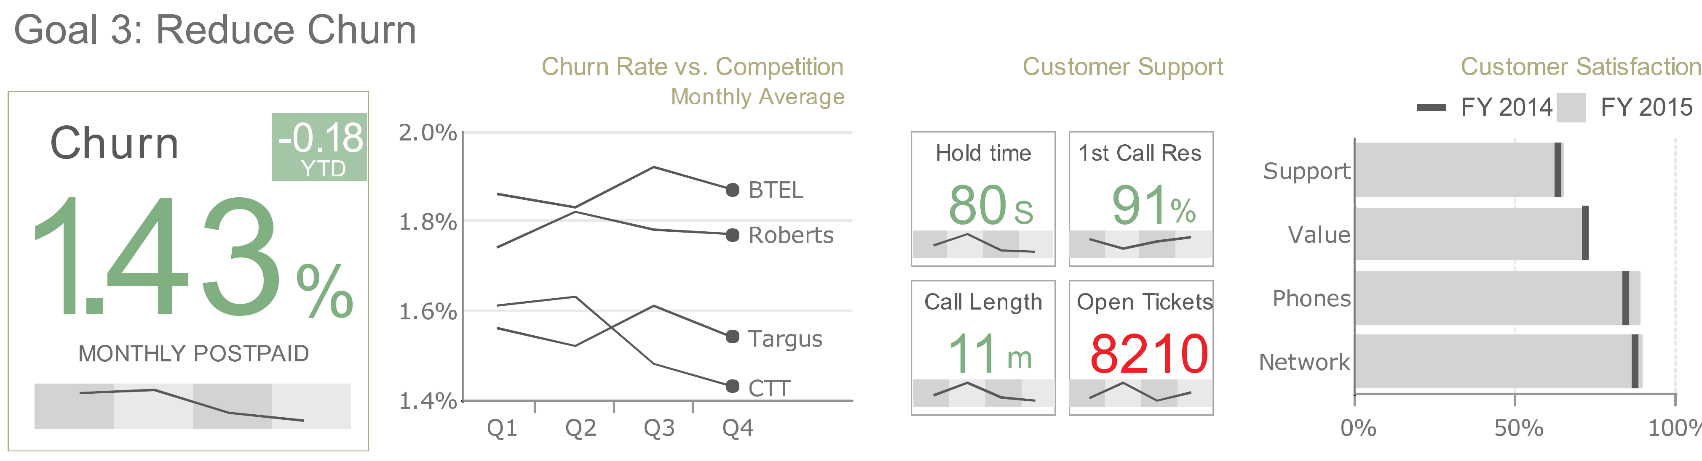
Goal 3: Reduce Churn
Status
Competitive view
Retention risk
•
1.43%
monthly churn.
•
CTT benchmarked vs peers.
•
Support KPIs show friction.
•
-0.18 YTD
improvement.
•
Direct labels avoid a legend.
•
Satisfaction flags churn risk.
6 / 13

Slide 7
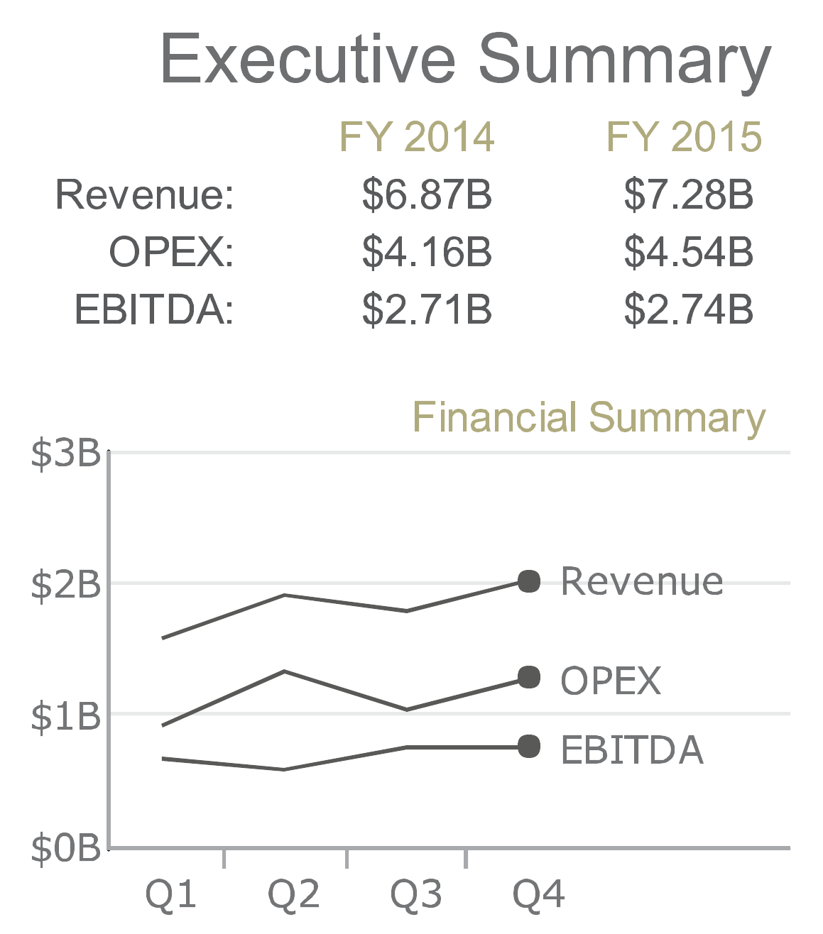
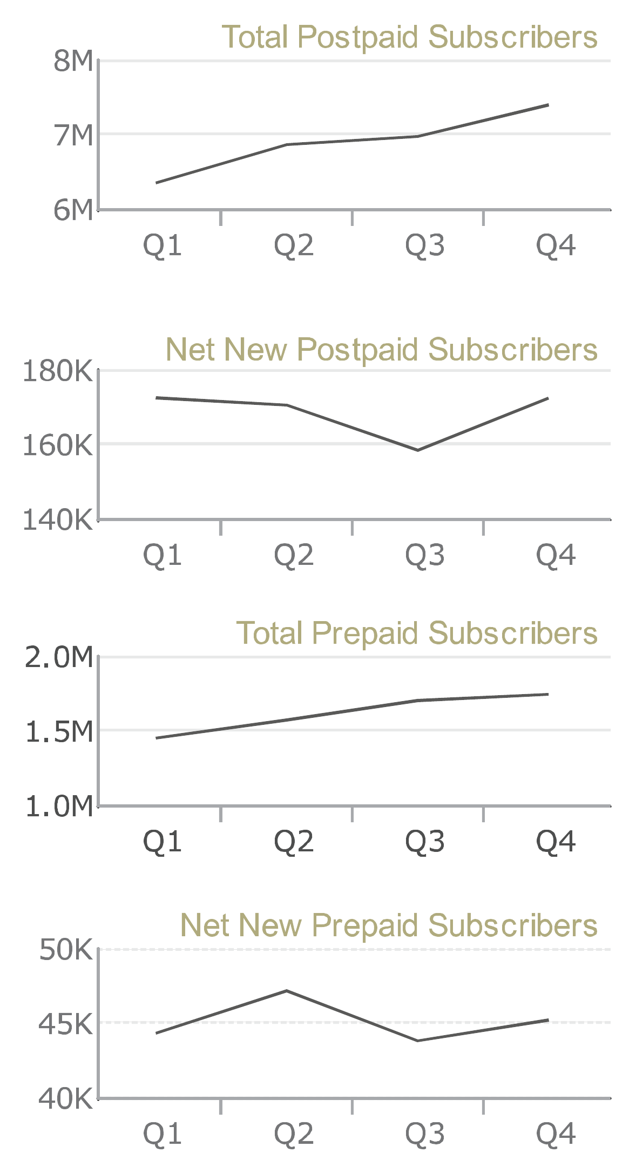
Executive Summary
Executive read
01
Financial health
02
Subscriber base
03
Net additions
Use:
company context for the
three goal rows.
Do not use:
detailed diagnosis
by itself.
Finance:
revenue, OPEX, and EBITDA stay visible as
executive context.
7 / 13

Slide 8
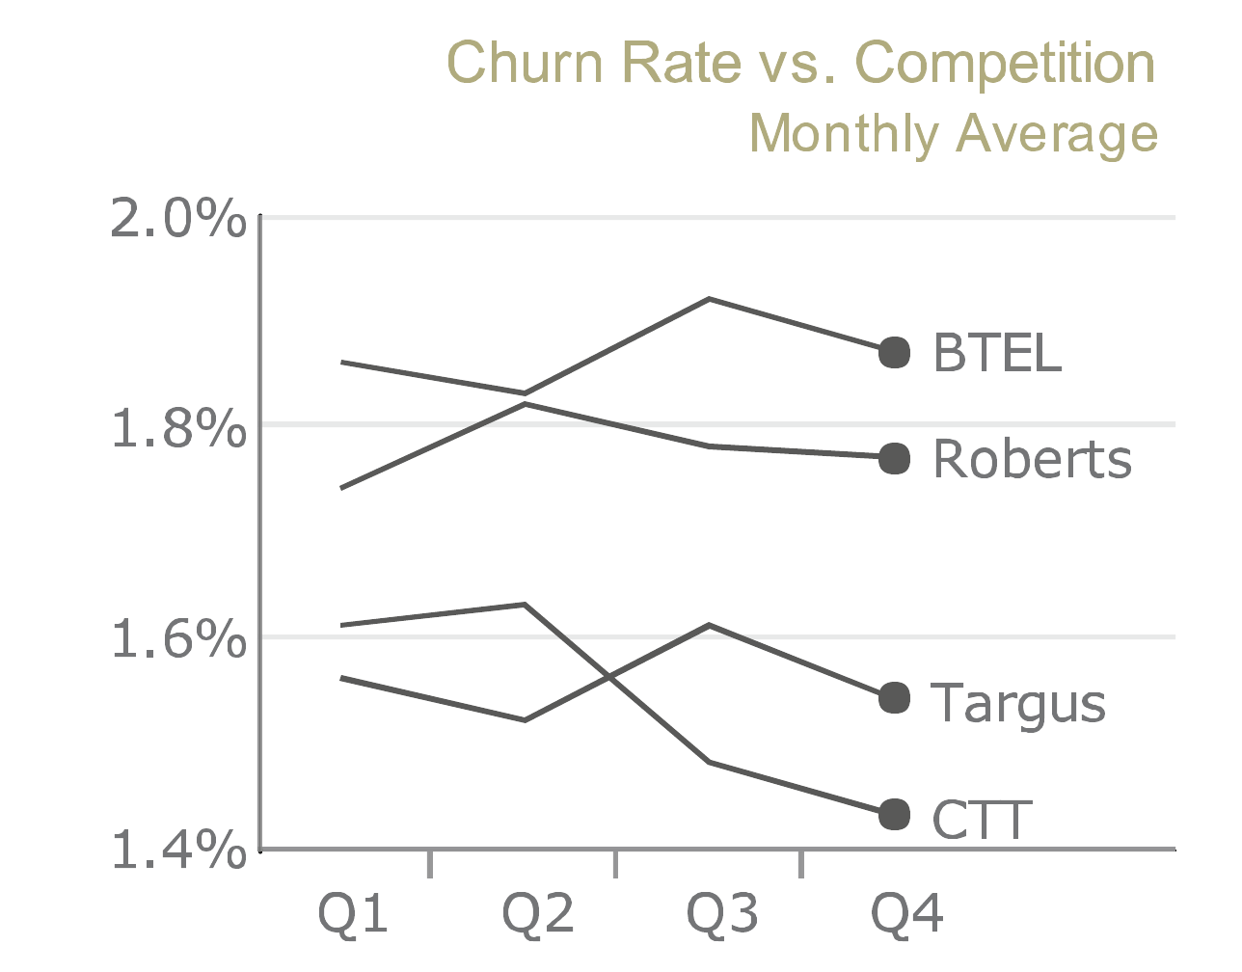
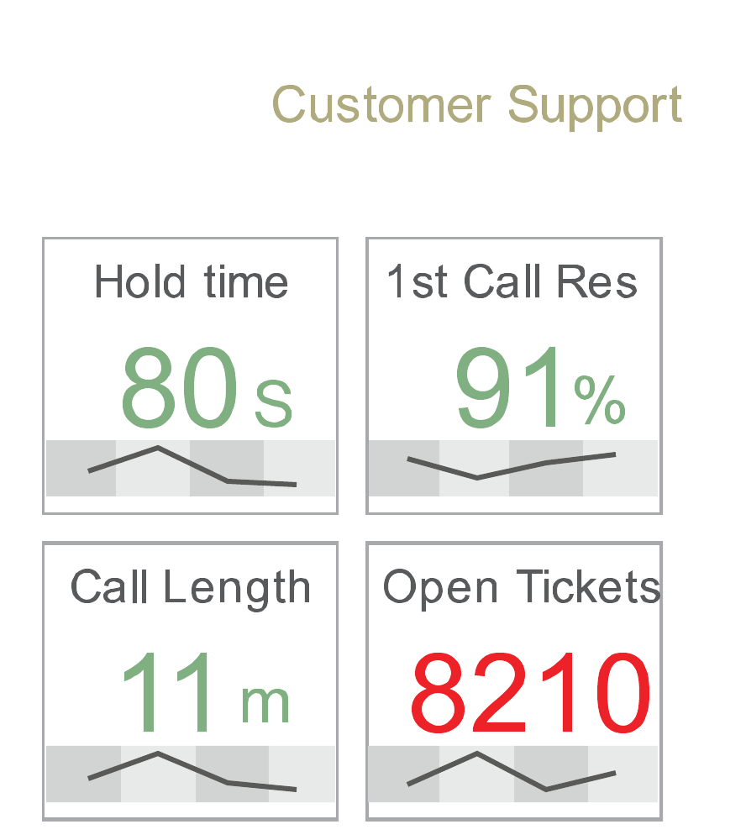
Why This Works: Compact but Informative
Direct labels.
Line-end labels remove the legend lookup and keep each
Small KPI cards.
Sparklines add trend context
series attached to its endpoint.
while keeping four support measures in a tight
space.
8 / 13

Slide 9
Layout Supports Quick Reading
Design principles used
•
Proximity
: related charts are placed near one
another.
•
Closure
: each goal is perceived as a separate
group.
•
Alignment
: rows and columns make scanning
predictable.
•
Visual hierarchy
: KPI cards appear first,
summary stays on the right.
Reading paths:
scan horizontally to analyze one goal; scan
the right column for company-wide status.
9 / 13

Slide 10
Chart Type Selection
Goal row:
KPI card, trend line, comparison bars, and target line are read as one
decision unit.
KPI cards:
sparklines provide
compact trend context without opening
a separate chart.
Line charts
Bar charts
Sparklines
Target lines
Trends over time.
Category and target comparisons.
Compact trend cues.
Current values versus benchmark.
10 / 13

Slide 11
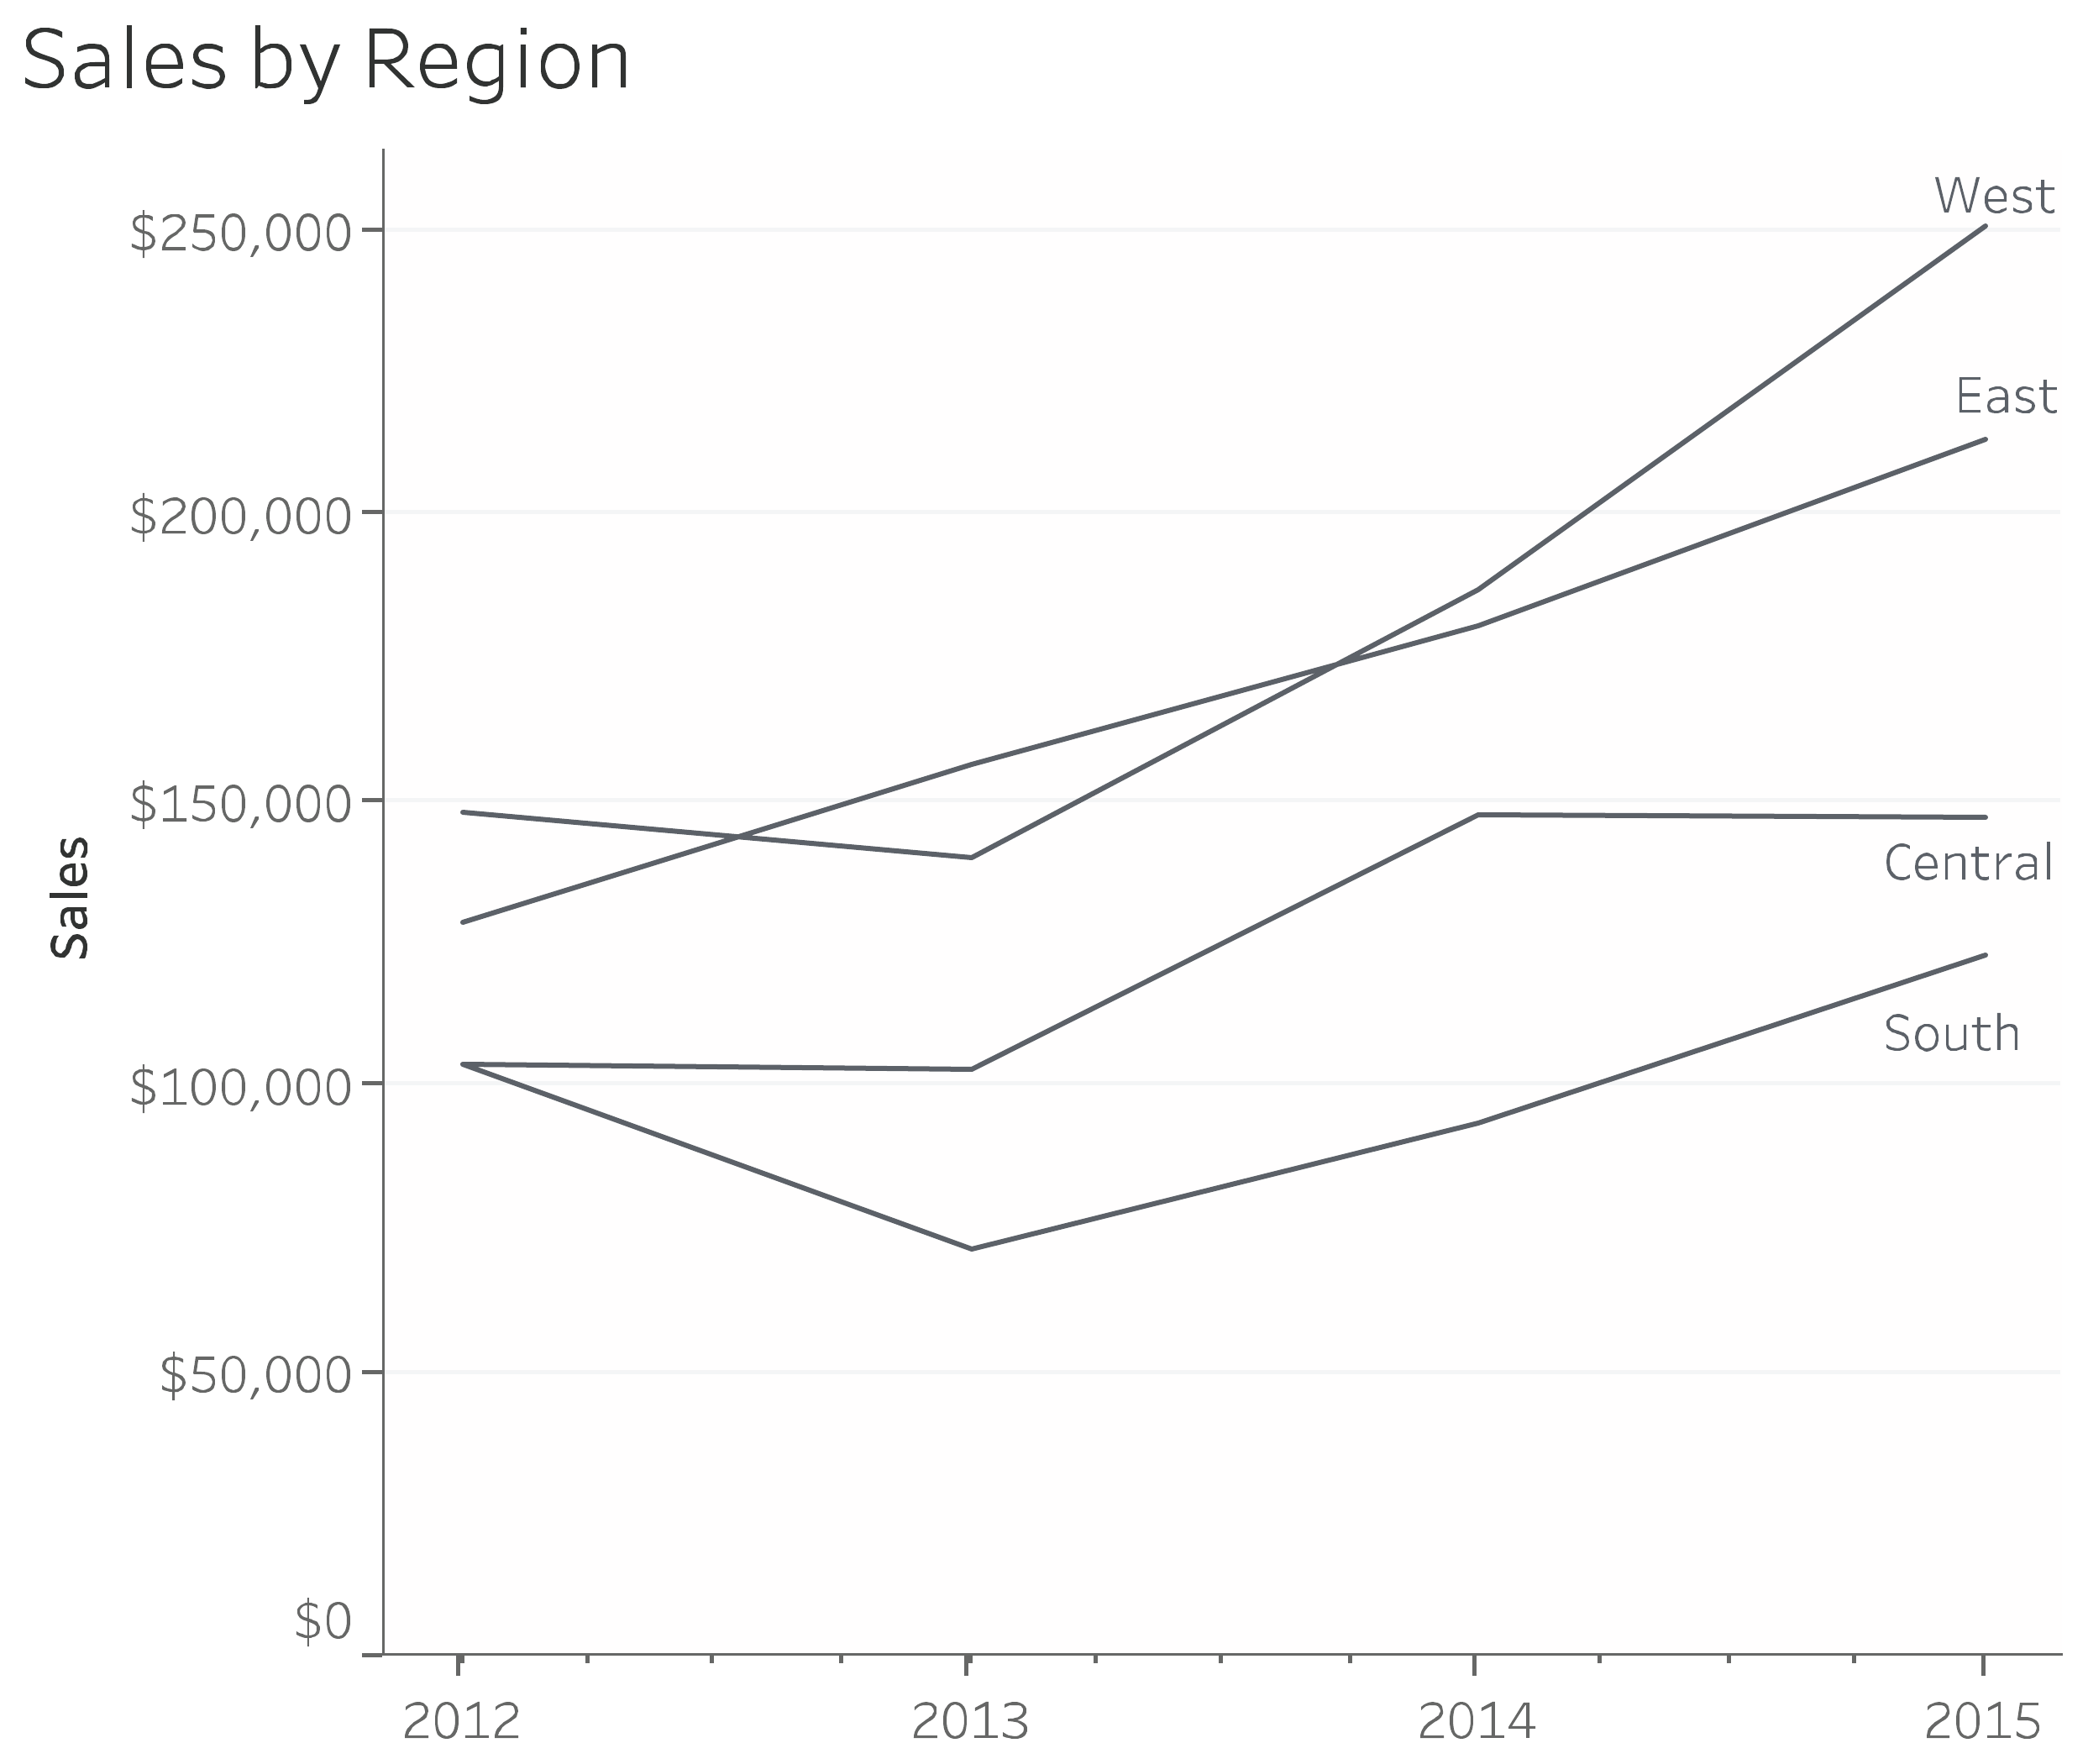
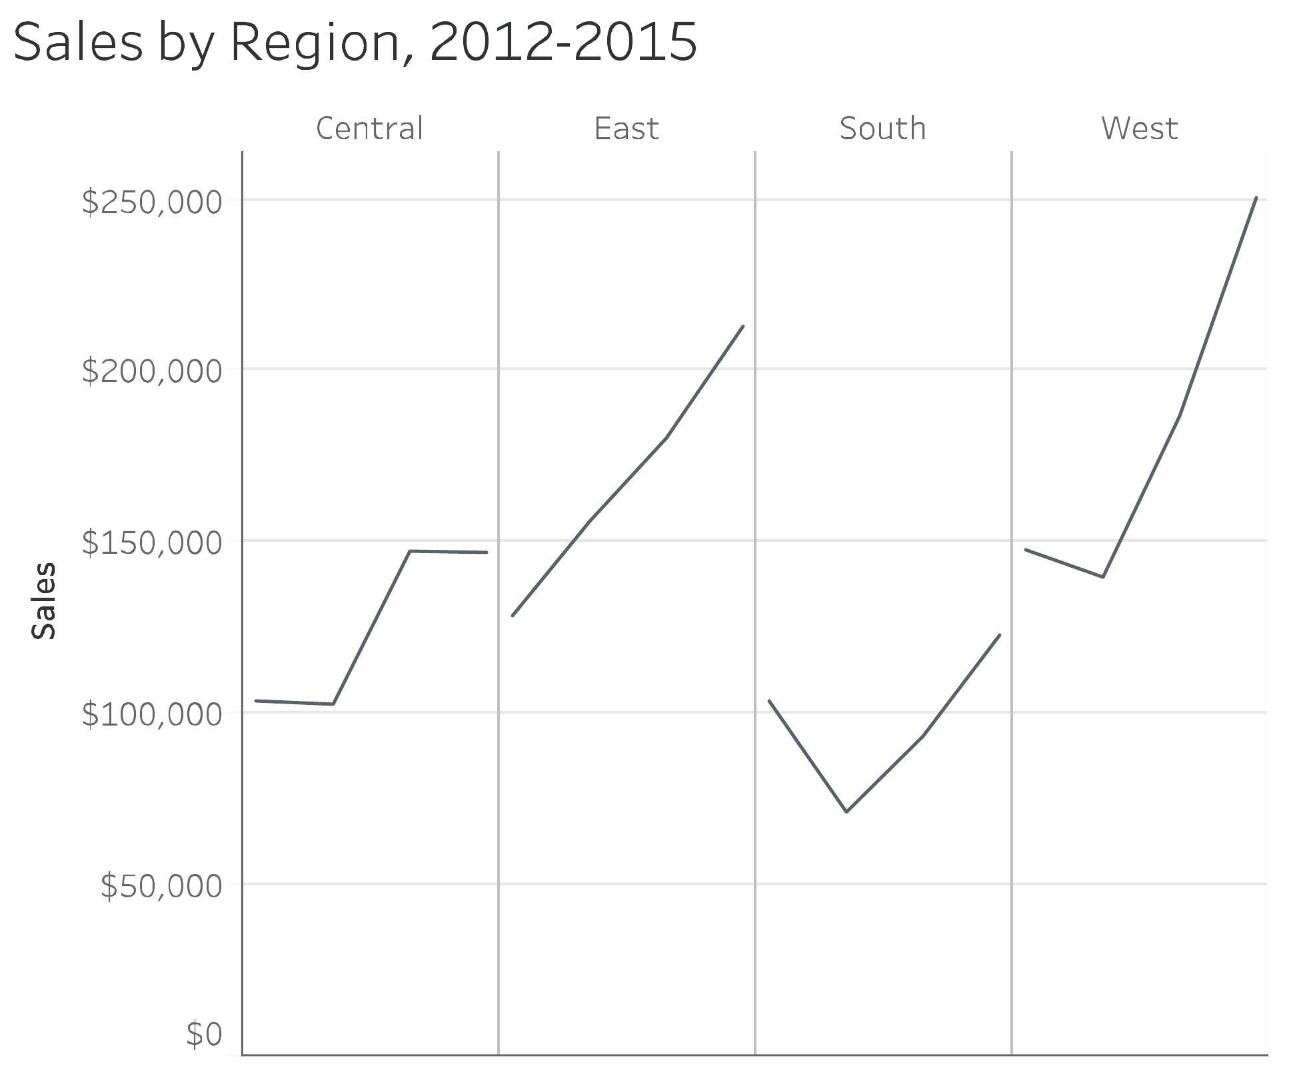
Critique and Design Lessons
Problem:
overlapping lines are hard to trace when several
Fix:
split dense series into small multiples so each region
regions cross in the same plot.
keeps a consistent time axis.
Other critiques:
red/green needs a non-color cue, and emphasis colors should be used sparingly.
11 / 13

Slide 12
Conclusion
What Chapter 27 teaches
•
A good dashboard helps decision-makers understand what is improving, what is worsening, and where action
is needed.
•
This dashboard succeeds because it follows three clear business goals.
•
The three-row plus one-summary-column layout makes scanning fast.
•
Small charts, direct labels, and limited color reduce clutter.
•
The design still requires care with accessibility, overlapping lines, and chart consistency.
12 / 13

Slide 13
References
•
Steve Wexler, Jeffrey Shaffer, Andy Cotgreave.
The Big Book of Dashboards
, Chapter 27: Telecom Operator
Executive Dashboard.
•
Dundas Data Visualization sample dashboard: Telecom / Wireless Executive Strategy Dashboard.
•
O’Reilly online excerpt for Chapter 27:
https://www.oreilly.com/library/view/the-big-book/9781119282716/c27.xhtml
•
Dashboard design references: related metric grouping, proximity, clutter reduction, clear KPI structure, and
accessibility.
Thank you
13 / 13

