Slide 1

Pedestrian Flow Modelling
Group 3:
Le Trung Dung – 20235489
Hoang Trung Dung – 20235488
Pham Khanh Chi – 20235482
Pham Thi Ngoc Anh – 20235473
Tran Thanh Vinh - 20225539

Slide 2
Overview
Introduction
Modelling Framework
Solving Algorithms
Simulation and Results
Discussion & Conclusion

Slide 3
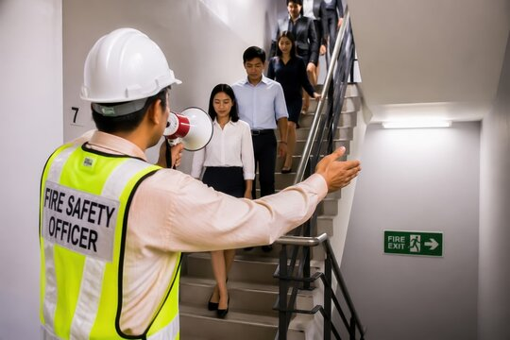
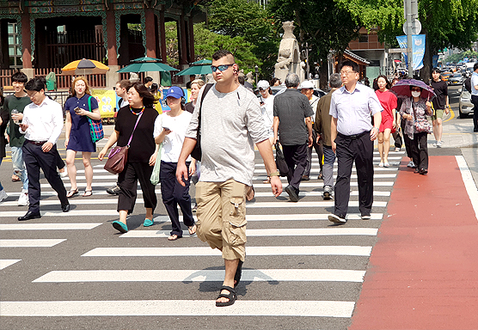
Introduction
Pedestrian flow modeling helps design emergency escape routes, public facilities,...
The "social force" model, for example, assumes a repulsive force with remote action between the pedestrians

Slide 4
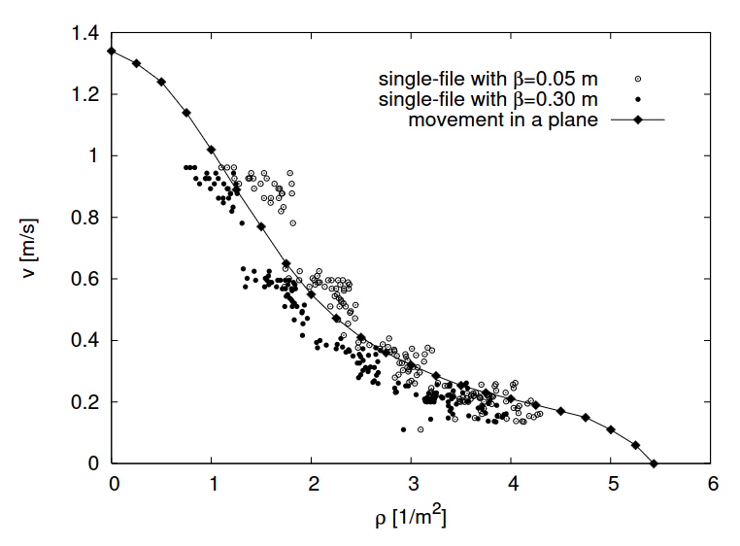
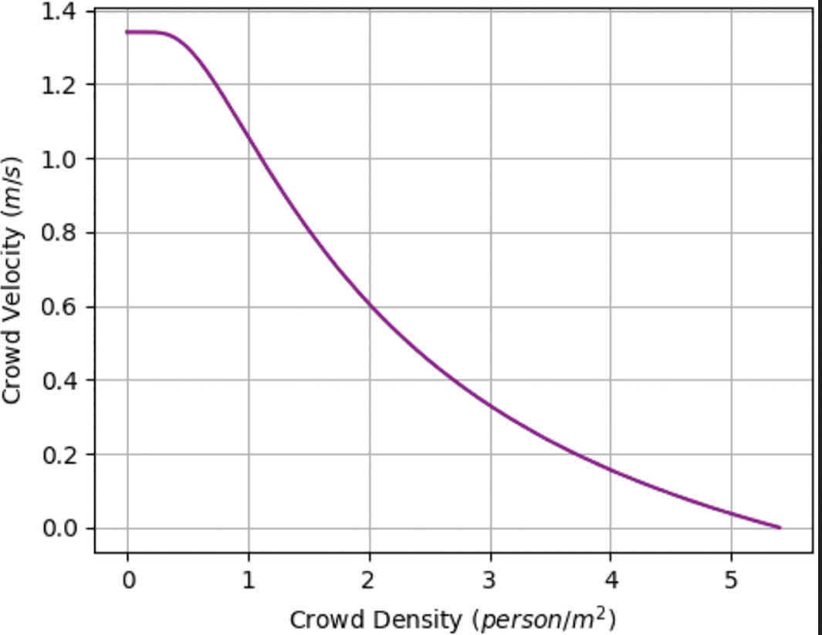
Introduction
Weidmann's fundamental diagram for 2D movement
1D movement vs Weidmann's diagram
This is a frequently-cited metric
This is empirical data

Slide 5
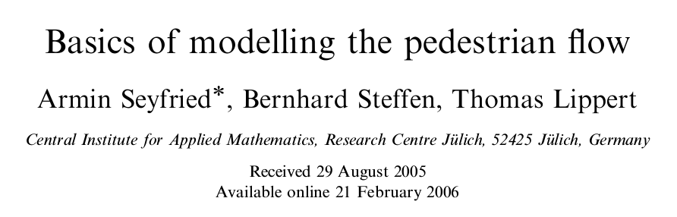
Introduction
In this work, the authors:
introduced a modified social force model and
investigated the effect of remote forces on the overall flow

Slide 6
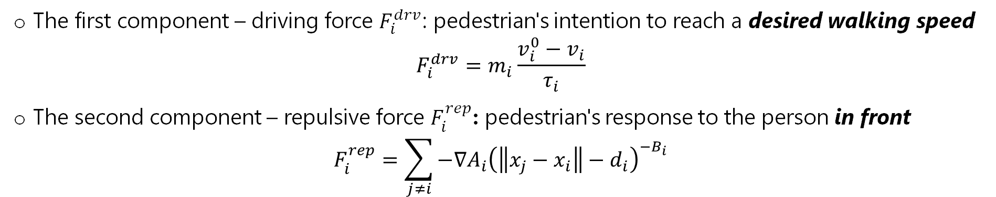
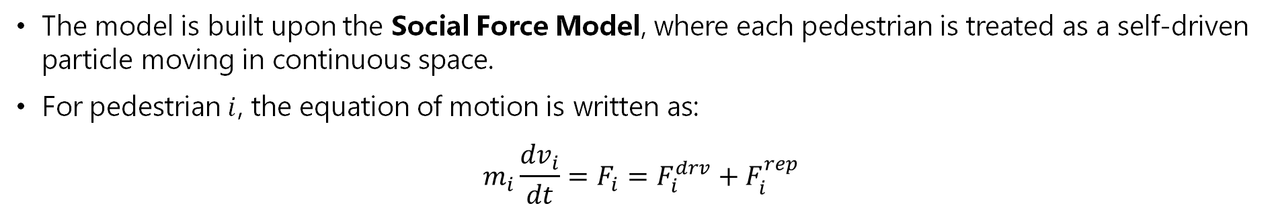
2. Modelling Framework
Social Force Model
The model is built upon the Social Force Model, where each pedestrian is treated as a self-driven particle moving in continuous space.
For pedestrian $i$, the equation of motion is written as:
$$m_{i}\frac{{dv}_{i}}{dt}=F_{i}=F_{i}^{drv}+F_{i}^{rep}$$
The first component – driving force $F_{i}^{drv}$: pedestrian's intention to reach a desired walking speed
$$F_{i}^{drv}=m_{i}\frac{v_{i}^{0}−v_{i}}{τ_{i}}$$
The second component – repulsive force $F_{i}^{rep}$: pedestrian's response to the person in front
$$F_{i}^{rep}=\sum_{j≠i}{−∇A_{i}{\left(\left\|x_{j}−x_{i}\right\|−d_{i}\right)}^{−B_{i}}}$$

Slide 7
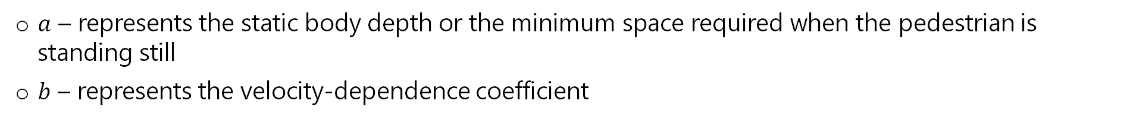
2. Modelling Framework
Velocity-Dependent Personal Space
A central assumption of this study is that the personal space required by a pedestrian is not constant
Instead, it increases linearly with the pedestrian's current velocity:
$$d=a+bv$$
$a$ – represents the static body depth or the minimum space required when the pedestrian is standing still
$b$ – represents the velocity-dependence coefficient
Faster pedestrian requires a larger distance from the person ahead

Slide 8
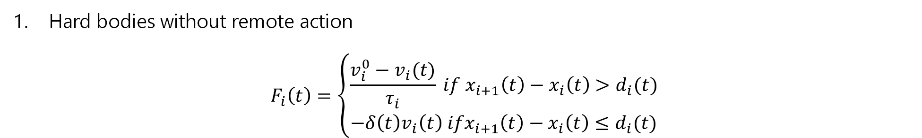
2. Modelling Framework
Interactions
To study how pedestrians respond to one another, the authors formulate two interaction models
Hard bodies without remote action
$$F_{i}\left(t\right)=\left\{\begin{aligned}\frac{v_{i}^{0}−v_{i}(t)}{τ_{i}} if x_{i+1}\left(t\right)−x_{i}\left(t\right)>d_{i}(t) \\ −δ\left(t\right)v_{i}\left(t\right) ifx_{i+1}\left(t\right)−x_{i}\left(t\right)≤d_{i}(t)\end{aligned}\right.$$
The pedestrian continues moving normally until the personal-space constraint is violated, and then stops abruptly

Slide 9
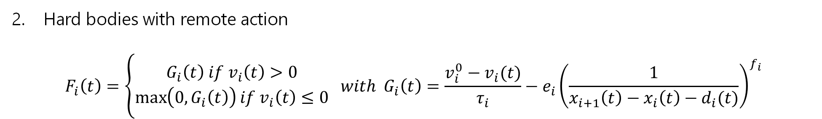
2. Modelling Framework
Interactions
To study how pedestrians respond to one another, the authors formulate two interaction models
Hard bodies with remote action
$$F_{i}\left(t\right)=\left\{\begin{aligned}G_{i}\left(t\right) if v_{i}\left(t\right)>0 \\ \max\left(0, G_{i}\left(t\right)\right)if v_{i}\left(t\right)≤0\end{aligned} with G_{i}\left(t\right)=\frac{v_{i}^{0}−v_{i}(t)}{τ_{i}}−e_{i}{\left(\frac{1}{x_{i+1}\left(t\right)−x_{i}\left(t\right)−d_{i}(t)}\right)}^{f_{i}}\right.$$
The repulsive force increases as the gap decreases
Pedestrians decelerate before reaching the minimum required distance and backward motion is prevented

Slide 10
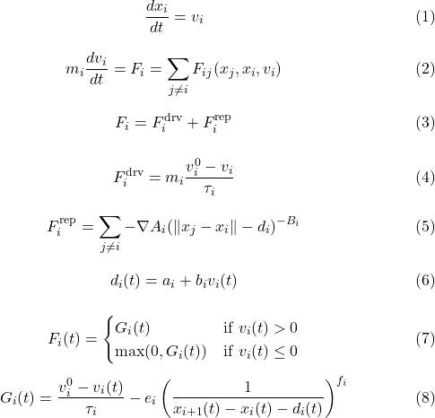
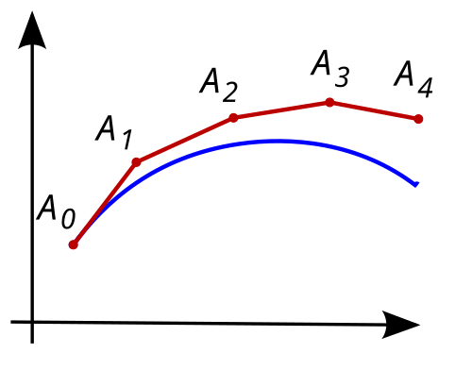
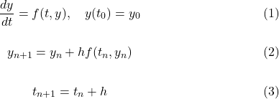
3.1. Solving algorithms: Social force model (model with remote action)
Large number of ordinary differential equations:
Use explicit Euler method to calculate force
approximation
unknown curve
Using current slope to estimate next point

Slide 11
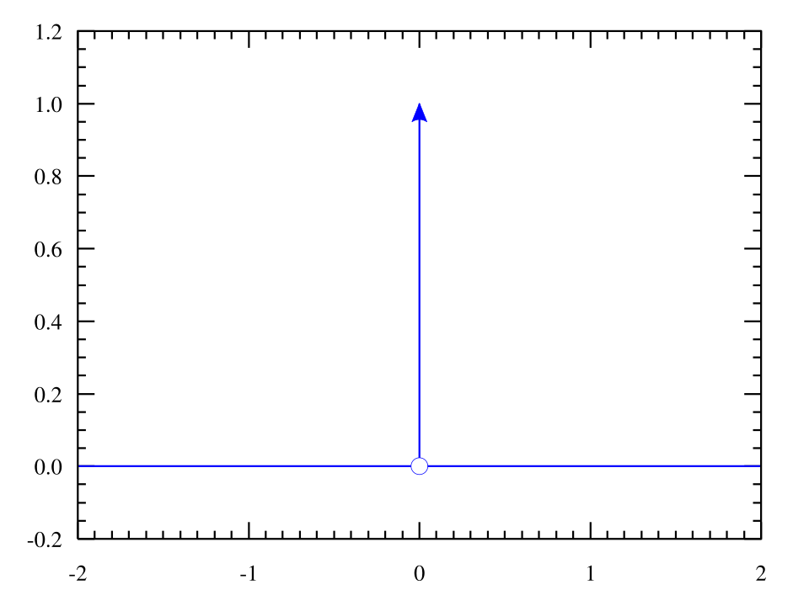
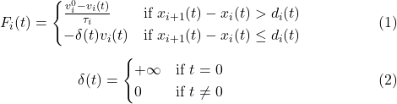
3.2. Solving algorithms: Modified model (model without remote action)
Locations of Dirac spikes are not known a priori
Need to use a custom procedure:
Step 1: Advance each pedestrian one step (Δt=0.001s) based on local forces.
Step 2: Check if the distance to the leading person is less than the required length.
Step 3: If the distance is too small, reset the pedestrian's velocity to zero and revert them to their previous position.
Step 4: Re-examine and adjust the step of the trailing pedestrian in the same manner.

Slide 12
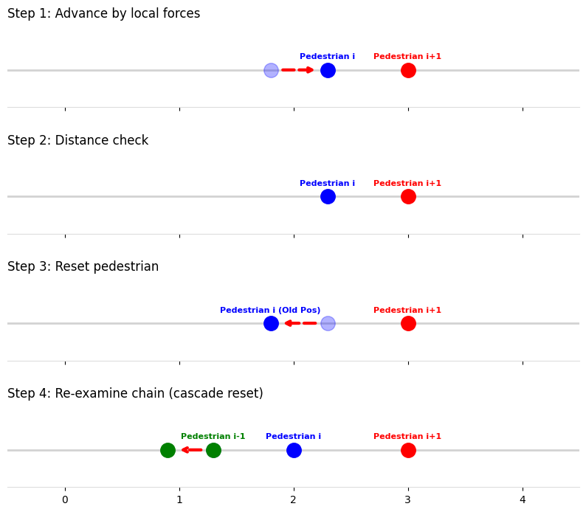
3.2. Solving algorithms: Modified model (model without remote action)
The procedure:
Step 1: Advance each pedestrian one step (Δt=0.001s) based on local forces.
Step 2: Check if the distance to the leading person is less than the required length.
Step 3: If the distance is too small, reset the pedestrian's velocity to zero and revert them to their previous position.
Step 4: Re-examine and adjust the step of the trailing pedestrian in the same manner.

Slide 13
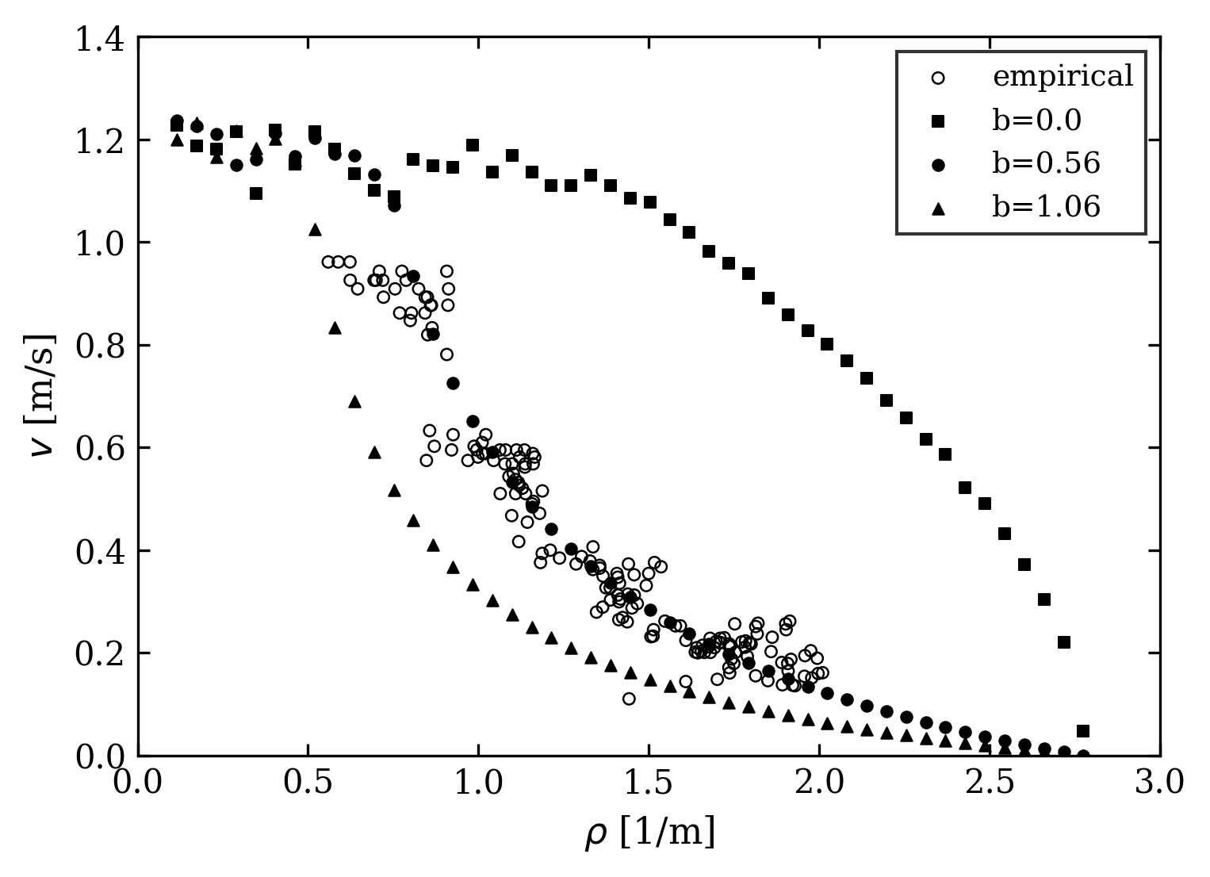
4. Simulation and Results
Velocity–density relation for hard bodies with a = 0.36 m, b = 0.56 s and without a remote action in comparison with empirical data

Slide 14
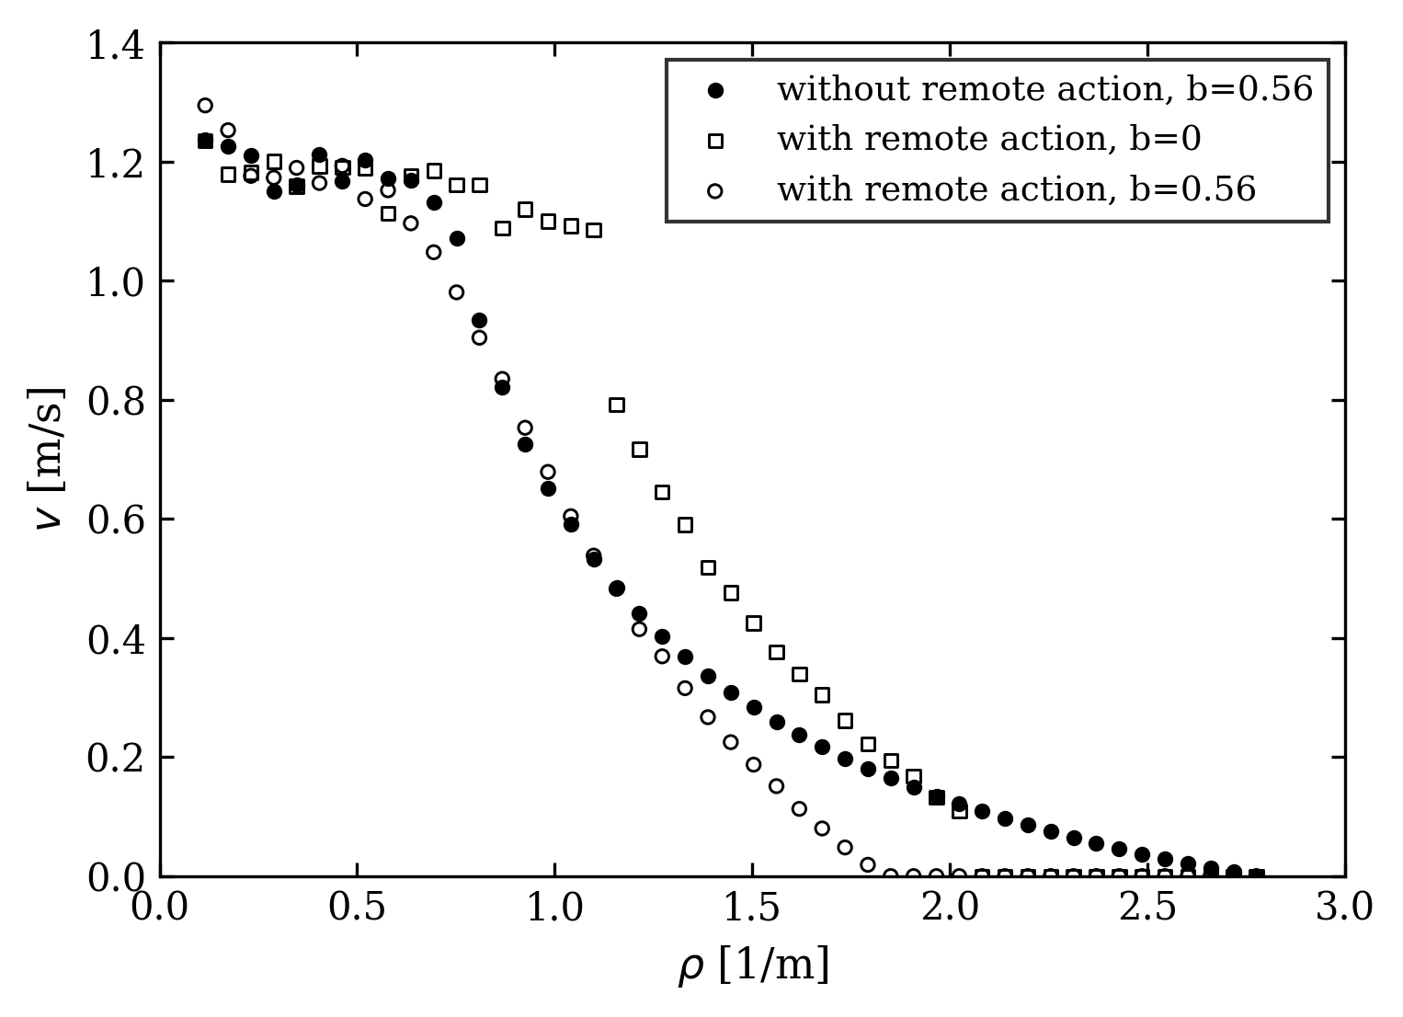
4. Simulation and Results
Velocity–density relation for hard bodies with remote action in comparison with hard bodies without a remote action

Slide 15
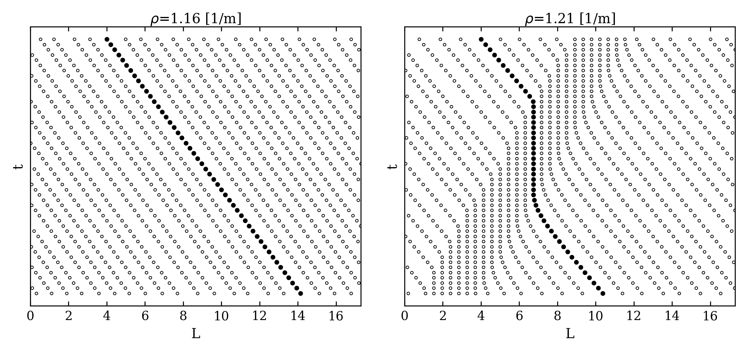
4. Simulation and Results
Time-development of the positions for densities near the velocity-gap

Slide 16
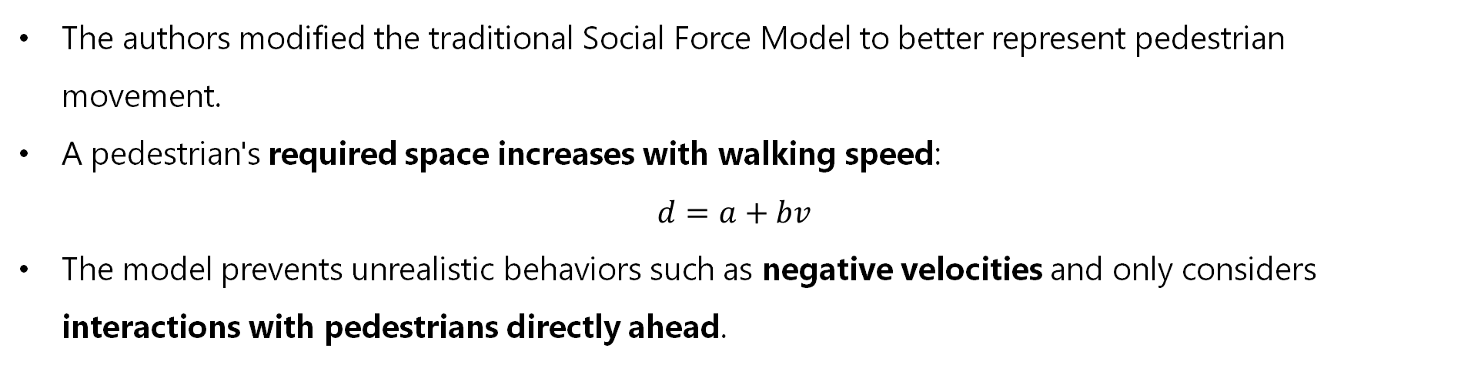
5. Discussion & Conclusion
Key Findings
The authors modified the traditional Social Force Model to better represent pedestrian movement.
A pedestrian's required space increases with walking speed:
$$d=a+bv$$
The model prevents unrealistic behaviors such as negative velocities and only considers interactions with pedestrians directly ahead.

Slide 17
5. Discussion & Conclusion
Main Results
The model reproduces the empirical Fundamental Diagram when the required length depends on velocity
Remote interaction has only a minor effect when velocity-dependent required space is included.
If the required length is constant, remote interaction generates density waves and velocity gaps.
Future Works
Extend the model to two-dimensional pedestrian movement.
Extend the model to more realistic microscopic interactions and additional interaction mechanisms.

Slide 18
THANK YOU !

