Slide 1
Christopher Asbrock
Tung Tran
Lawrence Li
Franco Perinotti
THE SNAKE GAME

Slide 2
About the project
A creative snake game
Multiplayer / network gaming
Object-oriented principle
Model, View, Controller

Slide 3
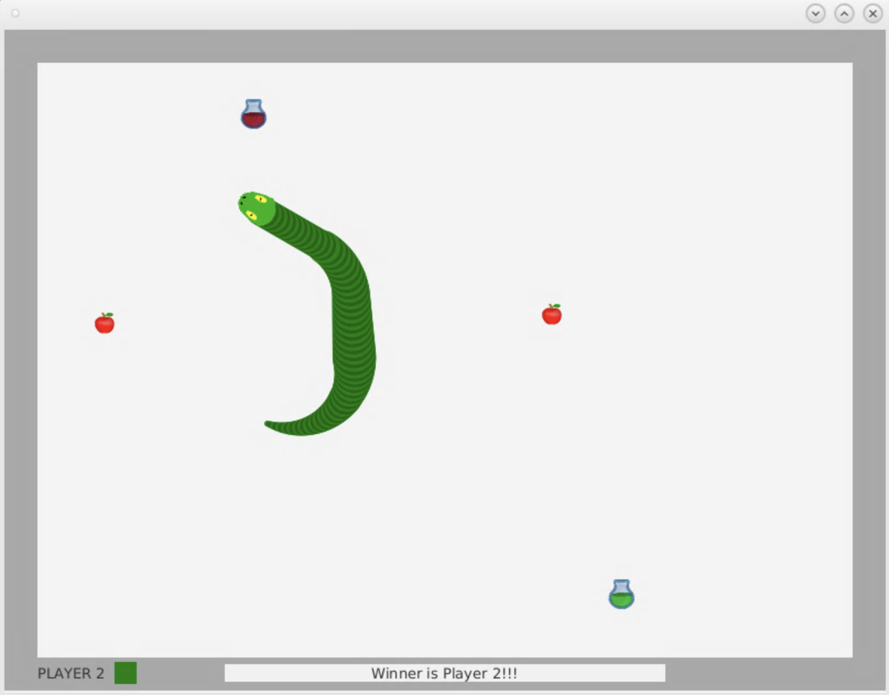
Background
Potion
Popular classic game
Single Player gameplay
Food, Snake, Wall only
Food
Motivation
Poison
Add creativity features!
Multiplayer up to 4 people
Compete with friends!
More fun!
Snake

Slide 4
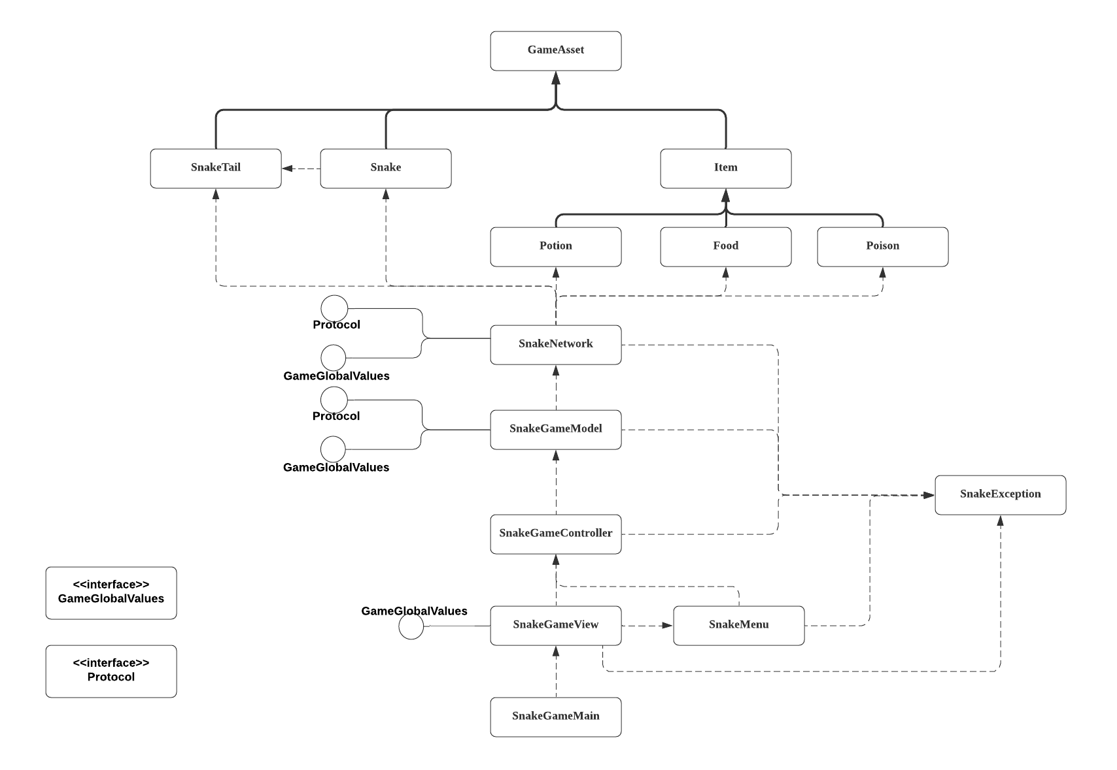

Slide 5
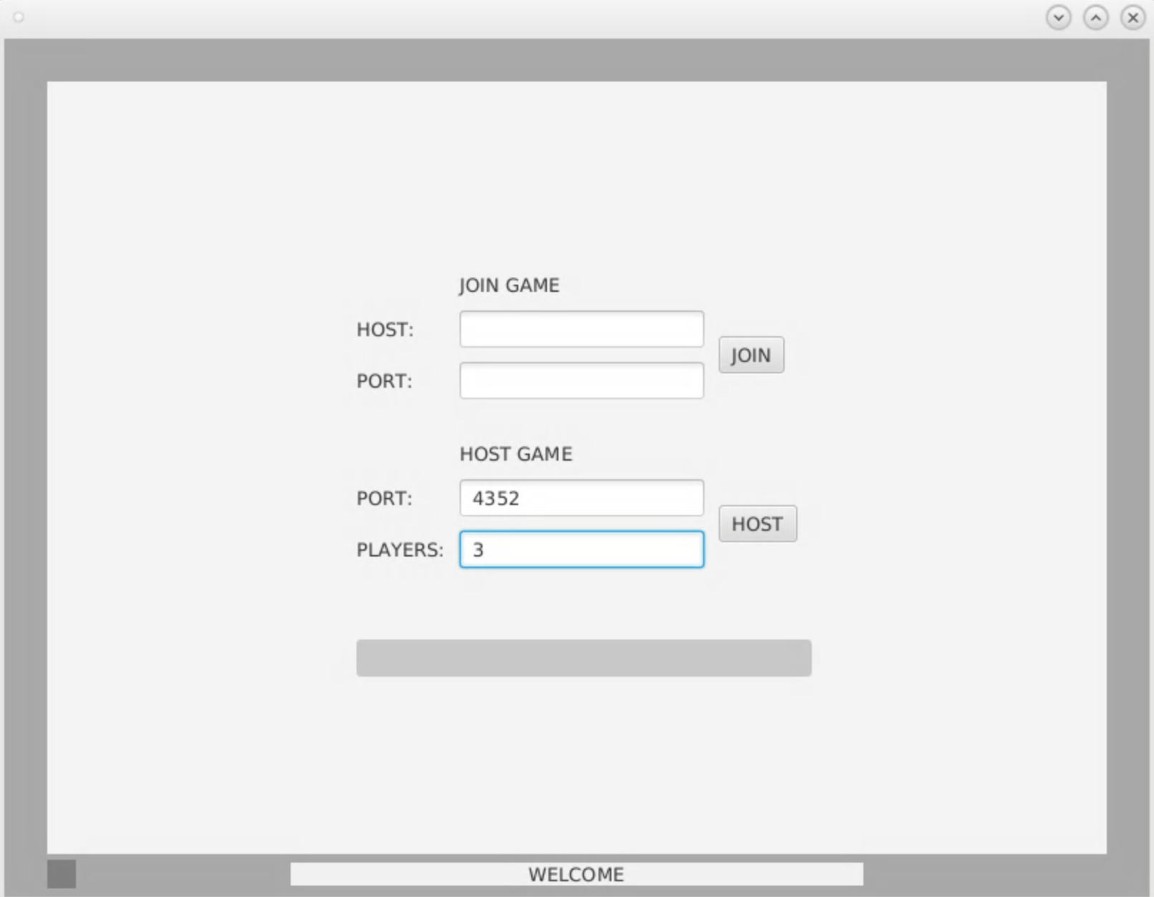
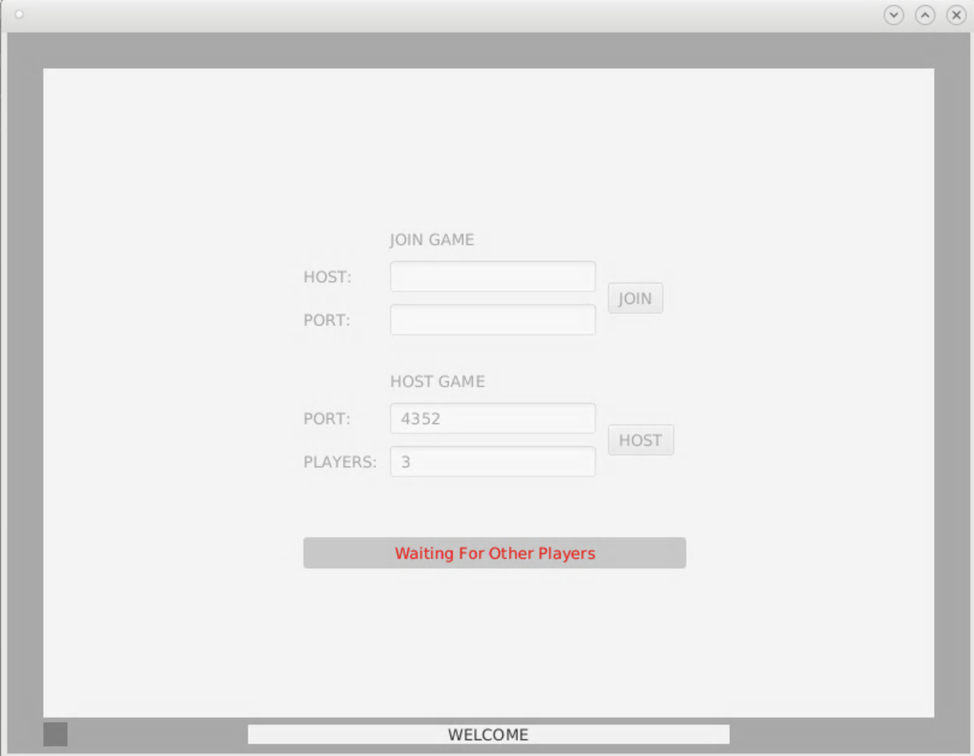
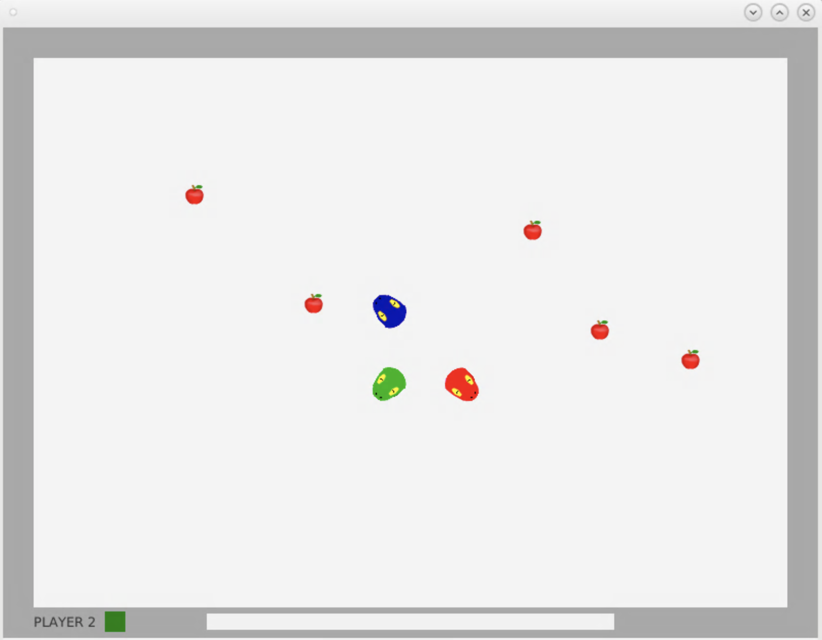
User interface

Slide 6
It’s demonstration time!

Slide 7
Scrum experiences
Key User stories
As a player, I want to be able to control my character with keyboard inputs (keyboard input)
As a player, I want to see the game board (The view and menu)
As a player, I want to see my snake (The game objects)
As the client, I want to input room # to join the host (multiplayer network)
As the host, I want to be able to share room #, so that other players can join (multiplayer network)
Strengths
Very organized with issues and priorities
Most issues have a corresponding user story
Weaknesses
Inaccurate time estimations (major underestimate in time)
This cause some issues (user stories) to be incomplete

Slide 8
Challenges
Multiplayer networking!
(So many connection issues and visual bugs!)
Making menus for the application
Making of a proper jar file

Slide 9
Christopher Asbrock | Tung Tran | Lawrence Li | Franco Perinotti
How to implement Animation timer in Javafx How to get User keystrokes and use them as input | Learned how painful jar files are Had the chance to practice MVC pattern programming and team programming with Scrum. Learned a great deal about JavaFX lib | I learned how to make a good video game using the JavaFX and the Java networking. Really learned a lot of socket with JavaFX. Learned some very useful ways implementations of game objects in the game. For example, here, all game objects are implemented using circles! | Learned the capabilities of the JavaFX library. Got to appreciate the usefulness of the scrum development process, and successfully working in a team environment in general. Learned how successfully manage a team and keep our priorities in order to successfully reach a deadline.

Slide 10
Snake Game 2.0 Future
Run faster
Calculate Score
(Unfinished user stories)
SUBG Snake Unknown Battlegrounds (up to 100 players)
A big map (not just a simple rectangle room)

