Slide 1
Algorithm and
Complexity Analysis

Slide 2
Objectives
Computational and Asymptotic Complexity
Big-O, Big-Ω and Big-Θ Notations
The Best, Average, and Worst Cases

Slide 3
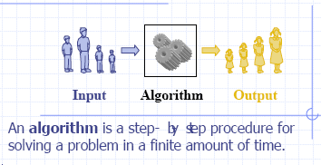
Simple definition of an algorithm

Slide 4
Analysis of Algorithms
What are requirements for a good algorithm?
Precision:
  Proved by mathematics
  Implementation and test
Simple and public
Effectiveness:
  Run time duration (time complexity)
  Memory space (space complexity)

Slide 5
What is a computational complexity?
The same problem can be solved with various algorithms that differ in efficiencies.
The computational complexity (or simply speaking, complexity) of an algorithm is a measure of how “complex” the algorithm is. The complexity answers the question: How difficult is to compute something that we know to be computable?
e.g. What resources (time, space, machines, ...) will it take to get a result?
Rather than referring to how “complex” an algorithm is, we often talk instead about how “efficient” the algorithm is. Measuring efficiency (or complexity) allows us to compare one algorithm to another (assuming that both algorithms compute the same result).
There are several measurements to compare algorithms. Here we’ll focus on one complexity measure: the computation time of an algorithm.
How can we compare program execution on two different machines? For example, if we use wall clock time to compare two different machines, will this tell us which algorithm/program is more efficient?

Slide 6
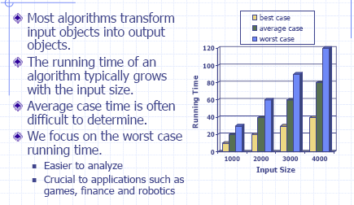
Running time

Slide 7
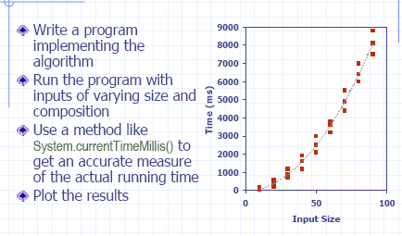
Experimental Studies

Slide 8
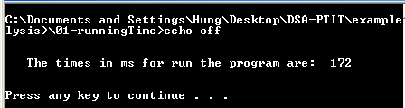
Experimental Study Example
import java.util.Calendar;
public class Main
{ public static void main(String[] args)
{ long beginTimes = Calendar.getInstance().getTimeInMillis();
long n = 10000;
for (long i=0; i<n;++i)
for(long j =0; j<n; ++j);
long endTimes = Calendar.getInstance().getTimeInMillis();
System.out.println("The times in ms for run the program are:");
System.out.println(endTimes - beginTimes);
}
}

Slide 9
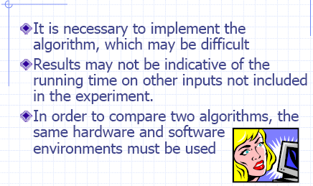
Limitations of Experiments

Slide 10
Time complexity of an algorithm (1)
Run time duration of a program depend on
  Size of data input
  Computing system (platform: operation system, speed of CPU, type of statement…)
  Programming languages
  State of data
=> It is necessary to evaluate the run time of a program such that it does not depend on computing system and programming languages.

Slide 11
Time complexity of an algorithm (2)
We’ll define a time complexity measure as the number of operations performed by the algorithm on an input of a given size.
What is meant by “number of operations”?
and
What is meant by “size”?
We want to express the number of operations performed as a function of the input size n.
What if there are many different inputs of size n?
Worst case
Best case
Average case
“number of operations” = “running time”?

Slide 12
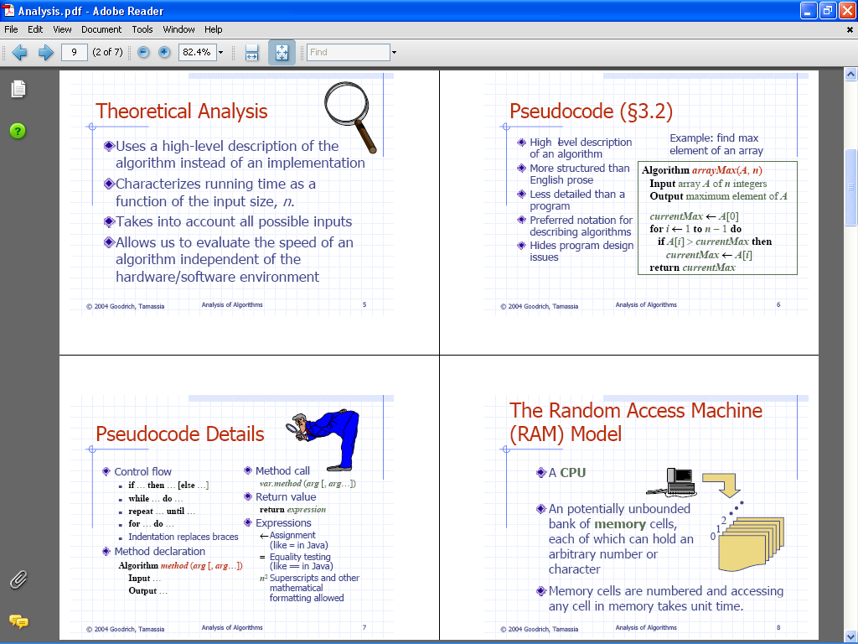

Slide 13
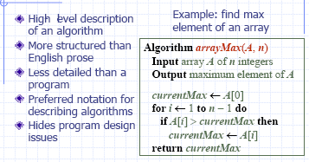
Pseudocode

Slide 15
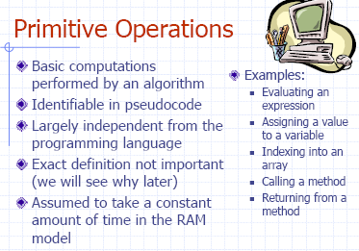

Slide 16
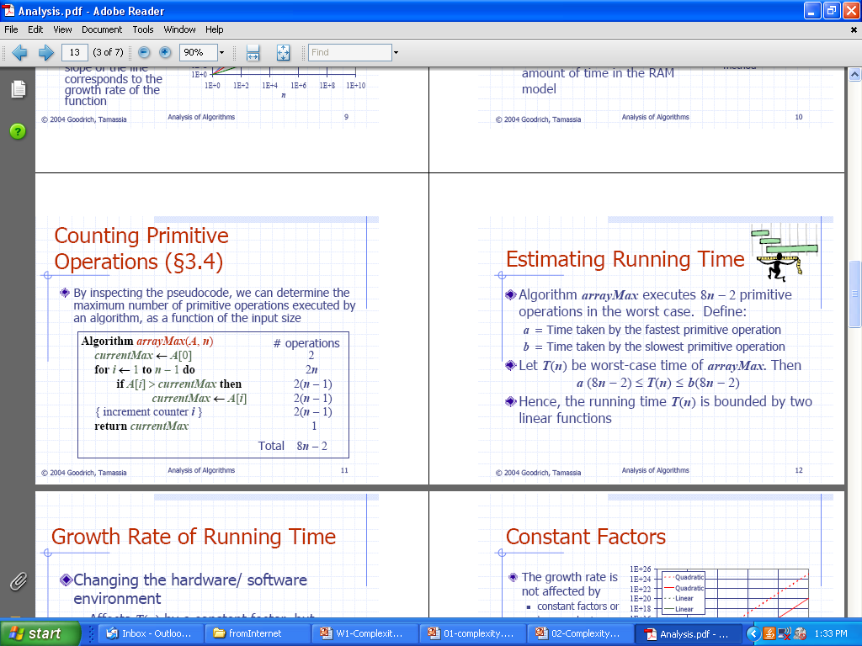
Counting Primitive Operation

Slide 18
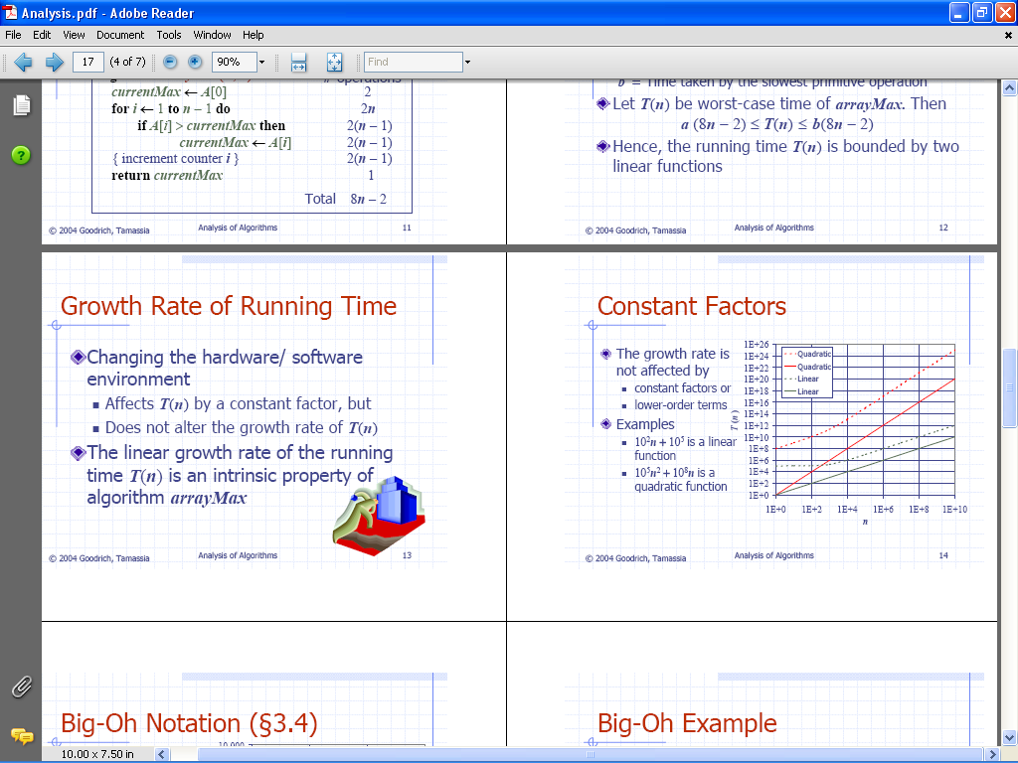

Slide 20
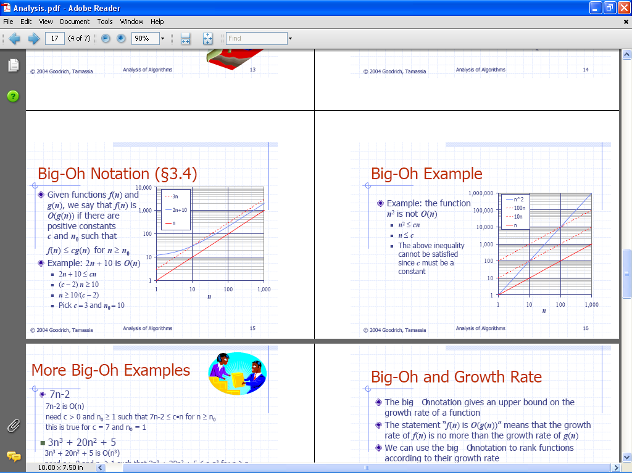
Big-Oh Notation
Big O notation is also called Big Oh notation, Landau notation, Bachmann–Landau notation, and asymptotic notation. A description of a function in terms of big O notation usually only provides an upper bound on the growth rate of the function; associated with big O notation are several related notations, using the symbols o, Ω, ω, and Θ, to describe other kinds of bounds on asymptotic growth rates.

Slide 21
big-oh notation pronouncement :
O(1) : O to the one
O(n) : O to the n, Big-O of n
O(log₂ n): O to the log₂ n

Slide 22
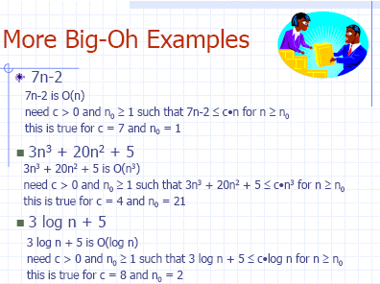

Slide 23
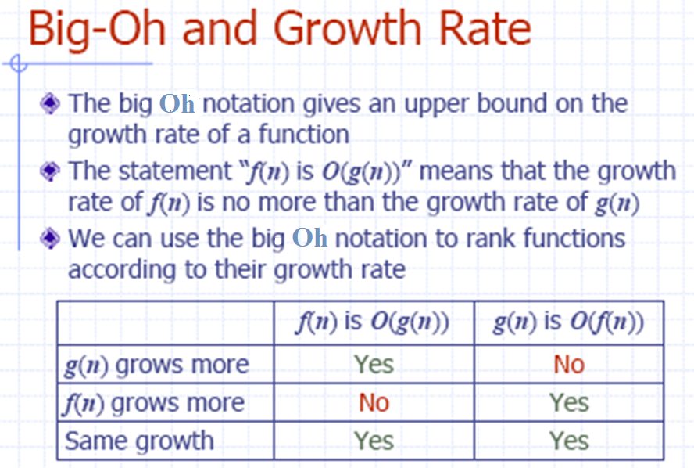
When we say that f(n) is O(g(n)), we use g(n) to provide a limit as to how fast f(n) can grow when n goes to infinity.

Slide 24
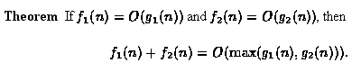
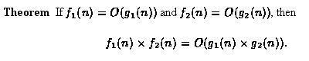
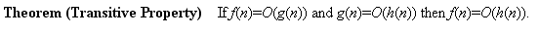
Properties of Big-Oh
The first theorem addresses the asymptotic behavior of the sum of two functions whose asymptotic behaviors are known:
The next theorem addresses the asymptotic behavior of the product of two functions whose asymptotic behaviors are known:
The last theorem in this section introduces the transitive property of big oh:

Slide 25
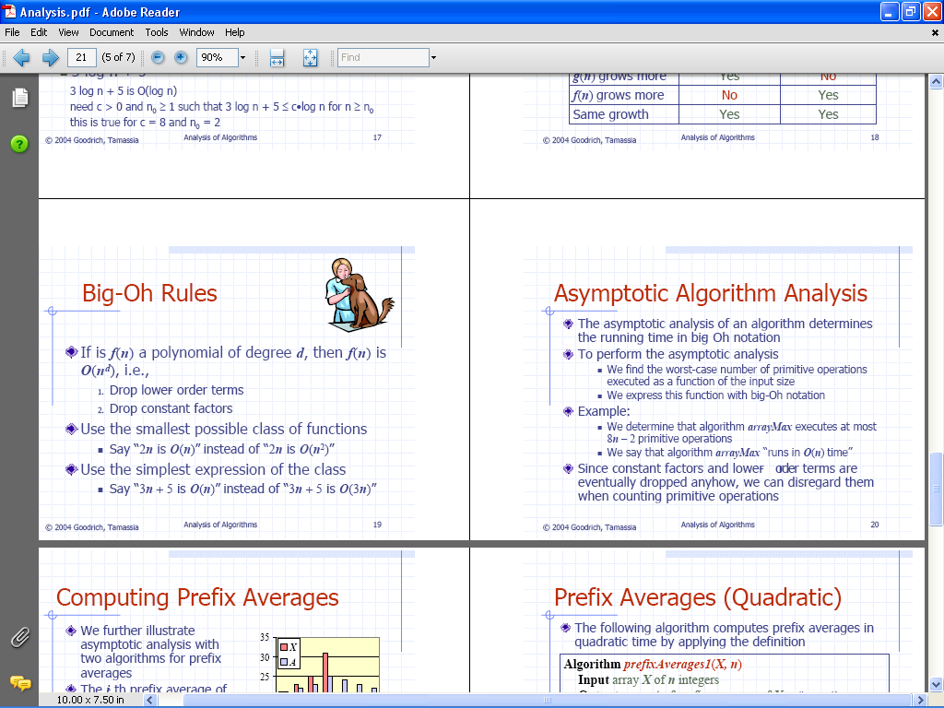

Slide 27
Time complexity of selection sort
Apply properties of big O in calculating time complexity, we only need to count the operations that appear most.
In this example the comparison a[j]<min occurs most often.
i= k=
0 n-1
n-2
…
n-2 1
Total = n(n-1)/2
= O(n²)
void selectSort() //Simple Selection Sort
{ int i,j,k;int min;
for(i=0;i<n-1;i++)
{ min=a[i];k=i;
for(j=i+1;j<n;j++)
if(a[j]<min) {k=j;min=a[j];}
if(k!=i) swap(a,i,k);
}
}
<number>/43

Slide 28
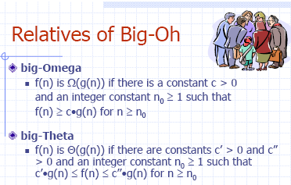

Slide 29
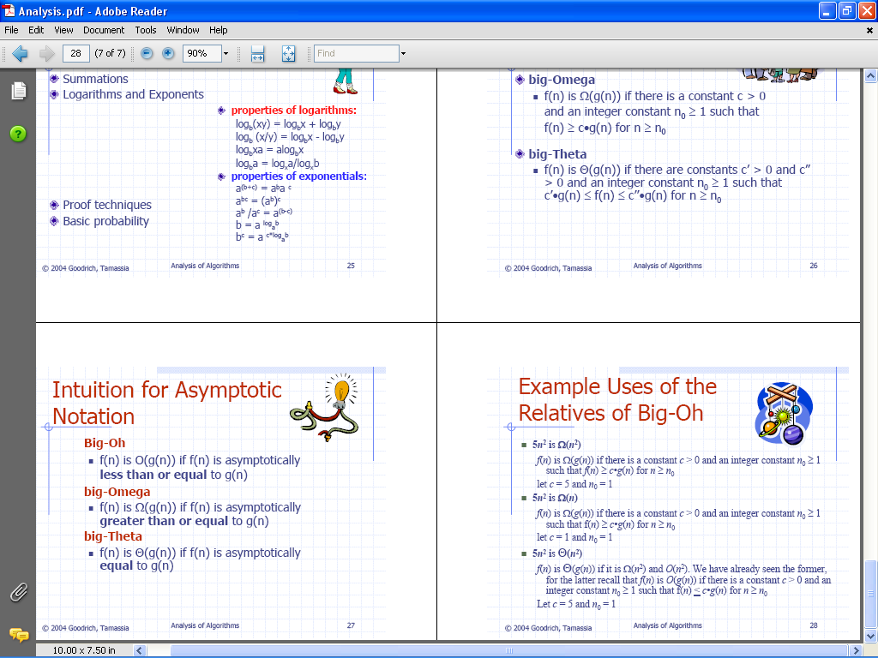

Slide 31
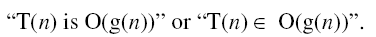
More notes about Big-Oh notation
Using Big-O notation, we might say that “Algorithm A runs in time Big-O of n log n”, or that “Algorithm B is an order n-squared algorithm”. We mean that the number of operations, as a function of the input size n, is O(n log n) or O(n²) for these cases.
Notes about style: We write
Both of these expressions are better than writing
“T(n) = O(g(n))”.
Some authors use the latter, but the first two choices are preferred.

Slide 32
Some common growth orders of functions
To express O(), we often use the following functions:
constant | O(1)
logarithmic | O(logn)
linear | O(n)
nlogn | O(nlogn)
quadratic | O(n²)
polynomial | O(n^{b})
exponential | O(b^{n})
factorial | O(n!)
The exact definition of “NP-hard problem” is very complicated, but simply speaking, NP-hard problem means there is no known algorithm can solve it in a polynomial time.

Slide 33
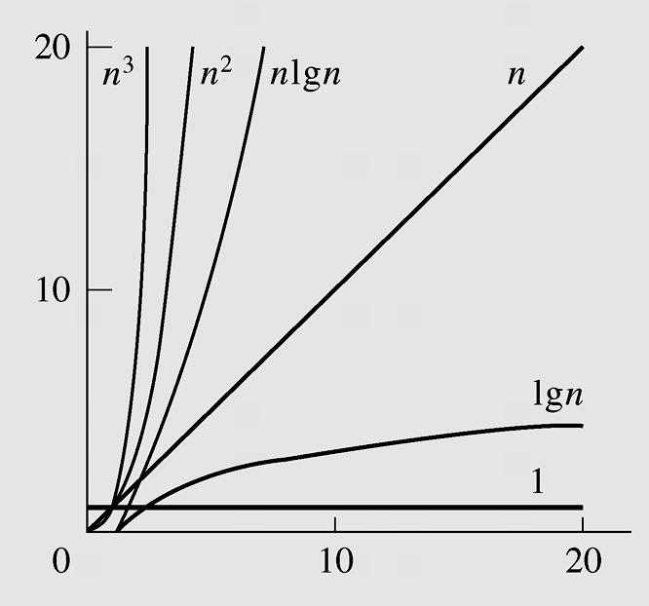
Growth orders of functions in graphics
Typical functions applied in big-O estimates

Slide 34
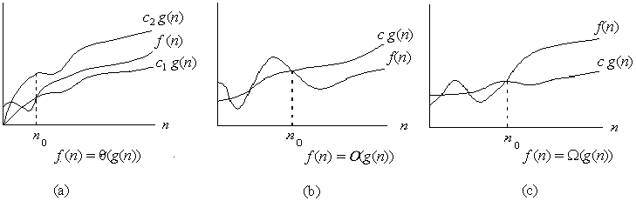

Asymptotic notation
Graphic examples of and .

Slide 35



Theorem
For any two functions and , we have
if and only if

Slide 36
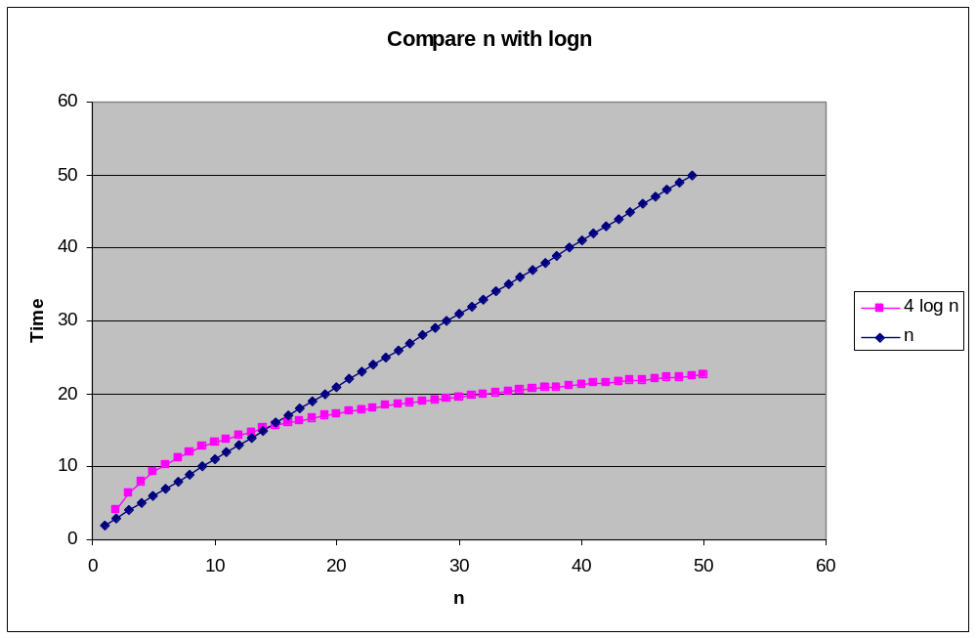
Binary Search vs Sequential Search
Find method
  Sequential
    Worst case time: c₁ n
  Binary search
    Worst case time: c₂ log₂n
Small
problems -
we’re not
interested!
n
Large
problems -
we’re
interested
in this gap!
4log₂n
Binary search
  More complex
  Higher constant factor

Slide 37
Determining time complexity
To determine time complexity:
  • Count operations, and
  • Convert to big-Oh notation.
We will use “pseudocode” to describe algorithms.

Slide 38
Examples for determining time complexity - 1
max returns the maximum element in a sequence.
procedure max(a₀ ,a₁, a₂, . . . , a_{n}: R)
max := a₀
for i := 1 to n
if max < a_{i} then max := a_{i}
end for
return max
end procedure
The comparison max < a_{i} is performed n − 1 times.
n − 1 is O(n).

Slide 39
Examples for determining time complexity - 2
Linear search returns the location of key in a sequence, or -1 if key is not in the sequence.
procedure linear search (key, a₀, a₁, . . . , a_{n}: R)
loc := -1
i := 0
while i <= n and loc = -1
if key = a_{i} then loc := i
i := i + 1
return loc
The comparison key = a_{i} is performed from 1 to n times.
Both 1 and n are O(n).

Slide 40
Examples for determining time complexity - 3
Binary search returns the location of key in a sorted sequence, or -1 if key is missing.
procedure binary search (key: R; a₀, a₁, . . . , a_{n}: increasing R)
left := 0; right := n-1
while left <= right
begin
mid := (left + right)/2
if a_{mid} = key return mid
if key > mid
then left := mid + 1
else right := mid -1
end
return -1
key > a_{mid} is performed log2 n times. O(log2 n).

