Slide 1
Efficient Sorting Algorithms
<number>/43

Slide 2
Objectives
  Quick Sort
  Merge Sort
  Heap sort
<number>/43

Slide 3
Quicksort - 1
Efficient sorting algorithm
  Discovered by C.A.R. Hoare
Example of Divide and Conquer algorithm
Two phases
  Partition phase
    Divides the work into half
  Sort phase
    Conquers the halves!
<number>/43

Slide 4
Quicksort - 2
Partition
  Choose a pivot
  Find the position for the pivot so that
    all elements to the left are less
    all elements to the right are greater
≤ pivot
pivot
> pivot
Conquer
  Apply the same algorithm to each half
≤ pivot
> pivot
≤ p’
p’
> p’
pivot
≤ p”
p”
> p”
<number>/43

Slide 5
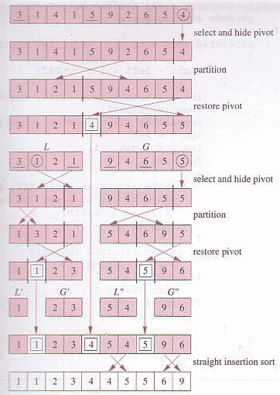
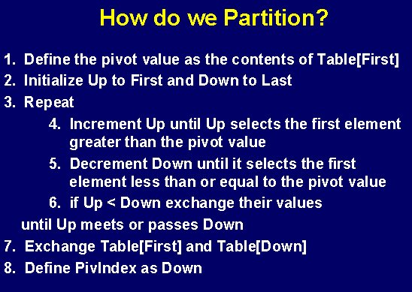
Quicksort - 3
<number>/43

Slide 6
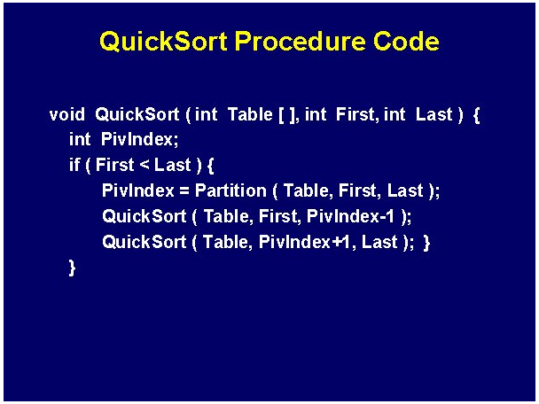
Quicksort code
<number>/43

Slide 7
Quicksort complexity
Quick Sort
    In the best case and average case: O(n log n) but ….
    Can be O(n²), the (rear) worst case. Moreover, the constant hidden in the O-notation is small.
    Depends on pivot selection
      Median-of-3
      Random pivot
      Better but not guaranteed
<number>/43

Slide 8
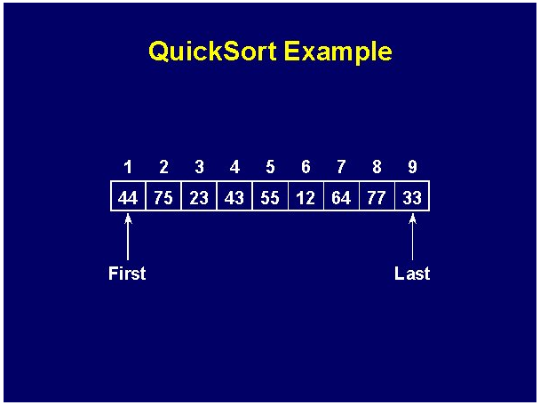
Quicksort example - 1
<number>/43

Slide 9
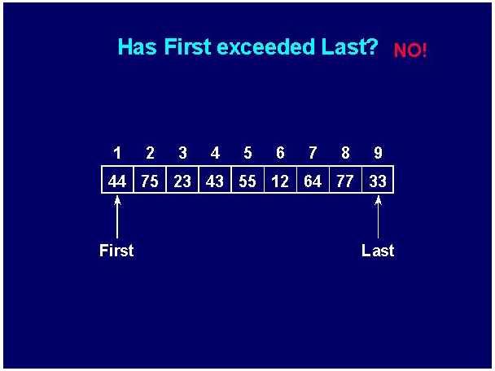
Quicksort example - 2
<number>/43

Slide 10
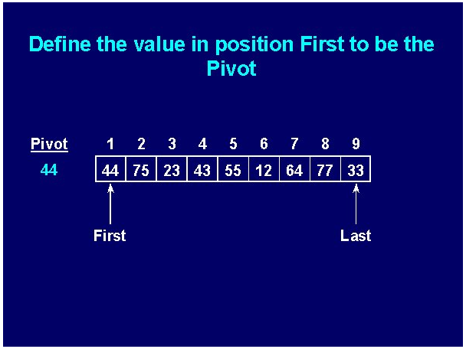
Quicksort example - 3
<number>/43

Slide 11
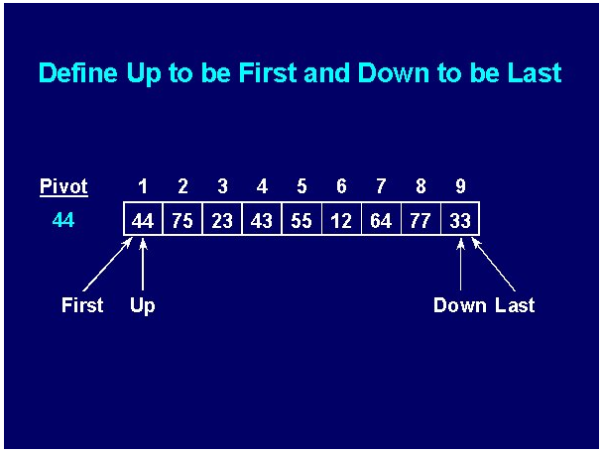
Quicksort example - 4
<number>/43

Slide 12
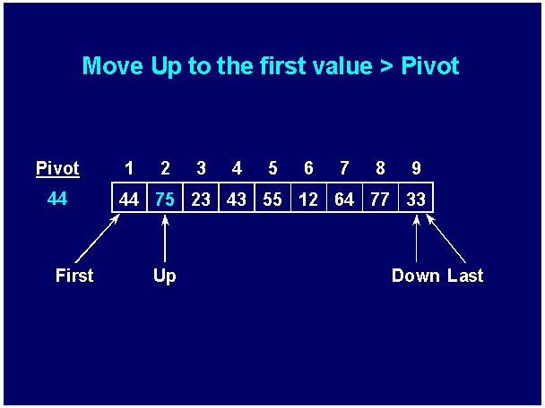
Quicksort example - 5
<number>/43

Slide 13
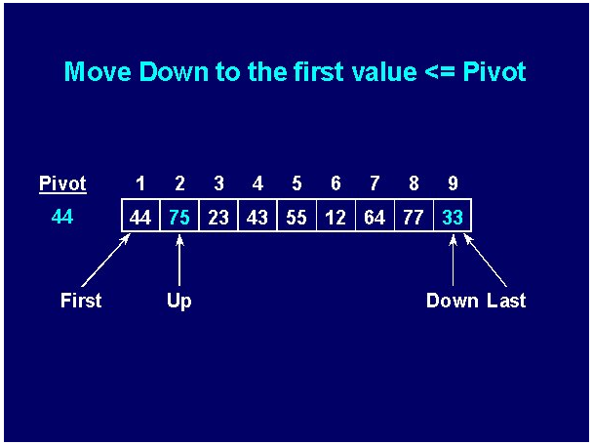
Quicksort example - 6
<number>/43

Slide 14
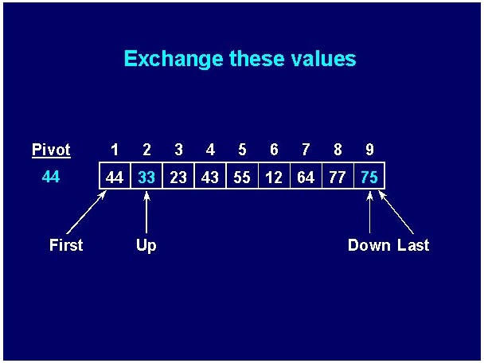
Quicksort example - 7
<number>/43

Slide 15


Quicksort example - 8
<number>/43

Slide 16
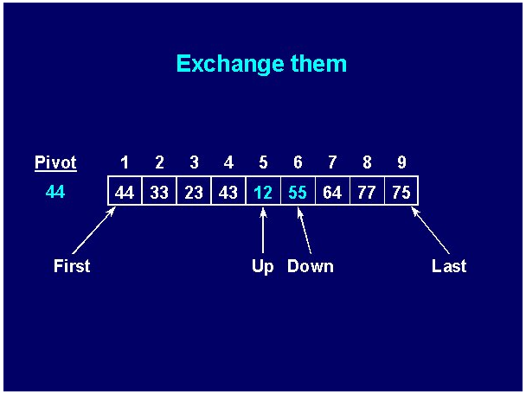
Quicksort example - 9
<number>/43

Slide 17


Quicksort example - 10
<number>/43

Slide 18
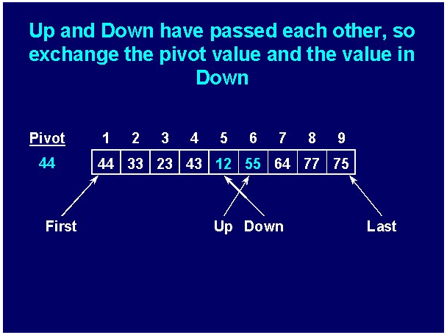
Quicksort example - 11
<number>/43

Slide 19
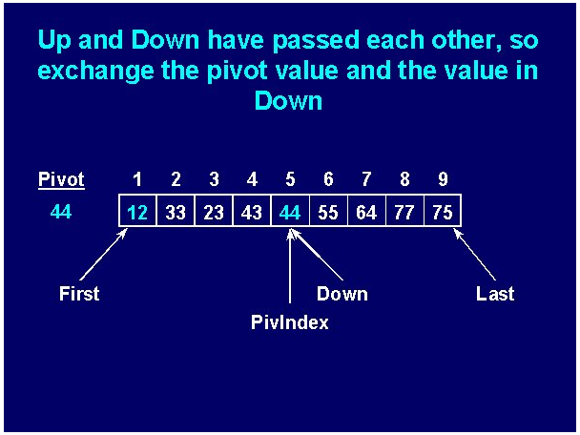
Quicksort example - 12
<number>/43

Slide 20
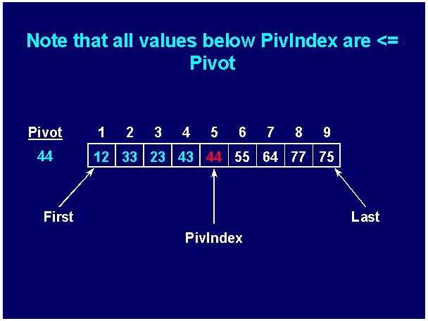
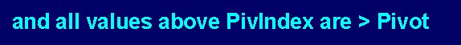
Quicksort example - 13
<number>/43

Slide 21
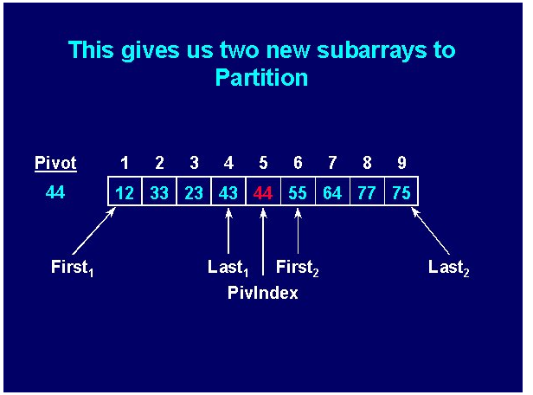
Quicksort example - 14
<number>/43

Slide 22
Mergesort
Mergesort makes partitioning as simple as possible and concentrates on merging sorted halves of an array into one sorted array
Complexity is O(nlogn)
It was one of the first sorting algorithms used on a computer and was developed by John von Neumann
    mergesort(data)
    if data have at least two elements
    mergesort(left half of data);
    mergesort(right half of data);
    merge(both halves into a sorted list);
<number>/43

Slide 23
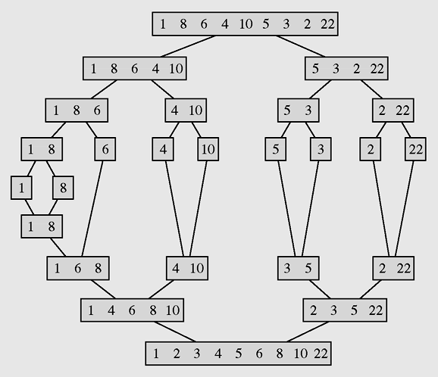
Mergesort example
The array [1 8 6 4 10 5 3 2 22] sorted by mergesort
<number>/43

Slide 24
Merge sort code
void mergeSort(int p, int r)
{if(p>=r) return;
int q = (p+r)/2;
mergeSort(p,q);
mergeSort(q+1,r);
merge(p,q,r);
}
void merge(int p, int q, int r)
{if(!(p<=q) && (q<=r)) return;
int n,i,j,k,x; n = r-p+1;
int [] b = new int[n];
i=p;j=q+1;k=0;
while(i<=q && j<=r)
{if(a[i]<a[j])
b[k++] = a[i++];
else
b[k++] = a[j++];
}
while(i<=q) b[k++] = a[i++];
while(j<=r) b[k++] = a[j++];
k=0;
for(i=p;i<=r;i++) a[i] = b[k++];
}
public class Main
{public static void main(String args[])
{int [] b = {7,3,5,9,11,8,6,15,10,12,14};
EffSort t = new EffSort(b);
int n=b.length;
t.mergeSort(0,n-1);t.display();
System.out.println();
}
}
<number>/43

Slide 25

Heap data structure - 1
Heap is a particular kind of binary tree, which has two properties:
  The value of each node is greater than or equal to the values stored in each of its children.
  If the height of the tree is h, then the tree is complete at level d for d = 1, 2, ..., h-1, and the leaves in the last level are all in the leftmost positions
(This kind of binary tree is called nearly complete binary tree)
These two properties define a max heap
If “greater” in the first property is replaced with “less,” then the definition specifies a min heap
<number>/43

Slide 26

Heap data structure - 2
We can represent heap by array in level order, going from left to right. The array corresponding to the heap above is [25, 13, 17, 5, 8, 3].
The root of the tree a[0] and given index i of a node, the indices of its parent, left child and right child can be computed:
PARENT (i)
return floor((i-1)/2)
LEFT (i)
return 2i+1
RIGHT (i)
return 2(i + 1)
<number>/43

Slide 27
Heap Sort - 1
Heap sort consists of 2 steps:
Transform the array to a heap:
Suppose the array a to be sorted has n elements: a[0], a[1], ..., a[n-1]
At first the heap has only one element: a[0]. Then
for i =1 to n-1 we insert the element a[i] to heap so that the heap property is maintained.
Transform the heap to sorted array:
for k = 1 to n-1 do
remove and put the root (a[0]) to the position n-k, then rearrange elements to keep the heap property.
<number>/43

Slide 28
Heap sort code
Addition and deletion are both O(logn) operations. We need to perform n additions and deletions, leading to an O(nlogn) algorithm.
//Transform the array to HEAP
int i,s,f;int x;
for(i=1;i<n;i++)
{ x=a[i]; s=i; //s is a son, f=(s-1)/2 is father
while(s>0 && x>a[(s-1)/2])
{ a[s]=a[(s-1)/2]; s=(s-1)/2;
};
a[s]=x;
};
// Transform heap to sorted array
for(i=n-1;i>0;i--)
{ x=a[i];a[i]=a[0];
f=0; //f is father
s=2*f+1; //s is a left son
// if the right son is larger then it is selected
if(s+1<i && a[s]<a[s+1]) s=s+1;
while(s<i && x<a[s])
{ a[f]=a[s]; f=s; s=2*f+1;
if(s+1<i && a[s]<a[s+1]) s=s+1;
};
a[f]=x;
};
Complexity O(nlog₂n)
<number>/43

Slide 29
Summary
Efficient Sorting Algorithms
  Quick Sort
  Merge Sort
  Heap sort
<number>/43

