Slide 1
Divide-and-Conquer

Slide 2
Divide-and-Conquer - 1
The most-well known algorithm design strategy:
Divide instance of problem into two or more smaller instances
Solve smaller instances recursively
Obtain solution to original (larger) instance by combining these solutions

Slide 3
Divide-and-Conquer Technique - 2
a problem of size n
(instance)
subproblem 1
of size n/2
subproblem 2
of size n/2
a solution to
subproblem 1
a solution to
subproblem 2
a solution to
the original problem
It general leads to a recursive algorithm!

Slide 4
Divide-and-Conquer Recurrence Relations
Suppose that a recursive algorithm divides a problem of size n into a sub problems, where each sub problem is of size n/b (for simplicity, assume that n is a multiple of b; in reality, the smaller problems are often of size equal to the nearest integers either less than or equal to, or greater than or equal to,n/b). Also, suppose that a total of g(n) extra operations are required in the conquer step of the algorithm to combine the solutions of the sub problems into a solution of the original problem. Then, if f(n) represents the number of operations required to solve the problem of size n, it follows that f satisfies the recurrence relation:
f(n) = af(n/b)+g(n).
This is called a divide-and-conquer recurrence relation.

Slide 5
Divide-and-Conquer Recurrence Relations examples - 1
Binary Search:
The binary search algorithm reduces the search for an element in a search sequence of size n to the binary search for this element in a search sequence of size n/2, when n is even. (Hence, the problem of size n has been reduced to one problem of size n/2) Two comparisons are needed to implement this reduction (one to determine which half of the list to use and the other to determine whether any terms of the list remain). Hence, if f(n) is the number of comparisons required to search for an element in a search sequence of size n, then
f(n)=f(n/2)+2
When n is even.

Slide 6
Divide-and-Conquer Recurrence Relations examples - 2
Merge Sort:
The merge sort algorithm splits a list to be sorted with n items, where n is even, into two lists with n/2 elements each, and uses fewer than n comparisons to merge the two sorted lists of n/2 items each into one sorted list. Consequently, the number of comparisons used by the merge sort to sort a list of n elements is less than f(n), where the function f(n) satisfies the divide-and-conquer recurrence relation:
f(n)=2f(n/2)+n.

Slide 7
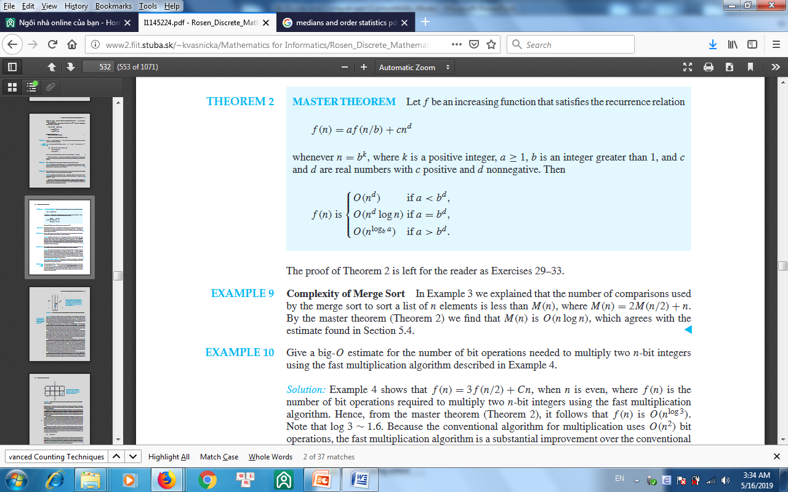
Divide-and-Conquer Recurrence Relations – Master theorem
Complexity of Merge Sort:
f(n)=2f(n/2)+n
By the master theorem we find that f(n) is O(nlogn),

Slide 8
Binary Search - Recursive Version
function location(lo,hi : index) return index is
begin
if lo>hi then
return 0;
else
mid:=(lo+hi)/2;
if x=S(mid) then
return mid;
elsif x<S(mid) then
return location(lo,mid-1);
else
return location(mid+1,hi);
end if;
end if;
end location;
x=42
lo=0 hi=9
mid=4 S(4)=19
lo=5 hi=9
mid=7 S(7)=45
lo=5 hi=6
mid=5 S(5)=24
lo=6 hi=6
mid=6 S(6)=39
lo=7 hi=6
return 0
S
0 10
1 12
2 15
3 19
4 19
5 24
6 39
7 45
8 53
9 77

Slide 9
Analysis of Function location( )
We need a closed form expression for T(n) that does not contain a term involving T.
We assume that n>1 and note that we need to replace T(n/2) with an explicit function of n.
We can use the recurrence relation to express the term T(n/2) in another form that can, in turn be substituted back into our expression for T(n). Eventually we can write a general expression for the kth substitution.
Then we can determine a value for k (in terms of n) that sets the parameter of T equal to one. This lets us substitute T(1)=C in our recurrence and replace any other occurrences of k with terms involving n.
We can then determine the order of complexity.
C n<=1
T(n) =
T(n/2) + D otherwise
T(n/2)=T(n/4) + D
T(n)=(T(n/4) + D) + D
T(n)=T(n/4) + 2D
T(n)=T(n/8) + 3D
:
T(n)=T(n/2^{k}) + kD
T(n)=T(1) + (lg₂n)D
T(n)=C + (lg₂n)D
T(n) -> O(lg₂n)

Slide 10
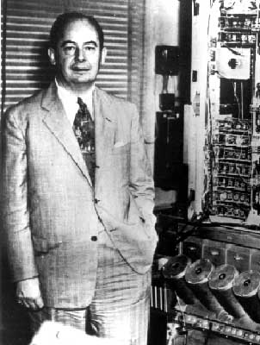
Mergesort
Mergesort.
  Divide array into two halves.
  Recursively sort each half.
  Merge two halves to make sorted whole.
Jon von Neumann (1945)
A
L
G
O
R
I
T
H
M
S
A
L
G
O
R
I
T
H
M
S
divide
O(1)
A
G
L
O
R
H
I
M
S
T
sort
2T(n/2)
A
G
H
I
L
M
O
R
S
T
merge
O(n)

Slide 11
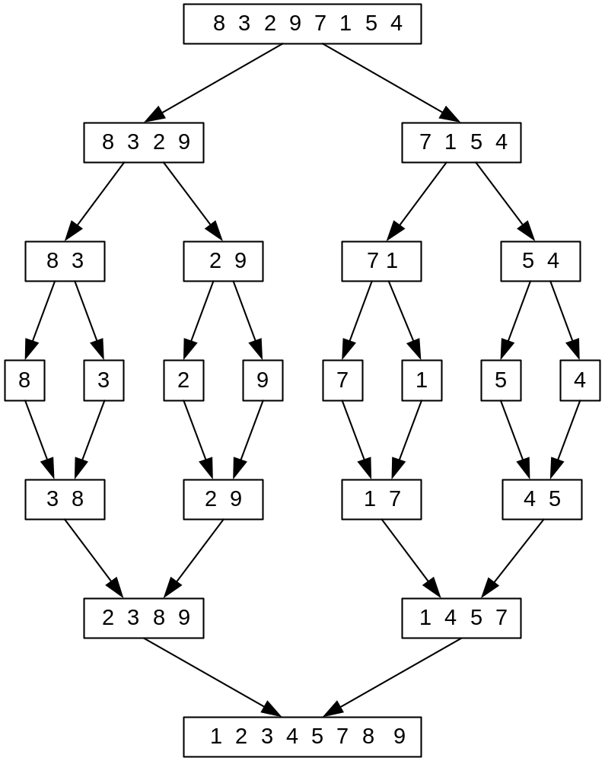
Mergesort Example
The non-recursive version of Mergesort starts from merging single elements into sorted pairs.
Notes:
Go over this example in detail, then do another example of merging, something like:
(1 2 5 7 9)
(3 4 6)

Slide 12
Merging
Merging. Combine two pre-sorted lists into a sorted whole.
How to merge efficiently?
  Linear number of comparisons.
  Use temporary array.
Challenge for the bored. In-place merge. [Kronrud, 1969]
A
G
L
O
R
H
I
M
S
T
A
G
H
I
using only a constant amount of extra storage

Slide 13
Merging
Merge.
  Keep track of smallest element in each sorted half.
  Insert smallest of two elements into auxiliary array.
  Repeat until done.
smallest
smallest
A
G
L
O
R
H
I
M
S
T
A
auxiliary array

Slide 14
Merging
Merge.
  Keep track of smallest element in each sorted half.
  Insert smallest of two elements into auxiliary array.
  Repeat until done.
smallest
smallest
A
G
L
O
R
H
I
M
S
T
A
G
auxiliary array

Slide 15
Merging
Merge.
  Keep track of smallest element in each sorted half.
  Insert smallest of two elements into auxiliary array.
  Repeat until done.
smallest
smallest
A
G
L
O
R
H
I
M
S
T
A
G
H
auxiliary array

Slide 16
Merging
Merge.
  Keep track of smallest element in each sorted half.
  Insert smallest of two elements into auxiliary array.
  Repeat until done.
smallest
smallest
A
G
L
O
R
H
I
M
S
T
A
G
H
I
auxiliary array

Slide 17
Merging
Merge.
  Keep track of smallest element in each sorted half.
  Insert smallest of two elements into auxiliary array.
  Repeat until done.
smallest
smallest
A
G
L
O
R
H
I
M
S
T
A
G
H
I
L
auxiliary array

Slide 18
Merging
Merge.
  Keep track of smallest element in each sorted half.
  Insert smallest of two elements into auxiliary array.
  Repeat until done.
smallest
smallest
A
G
L
O
R
H
I
M
S
T
A
G
H
I
L
M
auxiliary array

Slide 19
Merging
Merge.
  Keep track of smallest element in each sorted half.
  Insert smallest of two elements into auxiliary array.
  Repeat until done.
smallest
smallest
A
G
L
O
R
H
I
M
S
T
A
G
H
I
L
M
O
auxiliary array

Slide 20
Merging
Merge.
  Keep track of smallest element in each sorted half.
  Insert smallest of two elements into auxiliary array.
  Repeat until done.
smallest
smallest
A
G
L
O
R
H
I
M
S
T
A
G
H
I
L
M
O
R
auxiliary array

Slide 21
Merging
Merge.
  Keep track of smallest element in each sorted half.
  Insert smallest of two elements into auxiliary array.
  Repeat until done.
first half
exhausted
smallest
A
G
L
O
R
H
I
M
S
T
A
G
H
I
L
M
O
R
S
auxiliary array

Slide 22
Merging
Merge.
  Keep track of smallest element in each sorted half.
  Insert smallest of two elements into auxiliary array.
  Repeat until done.
first half
exhausted
smallest
A
G
L
O
R
H
I
M
S
T
A
G
H
I
L
M
O
R
S
T
auxiliary array

Slide 23
Merging
Merge.
  Keep track of smallest element in each sorted half.
  Insert smallest of two elements into auxiliary array.
  Repeat until done.
first half
exhausted
second half
exhausted
A
G
L
O
R
H
I
M
S
T
A
G
H
I
L
M
O
R
S
T
auxiliary array

Slide 24
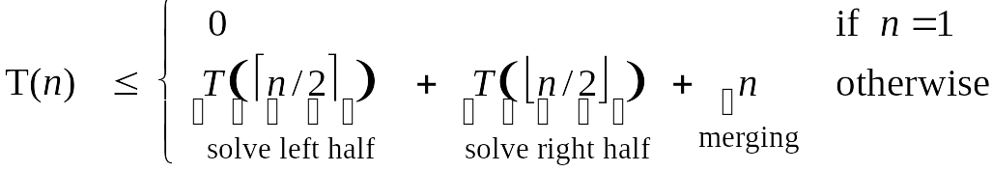
A Useful Recurrence Relation
Def. T(n) = number of comparisons to mergesort an input of size n.
Mergesort recurrence.
Solution. T(n) = O(n log₂ n).
Assorted proofs. We describe several ways to prove this recurrence. Initially we assume n is a power of 2 and replace ≤ with =.

Slide 25
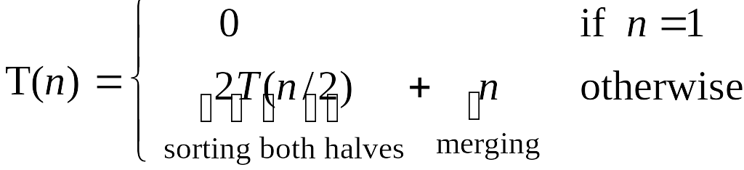
Proof by Recursion Tree
T(n)
n
T(n/2)
T(n/2)
2(n/2)
T(n/4)
T(n/4)
T(n/4)
T(n/4)
4(n/4)
log₂n
. . .
T(n / 2^{k})
2^{k} (n / 2^{k})
. . .
T(2)
T(2)
T(2)
T(2)
T(2)
T(2)
T(2)
T(2)
n/2 (2)
n log₂n

Slide 26
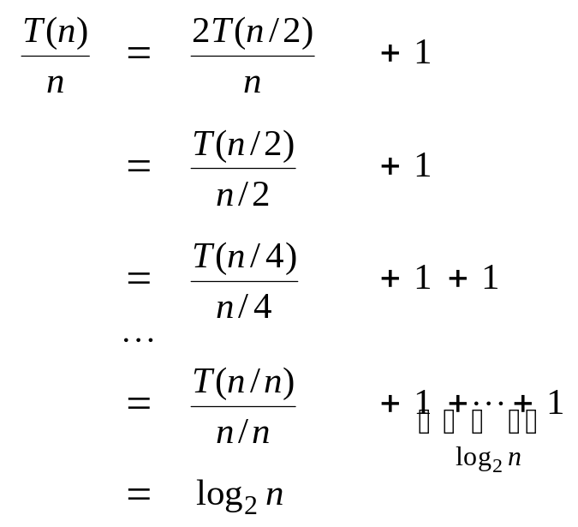
Proof by Telescoping
Claim. If T(n) satisfies this recurrence, then T(n) = n log₂ n.
Pf. For n > 1:
assumes n is a power of 2

Slide 27
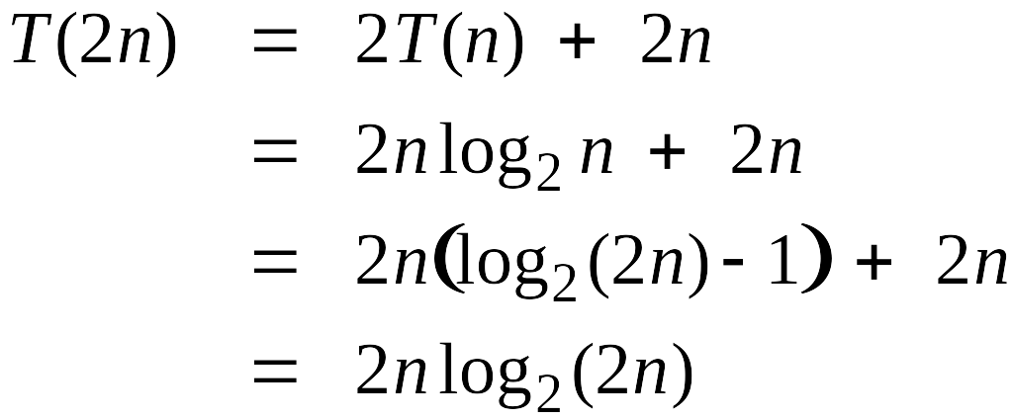
Proof by Induction
Claim. If T(n) satisfies this recurrence, then T(n) = n log₂ n.
Pf. (by induction on n)
  Base case: n = 1.
  Inductive hypothesis: T(n) = n log₂ n.
  Goal: show that T(2n) = 2n log₂ (2n).
assumes n is a power of 2

Slide 28
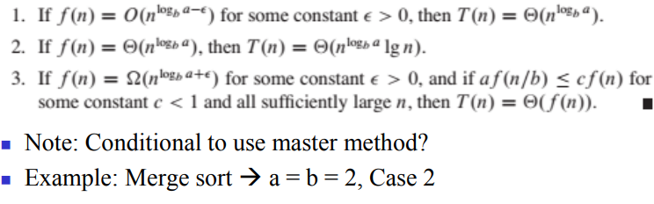
Proof by using Master theorem

Slide 29
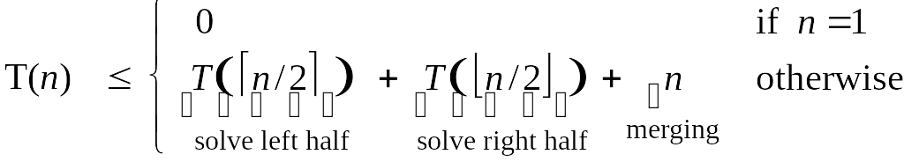
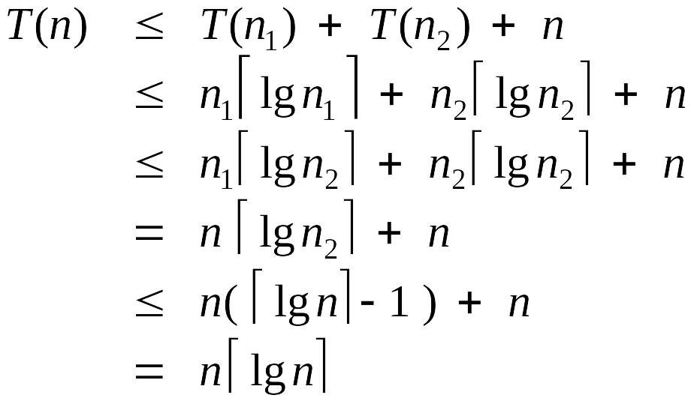
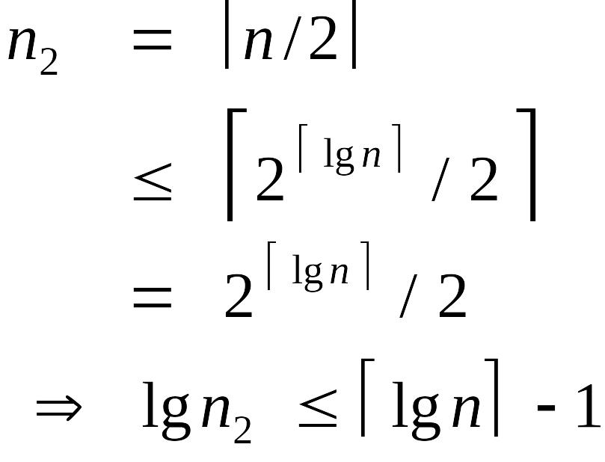
Analysis of Mergesort Recurrence
Claim. If T(n) satisfies the following recurrence, then T(n) ≤ n ⎡lg n⎤.
Pf. (by induction on n)
  Base case: n = 1.
  Define n₁ = ⎣n / 2⎦ , n₂ = ⎡n / 2⎤.
  Induction step: assume true for 1, 2, ... , n–1.
log₂n

Slide 30
Quicksort
procedure quicksort(lo,hi: integer) is
pivot : integer;
begin
if hi>lo then
partition(lo,hi,pivot);
quicksort(lo,pivot-1);
quicksort(pivot,+1,hi);
end if;
end quicksort;
procedure partition(lo,hi,pivot)is
j,item : integer;
begin
item := S(lo);
j:= lo;
for i in lo+1..hi loop
if S(i)<item then
j:=j+1;
swap(S(i),S(j));
end if;
end loop;
pivot:=j
swap(S(lo),S(pivot));
end partition;
Where is the recombine step in the quicksort divide-and-conquer algorithm?

Slide 31
Quicksort Example
i j 1 2 3 4 5 6 7 8 9 10 11 12 13 14
2 1 6 9 8 5 7 4 6 3 5 4 7 6 0 5
4 2 6 5 8 9 7 4 6 3 5 4 7 6 0 5
6 3 6 5 4 9 7 8 6 3 5 4 7 6 0 5
8 4 6 5 4 3 7 8 6 9 5 4 7 6 0 5
9 5 6 5 4 3 5 8 6 9 7 4 7 6 0 5
10 6 6 5 4 3 5 4 6 9 7 8 7 6 0 5
13 7 6 5 4 3 5 4 0 9 7 8 7 6 6 5
14 8 6 5 4 3 5 4 0 5 7 8 7 6 6 9
8 5 5 4 3 5 4 0 6 7 8 7 6 6 6
pivot value
items being swapped
new sublists for next pass of quicksort

Slide 32
Quicksort: Worst-Case Performance
What does it mean?
An analysis shows that the worst-case performance for quicksort( ) is order O(n²). However, quicksort performs much better than this in practice. Does this mean that algorithm analysis is a waste of effort?
Not really. In addition to showing worst-case performance, algorithm analysis provides us with a better understanding of the conditions under which an algorithm performs well.
We can see that the quicksort algorithm performs worst on a sorted list and performs best on a randomly distributed list (at least one in which the pivot value is always near the median value of the sublist being partitioned).
Algorithm analysis helps us determine which algorithm is best for a particular application, as well as suggesting ways to modify an algorithm to improve its performance.
Can you think of a simple way to improve quicksort( )?

