Slide 1
Probabilistic Analysis and Randomized Algorithms

Slide 2
What are Randomized Algorithms and Analyses? - 1
Randomized algorithms – Algorithms that make random decisions during their execution – Example: Quicksort with a random pivot.
Probabilistic analysis of algorithms – Using probability theory to analyze the behavior of (randomized or deterministic) algorithms – Example: determining the probability of a collision of a hash function

Slide 3
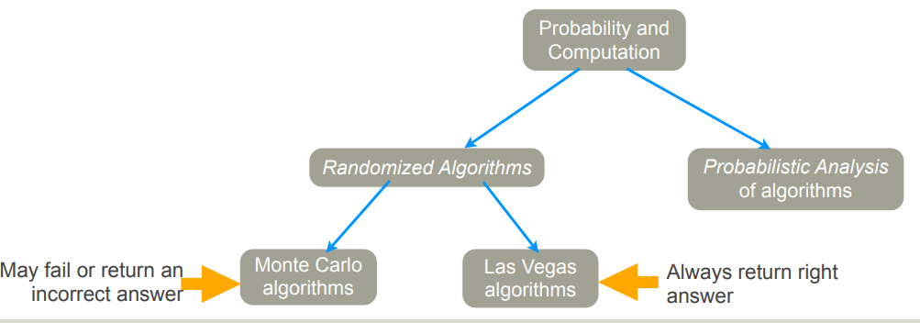
What are Randomized Algorithms and Analyses? - 2

Slide 4
Monte Carlo and Las Vegas algorithms
Monte Carlo algorithms are a subset of randomized algorithms where the final output of the algorithm is a random variable. Most simulations involving random events are Monte Carlo algorithms. Anytime you have uncertainty in your knowledge of a models parameters, Monte Carlo algorithms can help you understand how that uncertainly translates into a final result.
Las Vegas algorithms, on the other hand, also use randomness in their approach, but will always return the correct output. The canonical example of a Las Vegas algorithm is QuickSort. Here an element of a list i is chosen at random. Then the elements of the list are compared to i create a batch of numbers L that is less than i and a batch of numbers R that is greater than i. Then L and R are recursively sorted, and then the three groups are placed back in order to obtain a sorting of the original set.
At the end of the running of this algorithm, a correct output has been obtained: the numbers will be in sorted order. But the number of comparisons used by the algorithm depends on the element i chosen at random. If i was close to the median, the algorithm will be very fast, but if i is close to the maximum or minimum the algorithm could be slow.
Fortunately, on average the algorithm is very fast, and it is very unlikely that it will be much slower than average. Hence Las Vegas algorithms can be used to speed up and simplify deterministic algorithms, while Monte Carlo algorithms move beyond what algorithms that always return the same result can do.

Slide 5
Why Randomized Algorithms?
Many NP-hard problems may be easy to solve for “typical” inputs – One approach is to use heuristics to deal with pathological inputs – Another approach is to use randomization (of inputs, or of algorithm) to reduce the chance of worst-case behavior.
The exact definition of “NP-hard problem” is very complicated, but simply speaking, NP-hard problem means there is no known algorithm can solve it in a polynomial time.

Slide 6
Why probabilistic analysis of algorithms?
Naturally, if algorithm makes random decisions, performance is not deterministic – Also, deterministic algorithm behavior may vary with inputs – Probabilistic analysis also lets us estimate bounds on behavior.

Slide 7
Theoretical Foundations
Probability theory – Probability spaces – Events – Random variables – Characteristics of random variables.
Combinatorics & number theory – Many relations come in handy in simplifying analysis.
Algorithm analysis

Slide 8
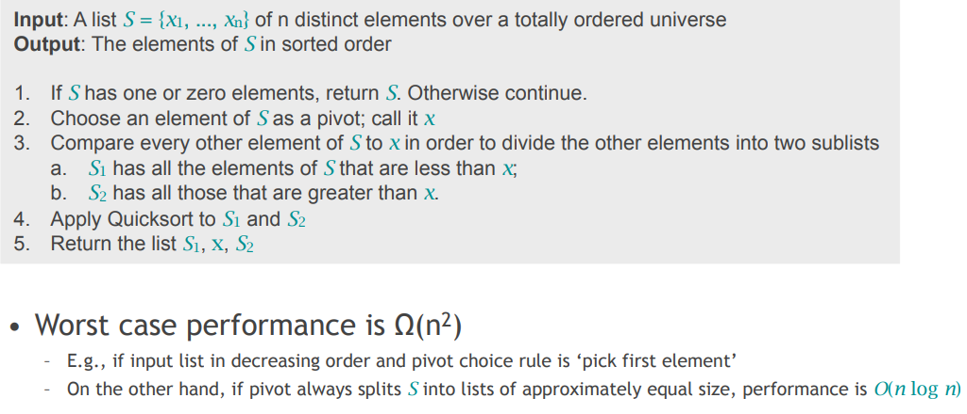
Probabilistic Analysis of Quicksort - 1

Slide 9
Probabilistic Analysis of Quicksort - 2
Question:
– Assuming we use the ‘pick first element’ pivot choice, and input elements are chosen from a uniform discrete distribution on a range of values, what is the expected number of comparisons?
– i.e., let X be an rvar denoting number of comparisons; what is E[X] ?

Slide 10
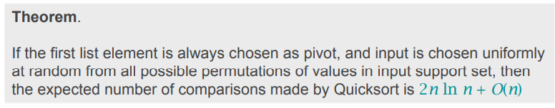
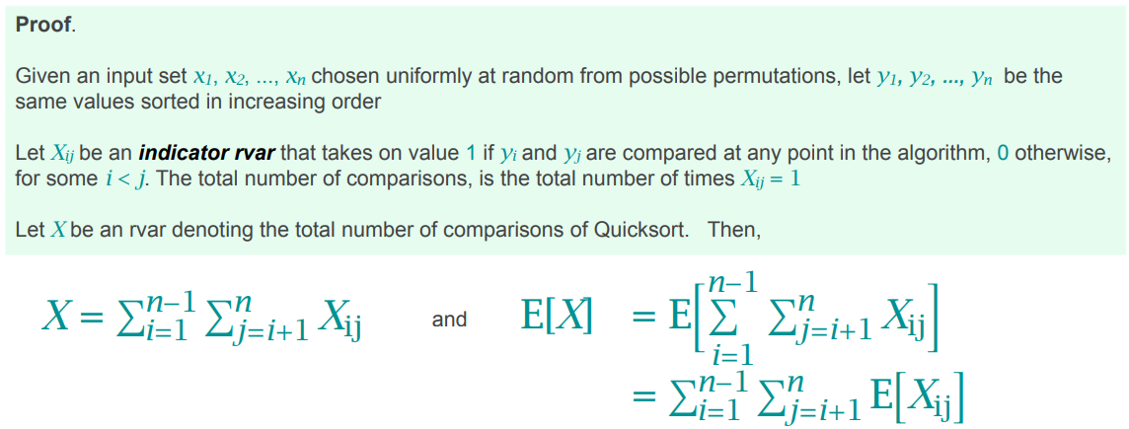
Probabilistic Analysis of Quicksort - 3

Slide 11
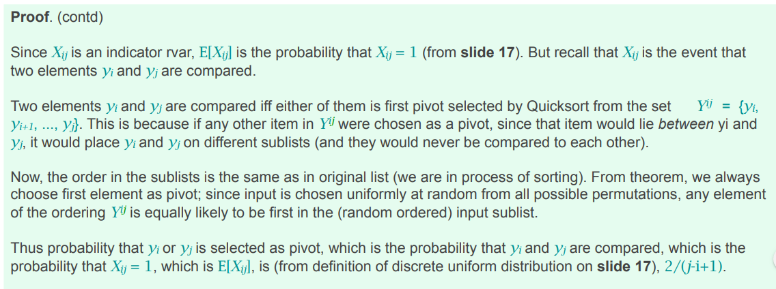
Probabilistic Analysis of Quicksort - 4

Slide 12
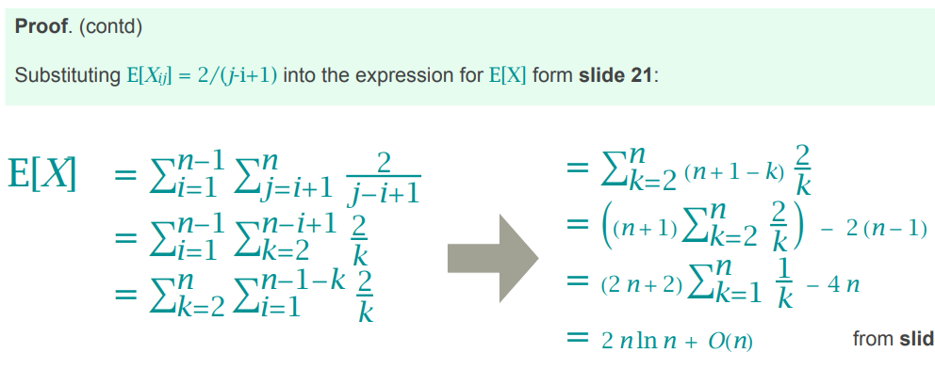
Probabilistic Analysis of Quicksort - 5

Slide 13
Randomized Quicksort - 1
• What if inputs are not the uniformly random selections of permutations?
• How to avoid pathological inputs? pick a random pivot!
• Analysis of number of comparisons is similar to foregoing analysis.

Slide 14
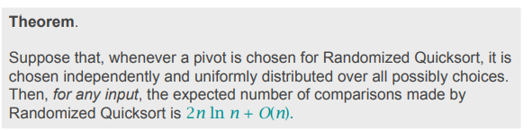
Randomized Quicksort - 2
Almost identical to proof of expected number of comparisons for deterministic Quicksort with randomized inputs. Try doing this proof yourself as an exercise.

