Slide 1
Red Black Tree deletion

Slide 2
Like Insertion, recoloring and rotations are used to maintain the Red-Black properties.
In the insert operation, we check the color of the uncle to decide the appropriate case. In the delete operation, we check the color of the sibling to decide the appropriate case.
After the insertion: The two consecutive node may be reds
After the deletion: The black height in subtrees may be changed.
Deletion is a fairly complex process. To understand deletion, the notion of double black is used. When a black node is deleted and replaced by a black child, the child is marked as double black. The main task now becomes to convert this double black to single black.

Slide 3
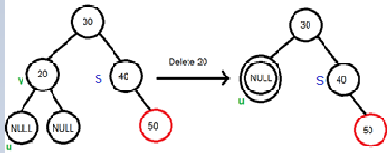
Deletion Steps
Perform standard BST delete by copying. Let v be the node to be deleted and u be the child that replaces v.
Simple Case: If either u or v is red, we mark the replaced child as black and stop (No change in black height).
Both u and v are Black: after replacing v is removed, u replaces v and becomes double black.
3.1 If u is root, make it single black and return (Black height of complete tree reduces by 1).
3.2 Mark u as double black Let sibling of node be s. There 3 cases:
….(a): If sibling s is black and at least one of sibling’s children is red, perform rotation(s).
When 20 is deleted, it is replaced by a NULL, so the NULL
becomes double black. Note that the deletion is not done yet.
The double black must become single black.
….(b): If sibling s is black and its both children are black, perform recoloring, and recur for the parent if parent is black.
….(c): If sibling is red, perform a rotation to move old sibling up, recolor the old sibling and parent.

Slide 4
Deletion Steps
Following are detailed steps for deletion.
1) Perform standard BST delete. When we perform standard delete operation in BST, we always end up deleting a node which is an either leaf or has only one child (For an internal node, we copy the successor and then recursively call delete for successor, successor is always a leaf node or a node with one child). So we only need to handle cases where a node is leaf or has one child. Let v be the node to be deleted and u be the child that replaces v (Note that u is NULL when v is a leaf and color of NULL is considered as Black).

Slide 5
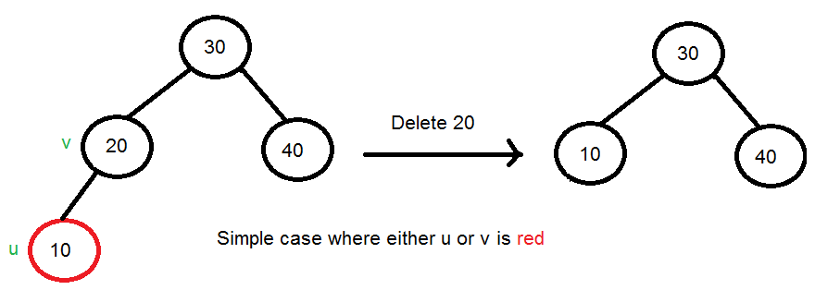
2) Simple Case: If either u or v is red, we mark the replaced child as black and stop (No change in black height). Note that both u and v cannot be red as v is parent of u and two consecutive reds are not allowed in red-black tree.
3) Both u and v are Black: Replace v by u, mark u double black.
3.1 If u is root, make it single black and return (Black height of complete tree reduces by 1).

Slide 6
3.2) Do following while the current node u is double black, and it is not the root. Let sibling of node be s.
….(a): If sibling s is black and at least one of sibling’s children is red, perform rotation(s). Let the red child of s be r. This case can be divided in four subcases depending upon positions of s and r.
…………..(i) Left Left Case (s is left child of its parent and r is left child of s or both children of s are red). This is mirror of right right case shown in below diagram.
…………..(ii) Left Right Case (s is left child of its parent and r is right child). This is mirror of right left case shown in below diagram.
…………..(iii) Right Right Case (s is right child of its parent and r is right child of s or both children of s are red)
…………..(iv) Right Left Case (s is right child of its parent and r is left child of s)

Slide 7
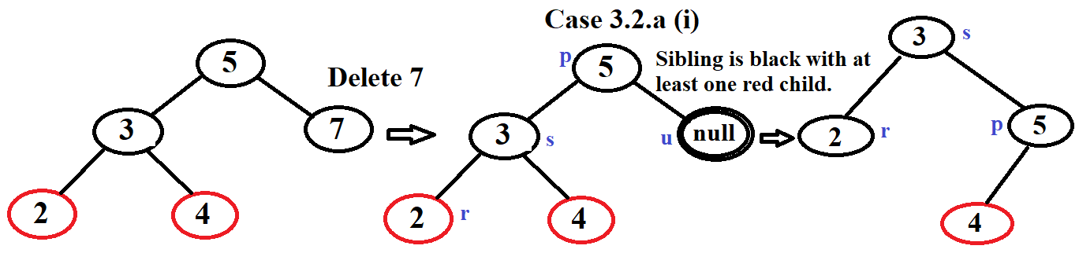
3.2) Do following while the current node u is double black, and it is not the root. Let sibling of node be s.
….(a): If sibling s is black and at least one of sibling’s children r is red, perform rotation(s).
…………..(i) Left Left Case (s is left child of its parent and r is left child of s or both children of s are red) ): using single rotation.
Figure 3.2.a(i)

Slide 8
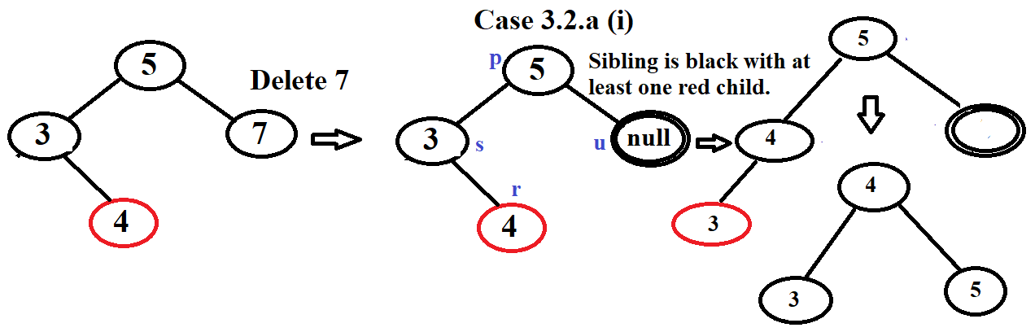
3.2) Do following while the current node u is double black, and it is not the root. Let sibling of node be s.
….(a): If sibling s is black and at least one of sibling’s children r is red, perform rotation(s).
…………..(ii) Left Right Case (s is left child of its parent and r is right child of s): using double rotation.
Figure 3.2.a(ii)

Slide 9
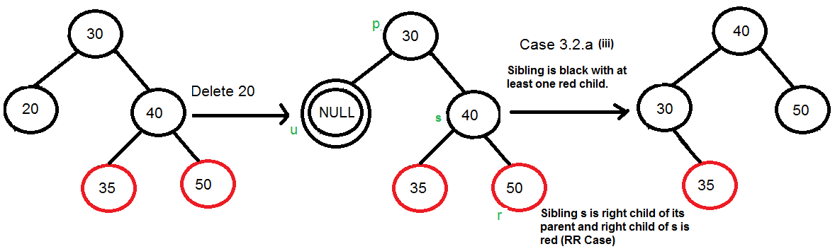
3.2) Do following while the current node u is double black, and it is not the root. Let sibling of node be s.
….(a): If sibling s is black and at least one of sibling’s children is red, perform rotation(s).
…………..(iii) Right Right Case (s is right child of its parent and r is right child of s or both children of s are red): using single rotation
Figure 3.2.a(iii)

Slide 10
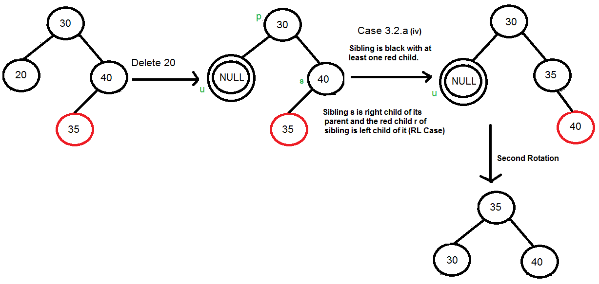
3.2) Do following while the current node u is double black, and it is not the root. Let sibling of node be s.
….(a): If sibling s is black and at least one of sibling’s children is red, perform rotation(s).
…………..(iv) Right Left Case (s is right child of its parent and r is left child of s): using double rotation.
Figure 3.2.a(iv)

Slide 11
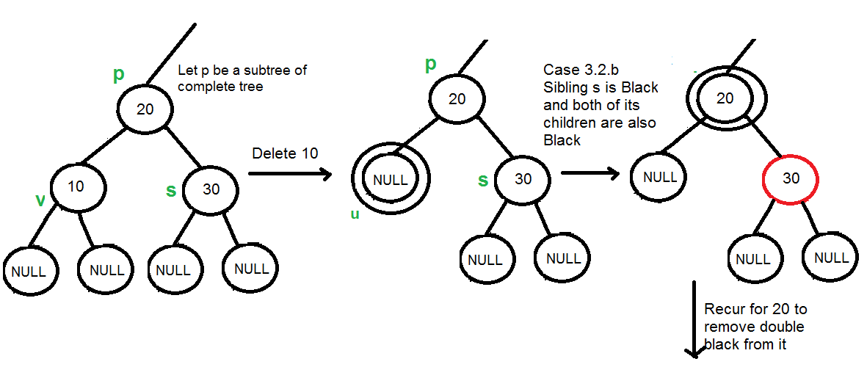
3.2) Do following while the current node u is double black, and it is not the root. Let sibling of node be s.
…..(b): If sibling is black and its both children are black, perform recoloring, and recur for the parent if parent is black.
In this case, if parent was red, then we didn’t need to recur for parent, we can simply make it black (red + double black = single black)

Slide 12
3.2) Do following while the current node u is double black, and it is not the root. Let sibling of node be s.
…..(c): If sibling is red, perform a rotation to move old sibling up, recolor the old sibling and parent. The new sibling is always black (See the below diagram). This mainly converts the tree to black sibling case (by rotation) and leads to case (a) or (b). This case can be divided in two subcases.
…………..(i) Left Case (s is left child of its parent). This is mirror of right right case shown in below diagram. We right rotate the parent p.
…………..(iii) Right Case (s is right child of its parent). We left rotate the parent p.
See Figure in next slide

Slide 13
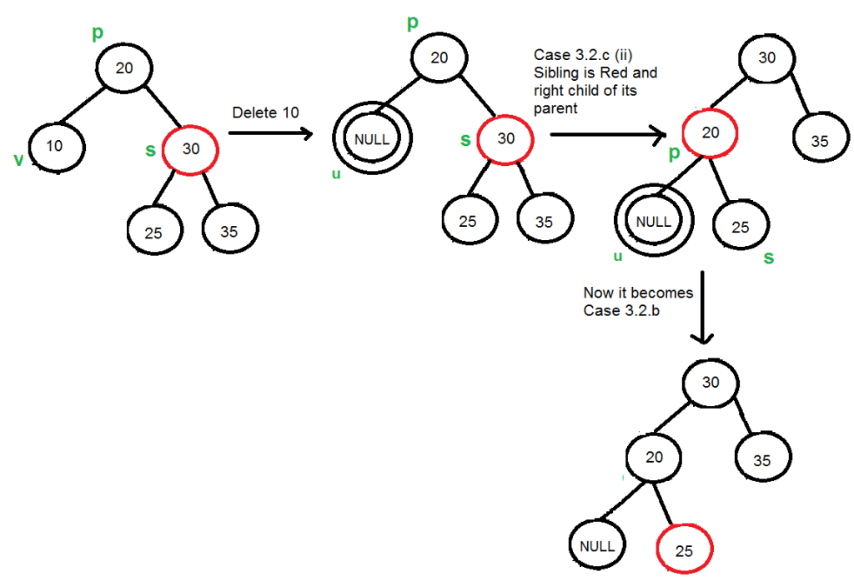
…..(c): If sibling is red
…………..(iii) Right Case (s is right child of its parent)

Slide 14
Deletion example:
Insert:
7, 3, 18, 10, 22, 8, 11, 26, 2, 6, 13,
Inorder:
2 3 6 7 8 10 11 13 18 22 26
Level order (breadth-first):
10 7 18 3 8 11 22 2 6 13 26
Deleting 18, 11, 3, 10, 22
Inorder:
2 6 7 8 13 26
Level order (breadth-first):
13 7 26 6 8 2

